Slide 1

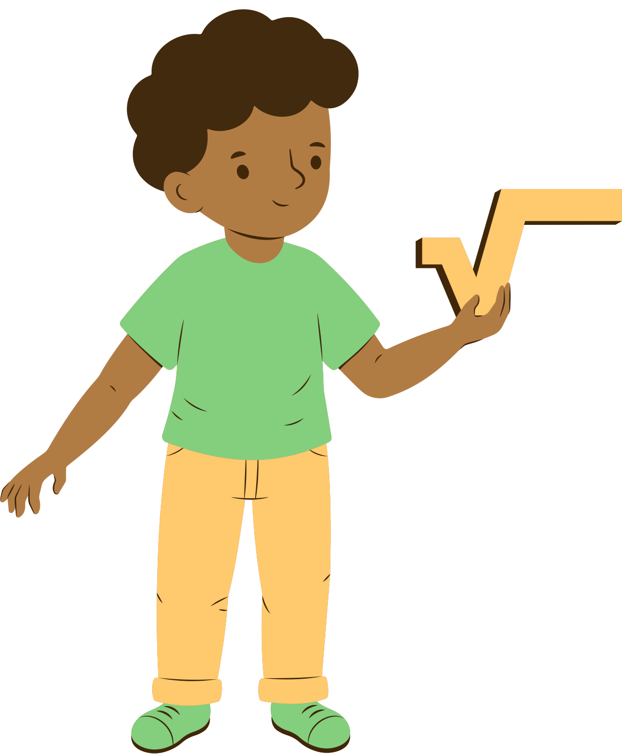

Welcome to
Math & Literacy Night

Slide 2





IMPORTANT Testing Dates
December
1st-19th
Amira Screener
iReady
Diagnostic
January
5th-23rd
January
5th-30th
MAP Winter
Assessment

Slide 3





Kindergarten
Things to Discuss
Math
Counting strategies (rote counting, one-to-one correspondence)
Number recognition and simple addition/subtraction
Games or activities with manipulatives (dice, counters, ten frames)
Literacy
Letter/sound recognition and phonemic awareness
High-frequency/sight words
Read-aloud strategies (pointing to words, using pictures for clues)
Tips for practicing at home (reading 10 minutes daily, rhyming games)

Slide 4
Ist Grade
Things to Discuss
Math
Addition and subtraction strategies (number bonds, doubles, counting on)
Place value with tens and ones
Math fact fluency games parents can play at home
Literacy
Building fluency through rereading
Retelling beginning, middle, end of a story
Sight word practice ideas
Encouraging writing simple sentences at home

Slide 5
2nd Grade
Things to Discuss
Math
Multi-digit addition and subtraction with regrouping
Introduction to arrays and basic multiplication concepts
Word problem-solving strategies
Literacy
Moving from "learning to read" to "reading to learn"
Using context clues and comprehension strategies (ask/answer questions)
Vocabulary-building games parents can do at home
Encouraging independent reading

Slide 6
3rd Grade
Things to Discuss
Math
Multiplication/division facts and strategies
Fractions introduction
Explaining how to support with homework without just giving answers
Literacy
Reading comprehension (summarizing, identifying main idea & details)
Importance of reading stamina
Writing strong paragraphs (topic sentence, details, closing)

Slide 7
4th Grade
Things to Discuss
Math
Multi-digit multiplication and long division strategies
Fractions and decimals (equivalents, adding/subtracting fractions)
Word problems requiring multiple steps
Literacy
Deepening comprehension (inference, theme, text evidence)
Writing with detail and supporting evidence
Encouraging discussion about books at home

Slide 8
5th Grade
Things to Discuss
Math
Fractions, decimals, percentages connections
Preparing for middle school concepts (volume, order of operations)
Growth mindset in problem-solving
Literacy
Analyzing text structure and author’s purpose
Comparing/contrasting across texts
Research and writing projects (organizing ideas, citing sources)
Encouraging independent reading of more complex texts

Slide 9



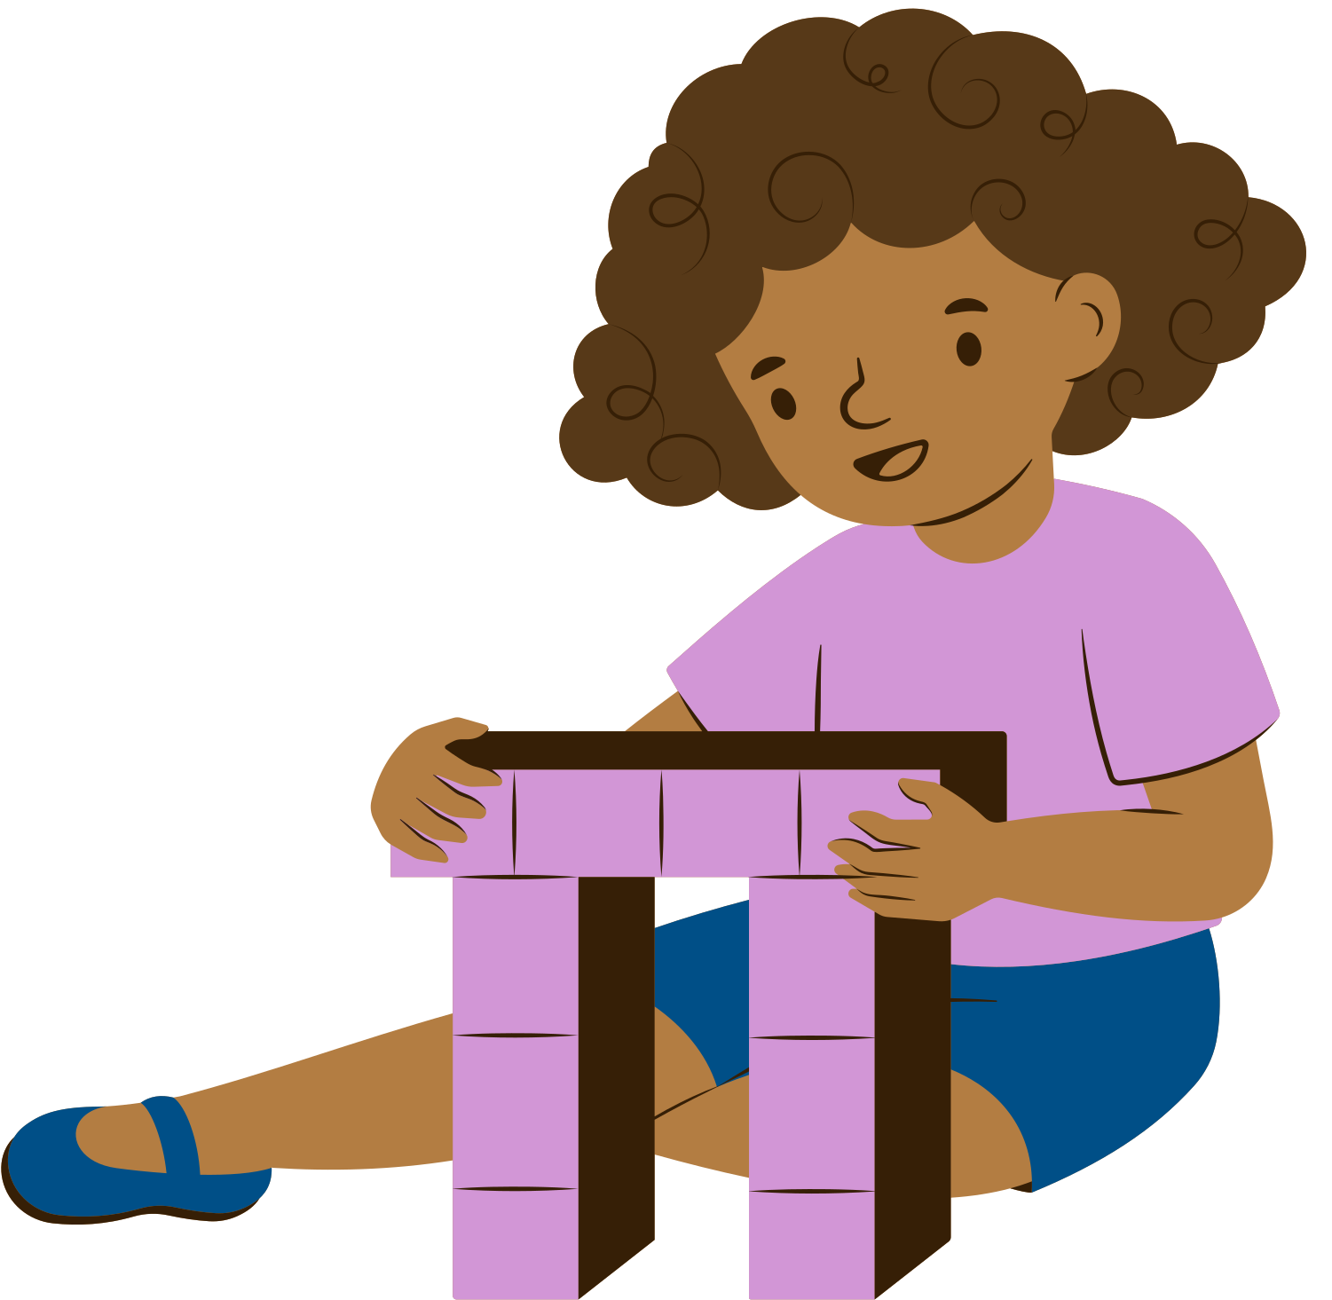
Breakout Session
Tables
Kindergarten Math
Kindergarten Reading
1st Grade Math
1st Grade Reading
2nd Grade Math
2nd Grade Reading
3rd Grade Math
3rd Grade Reading
4th Grade Math
4th Grade Reading
5th Grade Math
5th Grade Reading

Slide 10
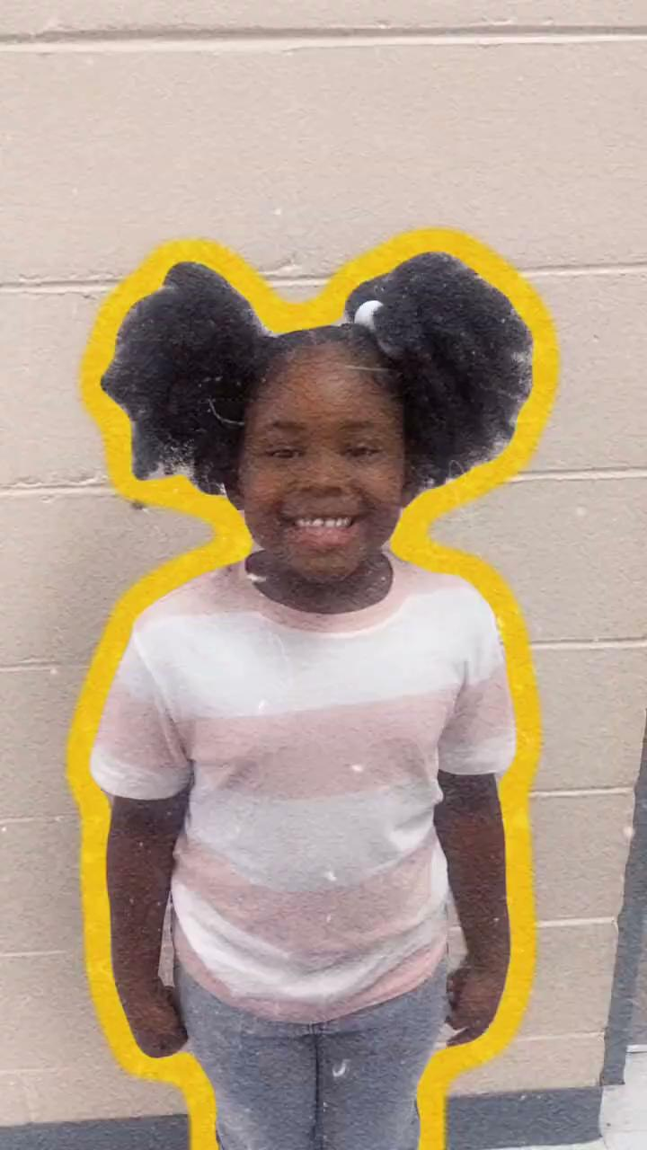
Kindergarten Performance

Slide 11


Books
Bookmark
Grab some COOL books to take home!
Create a Bookmark to take home!

