Slide 1
Substitute Teacher Training
2022-2023 School Year

Slide 2
Welcome
Calhoun County is made up of three schools:
1. St. Matthews K8
2. Sandy Run K8
3. Calhoun County High School

Slide 3
On any given day, approximately 274,000 substitute teachers serve in this country's classrooms .By the time a student graduates from high school, that person will have spent the equivalent of a full year being taught by a substitute.

Slide 4
Topics for Today
Professionalism and the substitute teacher
Legal aspects of being a substitute teacher
Classroom management & Discipline
The daily routine

Slide 5
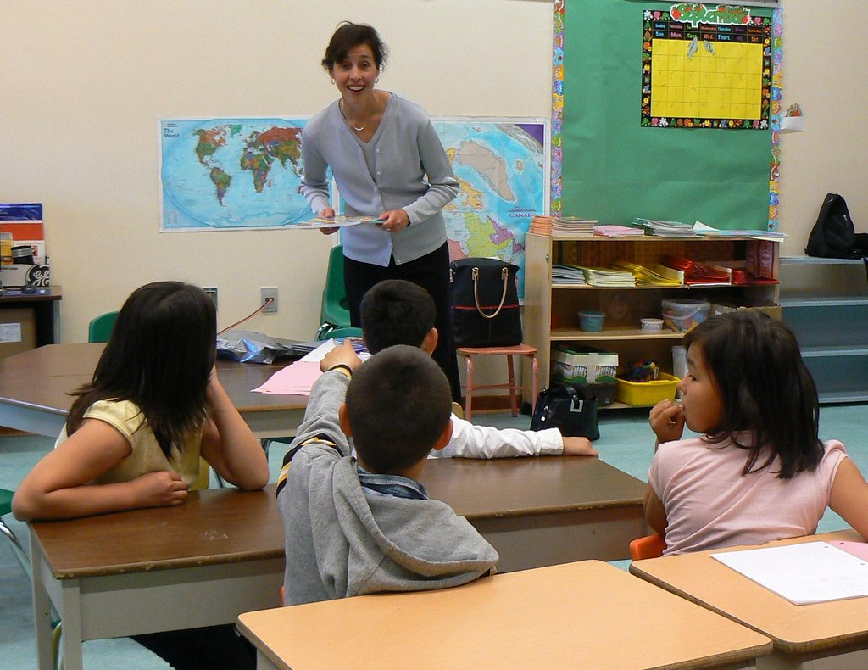
Professionalism
One of the most important aspects of becoming an effective substitute teacher is how you view and portray yourself to students, staff and the community. Above all, you need to consider yourself a professional. Remember, students will encounter substitutes on a regular basis, and for that reason alone you are a very important part of the educational process.

Slide 6
Professionalism
Students and other staff will respect you more if you exercise good judgment in how you dress. Your appearance contributes to creating a good first impression from the moment you walk into a school building--and every time thereafter. The following tips should be helpful:

Slide 7
Tips and Rules
Dress in a manner that sets you apart from students and enhances a businesslike atmosphere in the classroom.
First impressions are important, and, like it or not, the way you dress will make a difference in how you are treated by students and staff. You may find that many teachers dress very casually, but you need to remember that they already have a relationship with their students. They are not making a first impression, and they are not attempting to gain control of a new classroom. As a substitute teacher, you are making a first impression virtually every day. Remember comfortable and appropriate footwear.

Slide 8
Tips and Rules
Rule #1. You are to be attentive and present for the benefit of all students in the classroom. The most crucial reason you are in the classroom is to ensure safety. To accomplish that, your attention must be focused on the students at all times.
Do not give an assignment then sit down to read the newspaper or play on the computer. Do not walk out of the classroom. Do not make personal calls.

Slide 9
Tips and Rules
Rule #2. Never use the Internet at school to surf inappropriate web sites! This may sound obvious, but it happens.
Rule #3· Do not gossip about classes or students. This rule applies whether you are in the teachers' lounge at school or anywhere else. It is all right to ask advice about how to deal with certain students or classes, but don't let the conversation develop into one of complaining, ridiculing or spreading innuendoes about students or staff.

Slide 10
Rule #4. Keep your political, religious, and social beliefs to yourself. You are there to teach, not to proclaim your opinions or convert students to your way of thinking. By sticking to the teacher's lesson plans, you should be able to avoid these situations. If you find yourself in a class where students ask about your beliefs, be respectful of their inquiries but stick to the lesson at hand.

Slide 11
Tips and Rules
Rule #5. Be friendly, positive and enthusiastic. Although you are not there to become friends with students, you do need to be pleasant with them and demonstrate an interest in their assignment. Children are very quick to pick up on your overall attitude, and you want them to be at least cooperative if not deeply engaged.

Slide 12
Traps to Avoid.
Maintain a professional barrier between you and students. You are the adult, the teacher, and the professional; act like the expert - not like another one of the "kids."
Students should address you as Miss, Mr. or Mrs. and your last name. Students should never call a substitute by their first name.
Keep the classroom door open when talking with students.
Avoid any behavior that could be misinterpreted when interacting with students.
Avoid leaving your students unsupervised. Use verbal praise and reinforcement.
Avoid losing your temper and avoid corporal punishment.
Chaperon only school-sponsored functions. Do NOT socialize with students.

Slide 13
Expectations
Due Care And Caution - A teacher is required to exercise due care and caution for the safety of the students in his/her charge. Essentially, this means acting reasonably and with safety in mind, being able to explain circumstances and your actions, as well as following school safety policies and procedures.
Records - Maintaining notes on particular incidents in the classroom can protect you in problematic situations. If you feel that your actions might be questioned, note the date and time, the individuals involved, the choices for action considered, and the actions taken.

Slide 14
Bullying
Bullying- As a school district we will not accept bullying in any form.
Physical.
Emotional.
Social.
Use of technology.
Report any bullying to your school administration, or guidance.
If you suspect any form of sexual harassment please contact Mr. Kiernan.

Slide 15
How to move onto obtaining a Teaching License.
The State of South Carolina has created alternate pathways to obtain a teaching license. If you have a Bachelor’s Degree and want to work towards becoming a fully certified teacher, please speak to Mr. Kiernan.
FYI- We are moving to a digital sign in system sometime in 2021.
Any Questions?
THANK YOU and have a GREAT YEAR!

