Slide 1
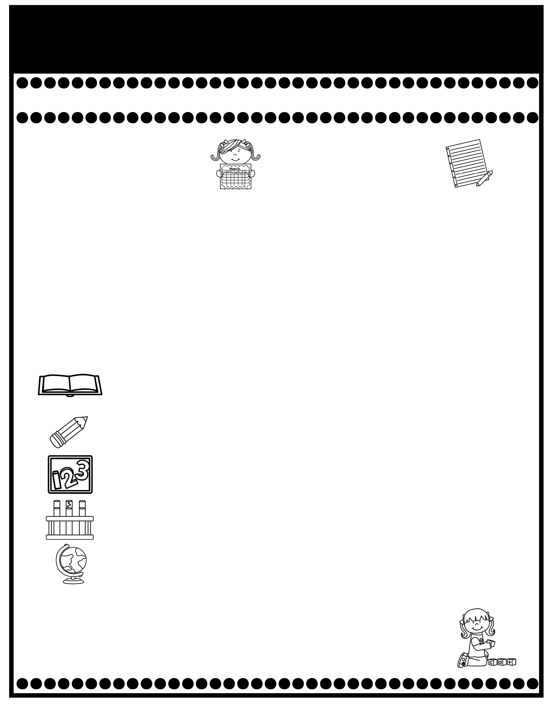
Branning’s Buzz
Week of: January 13-17, 2025
What’s Happening
This Week
Upcoming Events
Don’t forget to complete the Reading for
Education emails and return the form with your child’s code
To receive a prize.
Tuesday Folders will be sent home Tuesday. Please sign and
return
The cost for snack is $.1.00.
A Weekly Reading Overview page will be sent home each week to help you practice skills and vocabulary words with your child. Also, nightly reading homework will be assigned in your child’s Take Home Binder. Please don’t remove pages.
Please make sure your child is reading his/her A.R. book to you. After reading 3 times & asking comprehension questions, please sign the reading log in the back of their Take Home Binder indicating they are ready to test.
January 17: Special Snack, Slushy $1.00
January 20: Martin Luther King, Jr. Holiday
January 22: 100th Day of School
If you have questions or concerns, you may email me at Wendy.branning@acboe.net.
A Peek At What We Are Learning
Reading | Phonics: o_e, u_e Comprehension: Making inferences, characters Vocabulary: sketched, compass, symbols, arrive, practice. 1/17 Comprehension Story
Writing/ Grammar | Persuasive Poster, Penmanship: Lowercase letters u and m Capitalizing 1/17 Dictation & Grammar (Capitalization)
Math | Topic 5: Work with Addition & Subtraction Equations 1/16 Minor Grade & 1/17 Topic 5Test (Review pages will be sent home Thursday).
Science | We rotate Science and Social Studies.
Social Studies | Martin Luther King, Jr. Unit
Spelling Words
No Spelling Test will be given until Unit 7.
.

