Slide 1
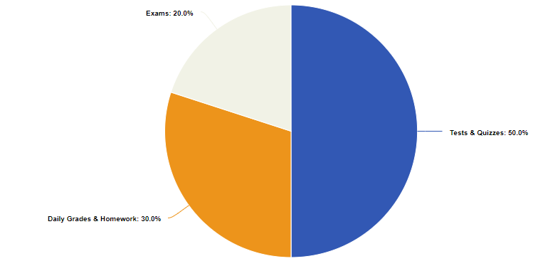
ACT
TEST
PREP
ACT TEST PREP ⬤ 2 0 2 3 - 2 0 2 4
M S . B R A D F O R D
CLASS MATERIALS
ELECTRONIC
DEVICES
ACT WORKBOOKS
ERASERS
NOTEBOOK PAPER
Electronic devices are only to be used in class when instructed to do so. If technology is not used appropriately, parents will be notified and the school-wide cell phone policy will be followed.
COMPOSITION NOTEBOOK
PENCILS
%
GRADING
PERCENTAGES
LAPTOPS
HIGHLIGHTERS
FOLDER
RULES + EXPECTATIONS
BE PREPARED Be on time, in your seat, and ready to work when class begins. Have the necessary supplies for our class. Try your best in all assignments and complete your weekly homework.
BE RESPECTFUL You are expected to conduct yourself in a mature way. Respect the rights of others. Be kind and considerate. Respect and follow all school rules and Dress Code.
GRADE SCALE
A 90-100
B 80-89 C 70-79 D 65-69 F 0-64
It is your responsibility to check your grades weekly.
A “1” means that the assignment(s) was NOT turned in and completion of the assignment is due as soon as possible (ASAP) for a grade.
No name papers will have points deducted from the total score and hung up on the bulletin board
LATE ASSIGNMENTS: There will be a 5% penalty for each day an assignment is late. After three days, you will receive a ZERO.
All assignments/notes will be on Schoology.
BE RESPONSIBLE Have integrity with your work, do not cheat, or plagiarize (doing so may result in an automatic zero). If you are absent for any reason it is your responsibility to find out what assignments/notes were missed and make arrangements for makeup work.
CONSEQUENCES Verbal Warning Confer with the Student (possible loss of privilege) Parent Notification Teacher Detention Office Referral Note: A serious violation in the code of conduct may result in an immediate referral to the Office.
662-393-9300 | latasha.bradford@dcsms.org | via Schoology

Slide 2
ASSIGNMENTS
Daily Assignments
Bell Ringers will be completed in class and submitted for a grade on Fridays.
ACT Prep Workbook Modules.
Exit Tickets will be given during the last 10 minutes of class.
Weekly Assignments
Bell Ringers for the week must be submitted for a grade on Fridays.
There will be a short quiz in class every Friday.
Practice Tests
There will be a practice test every other Wednesday during class. The first two dates are listed below.
August 16th
August 30th
Questions:
I encourage students to engage in discussion during lectures and while working in groups. For individualized advice on solving problems, students should send me their questions, but know that I will have a response provided within 24 hours.

