Slide 1
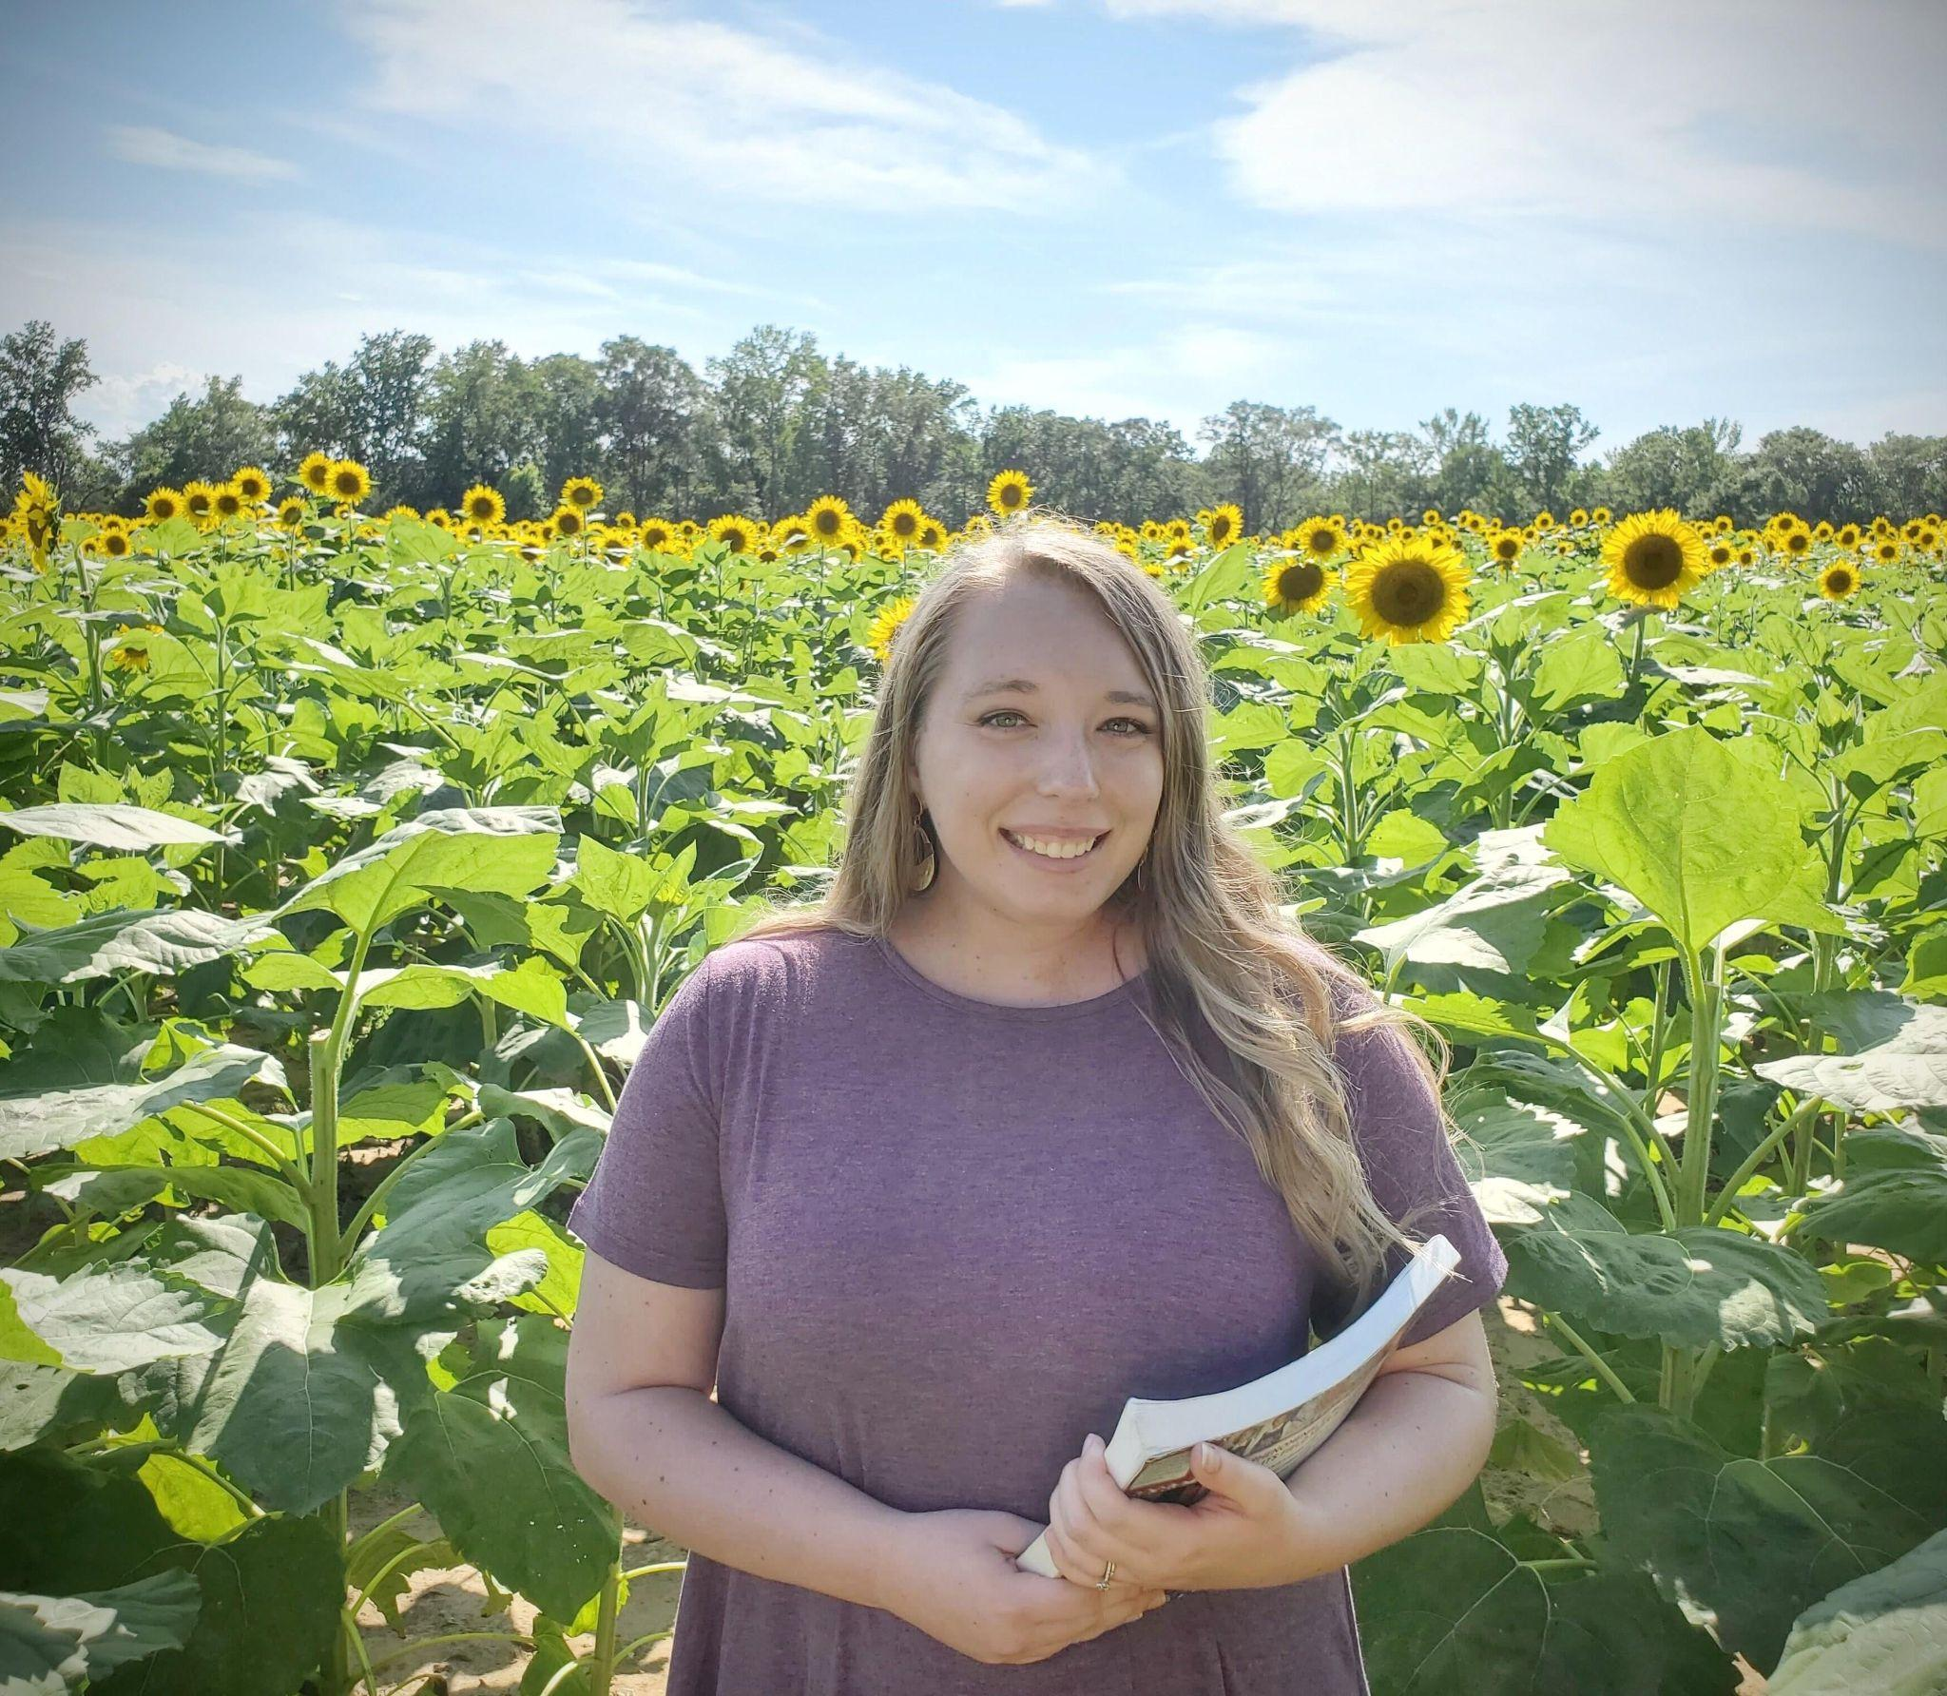
Meet your teacher
Mrs. Talley
*Insert image here*
Use crop > shape > circle
to make your image a circle to fit the space

Slide 2
About me
I am 26 years old. My birthday is September 12. I graduated from AUM with a bachelor’s degree in elementary education in 2020 and received my masters degree in education from UWA this past July. I have taught both fourth grade and kindergarten during my career. I am from and currently live in Millbrook. In my free time, I enjoy sitting by the pool, going on long walks, strolling through Target, and watching Disney vlogs. I love all things Disney!
Favorites
Color: pink
Restaurant: chic-fil-a
Food: sushi
Drink: caramel coffee
Animal: dogs
Movie: Moana
Season: Fall
Book: Dragons love tacos

Slide 3
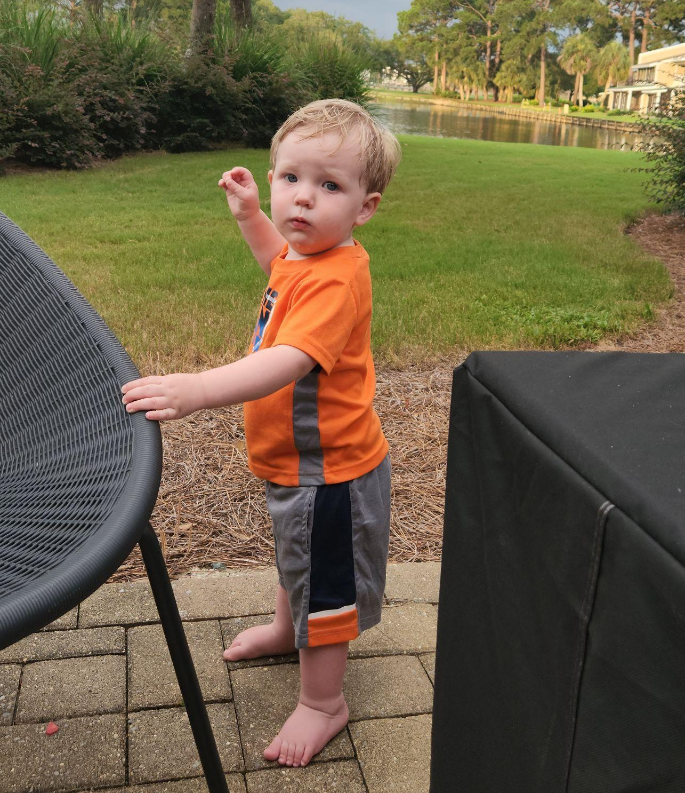
MY family
I am married to my wonderful husband, Michael and we have a sweet three year old son named Matthew. We also have a sweet baby girl named Sarah on the way.

Slide 4
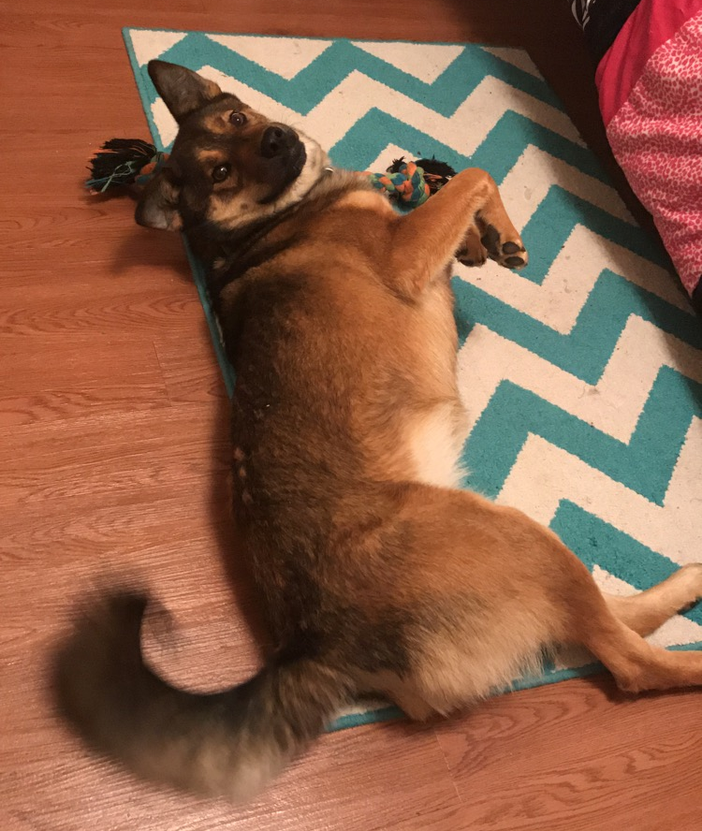
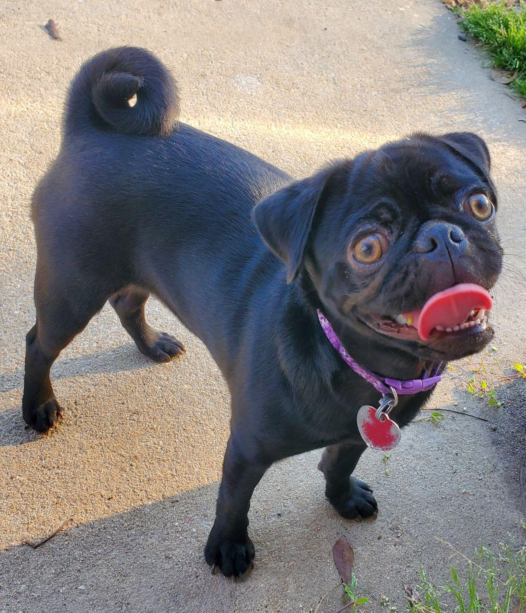
MY pets
I have a pug named Priscilla and a german shepherd named Leia.

Slide 5
Maternity leave
. I am due to have my baby January 8 which means that I will more than likely not be back right after Christmas break. If all goes well, I will be out from Christmas break until the end of February or early March. I will communicate more details with you about what to expect during this time via remind as we get closer to time.

Slide 6
Staggered start
Wednesday:
Elliot
Julia
Olivia
Eli
Thursday
Ava
Avani
Karson
Troy
Friday
Antonio
Payton
Ivey
Nicole
Each student will only come one day the first week of school. August 7-9

Slide 7
Start and End times
Dismissal
Car riders will dismiss at 2:35p.m. You will be allowed into the car rider lanes at 2:00p.m. Car riders ends at 2:55p.m. Any child not picked up by 2:55 will need to be
picked up from the front office. A meeting will be held with administration if this occurs more than 3 times. The first car tag is free and additional are $5 each.
YOU MUST ALWAYS HAVE YOUR CAR TAG TO PICK UP YOUR CHILD IN THE CAR LINE. If you already have a tag, you can add your child to the existing tag.
Arrival
Students may arrive as early as 7:10a.m. and as late as 7:40a.m.
Please contact your child's bus driver for morning pick-up time.

Slide 8
Procedures
Morning Car Riders - Students should stay inside the car until school staff indicates it is time to walk to the sidewalk. Parents stay inside your car. Students will walk to the sidewalk independently and staff will help when needed. ALL CARS WILL COME THROUGH THE LOOP EVEN IF YOU ARE TARDY.
Afternoon Car Riders - Parents should stand by the driver's side door once students begin to exit. Please do not follow your child.
Afternoon dismissal
2:30 - First load buses 2:40 - Second load buses
Someone must be home when students are dropped off.
The first few weeks will be HECTIC! Please be patient it will get better.

Slide 9
Sending money
. Please make sure to send exact change when paying for anything because the office will not send back change.
please label all money with a sticky note, sharpie on the bag, or piece of paper. We can’t accept any money without it being labeled. I will have to send it back home with the student if it is not labeled.
Please make sure you do not combine money for two different things. For example, if you are paying for a shirt and snack at the same time, please split it up with a bag of 12.75 and a bag of 1.50, not $14.25 in one bag. We can’t split bills

Slide 10
meals
Snack
Students can bring snacks from home or bring $1.50 to purchase one juice and
one snack. Sodas, candy, and icing cans are not permitted and please do not send large beverages/snacks for snack time. They will have 10 minutes. A quick snack and drink is perfect! Example: apple slices and a juice box. Also, please make sure that your child is able to open what you send them.
Breakfast and lunch are free to all students this year!!!

Slide 11
behavior
. We have 3 schoolwide rules. They are:
• Respect for self: Always make sure you are doing your very best by listening and cleaning up after yourself!
• Respect for others: For an entire school year, this will be your classroom family. We will always share with others, take turns, and keep our hands and feet to ourselves. We will make sure to always listen to the teacher.
• Respect for property: no destruction of property, toilet paper in the toilet, no taking things that do not belong to us.
Student behaviors will be communicated daily on their calendar. Parents: please initial it every day. In addition, we use class dojo. Please use the link provided at the end of this packet to sign up. 20 points = a treasure box treat on Friday!

Slide 12
Behavior continued
Steps: In our school, we use the step system for behavior management. If we notice that a negative behavior happens often, they will be written up on a step.
Step 1: teacher- student conference, note on behavior chart.
Step 2: parent- teacher conference
Step 3: counselor referral.
Step 4: office referral
Student behaviors will be communicated daily on their calendar. Parents: please initial it every day. In addition, we use class dojo. Please use the link provided at the end of this packet to sign up. 20 points = a treasure box treat on Friday!

Slide 13
notes
If a transportation change is made, it must be a written note and turned in
the morning of the transportation change. Texts, phone calls, and Remind
messages will not be accepted. Examples for note:
• “Johnny Smith will be riding bus 18-32 today, August 4th, to 123 Smith Rd Millbrook, AL 36054. My number is 3341234567. Thank you, Lisa Smith.”
• “Sally May will be a car rider this afternoon, August 4th. My number is
3341234567. Thank you, Lisa May.”
Notes need to be turned in any time your child is missing school, whether it be a doctor’s appointment or illness, a note with the child’s name, parent/guardian’s name, and a phone number must be turned in within 3 days of the absence for it to be excused. When a child is checked in/out, it will show up in PowerSchool as a “tardy”. You may turn in notes for tardies to get them excused. Attendance is important and can be considered a reason to retain if absences become excessive.

Slide 14
communication
I will communicate with you via remind, weekly newsletters, phone calls, and in person meetings when needed.
Please make sure to check remind daily.
*Parent report day is September 12.
***Dojo will be mainly used for behavior tracking. Please message me through remind. ***
Remind code:
@6aa2h4

Slide 15
tardies
When a child is checked in or out in PowerSchool it will show as a tardy.
A student who leaves the school for any reason must check out through the office.
Students who check out before 11:30 am or check in after 11:30 am will be considered absent for the day.
Identification MUST be shown when checking out a student.
NO CHECK-OUTS AFTER 2:00 PM.

Slide 16
Instruction
What can you do at home starting now?
Letter flashcards
Number flashcards
Read to your child every night
Have them write their name
Practice saying rhyming words
Have them practice counting to 100
While in class, students will receive instruction in many ways. Most whole group instruction will happen at our classroom rug. Independent work will be worked on at their tables. In addition, students will receive instruction in a small group setting at my table. While I have a group at my table, the other students are expected to work independently or with a partner on an activity at one of our stations. If needed, during nap time or technology time, one on one intervention will be administered by me at my teacher’s table. You will be notified of a problem area that I am noticing and will be given tips to work on at home with your child. If four weeks go by without improvement, their name will be brought up to our grade level to be discussed. If another four weeks go by with no improvement, I will submit their name to our PST team to see if they qualify for out of classroom intervention by our specialists.

Slide 17
rest time
. We will have a 30 minute rest time until January. Please send a blanket, towel, or nap sack that your child can carry by themselves. They will keep their blanket either in their bag or under the bag. They will bring them home daily. In kindergarten, we do not use cots, we will just spread out on the floor during rest time. Due to my maternity leave, our class only will have an extended nap time. We will have a nap time from August until March. Most kindergarten classes will have nap time until January.

Slide 18
Life Skills that should be mastered asap
. We ask that you work with these skills at home with your child so they can do them independently:
Tying shoes or velcroing shoes
Buttoning pants
Putting on a jacket
Hanging up their backpack
Eating over their plate
Opening snacks/ twist top drinks/ juice pouches
Properly washing their hands
Using the restroom/cleaning themselves
Saying their full name and teacher’s name

Slide 19
nurses
We have two fantastic nurses! Nurse Allyson and Nurse Beverly take such wonderful care of our kids. They are in Kindergarten Red Pod. If your child has a medical condition the nurse’s have not been made aware of yet, please stop by their station today before leaving. It is super important I am aware of ALL allergies, conditions, and special care instructions so we can have the best and safest year possible!

Slide 20
Medical conditions
Students CAN NOT transport medication of any form (over the counter or prescribed) to school.
In order for the student to have medication administered at school, their doctor must complete a form and return it to the nurses.
Parents MUST bring the medication to the nurses NOT the student.
If your child has a fever they can not return to school until they are fever free with no medication for 24hrs

Slide 21
Extra clothes
Please put two extra sets of clothes in your child’s bag to keep in there for bathroom emergencies. Many students struggle with adjusting to the long walk to the restroom during emergencies. Also, there are a few times throughout the day where it is hard to immediately go to the restroom. (lunch, pe, dismissal)
We are accepting clothing donations currently. No used underwear.

Slide 22
Class fees
. CLASS DONATION - $1O
TAKE HOME FOLDER - $3
FIELD TRIP T-SHIRT - $9
All of these items can be combined together for a total of $22. If paying with a check, please make it payable to Coosada Elementary School. Make sure to have a phone number on the check as well.

Slide 23
PAPERWORK
Please fill out all necessary paperwork today.
It is easier for you and myself. They are located at your child’s table. Any papers on the right side of your child’s folder are for you to take home! Please do not take the folder home yet. I just wanted to let you know what you should be looking for each night.

Slide 24
Extra info
Join the Elmore County Public School REMIND by texting @ecboeinfo to 81010
Students are required to wear closed-toed shoes for P.E. They may sit out if they are not. This is for their safety.
Students may bring special snack on their birthday!
Preapproved absences will not begin until after October 1st.
Join the CES REMIND by texting @coosadaelem to 81010

Slide 25
dominos
Please see flyer

Slide 26
Meet your teacher
Thanks for coming!!
Drive safe and I can’t wait to start our amazing year!!!

