Slide 1
2-Factor Authentication
Steps to enable in chrome

Slide 2
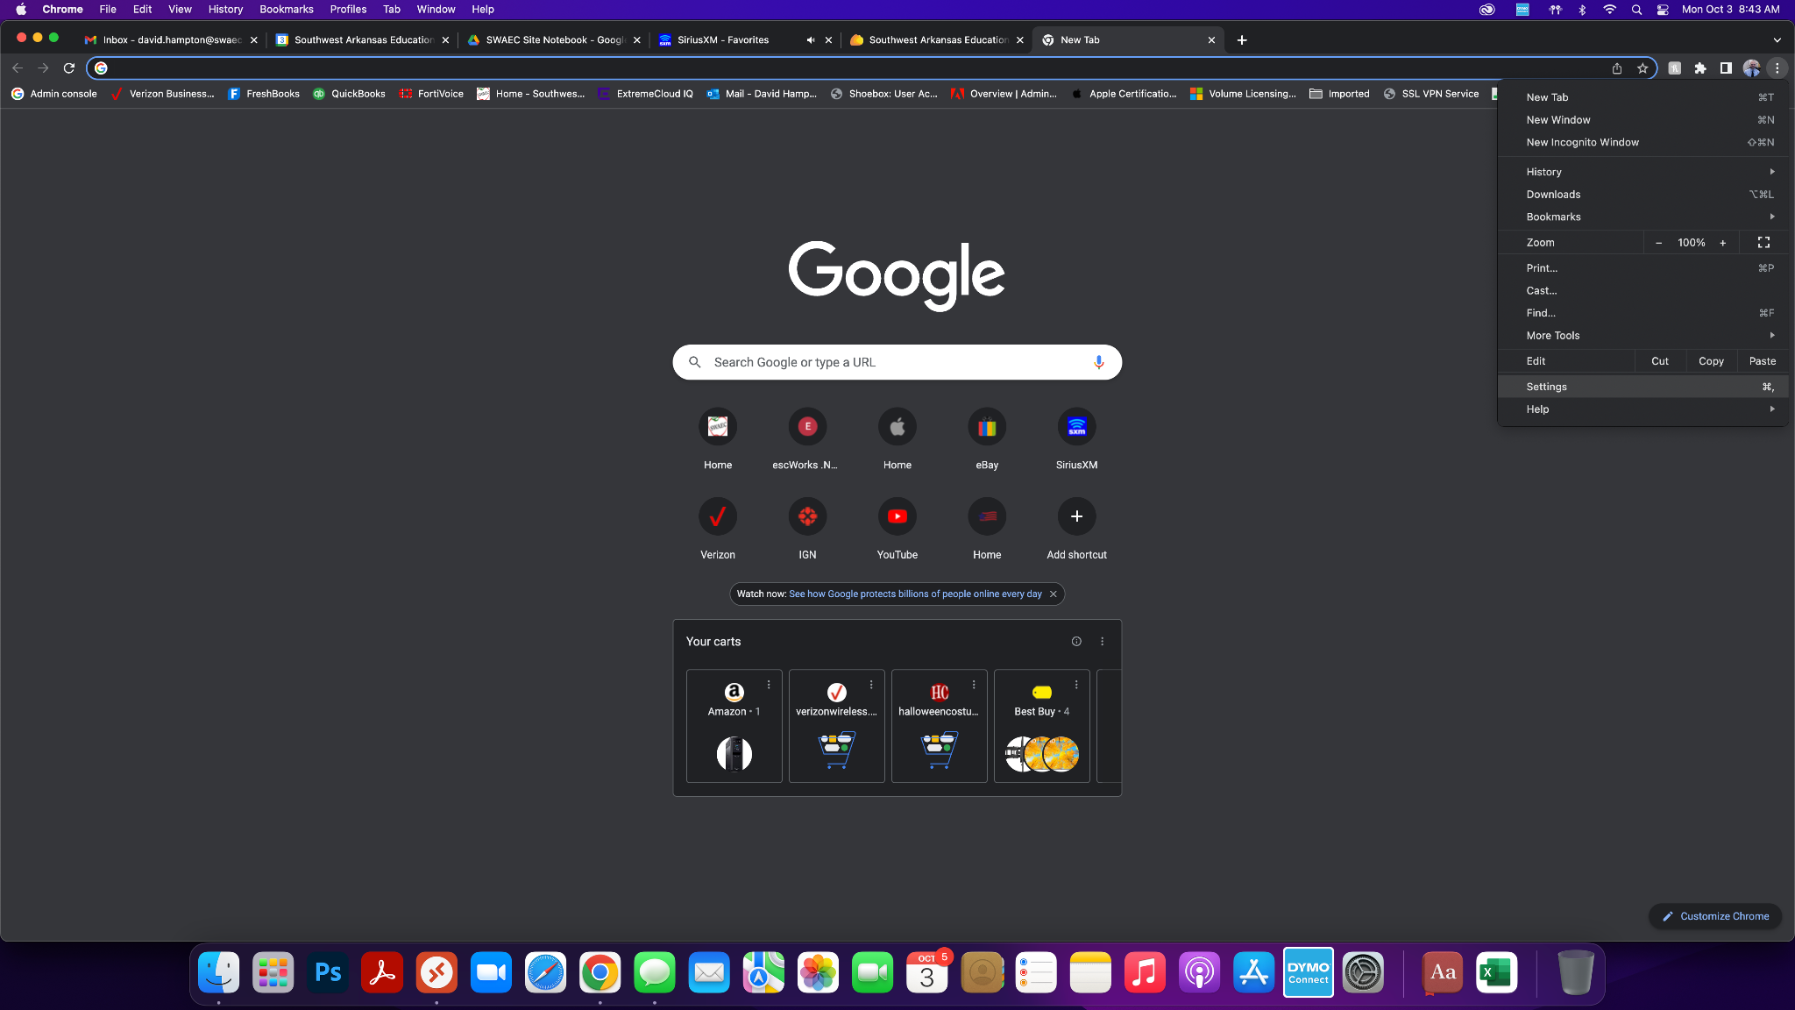
Step 1: Navigate to settings
Click Here 1st
Click Settings

Slide 3
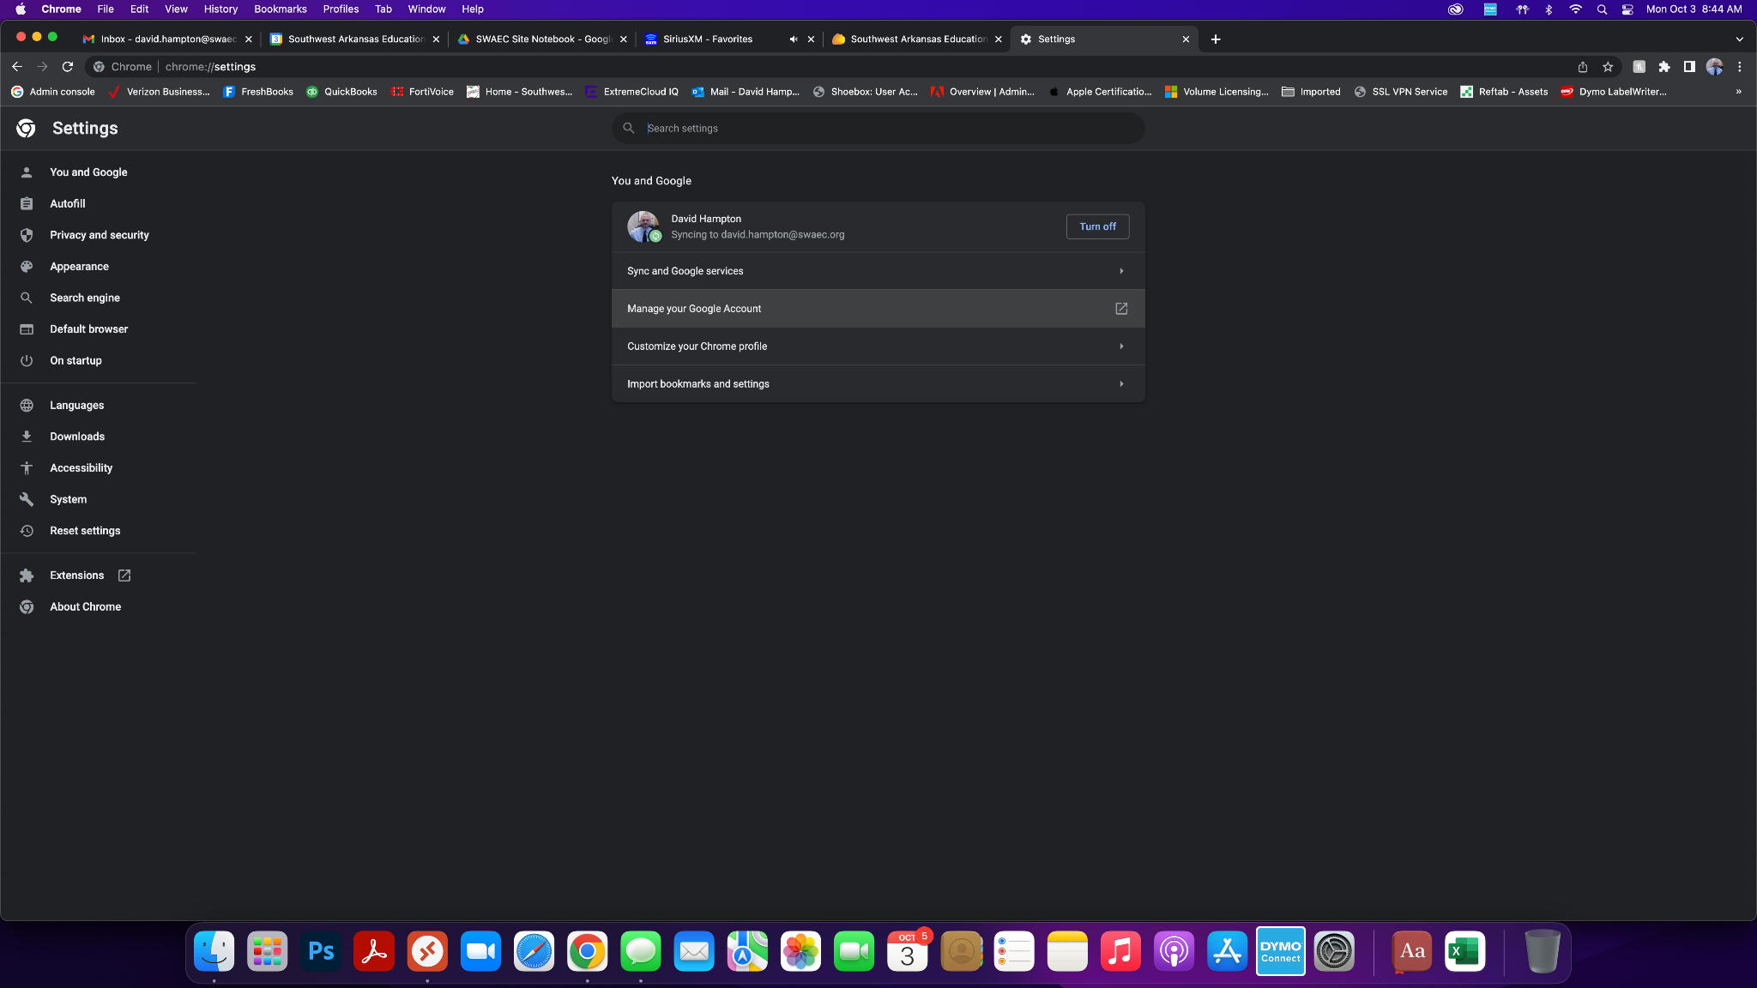
Step 2: Click Manage your Google Account

Slide 4
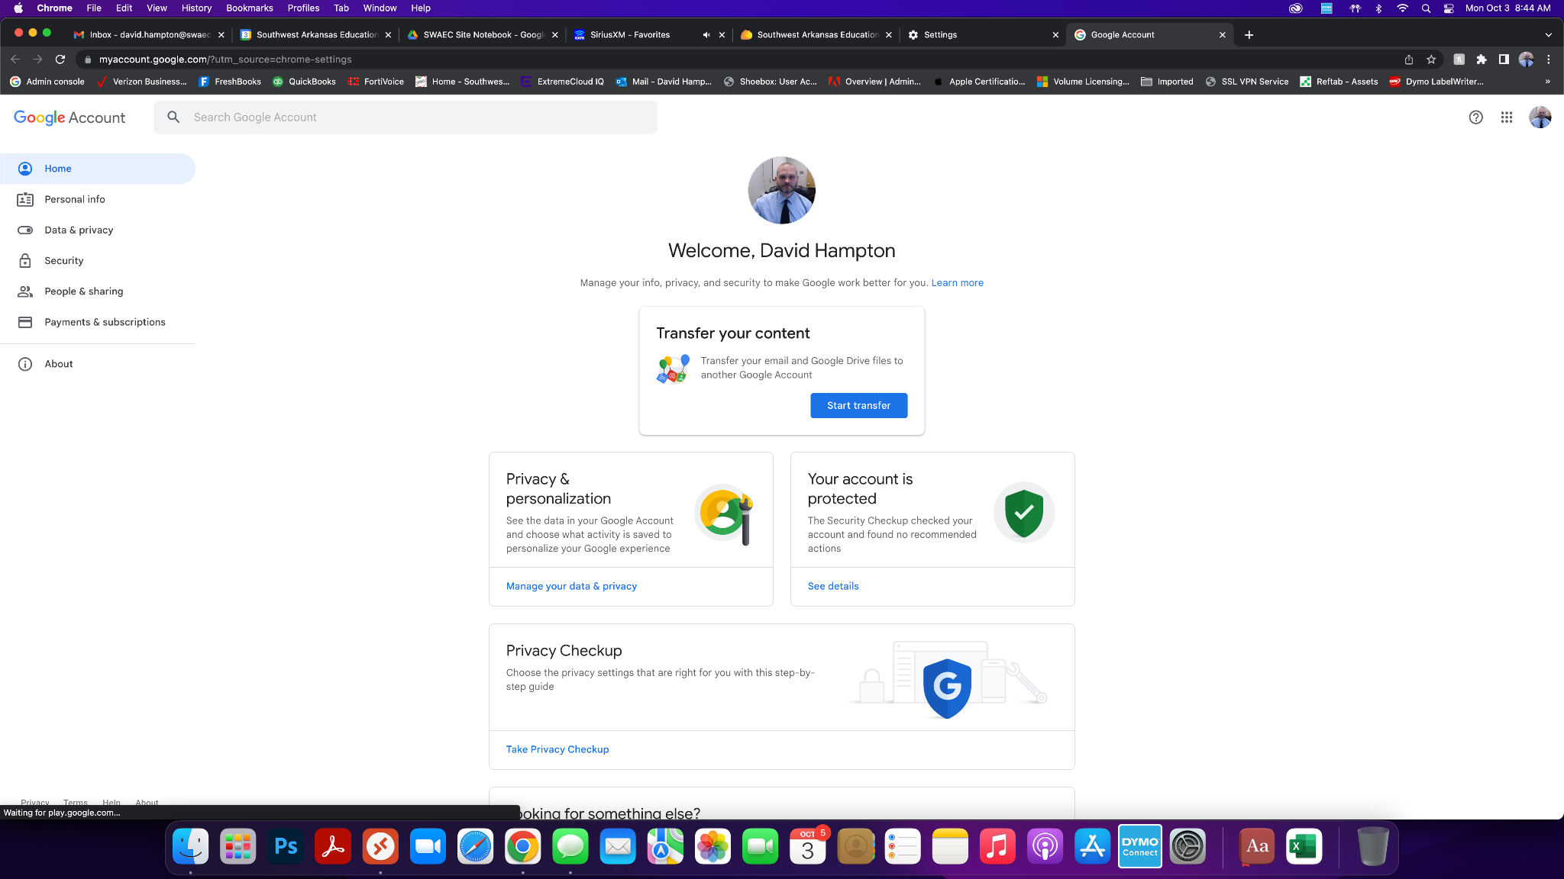
Step 3: Click Security

Slide 5
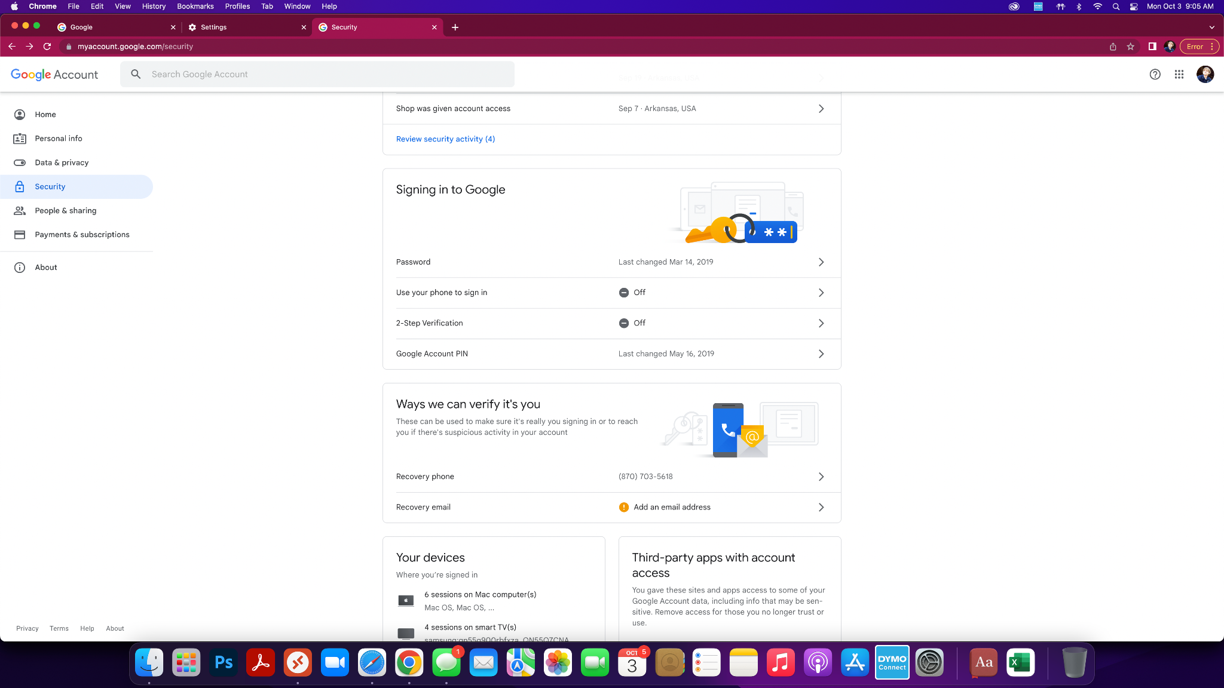
Step 4: Click 2-step Verification

Slide 6
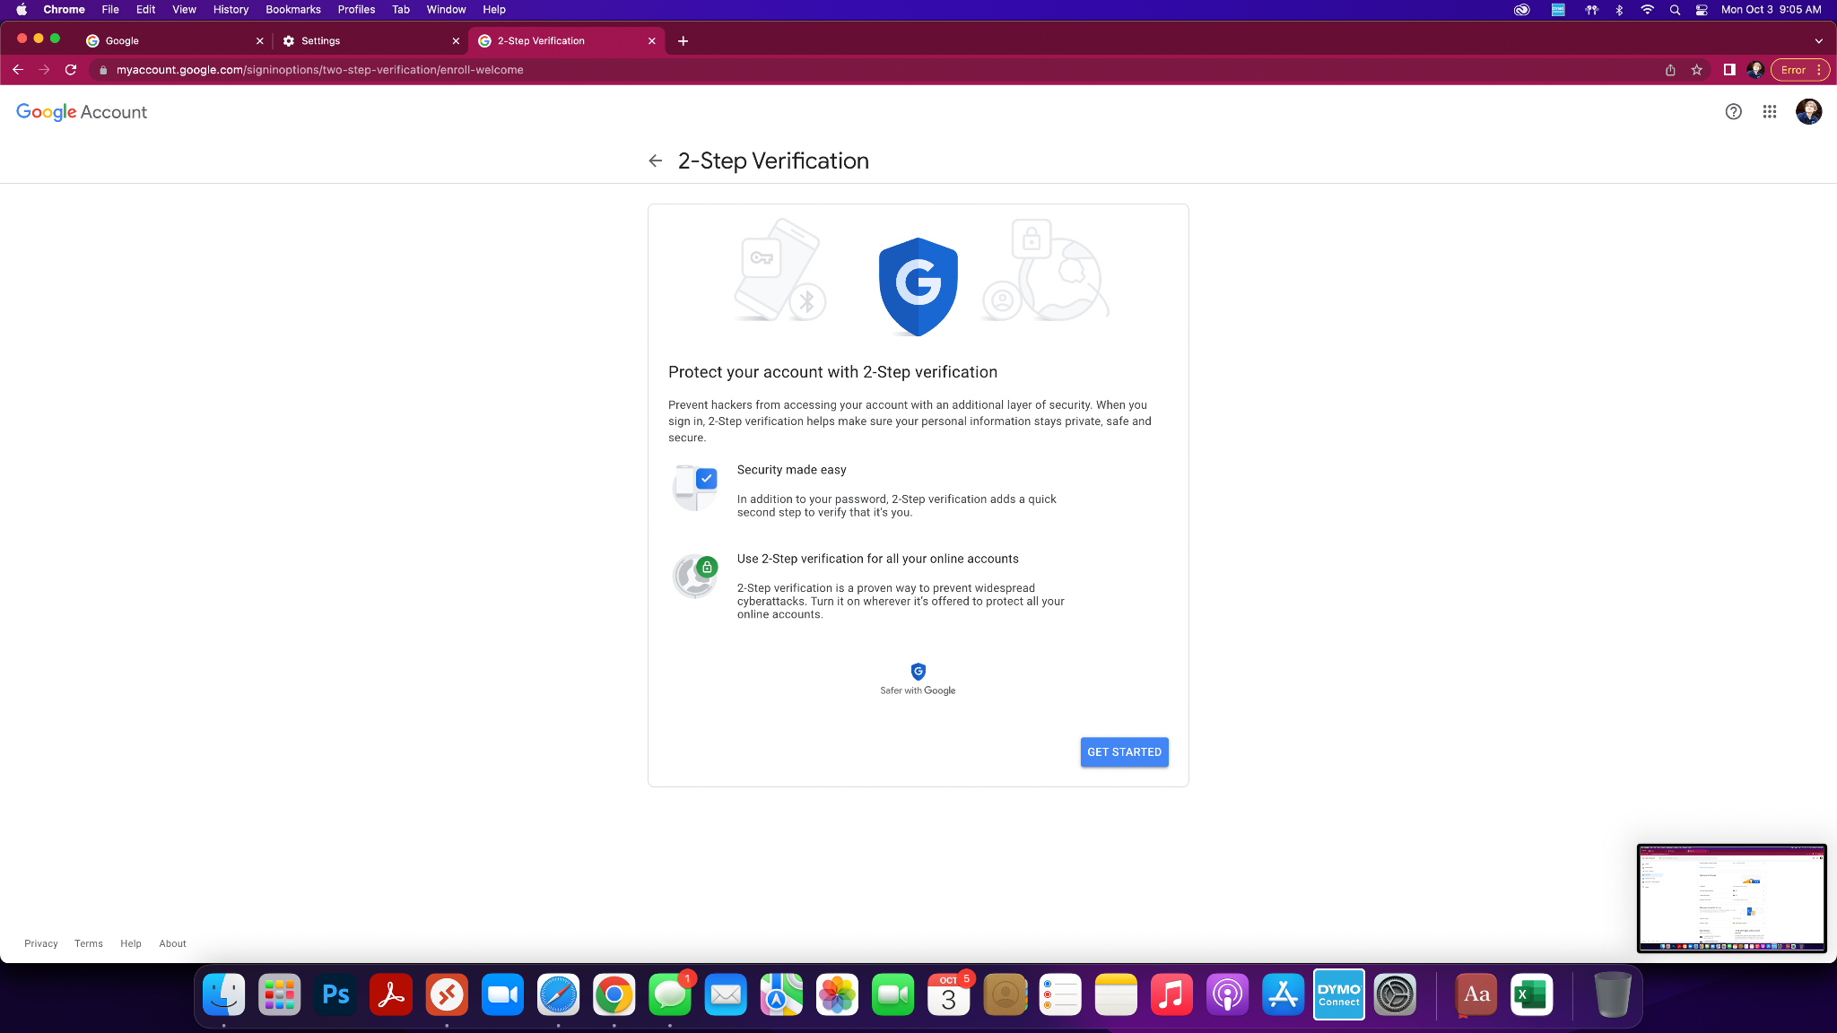
Step 5: On next screen click get started

Slide 7
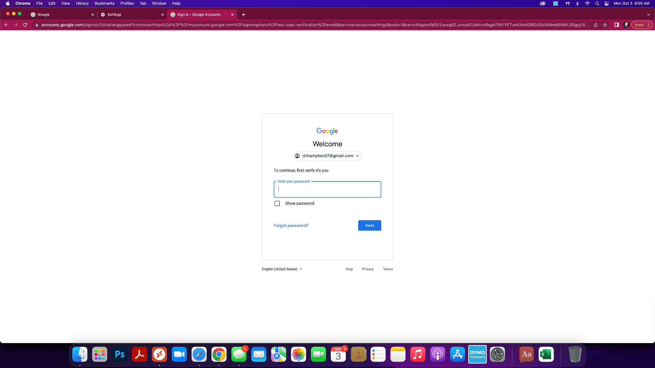
Step 6: Enter password for your gmail account

Slide 8
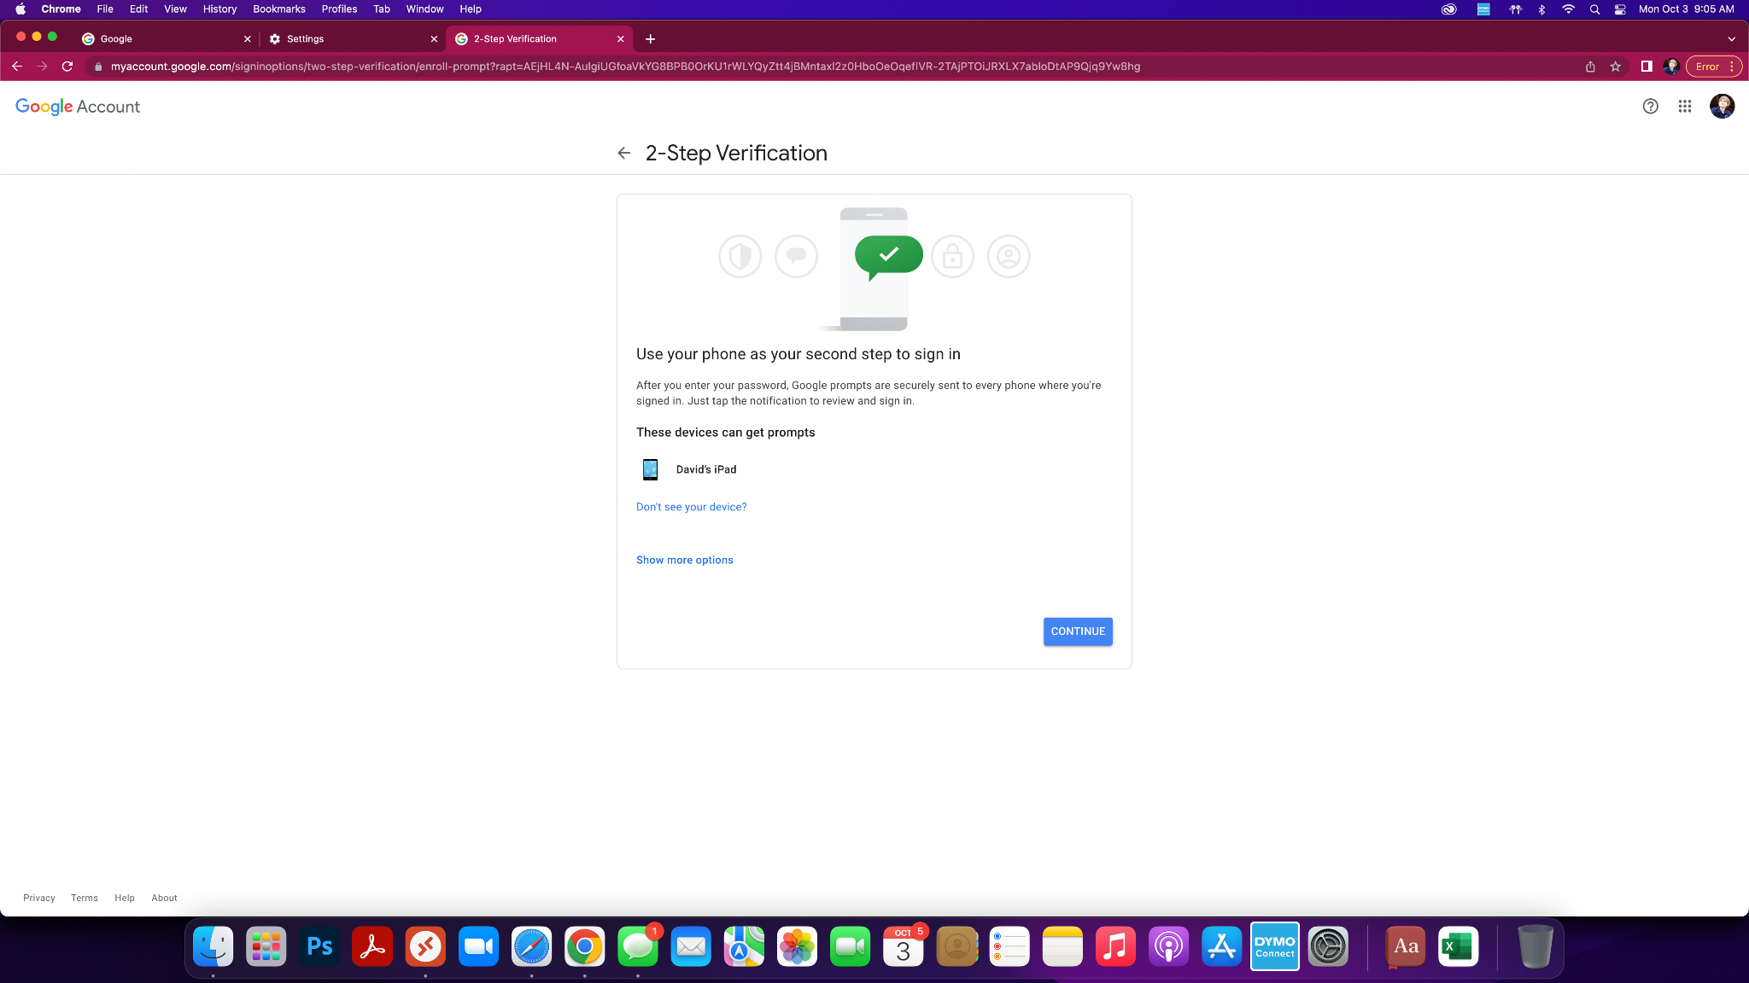
Step 7: you will see devices that will give you 2-step prompts, I recommend clicking see more options

Slide 9
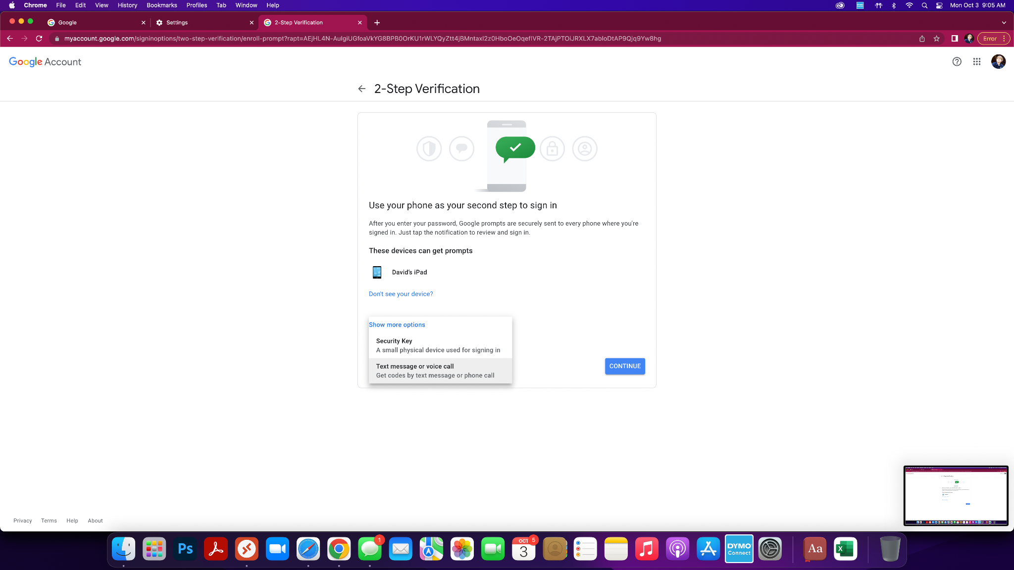
Step 8: Click text message or voice call

Slide 10
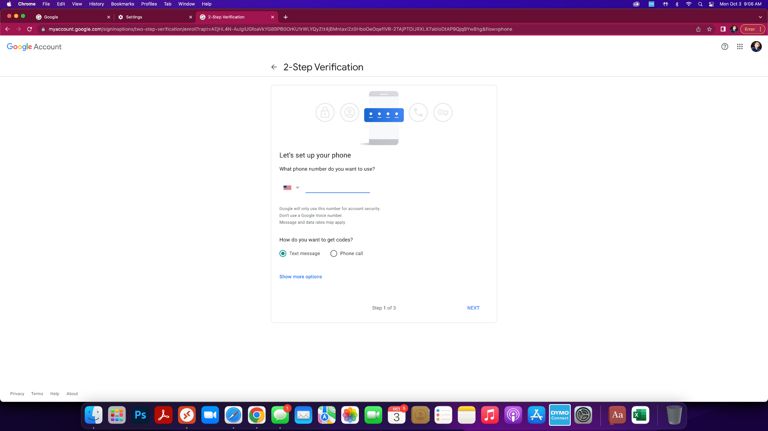
Step 9: Add phone number and click next

Slide 11
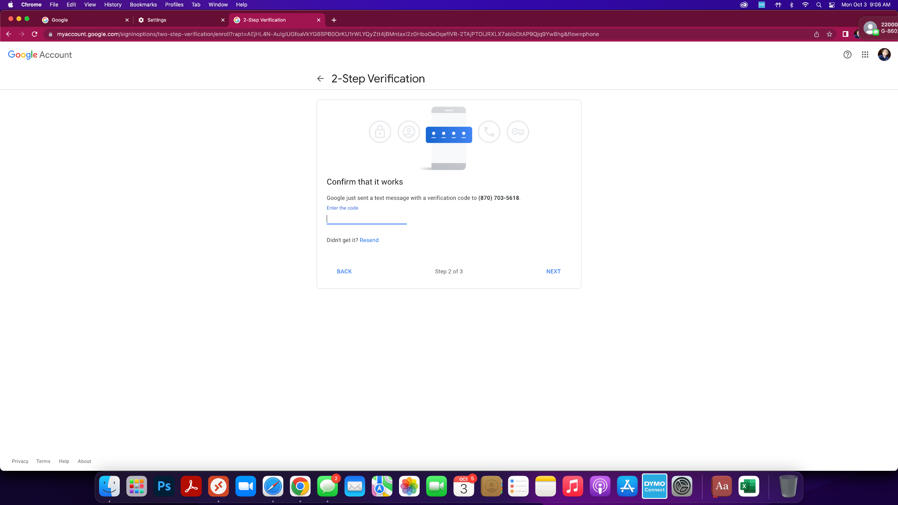
Step 10: You will get a text with a code, enter, click next

Slide 12
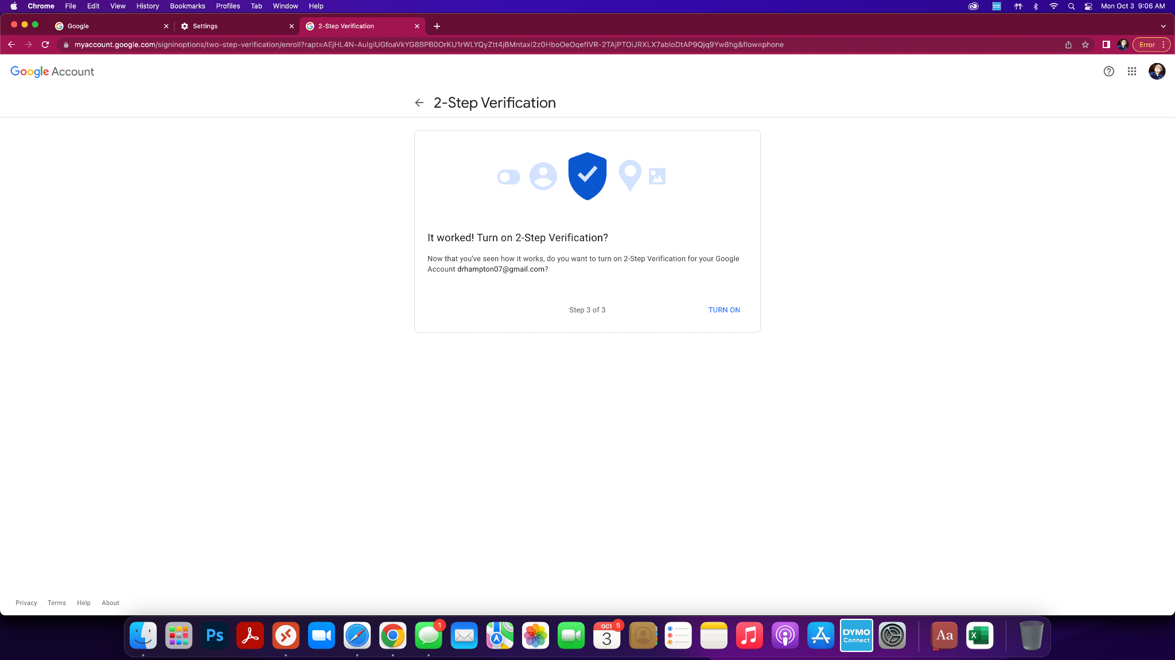
Step 11: On final screen click turn on

