Slide 2
What is the New Deal?
FDR’s domestic policy in response to the Great Depression
Fundamentally changed relationship between citizens and the federal government (government takes on responsibility of well being of its citizens)
Caused federal government to increase in size and power.

Slide 3
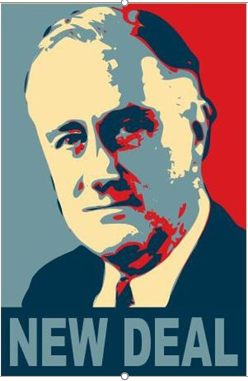
3 R’s of the New Deal
Financial Reform
Economic Recovery
Relief for the Needy

Slide 4
Deficit Spending
When federal government borrows money to pay for things
Goal is to spend the U.S.’s way out of the depression by putting money in hands of consumers.
https://usdebtclock.org/

Slide 5
Fireside Chats
Radio talks by FDR
Promoted New Deal policies and reassured nation.

Slide 6
The Hundred Days
First 100 days of FDR presidency beginning in March 1933
Congress passed more than 15 major pieces of legislation.
“the only thing we have to fear is fear itself”

Slide 7
Fix the Banks
Bank holiday – FDR closed banks across nation by executive order
Emergency Banking Act – federal government reviewed banks and allowed stable ones to reopen

Slide 8
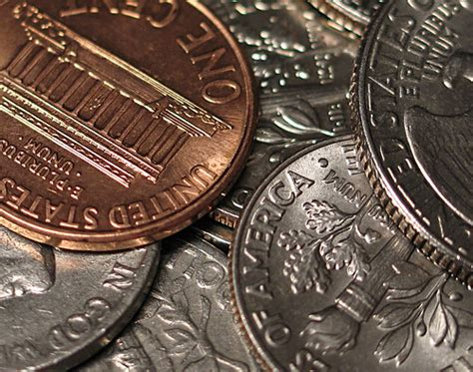
Federal Deposit Insurance Corporation
FIDC
Government insurance for bank deposits
Created by Glass-Steagall Act

Slide 9
Securities and Exchange Commission
SEC
Regulates stock market and stops fraud
Created by Federal Securities Act
Companies must provide complete and truthful information to investors

Slide 10
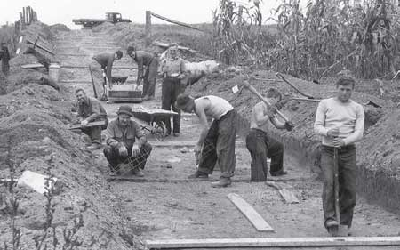
Civilian Conservation Corps
CCC
3 million Jobs for 18-25 year old men
Lived in camps
Earned $30 a month, $25 of which was sent home
Planted 200 million trees in Great Plains

Slide 11
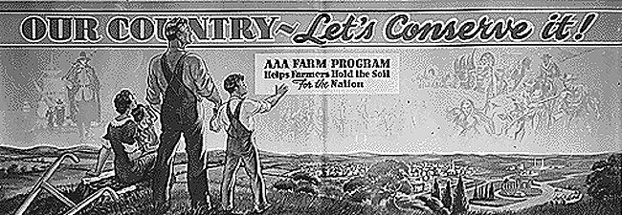
Agricultural Adjustment Administration
AAA
Would pay farmers not to produce certain crops, dairy products, or raise animals
Farmers receive $1 billion

Slide 12
Tennessee Valley Authority
TVA
Build dams to control floods and generate electricity

Slide 13
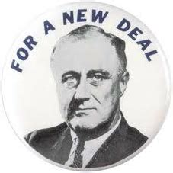
National Industrial Recovery Act
NIRA
Money to states to create jobs building schools and community buildings

Slide 14
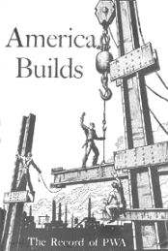
Public Works Administration
PWA
Built highways, dams, schools, and government facilities
Created by NIRA

Slide 15
Civil Works Administration
CWA
Jobs for 4 million
Built 1000 airports, 40,000 schools, 3,500 playgrounds, and 500,000 miles of road
Created by NIRA

Slide 16
Federal Emergency Relief Administration
FERA
$500 million direct relief like food, clothing and shelter to the neediest Americans
Gave money to state and local agencies to fund relief projects

Slide 17
Mortgage Relief
Home Owners Loan Corporation (HOLC) – loans to help make mortgage payments
Federal Housing Administration (FHA) – loans for building and repairing homes

Slide 19
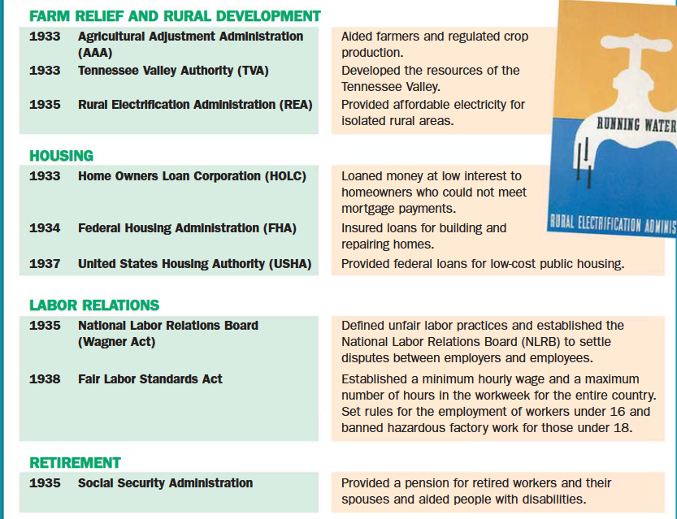

Slide 20
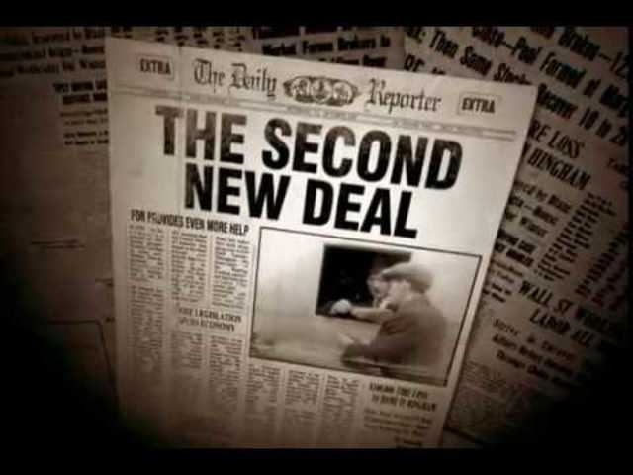

Slide 21
What is the Second New Deal?
Also called Second Hundred Days
Began in 1935
FDR launched series of programs to generate greater economic recovery.

Slide 22
FDR easily wins reelection.
Evidence that most Americans supported the New Deal.

Slide 23
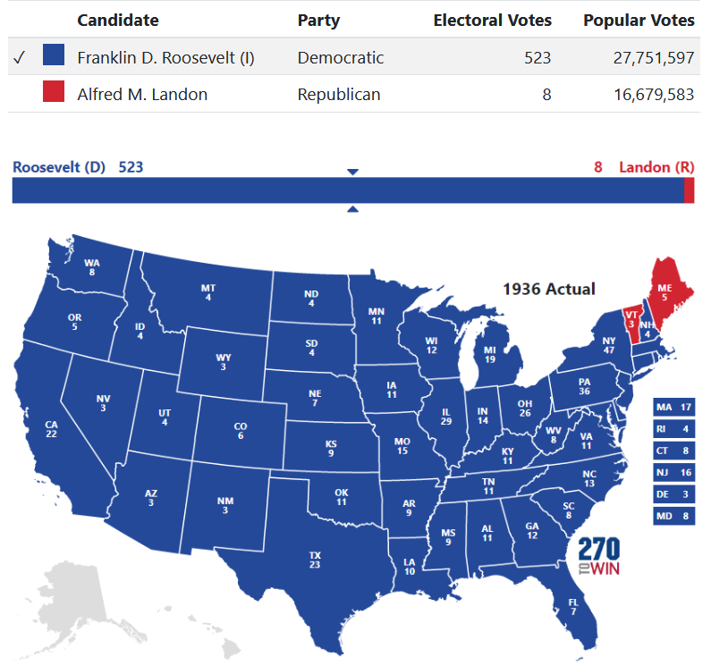

Slide 24
Roosevelt and the Supreme Court
Supreme Court struck down the NIRA as unconstitutional (citing too much government control over industry)
The Court also struck down the AAA (said agricultural was a local matter)
FDR proposed “packing the court” which involved increasing number of justices to 15.
Over time, FDR was able to appoint 7 justices, ensuring safety of New Deal

Slide 25
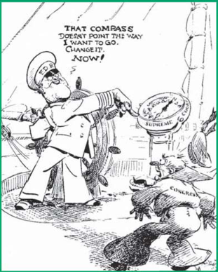

Slide 26
Works Progress Administration
Set out to create as many jobs as possible as quickly as possible
1935-1943, the WPA spent $11 billion to give jobs to 8.5 million workers
built 850 airports, 651,000 miles of road, 125,000 public buildings, 124,000 bridges, and 8,000 parks
also hired artists, writers and photographers to create art

Slide 27
Dorothea Lange
Photographer
Funded by New Deal programs
Her pictures humanized the Great Depression Era

Slide 28
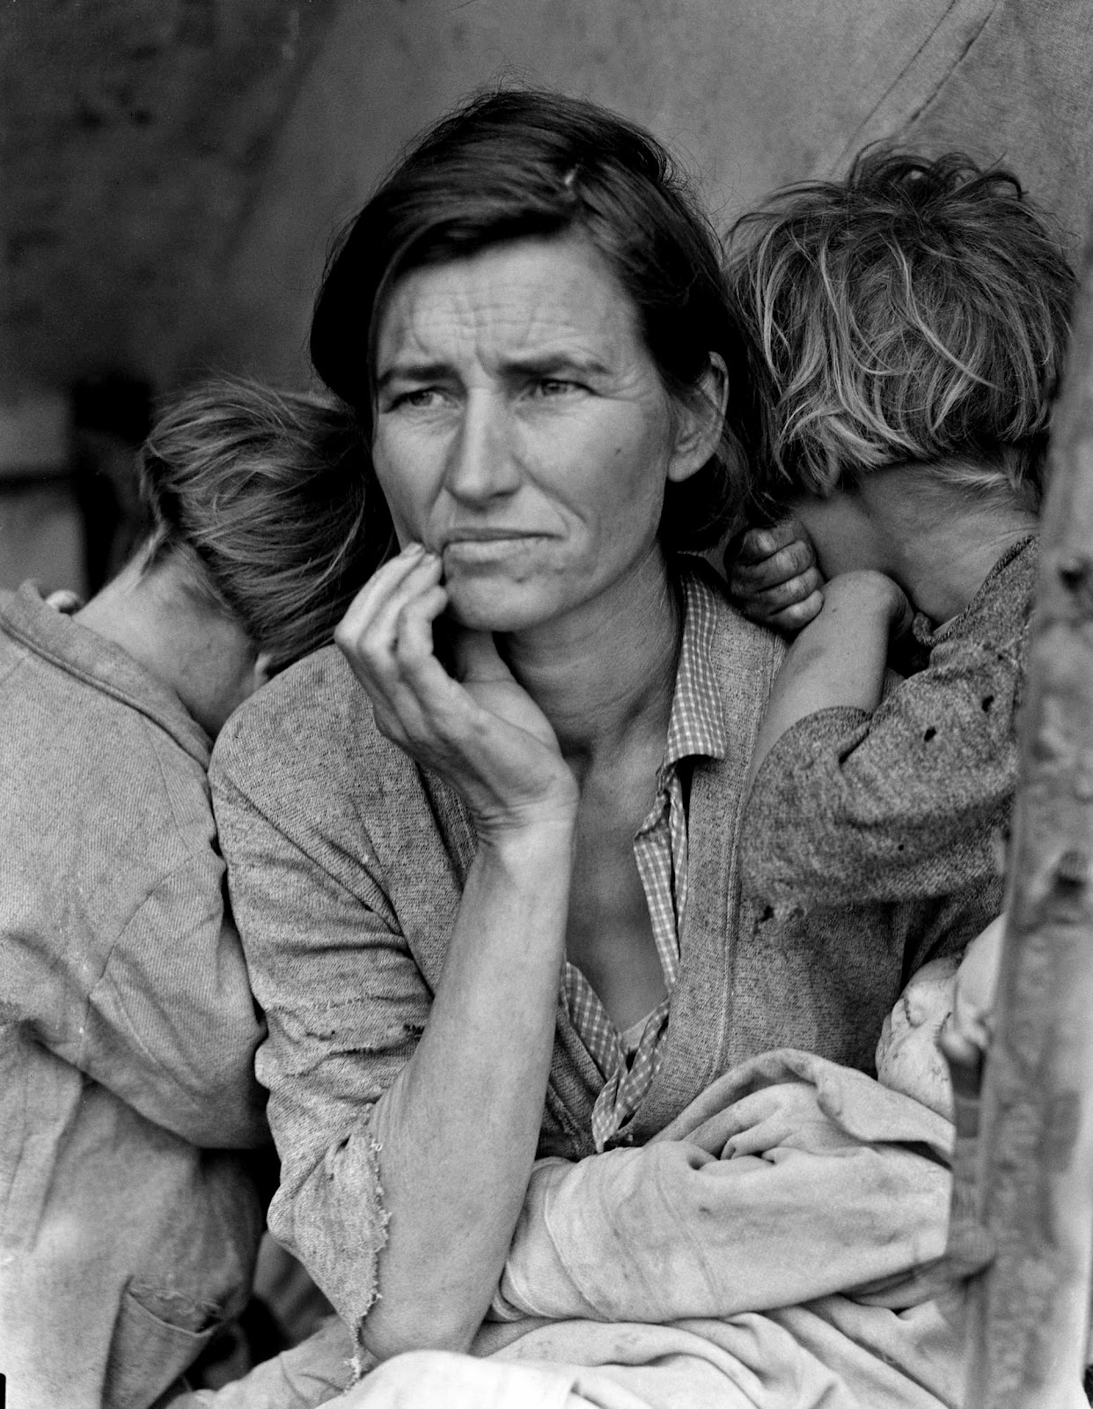

Slide 29
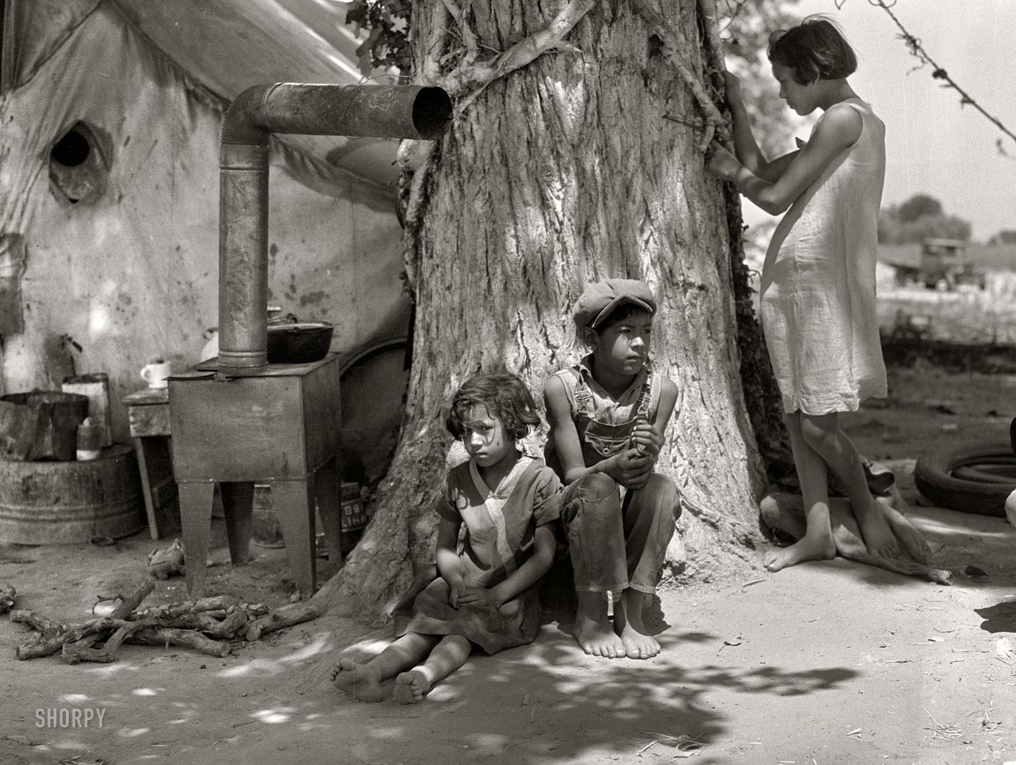

Slide 30
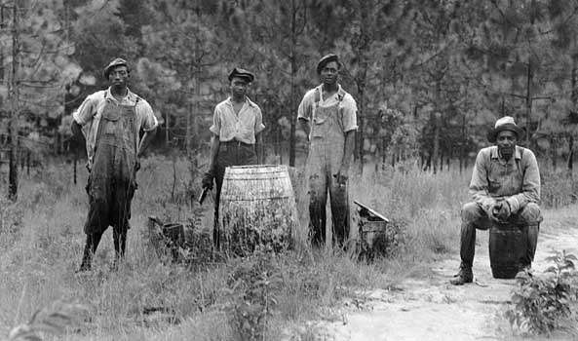

Slide 31
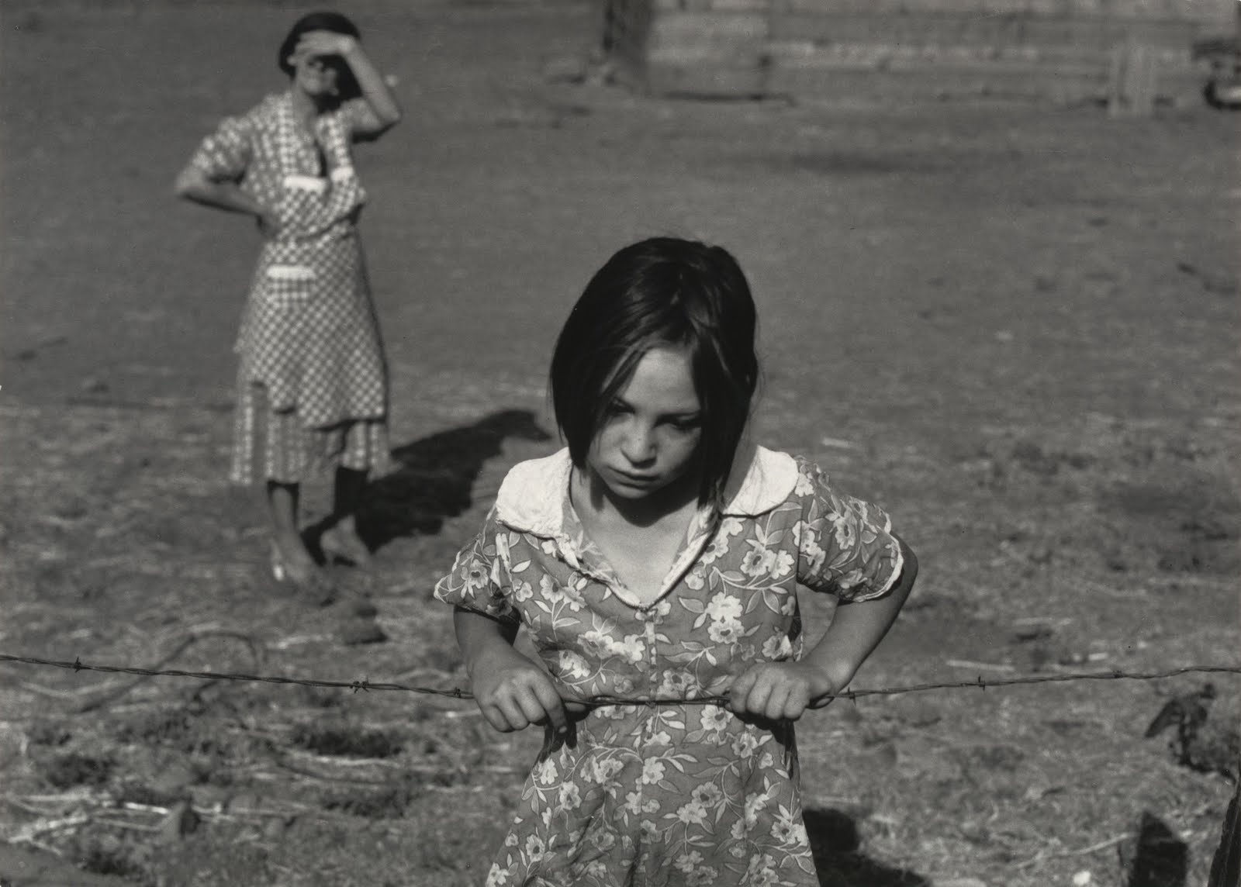

Slide 32
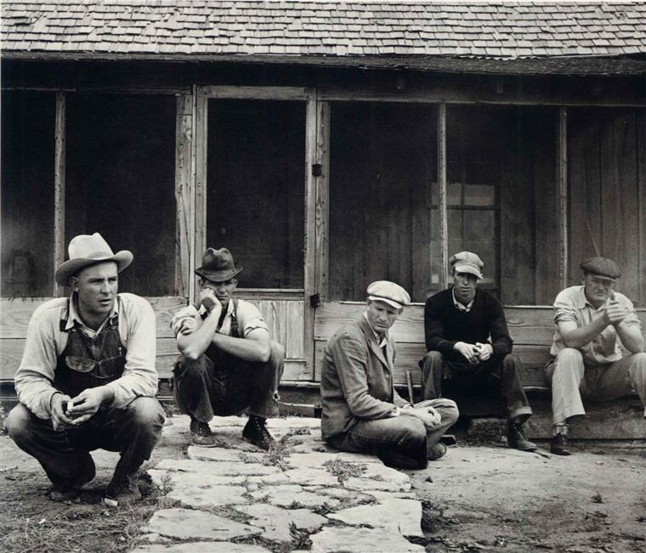

Slide 33
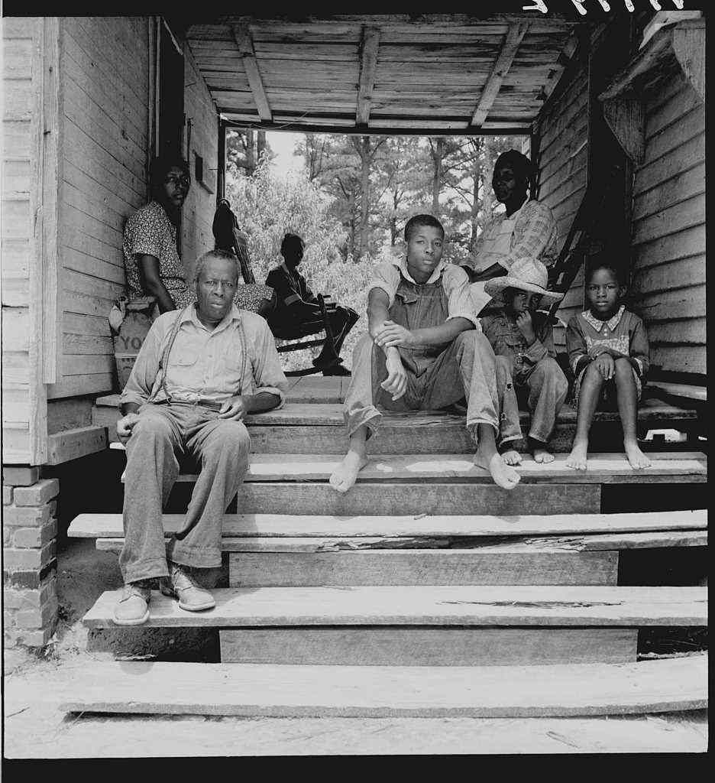

Slide 34
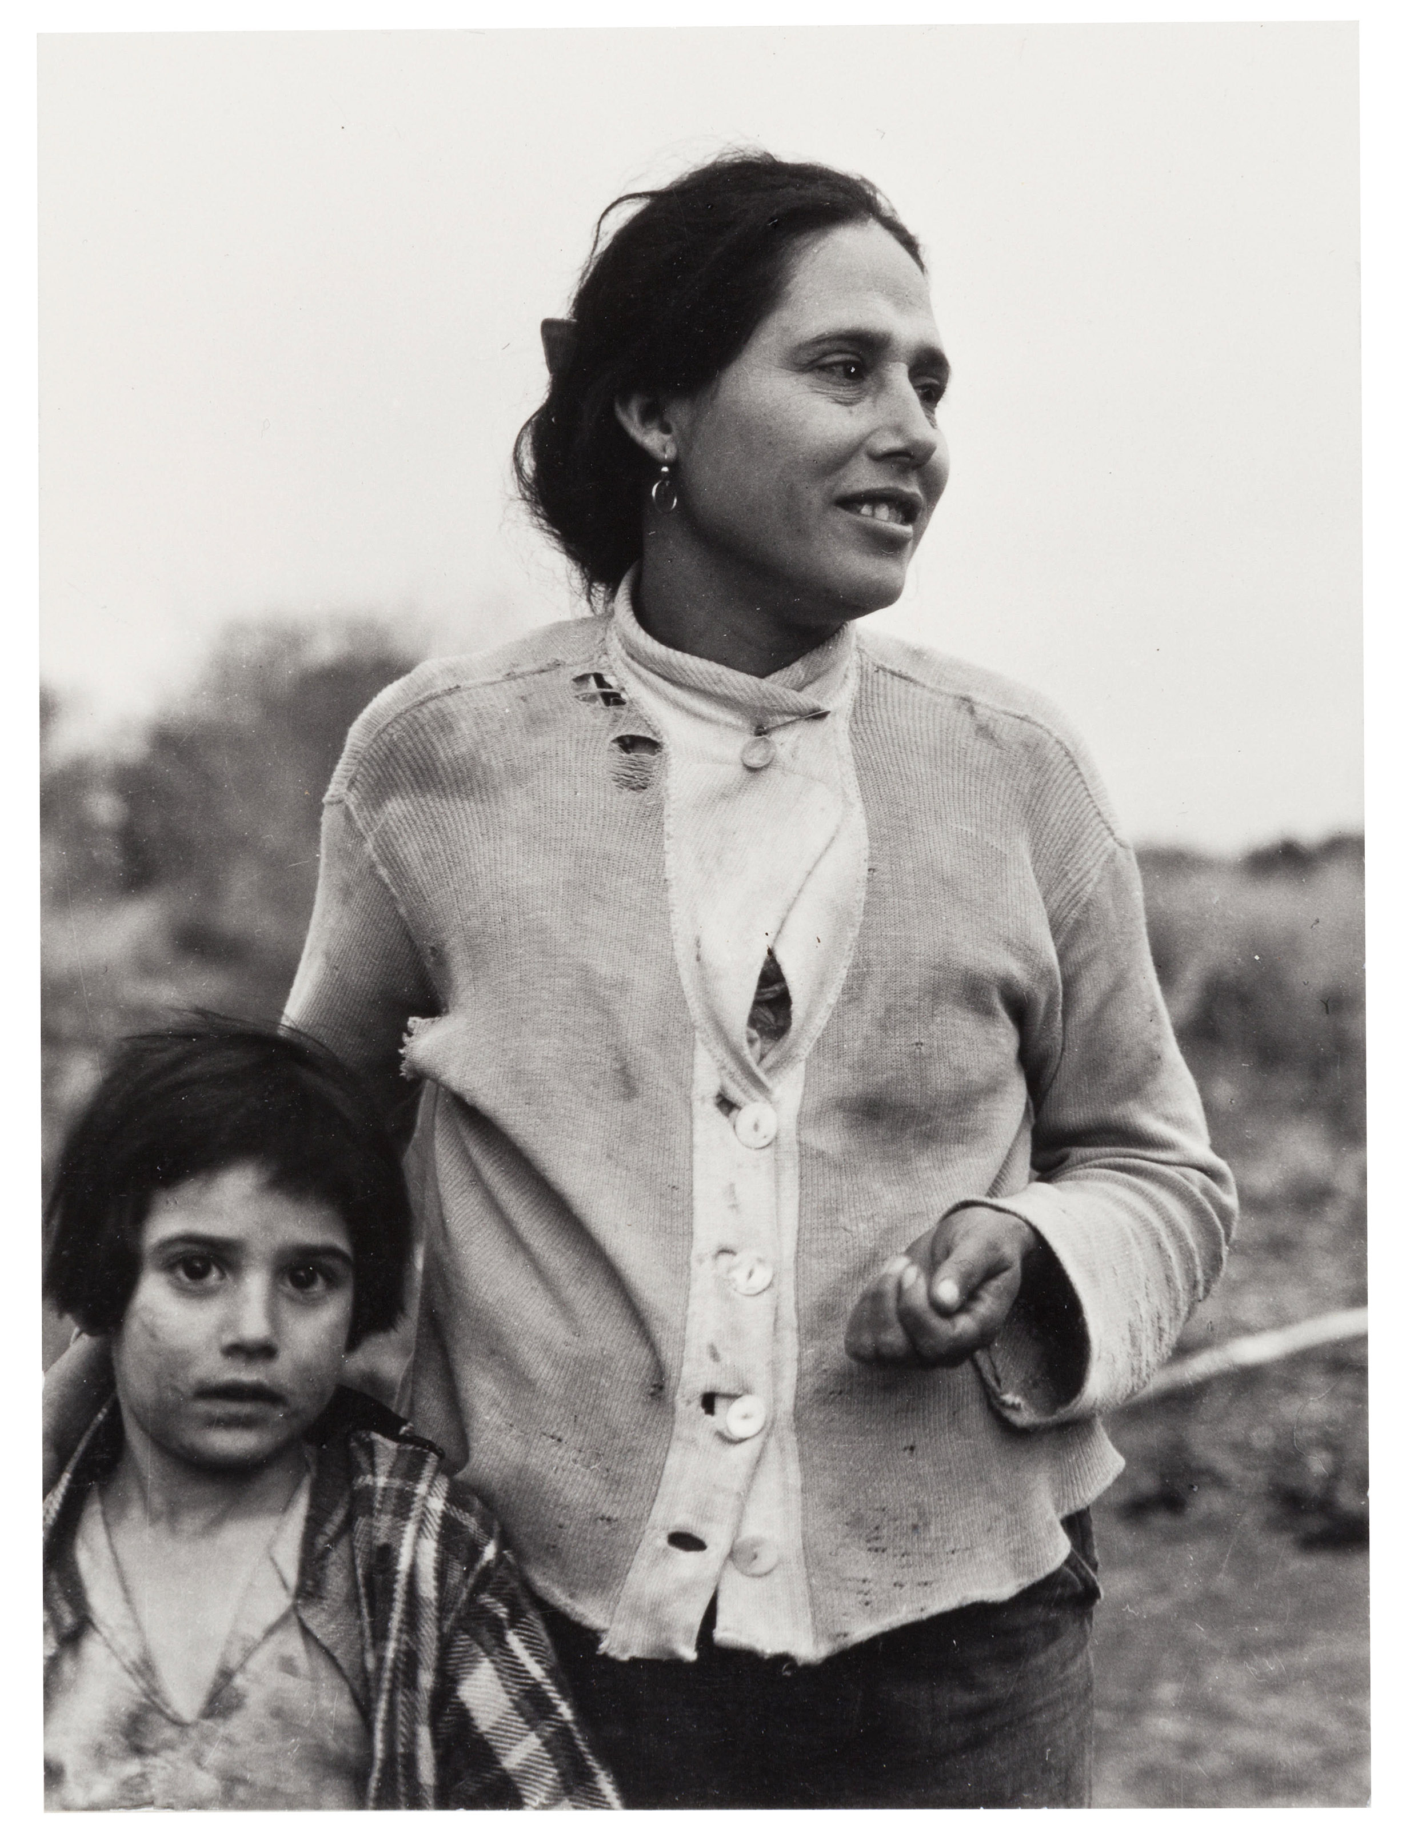

Slide 35
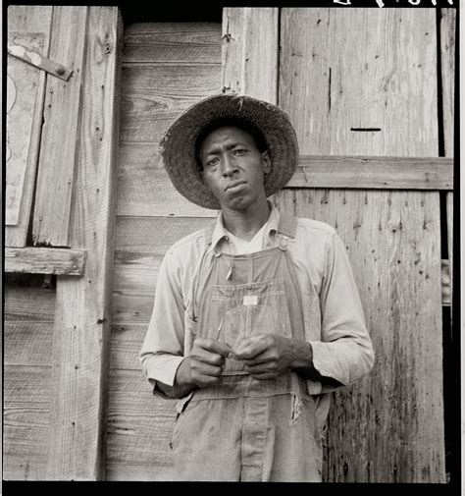

Slide 36
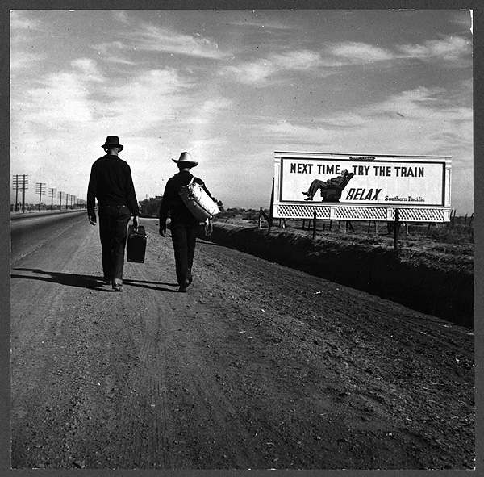

Slide 38
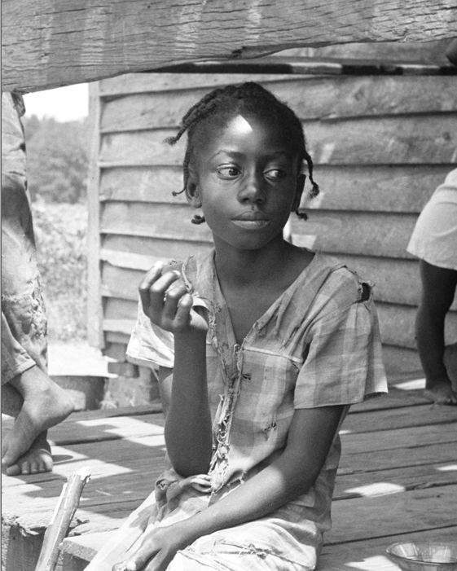

Slide 39
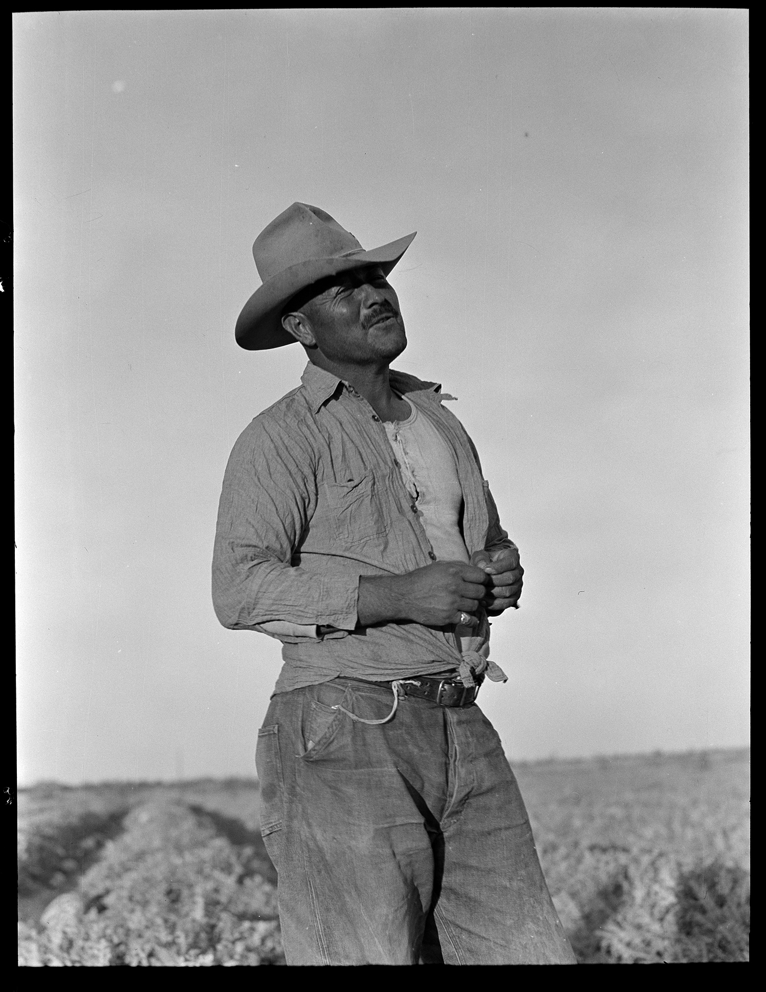

Slide 40
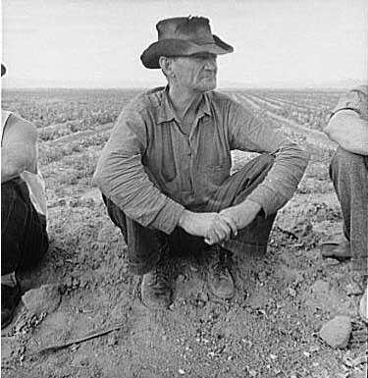

Slide 41
Wagner Act
National Labor Relations Act
Protected workers, ensured collective bargaining, and preserved the right to unionize

Slide 42
Fair Labor and Standards Act
1938
Set max work week to 44 hours
Established first minimum wage. It was 25 cents.

Slide 43
Social Security
Old age insurance for retirees 65 older and spouses – insurance was a supplemental retirement plan. Half of funds from the worker and half from the employer.
Unemployment compensation system – funded by federal tax on employers. Administered at state level.
Aid to disabled and families with dependent children – paid with federal funds made available to states

