Slide 1
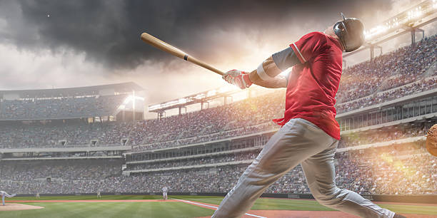
Knock SC READY & SC PASS Out of the Park!

Slide 2
We have some amazing incentives this year for doing your very best!

Slide 3
This Year’s Testing Incentives
Day 1 – Snack Wagon
Day 2 – Mama D’s Ice Cream
Day 3 – Wiffle/Kickball Games and Extra Recess
Day 4 – Little Caesar's Pizza Party and Monetary Drawings
(6th Grade Only)

Slide 4
Day 1 – Snack Wagon
Mrs. Robin Tanner will be coming around with the snack wagon!
If you receive a ticket, it can be redeemed for:
Full Sized Candy Bars
Chips

Slide 5
Day 2 – Mama D’s Ice Cream
Schedule:
3rd Period at 1:00 – 8th Grade
4th Period at 1:33 – 7th Grade
5th Period at 2:05 – 5th Grade
6th Period at 2:37 – 6th Grade
Ice cream cones in a choice of six flavors:
Vanilla
Chocolate
Superman
Cookies and Cream
Cookie Dough
Cotton Candy

Slide 6
Day 3 – Wiffle Ball and Kick Ball Games
Schedule:
3rd Period at 1:00 – 8th Grade
4th Period at 1:33 – 6th Grade
5th Period at 2:05 – 7th Grade
6th Period at 2:37 – 5th Grade
You will be able to choose which you want to play!

Slide 7
Day 4 – PIZZA PARTY!
6th grade students will report to the covered picnic area at 1:33 during 4th period.
Drawings for money will take place at this time!!

Slide 8
How Do I Get These Amazing Incentives?
Day 1 – Writing
Carefully reading and rereading
Taking notes or use tools on computer
Write a rough draft!!
TAKE YOUR TIME!
Takes longer than 30 minutes.
Not falling asleep during the test.

Slide 9
How Do I Get These Amazing Incentives?
Day 2 – Reading
Carefully reading and rereading
Taking notes or use tools on computer
TAKE YOUR TIME!
Takes longer than 30 minutes.
Not falling asleep during the test.

Slide 10
How Do I Get These Amazing Incentives?
Day 3 – Math
Carefully reading and rereading
Use scratch paper to work out problems!
TAKE YOUR TIME!
Takes longer than 30 minutes.
Not falling asleep during the test.

Slide 11
How Do I Get These Amazing Incentives?
Day 4 – Science (6th Grade Only)
Carefully reading and rereading
Use scratch paper to work out problems!
TAKE YOUR TIME!
Takes longer than 30 minutes.
Not falling asleep during the test.

Slide 12
However, if you do these things, you will not receive a ticket for that day’s incentive:
Don’t do scratch work on Math and Science
Don’t write a rough draft on writing
Finish in less than 30 minutes
Fall Asleep during the test
Disrupt Other Students!

