Slide 1
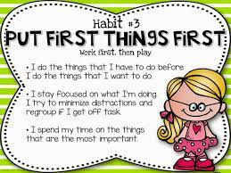
Mrs. Daniels’ Newsletter October 10-13, 2023
Field Trip Money is due on Oct. 13 at 8:00.
Field Trip is Oct.23. Penton Farm Pumpkin Patch
Contact Me
Parent Square App
334-365-6277
Letaka.Daniels @acboe.net
What We Are Learning
Math: Fluently subtract to 100. See Calendar.
Reading-See green folder
Reading Tests and Spelling Test for unit 2 lesson 2 is October 17, 2023.
Science – In what ways can frozen water change the shape of the land?
Events
Oct. 12- Parent P.E
Oct.13- Special Snack
Oct.16- Report Card
Oct. 31-Costume Day
Please check Blue Folder Weekly!

