Slide 1
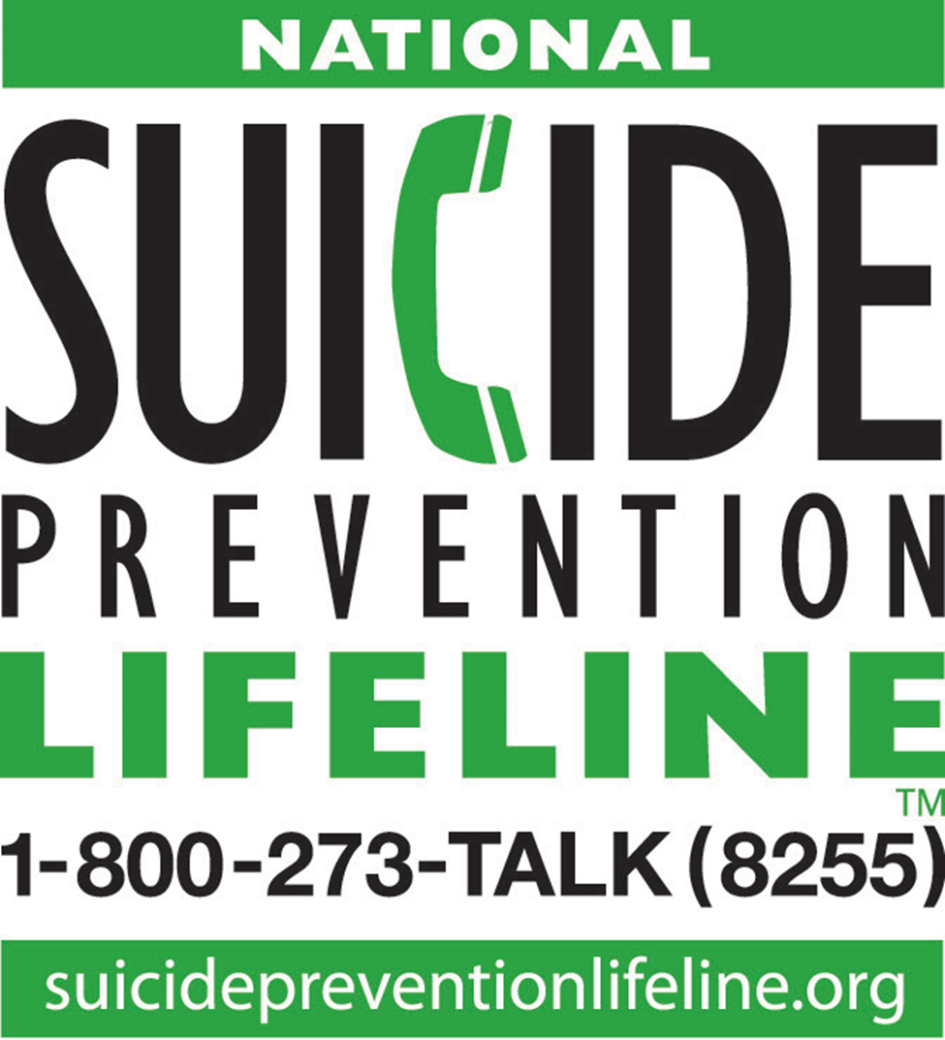


National Suicide Prevention Lifelines
The Lifeline provides 24/7, free and confidential support for people in distress, prevention and crisis resources for you or your loved ones, and best practices for professionals.

Slide 2
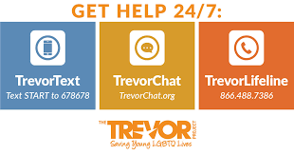
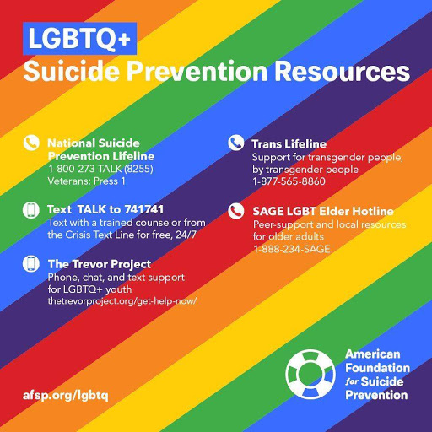
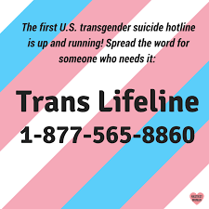
LGBTQI+ Suicide Prevention Lifelines
Free 24/7 support for those who are LGBTQI+.
Text or call from anywhere in the US to text with a trained Crisis Counselor.

