Slide 1

Centerville Elementary School
Annual Title I Parent Meeting
August 21, 2025
6:00 pm

Slide 2

What is A Title I School?
The purpose of Title I under ESSA is to “ensure that all children have a fair, equal, and significant opportunity to obtain a high-quality education and reach, at a minimum, proficiency on challenging state academic achievement standards and state academic assessments.”
A title 1 school works to:
Identify students most in need of educational help
Set goals for improvement
Measure student progress and develop programs that add to classroom instruction
Involve parents in all aspects of the program

Slide 3
What does this mean for Centerville?
It means that we receive additional federal funding to provide a quality education for all of our students.
This funding helps school offer improved programs such as a family engagement liaison, instructional & technology resources, activities/workshops for families, intervention specialist teacher, and professional development for teachers.

Slide 4

How does Centerville spend Title I funds?
Two part-time intervention teachers
Classroom libraries and other resources
Instructional supplies
Technology (software programs)
Professional development and learning opportunities for staff
Family Engagement Liaison

Slide 5
Centerville Elementary
Schoolwide Goals
Increase
Increase
Implement
Increase the percentage of students reading on or above grade level as measured by GA Milestones by 3%.
Increase by at least 3% the number of students in grades 3-5 scoring a 2, 3, or 4 in English Language Arts, Math, and Science measured by GA Milestones.
Develop a strong, positive culture to improve behavior and academic performance by decreasing the percentage of students having an office referral by 3%.
Decrease
Decrease the amount of SWD falling in the Beginning Learner level range in ELA and Math as measured by the GA Milestones by 2%.

Slide 6
Programs to Support our Students
EIP
ESOL
Intervention Teachers
Read United
IXL. BrainPOP, Quaver, i-Ready
New Instructional Resources
Imagination Station
Positive Behavioral Interventions and Supports

Slide 7





What curriculum does our school use?

Slide 8
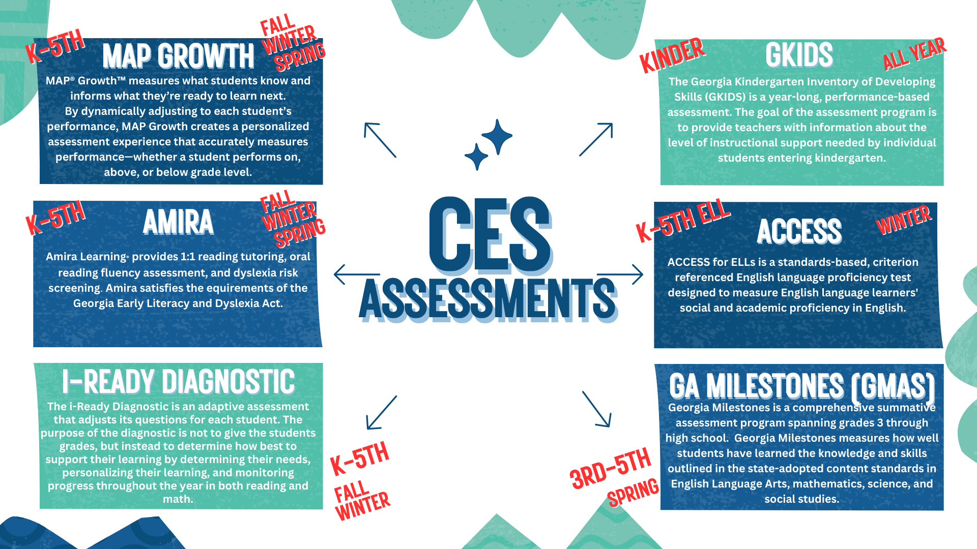
What tests will my child take?

Slide 9

Parent and Family Engagement Program

Slide 10
Family Engagement Liaison
Our Family Engagement Liaison is Mrs. Jessica Gardner. She is available in the office each day during regular school hours. You may email her at jessica.gardner@hcbe.net or call her at 478-953-0400 Ext. 1328.

Slide 11
Requirements for Family Engagement
The law requires a 1% set-aside of Title I Funds be allocated for a District Parent and Family Engagement Liaison
Parent and Family Engagement Coordinator salary
Technology to support student learning
Workshop materials
Conferences
Programs that will improve student achievement and include ways to help parents help their children succeed (Building Capacity)
Parent input in the development of a written Parent & Family Engagement Plan
Shared decision-making opportunities
Title I Handbook
Parent & Family Engagement Plan
School-Parent Compact

Slide 12
What is a school-parent compact?
A school-parent compact is an agreement that explains how parents, teachers and students will work together to make sure all students reach grade-level standards.
This agreement was jointly developed by stakeholders and is reviewed/revised annually based on feedback from all stakeholders. Compacts will be discussed during parent-teacher conferences.

Slide 13
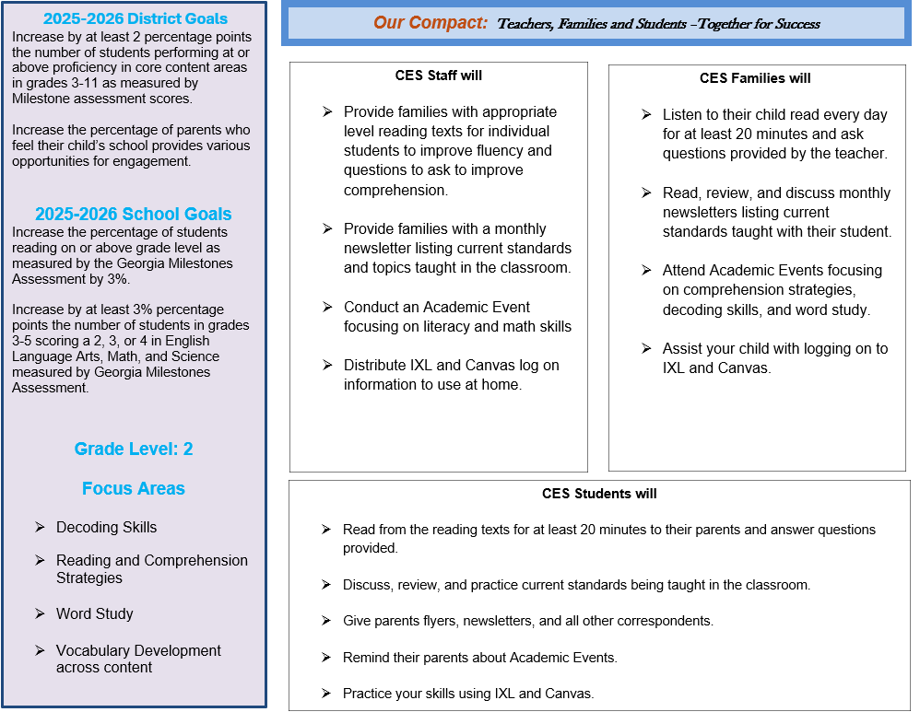
Teachers, Parents, and Students Responsibilities

Slide 14

Parent Information on the CES Website
Go to the system website (www.hcbe.ces.net); then select Parent and student Tab followed by Title I Family Engagement.
You will able to view Centerville Elementary Family Engagement Paperwork.
We want your feedback! Please email us through the website or attend academic events throughout the school year.
This Photo by Unknown Author is licensed under CC BY-SA

Slide 15

Is my child’s teacher qualified?
What is right to know?
All CES teachers are highly qualified.
(Parent’s Right to Know*)

Slide 16

How is Title I Parent & Family Engagement money spent?
Family Engagement Liaison
Family/Academic events
Resources for instructional activities with families.
Modes of communication with families

Slide 17

Parent & Family Engagement Opportunities
Volunteers
Classroom volunteers
Media Center
PTO
Milestones Proctors
READ United
Family engagement
Check and sign agendas, EVERYDAY!
Attend Parent Conferences
Read to or listen to your child read, EVERYDAY!
Stay in contact with your child’s teacher!
BUILDING CAPACITY
Homework Workshop
Reading/Writing Workshop
Milestones Workshops
Technology Talk Workshop
Community Resource Fair
SHARED DECISION MAKING
School council
Shared decision making (Spring)
Parent Action Team

Slide 18

Contact Information
Your concerns are our concerns!
Contact us with any questions you have.
Mrs. Marcie Shaw, Principal
Ms. Bridget Snooks, Asst. Principal for Instruction
Ms. Rachada Page Asst. Principal for Discipline
At (478) 953-0400

Slide 19
Other Federal Programs
For more information about these programs contact:
Patricia Lane- McKinney-Vento Program
Rosalin Rodriguez and Jessica Perez - ESOL
Aricelli Ulmer - Migrant Education
Located at the Central Registration

