Slide 1
Coffee County School System
Strategic Plan
2022-2027
Notes:
Kelly - Introduction

Slide 2
VISION STATEMENT
“Educate, Elevate, Empower”
MISSION STATEMENT
“Preparing all students for a successful future by providing challenging and meaningful learning opportunities.”
Notes:
Broaden - Vision, Mission, Steering Committee

Slide 3
CORE BELIEFS AND VALUES
All students deserve equitable and engaging learning opportunities preparing them for the future.
Our employees are crucial to our success.
Strong family and community partnerships are critical to student success.
A well-rounded education supports the developmental needs of all learners.
Excellence is sustained through a commitment to continuous improvement by all stakeholders.
We value integrity, open and consistent communication, shared responsibility, innovation, and accountability.
We believe in providing a safe and inclusive learning environment that embraces diversity and promotes respectful relationships.
Notes:
Broaden - Steering Committee

Slide 4
Teaching and Learning
Goal 1: To provide equitable access to challenging curriculum and adaptable learning experiences that increase student achievement in all academic areas, focusing on reading and math for all students.
Notes:
Gray - Areas of Focus - Teaching and Learning

Slide 5
Teaching and Learning
Objective 1: Implement course content and offerings aligned with state standards to support student success during and after Pre-K through 12 education, resulting in college and career readiness.
Objective 2: Enhance learning experiences by providing students with relevant and appropriate technology, tools, and resources.
Objective 3: Implement the education of the whole child by providing evidence-based instruction and assessment designed and delivered to be engaging, inclusive, and success-oriented.
Objective 4: Examine opportunities to add or expand programs to improve student achievement when financially possible (Pre-K programs, expanded fine arts courses, additional Career Technical Education programs, dual enrollment options, additional competitive and non-competitive sports, early identification and interventions for At-Risk students).

Slide 6
Teaching and Learning
Goal 2: Provide high-quality, highly-effective personnel to meet the needs of the instructional program.
Notes:
Gray Harrison

Slide 7
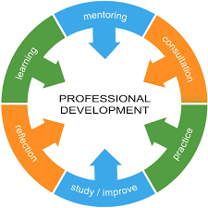
Teaching and Learning
Objective 1: Recruit, employ, develop and retain high-quality, effective teachers and instructional support personnel.
Objective 2: Provide high-quality professional development targeting improved practice to meet the needs of all students.
Objective 3: Collect, analyze, report, and effectively use student achievement and performance data for improved teaching and learning.
Notes:
Gray Harrison

Slide 8
Performance Measures
Academic Growth and Achievement
Graduation Rate, CRIs, WorkKeys, ACT, DE, COOP, Military Enlistment
Student Engagement of Learning - Eleot Observation Tool
CCSS Mentoring Program and Alabama Teacher Mentoring Program
Technology Integration, Technology Plan, Technology Inventory
Expand electives, fine arts, career tech education, clubs, athletics
Internships with local colleges
High-Quality Professional Development Plan
Leadership Academy and Aspiring Administrators Academy
Career Fairs
Notes:
Gray Harrison

Slide 9
Governance and Leadership
Goal 1- Sustain qualified, effective, and innovative Board of Education members.
Objective 1: Maintain effective Board policies on which to base sound decisions, effective procedures, and fair, consistent implementation of laws, rules, and guidelines.
Objective 2: Participate in ongoing, high-quality orientation and professional learning opportunities for Board of Education members.
Objective 3: Focus human and fiscal resources on student learning while ensuring transparency and accountability in the day-to-day operations of the education system at all levels.
Notes:
Dewayne Hamilton

Slide 10
Governance and Leadership
Goal 2 - Sustain and support qualified, innovative system and school leaders.
Objective 1 - Recruit, employ, develop and retain highly qualified, effective, innovative system and school administrators.
Objective 2 - Support, encourage and recognize administrators' participation in local school and community events that build positive community relationships.
Objective 3 - Establish and participate in programs of leadership development that prepare lead teachers, aspiring administrators, and administrators for future school and system-level leadership roles and responsibilities.

Slide 11
Performance Measures
Board Policy, Whole Board Training, Board Meetings, Work Sessions
Leadership Academy and Aspiring Leadership Academy, CLAS opportunities, PLUs
Support professional development for leaders in the system: Superintendent, District Administrators, Principals, Assistant Principals, Aspiring Administrators, Teachers
Notes:
Dewayne Hamilton

Slide 12
Finance, Resources, and Support Systems
Goal 1: Coffee County Schools will practice responsible financial management and maintain appropriate financial reserves to meet system, school, and student needs.
Objective 1: Establish transparency and accountability among all schools regarding how funds and resources are appropriated.
Objective 2: Ensure all money is appropriately given to schools based on state and federal guidelines at statutes.
Objective 3: Maintain effective procedures and processes for collecting, analyzing, and reporting financial, demographic, and fiscal planning data to maximize and ensure equitable distribution of the system’s financial resources.
Objective 4: Seek additional financial resources to support the successful implementation of all strategic plan initiatives.
Notes:
Carolyn Broaden

Slide 13
Finance, Resources, and Support Systems
Goal 2: Maintain, renovate, and create facilities to provide a safe, secure, supportive learning environment for all programs and provide appropriate venues for all activities.
Objective 1: Provide increased access to and creative use of technology resources and improve system technology infrastructure and support throughout the system.
Objective 2: Maintain and expand equipment and instructional resources to provide successful Career Technical Education, fine arts, and athletic programs.
Objective 3: Identify and seek grants and scholarships with community and state organizations, groups, agencies, and other educational institutions to increase resources for student achievement.
Notes:
Carolyn Broaden

Slide 14
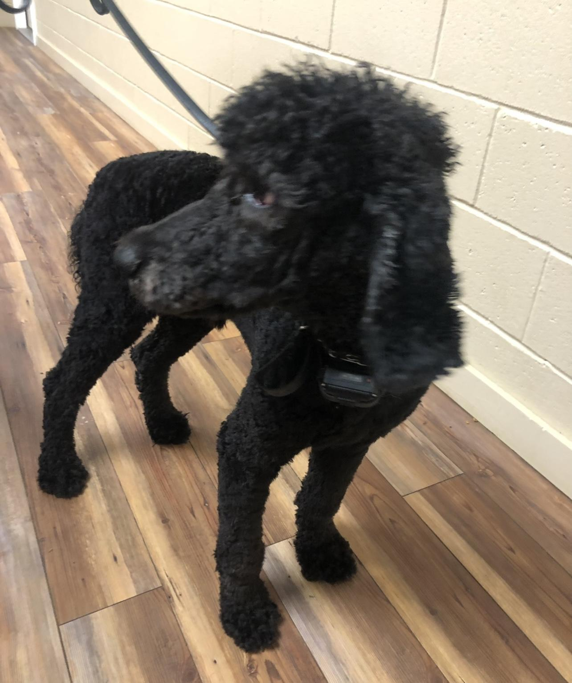
Finance, Resources, and Support Systems
Goal 3: Provide safe environments that support all students' physical, mental, emotional, social, and cognitive development in every school.
Objective 1: Expand access to mental health services and support in schools.
Objective 2: Provide support and high-quality training to school system safety personnel in collaboration with local law enforcement officials and surrounding agencies.
“Mayor”
Notes:
Carolyn Broaden

Slide 15
Performance Measures
Financial reports, State Monitoring Report, Cognia Report, local, state, and federal budgets, ACIP, and Title I Budgets, Needs Assessments
Capital Plan, Technology Plan,
Safety Plans, Safety Trainings, School Resource Officers, Facility Dog
Partnership with Pathway, Coffee County Family Services, EMA, Sheriff’s Dept., Elba Career Academy
Grants, Dual Enrollment Scholarships, Career Tech Opportunities
Mental Health Coordinator
Notes:
Carolyn Broaden

Slide 16
Communication and Relationships
Goal 1: Lead the way in establishing and maintaining collaborative relationships with parents, families, and communities to maximize student success.
Objective 1: Create and maintain open and effective communication strategies to improve communication between Coffee County Schools and stakeholders.
Objective 2: Regularly review stakeholder feedback to inform decision-making.
Objective 3: Communicate progress toward and accomplishment of school system goals, objectives, and continuous improvement plans.
Notes:
Carolyn Broaden

Slide 17
Communication and Relationships
Goal 2: Provide opportunities and programs to involve all stakeholders or agencies in collaborative efforts to improve the school system.
Objective 1: Establish and/or maintain advisory groups, councils, community partnerships, booster clubs, and school support groups to include representatives from all system stakeholders to provide input, feedback, and ideas for improving the school system.
Objective 2: Maintain system accreditation, utilizing the accreditation monitoring and reporting processes to promote and achieve continuous improvement toward system and school goals.
Objective 3: Effectively monitor, evaluate and report on the school system strategic plan.
Notes:
Tami Crosby

Slide 18
Performance Measures
Surveys - Title I, Local Surveys, Strategic Plan Surveys, Cognia Surveys
Advisory groups - Parents, Students, Community Partners
Progress and evaluation of Strategic Plan
Administrator Meetings, BLT Meetings, focus groups (Federal Programs & ESSER)
Partnership with Community Colleges & Elba Career Tech Academy
Cognia Reports, processes, and results
Notes:
Tami Crosby

Slide 19
Notes:
Kelly Cobb

