Slide 2
Tissue: The Living Fabric
Individual body cells are specialized
Tissues
Groups of cells similar in structure that perform common or related function
Histology
Study of tissues

Slide 4
4.2 Epithelial Tissue
Epithelial tissue (epithelium) is a sheet of cells that covers body surfaces or cavities
Two main forms:
Covering and lining epithelia
Glandular epithelia
Main functions: protection, absorption, filtration, excretion, secretion, and sensory reception

Slide 5
Special Characteristics of Epithelial Tissues
Epithelial tissue has five distinguishing characteristics:
Polarity
Specialized contacts
Supported by connective tissues
Avascular, but innervated
Regeneration

Slide 6
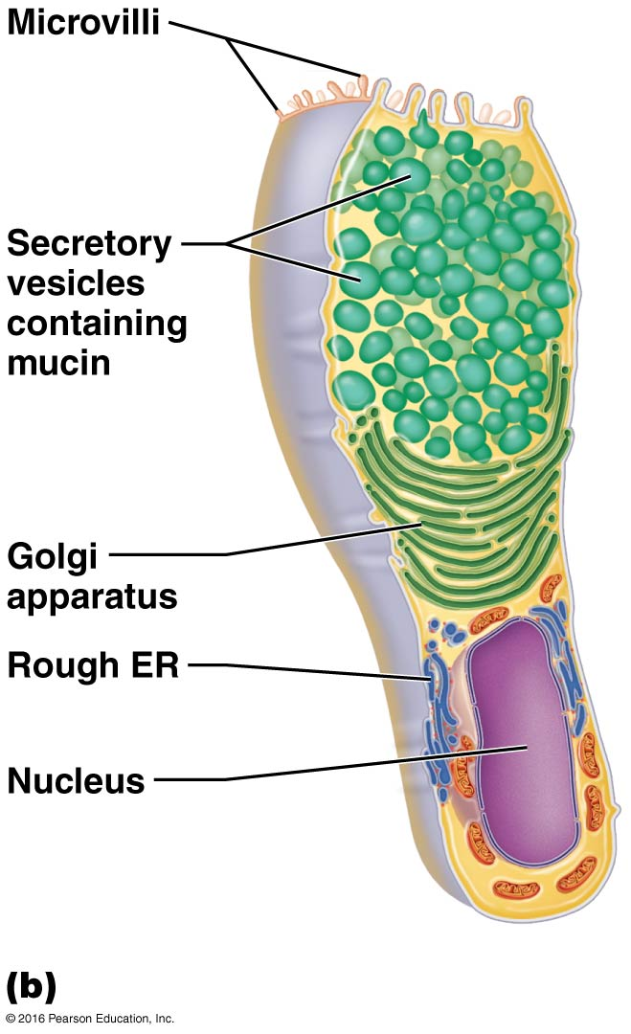
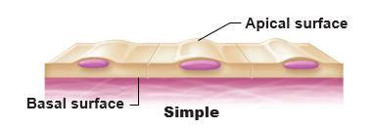
Special Characteristics of Epithelial Tissues (cont.)
Polarity
Apical surface, upper free side, is exposed to surface or cavity
Basal surface, lower attached side, faces inwards toward body

Slide 7
Special Characteristics of Epithelial Tissues (cont.)
Specialized contacts
Epithelial tissues need to fit closely together
Many form continuous sheets
Specialized contact points bind adjacent epithelial cells together
Lateral contacts include:
Tight junctions
Desmosomes

Slide 8
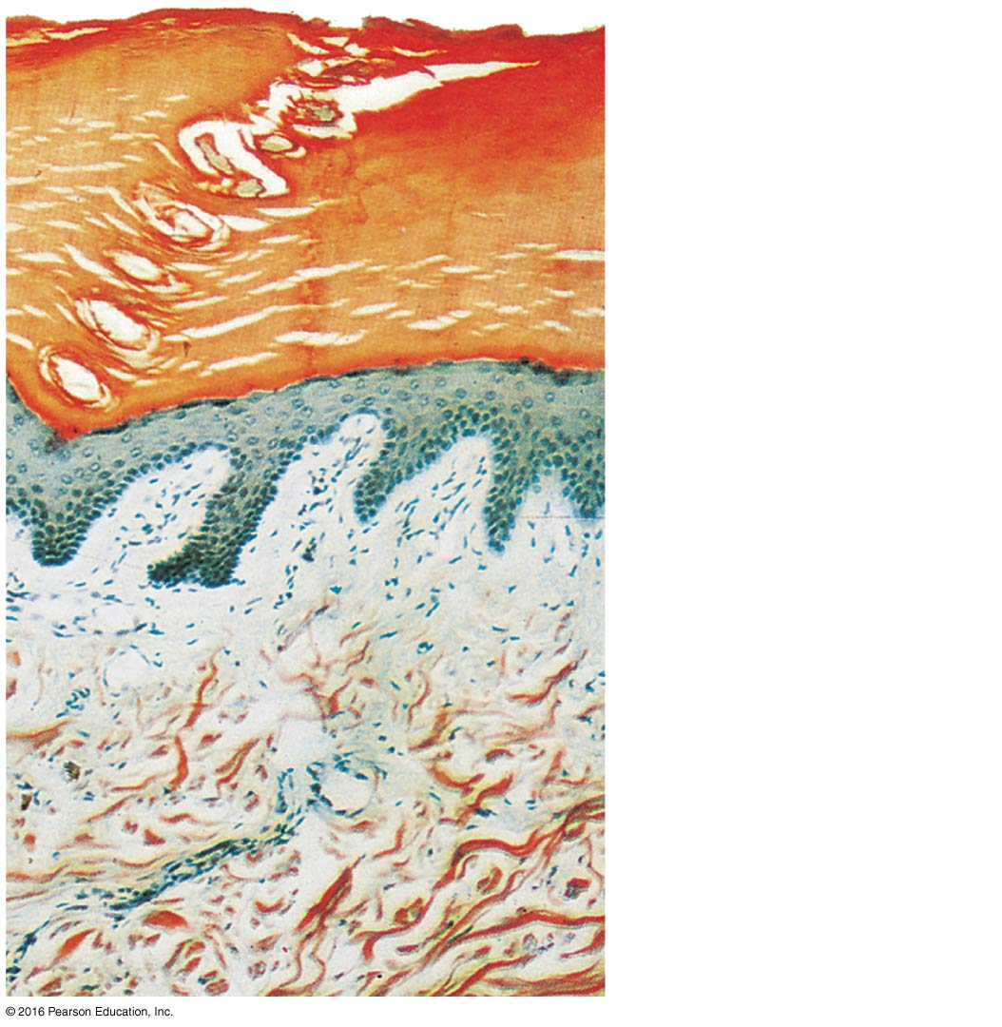
Special Characteristics of Epithelial Tissues (cont.)
Connective tissue support
All epithelial sheets are supported by connective tissue
Reticular lamina
Basement membrane

Slide 9
Clinical – Homeostatic Imbalance 4.1
Cancerous epithelial cells are not contained by the basement membrane boundary
They penetrate the boundary and invade underlying tissues, resulting in spread of cancer

Slide 10
Special Characteristics of Epithelial Tissues (cont.)
Avascular, but innervated
No blood vessels are found in epithelial tissue
Must be nourished by diffusion from underlying connective tissues
Epithelia are supplied by nerve fibers, however

Slide 11
Special Characteristics of Epithelial Tissues (cont.)
Regeneration
Epithelial cells have high regenerative capacities
Stimulated by loss of apical-basal polarity and broken lateral contacts
Some cells are exposed to friction, some to hostile substances, resulting in damage
Must be replaced
Requires adequate nutrients and cell division

Slide 12
Classification of Epithelia
All epithelial tissues have two names
First name indicates number of cell layers
Simple epithelia 1 layer
Stratified epithelia 2+ layers
Second name indicates shape of cells in apical layer
Squamous: flattened and scale-like
Cuboidal: box-like, cube
Columnar: tall, column-like

Slide 13
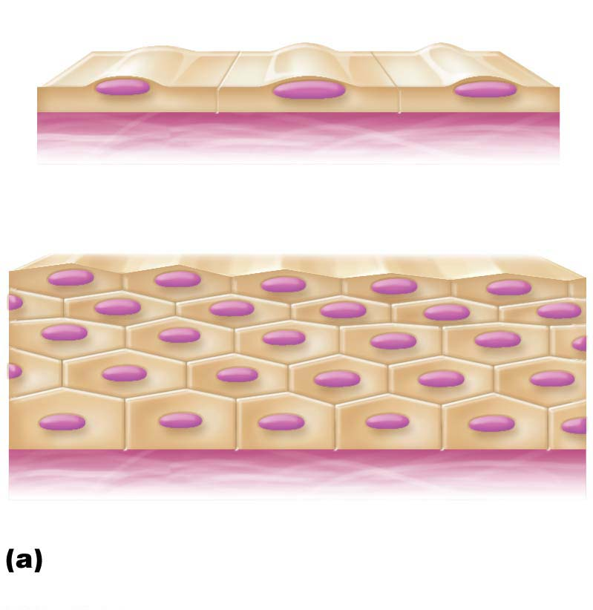
Figure 4.2a Classification of epithelia.
Apical surface
Basal surface
Simple
Apical surface
Basal surface
Stratified
Classification based on number of
cell layers.

Slide 14
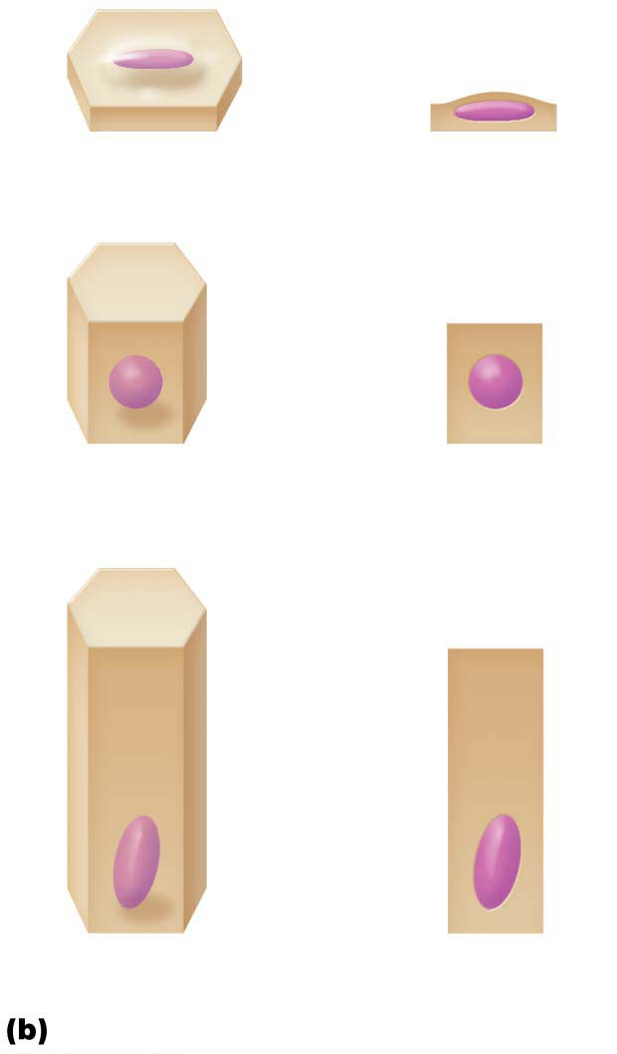
Figure 4.2b Classification of epithelia.
Squamous
Cuboidal
Columnar
Classification based on cell shape.

Slide 15
Classification of Epithelia (cont.)
Simple epithelia
Involved in absorption, secretion, or filtration processes
Photomicrograph: Simple squamous
epithelium forming part of the alveolar
(air sac) walls (140⋅).

Slide 16
Classification of Epithelia (cont.)
Simple cuboidal epithelium
Involved in secretion and absorption
Forms walls of smallest ducts of glands and many kidney tubules
Photomicrograph: Simple cuboidal
epithelium in kidney tubules (430⋅).

Slide 17
Classification of Epithelia (cont.)
Simple columnar epithelium
Single layer of tall, closely packed cells
Some cells have microvilli, and some have cilia
Involved in absorption and secretion of mucus, enzymes, and other substances
Found in digestive tract, gallbladder, ducts of some glands, bronchi, and uterine tubes
Photomicrograph: Simple columnar
epithelium of the small intestine mucosa
(640⋅).

Slide 18
Classification of Epithelia (cont.)
Pseudostratified columnar epithelium
Cells vary in height and appear to be multi-layered and stratified
Involved in secretion, particularly of mucus, and also in movement of mucus via ciliary sweeping action
Located mostly in upper respiratory tract, ducts of large glands, &tubules in testes
Photomicrograph: Pseudostratified ciliated columnar epithelium lining the human trachea (780⋅).

Slide 19
Classification of Epithelia (cont.)
Stratified epithelial tissues
Involve two or more layers of cells
More durable than simple epithelia because protection is the major role
Photomicrograph: Stratified squamous
epithelium lining the esophagus (285⋅).

Slide 20
Classification of Epithelia (cont.)
Stratified epithelial tissues (cont.)
Stratified cuboidal epithelium
Quite rare
Found in some sweat and mammary glands
Typically only two cell layers thick
Stratified columnar epithelium
very limited distribution
in pharynx, in male urethra, and lining some glandular ducts
occurs at transition areas between two other types of epithelia
Only apical layer is columnar

Slide 21
Classification of Epithelia (cont.)
Stratified epithelial tissues (cont.)
Transitional epithelium
Forms lining of hollow urinary organs
Found in bladder, ureters, and urethra
Ability of cells to change shape when stretched allows for increased flow of urine and, in the case of bladder, more storage space
Photomicrograph: Transitional epithelium
lining the bladder, relaxed state (360⋅); note
the bulbous, or rounded, appearance of the
cells at the surface; these cells flatten and
elongate when the bladder fills with urine.

Slide 22
Glandular Epithelia
Gland
One or more cells that makes and secretes an aqueous fluid called a secretion
Classified by:
Site of product release:
Endocrine: internally secreting (example: hormones)
Exocrine: externally secreting (example: sweat)
Relative number of cells forming the gland
Unicellular (example: goblet cells) or multicellular (example: salivary)

Slide 23
Glandular Epithelia (cont.)
Endocrine glands
Ductless glands
Secretions are not released into a duct; are released into surrounding interstitial fluid, which is picked up by circulatory system
Secrete (by exocytosis) hormones, messenger chemicals that travel through lymph or blood to their specific target organs
Target organs respond in some characteristic way

Slide 24
Glandular Epithelia (cont.)
Exocrine glands
Secretions are released onto body surfaces, such as skin, or into body cavities
More numerous than endocrine glands
Secrete products into ducts
Examples include mucous, sweat, oil, and salivary glands
Can be:
Unicellular
Multicellular

Slide 25
4.3 Connective Tissue
Connective tissue is the most abundant and widely distributed of primary tissues
Major functions: binding and support, protecting, insulating, storing reserve fuel, and transporting substances (blood)
Four main classes
Connective tissue proper
Cartilage
Bone
Blood

Slide 26
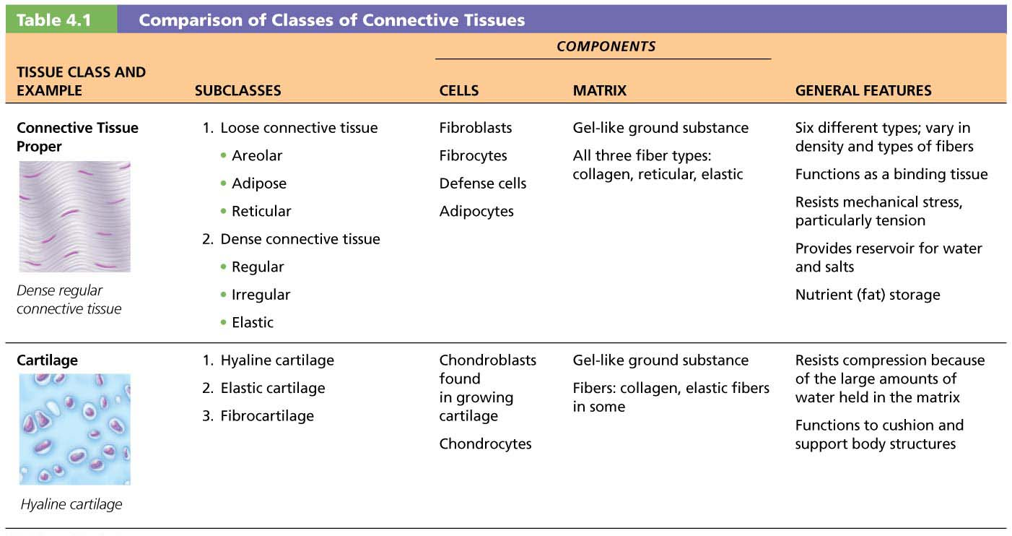
Table 4.1-1 Comparison of Classes of Connective Tissues

Slide 27
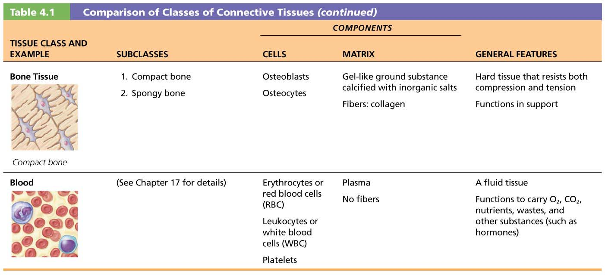
Table 4.1-2 Comparison of Classes of Connective Tissues (continued)

Slide 28
Structural Elements of Connective Tissue
All connective tissues have three main elements
Ground substance
Fibers
Cells
The first two elements (ground substance and fibers) together make up the extracellular matrix
Composition and arrangement of these three elements vary considerably in different types of connective tissues

Slide 29
Structural Elements of Connective Tissue (cont.)
Connective tissue fibers
Three types of fibers provide support
Collagen
Strongest and most abundant type
Tough; provides high tensile strength
Elastic fibers
Networks of long, thin, elastin fibers that allow for stretch and recoil
Reticular
Short, fine, highly branched collagenous fibers (different chemistry and form from collagen fibers)
Branching forms networks that offer more “give”

Slide 30
Structural Elements of Connective Tissue (cont.)
Cells
“Blast” cells
Immature form of cell that actively secretes ground substance and ECM fibers
Fibroblasts found in connective tissue proper
Chondroblasts found in cartilage
Osteoblasts found in bone
Hematopoietic stem cells in bone marrow
“Cyte” cells
Mature, less active form of “blast” cell that now becomes part of and helps maintain health of matrix

Slide 31
Structural Elements of Connective Tissue (cont.)
Other cell types in connective tissues
Fat cells
Store nutrients
White blood cells
Neutrophils, eosinophils, lymphocytes
Tissue response to injury
Mast cells
Initiate local inflammatory response against foreign microorganisms they detect
Macrophages
Phagocytic cells that “eat” dead cells, microorganisms; function in immune system

Slide 32
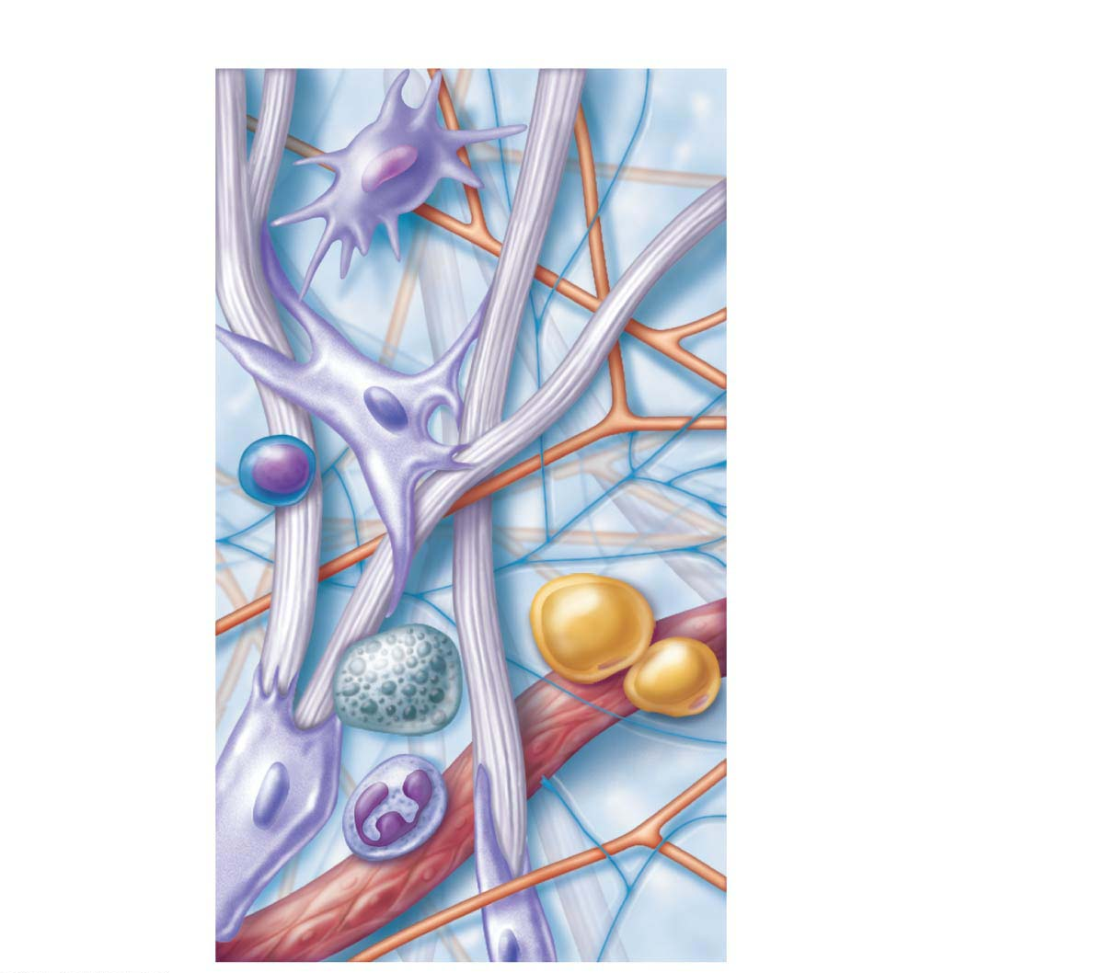
Figure 4.7 Areolar connective tissue: A prototype (model) connective tissue.
Cell types
Extracellular
matrix
Ground substance
Fibers
Macrophage
• Collagen fiber
• Elastic fiber
• Reticular fiber
Fibroblast
Lymphocyte
Fat cell
Capillary
Mast cell
Neutrophil

Slide 33
Types of Connective Tissues
There are four main classes of connective tissue:
Connective tissue proper
Cartilage
Bone
Blood

Slide 34
Types of Connective Tissues (cont.)
Connective tissue proper
Consists of all connective tissues except bone, cartilage, and blood
Two subclasses
CT proper: loose connective tissues
Areolar
Adipose
Reticular
CT proper: dense connective tissues
Dense regular
Dense irregular
Elastic

Slide 35
Types of Connective Tissues (cont.)
CT proper: loose connective tissues
Areolar connective tissue
Most widely distributed CT
Supports and binds other tissues
Universal packing material between other tissues
Photomicrograph: Areolar connective tissue, a soft packaging tissue of the body (340⋅).

Slide 36
Types of Connective Tissues (cont.)
CT proper: loose connective tissues (cont.)
Adipose tissue
Similar to areolar tissue but greater nutrient storage
Functions in shock absorption, insulation, and energy storage
Photomicrograph: Adipose tissue from the
subcutaneous layer under the skin (350⋅).

Slide 37
Types of Connective Tissues (cont.)
CT proper: loose connective tissues (cont.)
Reticular connective tissue
Resembles areolar tissue, but fibers are thinner reticular fibers
Photomicrograph: Dark-staining network
of reticular connective tissue fibers forming
the internal skeleton of the spleen (350⋅).

Slide 38
Types of Connective Tissues (cont.)
CT proper: dense connective tissues
Three varieties of dense connective tissue
Dense regular
Dense irregular
Elastic

Slide 39
Types of Connective Tissues (cont.)
CT proper: dense connective tissues (cont.)
Dense regular connective tissue
Very high tensile strength; can withstand high tension and stretching
Closely packed bundles of thick collagen fibers run parallel to direction of pull
Example: tendons and ligaments
Photomicrograph: Dense regular connective
tissue from a tendon (430⋅).

Slide 40
Types of Connective Tissues (cont.)
CT proper: dense connective tissues (cont.)
Dense irregular connective tissue
Same elements as dense regular, but bundles of collagen are thicker and irregularly arranged
Forms sheets rather than bundles
Resists tension from many directions
Photomicrograph: Dense irregular
Connective tissue from the fibrous capsule
of a joint (430⋅).

Slide 41
Types of Connective Tissues (cont.)
CT proper: dense connective tissues (cont.)
Elastic connective tissue
Some ligaments are very elastic
Also found in walls of many large arteries
Photomicrograph: Elastic connective tissue
in the wall of the aorta (250⋅).

Slide 42
Types of Connective Tissues (cont.)
Cartilage
Matrix secreted from chondroblasts (during growth) and chondrocytes (adults)
80% water
Tough yet flexible material that lacks nerve fibers
Avascular: receives nutrients from membrane surrounding it

Slide 43
Types of Connective Tissues (cont.)
Three types of cartilage:
Hyaline cartilage
Most abundant; “gristle”
Appears as shiny bluish glass
Found at tips of long bones, nose, trachea, larynx, and cartilage of the ribs
Elastic cartilage
Similar to hyaline but with more elastic fibers
Found in ears and epiglottis
Fibrocartilage
Properties between hyaline and dense regular tissue
Strong, so found in areas such as intervertebral discs and knee

Slide 44
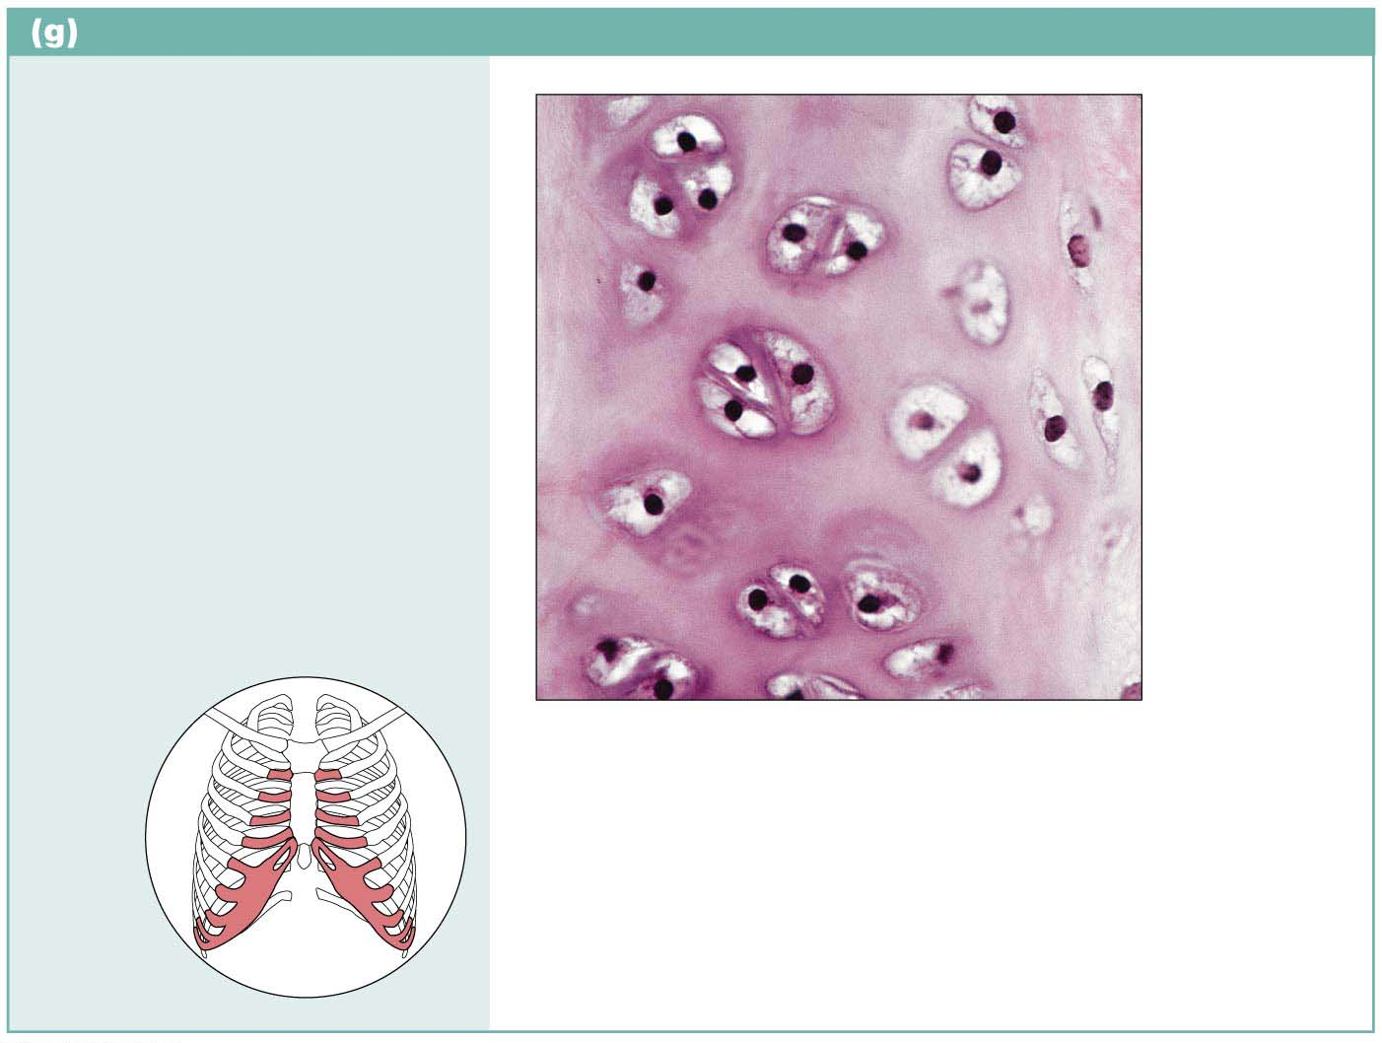
Figure 4.8g Connective tissues.
Cartilage: hyaline
Description: Amorphous but
firm matrix; collagen fibers form
an imperceptible network;
chondroblasts produce the
matrix and when mature
(chondrocytes) lie in lacunae.
Chondrocyte
in lacuna
Function: Supports and
reinforces; serves as resilient
cushion; resists compressive
stress.
Matrix
Location: Forms most of the
embryonic skeleton; covers the
ends of long bones in joint
cavities; forms costal cartilages
of the ribs; cartilages of the
nose, trachea, and larynx.
Photomicrograph: Hyaline cartilage from
a costal cartilage of a rib (470⋅).
Costal
cartilages

Slide 45
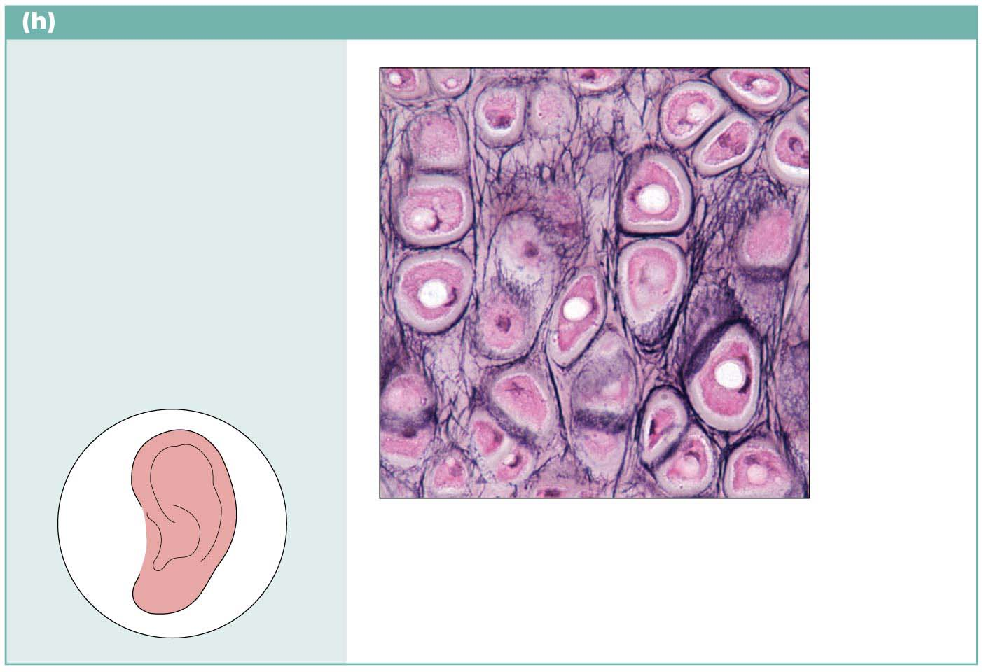
Figure 4.8h Connective tissues.
Cartilage: elastic
Description: Similar to hyaline
cartilage, but more elastic
fibers in matrix.
Chondrocyte
in lacuna
Function: Maintains the shape
of a structure while allowing
great flexibility.
Matrix
Location: Supports the
external ear (pinna); epiglottis.
Photomicrograph: Elastic cartilage from the
human ear pinna; forms the flexible skeleton
of the ear (800⋅).

Slide 46
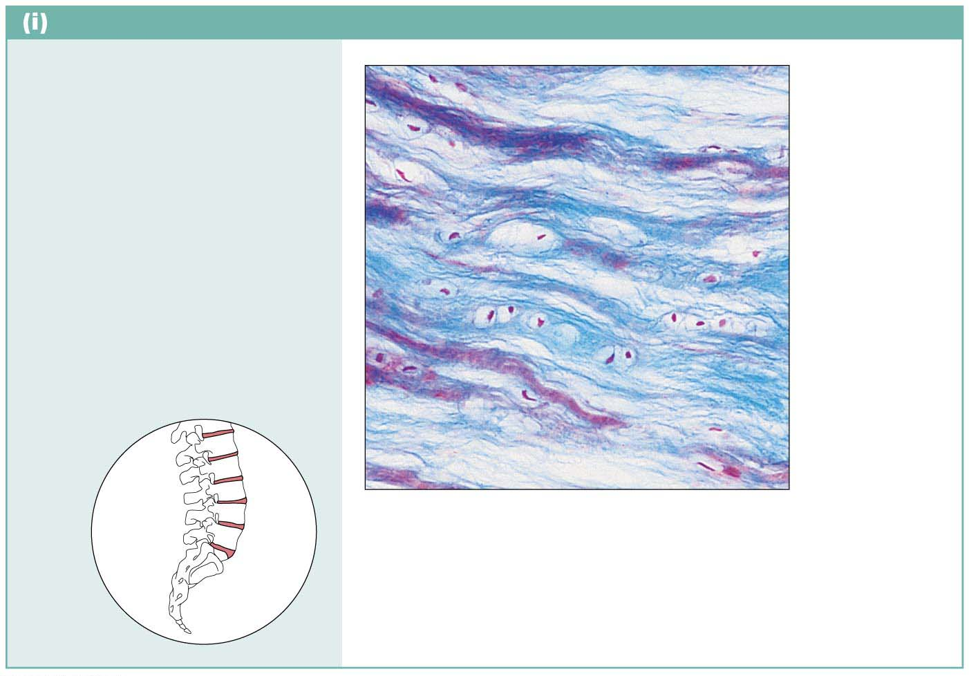
Figure 4.8i Connective tissues.
Cartilage: fibrocartilage
Description: Matrix similar to
but less firm than that in hyaline
cartilage; thick collagen fibers
predominate.
Function: Tensile strength
allows it to absorb compressive
shock.
Chondrocytes
in lacunae
Location: Intervertebral discs;
pubic symphysis; discs of knee
joint.
Collagen
fiber
Intervertebral
discs
Photomicrograph: Fibrocartilage of an
intervertebral disc (125⋅). Special staining
produced the blue color seen.

Slide 47
Types of Connective Tissues (cont.)
Bone
Also called osseous tissue
Supports and protects body structures
Stores fat and synthesizes blood cells in cavities
Has more collagen compared to cartilage
Osteoblasts produce matrix
Osteocytes maintain the matrix
Reside in cavities in matrix called lacunae
Osteons: individual structural units
Richly vascularized

Slide 48
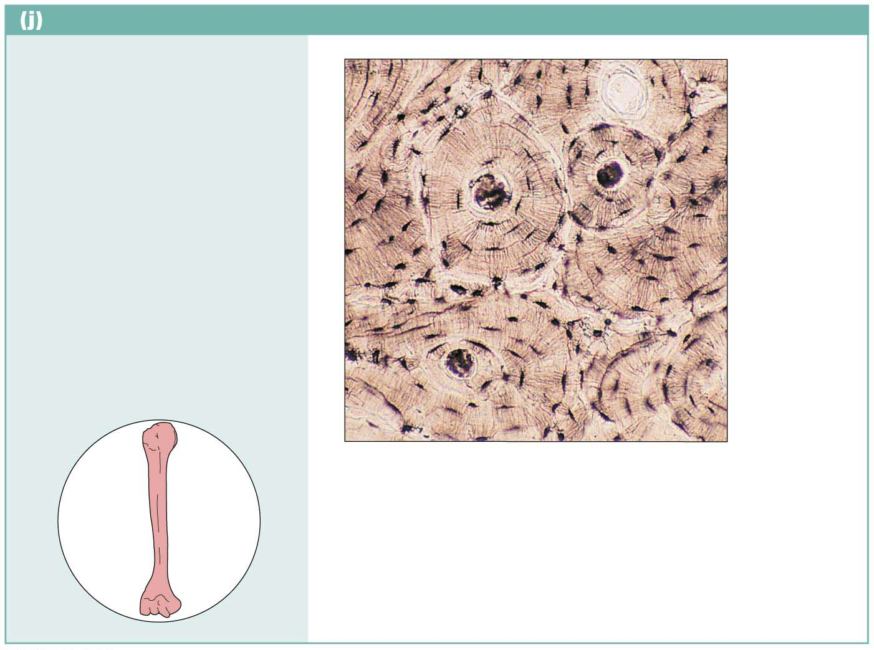
Figure 4.8j Connective tissues.
Others: bone (osseous tissue)
Description: Hard, calcified
matrix containing many
collagen fibers; osteocytes
lie in lacunae. Very well
vascularized.
Central
canal
Lacunae
Function: Supports and
protects (by enclosing);
provides levers for the muscles
to act on; stores calcium and
other minerals and fat; marrow
inside bones is the site for
blood cell formation
(hematopoiesis).
Lamella
Location: Bones
Photomicrograph: Cross-sectional view of
bone (125⋅).

Slide 49
Types of Connective Tissues (cont.)
Blood
Most atypical connective tissue because it is fluid
Consists of cells surrounded by matrix (plasma)
Red blood cells are most common cell type
Also contains white blood cells and platelets
Fibers are soluble proteins that precipitate during blood clotting
Functions in transport and in carrying nutrients, wastes, gases, and other substances

Slide 50
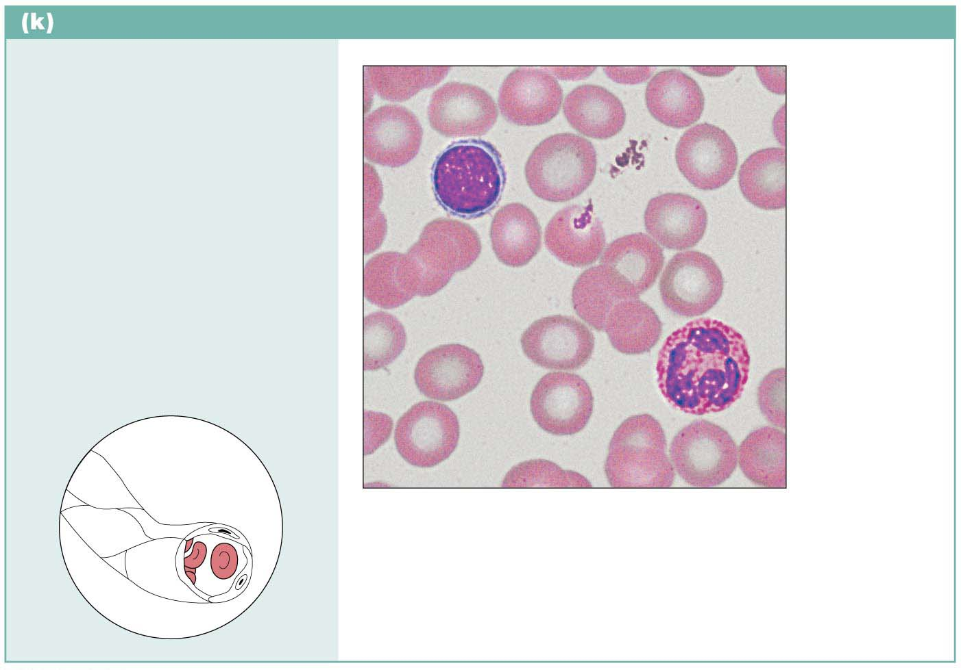
Figure 4.8k Connective tissues.
Connective tissue: blood
Description: Red and white
blood cells in a fluid matrix
(plasma).
Red blood
cells
(erythrocytes)
Function: Transport
respiratory gases, nutrients,
wastes, and other substances.
White blood
cells:
• Lymphocyte
• Neutrophil
Location: Contained within
blood vessels.
Plasma
Photomicrograph: Smear of human blood (1670⋅);
shows two white blood cells surrounded by red
blood cells.

Slide 51
4.4 Muscle Tissue
Highly vascularized
Responsible for most types of movement
Muscle cells possess myofilaments made up of actin and myosin proteins that bring about contraction
Three types of muscle tissues:
Skeletal muscle
Cardiac muscle
Smooth muscle

Slide 52
Skeletal Muscle
Skeletal muscle tissue
Attached to and causes movement of bones
Also called voluntary muscle
consciously controlled
Cells are called muscle fibers
Contain multiple nuclei
Appear striated or banded
Photomicrograph: Skeletal muscle (440⋅).
Notice the obvious banding pattern and the
fact that these large cells are multinucleate.

Slide 53
Cardiac Muscle
Cardiac muscle tissue
Found only in walls of heart
Involuntary muscle
Striated
One nucleus
Cells can have many branches that join branches of other cardiac cells
Intercalated discs
Photomicrograph: Cardiac muscle (475⋅);
notice the striations, branching of cells, and
the intercalated discs.

Slide 54
Smooth Muscle
Smooth muscle tissue
Found mainly in walls of hollow organs (other than heart)
Involuntary muscle
Has no visible striations
Spindle-shaped cells with one nucleus
Photomicrograph: Sheet of smooth muscle
from the digestive tract (500⋅).

Slide 55
4.5 Nervous Tissue
Main component of nervous system (brain, spinal cord, nerves)
Regulates and controls body functions
Made up of two specialized cells:
Neurons: specialized nerve cells that generate and conduct nerve impulses
Supporting cells that support, insulate, and protect neurons

Slide 56
Figure 4.10 Nervous tissue.
Nervous tissue
Description: Neurons are
branching cells; cell processes
that may be quite long extend
from the nucleus-containing
cell body; also contributing to
nervous tissue are nonexcitable
supporting cells.
Neuron processes
Cell body
Nuclei of
supporting
cells
Axon
Dendrites
Cell body
of a neuron
Function: Neurons transmit
electrical signals from sensory
receptors and to effectors
(muscles and glands); supporting
cells support and protect neurons.
Location: Brain, spinal
cord, and nerves.
Neuron
processes
Photomicrograph: Neurons (350⋅)

Slide 57
4.7 Tissue Repair
When the body’s barriers are compromised, the inflammatory and immune responses are activated
Repair starts very quickly
Repair is the function of the inflammatory process

Slide 58
Steps in Tissue Repair
Repair can occur in two major ways:
Regeneration: same kind of tissue replaces destroyed tissue, so original function is restored
Fibrosis: connective tissue replaces destroyed tissue, and original function lost
Step 1: Inflammation sets stage
Release of inflammatory chemicals causes:
Dilation of blood vessels
Increase in blood vessel permeability
Clotting of blood occurs

Slide 59
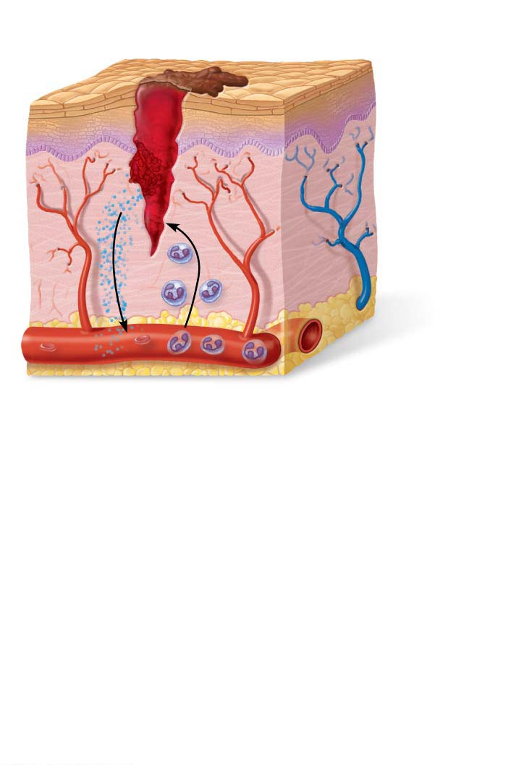
Figure 4.12-1 Tissue repair of a nonextensive skin wound: regeneration and fibrosis.
Scab
Blood clot in
incised wound
Epidermis
Vein
Inflammatory
chemicals
Migrating
white
blood cell
Artery
1
Inflammation sets the stage:
Severed blood vessels bleed.
Inflammatory chemicals are released by
injured tissue cells, mast cells, and others.
Local blood vessels become more permeable, allowing white blood cells, fluid, clotting proteins, and other plasma proteins to seep into the injured area.
Clotting occurs; surface exposed to air dries and forms a scab.

Slide 60
Steps in Tissue Repair (cont.)
Step 2: Organization restores blood supply
Organization begins as the blood clot is replaced with granulation tissue (new capillary-enriched tissue)
Epithelium begins to regenerate
Fibroblasts produce collagen fibers to bridge the gap until regeneration is complete
Any debris in area is phagocytized

Slide 61
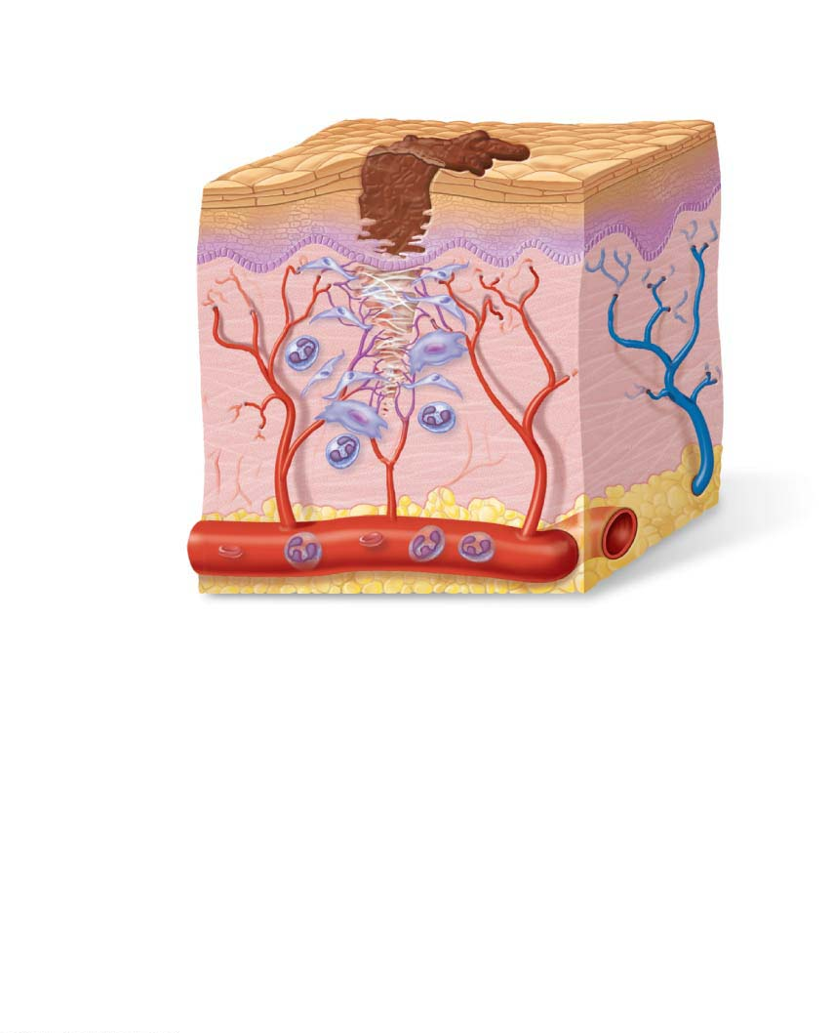
Figure 4.12-2 Tissue repair of a nonextensive skin wound: regeneration and fibrosis.
Regenerating
epithelium
Area of
granulation
tissue
ingrowth
Fibroblast
Macrophage
Budding
capillary
2
Organization restores the blood supply:
The clot is replaced by granulation tissue, which restores the vascular supply.
Fibroblasts produce collagen fibers that bridge the gap.
Macrophages phagocytize dead and dying cells and other debris.
Surface epithelial cells multiply and migrate over the granulation tissue.

Slide 62
Steps in Tissue Repair (cont.)
Step 3: Regeneration and fibrosis effect permanent repair
The scab detaches
Fibrous tissue matures
Epithelium thickens and begins to resemble adjacent tissue
Results in a fully regenerated epithelium with underlying scar tissue, which may or may not be visible

Slide 63
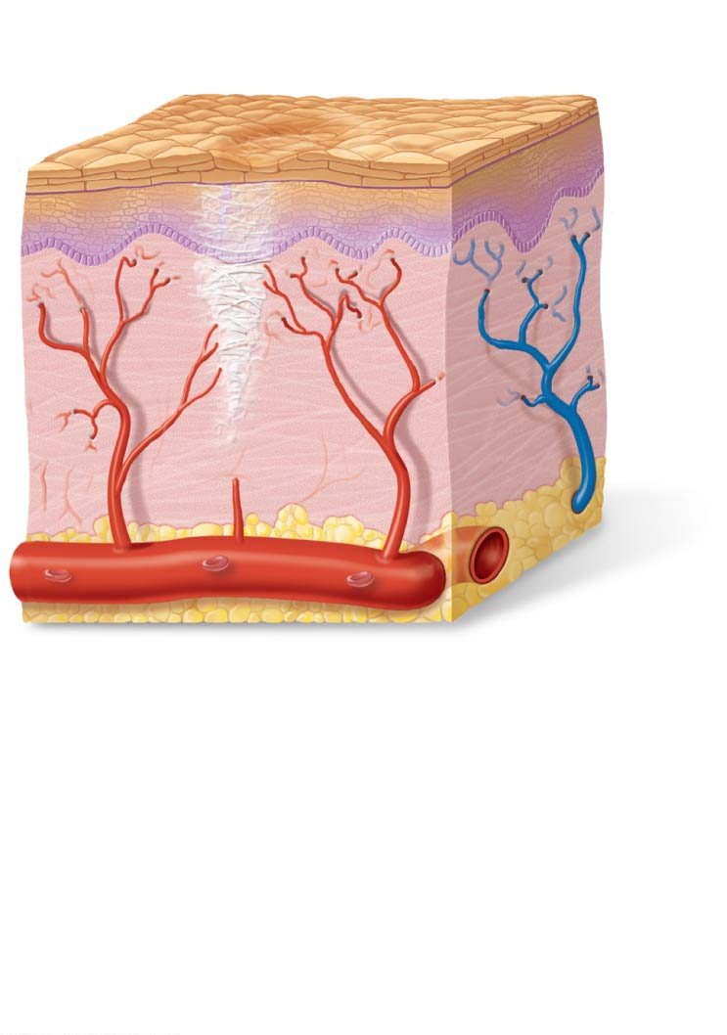
Figure 4.12-3 Tissue repair of a nonextensive skin wound: regeneration and fibrosis.
Regenerated epithelium
Fibrosed area
3
Regeneration and fibrosis effect
permanent repair:
The fibrosed area matures and contracts; the epithelium thickens.
A fully regenerated epithelium with an underlying area of scar tissue results.

Slide 64
Regenerative Capacity of Different Tissues
Tissues that regenerate extremely well include:
Epithelial tissues, bone, areolar connective tissue, dense irregular connective tissue, blood-forming tissue
Tissue with moderate regenerating capacity:
Smooth muscle and dense regular connective tissue

Slide 65
Regenerative Capacity of Different Tissues (cont.)
Tissues with virtually no functional regenerative capacity:
Cardiac muscle and nervous tissue of brain and spinal cord
New research shows cell division does occur, and efforts are underway to coax them to regenerate better

Slide 66
Clinical – Homeostatic Imbalance 4.3
Scar tissue that forms in organs, particularly the heart, can severely impair the function of that organ
May cause the organ to lose volume capacity
May block substances from moving through organ
May interfere with ability of muscles to contract or may impair nerve transmissions

Slide 67
Clinical – Homeostatic Imbalance 4.3
Scar adhesions may cause organs to adhere to neighboring structures, preventing normal functions
Scarring can potentially cause progressive failure of the organ, particularly the heart

