Slide 1
Mission: To take the “Mystery” out of 2nd Grade Curriculum!
Prattville Primary School
Mrs. Kirkham’s Class

Slide 2
Reading Grades
Activity | Category | Frequency
Weekly Vocabulary & High Frequency Words Page | Minor | Weekly
Weekly Skill Test: High Frequency Words, Phonics, Comprehension | Major | Weekly
Unit Test | Major | At the end of a Unit (After 5 stories)
Timed Fluency Passage | Minor | 2 per Grading Period 1st Nine Weeks Goal: 81

Slide 3
Grammar and Spelling Grades
Activity | Category | Frequency
Grammar Page | Average (No Major or Minor- Equal Weight) | Weekly
Spelling Test | Average | Weekly
A page that contains a list of the spelling words, reading vocabulary words and definitions, high frequency words, as well as identifying the grammar skill and reading skill for each story is in your child’s take home binder.
Spelling tests grading: All letter reversals/ incorrect capitals will be deducted one point- if the reversal results in an entire new word the entire word is wrong.

Slide 4
Math Grades
Activity | Weight | Frequency
Math Skill Pages and Activities | Minor | 1-2 Weekly
Topic Test | Major | End of a Topic

Slide 5
Science and Social Studies Grades
Activity | Weight | Frequency
Science Pages, Experiments, and Activities | S (Satisfactory) N (Needs Improvement) U (Unsatisfactory) | Varies per Grading Period
Social Studies Pages, Projects, and Activities | S (Satisfactory) N (Needs Improvement) U (Unsatisfactory) | Varies per Grading Period

Slide 6
Retention Policy
Autauga County Retention Policy
Grades 1-2
Regular education students in grades one (1) through two (2)will be retained if they do not pass both Reading and Mathematics in a given school year. A yearly numerical average of 60% or above constitutes a passing grade.
Letters will be sent home (starting the end of the first semester) to notify parents of their child’s potential or definite retention.

Slide 7
What Can Parents Do At Home?
Newsletter: Stay informed with our class newsletter. It is posted on my webpage. The newsletter gives you an idea of the curriculum/topics we will cover and other important information.
Tuesday Folder/Graded Papers: Your child will bring their “Tuesday Folder” home every week. The folder will have graded papers and important information in it. Please take time to look over your child’s work, sign by the current date, and return the folder (along with the papers) the next day.
Power School: Grades will be put in Power School on a weekly basis.
Lexia and Reflex: These are online programs (Reading and Math) that are both designed to meet the needs of individual students. The children work at their own pace to accomplish goals and pass levels. The websites and log in information will be sent home.

Slide 8
Accelerated Reader
AR is an amazing program for reading comprehension! The children have the opportunity to select books and read on their own reading level (levels are determined by the STAR reading assessment). As the children show success on AR tests, higher reading levels will be added.
The AR Challenge for the 1st Nine Weeks will be set after the students take the first STAR reading assessment.
Students who meet the AR Challenge will be rewarded each nine weeks.
The 2nd, 3rd, and 4th Nine Weeks will each have different goals. The requirements will be sent home at the beginning of each nine weeks.

Slide 9
A Few Announcements So You Won’t Be “Clueless”
Snack Cart: Snacks, juice, and water are available for purchase each morning (before 8:05) for $0. 75 each. Please try to send the exact cash amount.
Special Snacks: PPS sells a special snack item every Friday. The cost is $1.00.
Birthday Snacks: You are welcome to send a simple, individually packaged or store bought snack for the class to celebrate your child’s birthday, but please let me know in advance. You may send the snack with your child that morning or drop it off in the office. We will have birthday snacks during our regular snack time at 9:50.
Visitors: PPS is not allowing visitors at this time. We hope to have special scheduled lunch dates for visitors soon!
Attendance: It is so important for your child to be at school every day (when they are well), arrive on time, and avoid checking out, if possible. If your child misses a day of school, please make sure you send an excuse to avoid truancy issues.

Slide 10
Leader In Me
PPS is committed to developing and cultivating student leaders. We will focus on teaching the 7 Habits throughout the year.
Habit #1 Be Proactive
Habit #2 Begin With The End In Mind
Habit #3 Put First Things First
Habit #4 Think Win Win
Habit #5 Seek First To Understand, Then To Be Understood
Habit #6 Synergize
Habit #7 Sharpen The Saw
“Class Mission Statement: In our classroom we will be kind, have a good attitude, and be the best leaders we can be”

Slide 11
Resources
School Counselor: Mrs. Hardy provides a school counseling program that supports the academic, personal/social, and career development of students. If your child is having trouble adjusting to school, has difficulties with friendships, or anything else that may be a concern, you can reach out to Mrs. Hardy. veronica.hardy@acboe.net
School Nurse: Mrs. Coker takes such good care of our students and following the health guidelines! If you have any questions or health concerns, please feel free to contact her. jeannie.coker@acboe.net
Parent Resource Center: We have an amazing Parent Resource Room! We have learning activities, games, books, and so many things you can use to help your child at home. Let me know if you are interested in checking out some items to use at home.
Literacy Act at Home Resource Packet: If your child is struggling with reading/language arts skills, check out the Literacy Act Package link on our PPS homepage. The link connects you to a wonderful resource full of activities and suggestions for parents to help their child at home. (Students that are struggling are identified through a Universal Screening process and move through a tiered process to receive extra intensive instruction.)

Slide 12
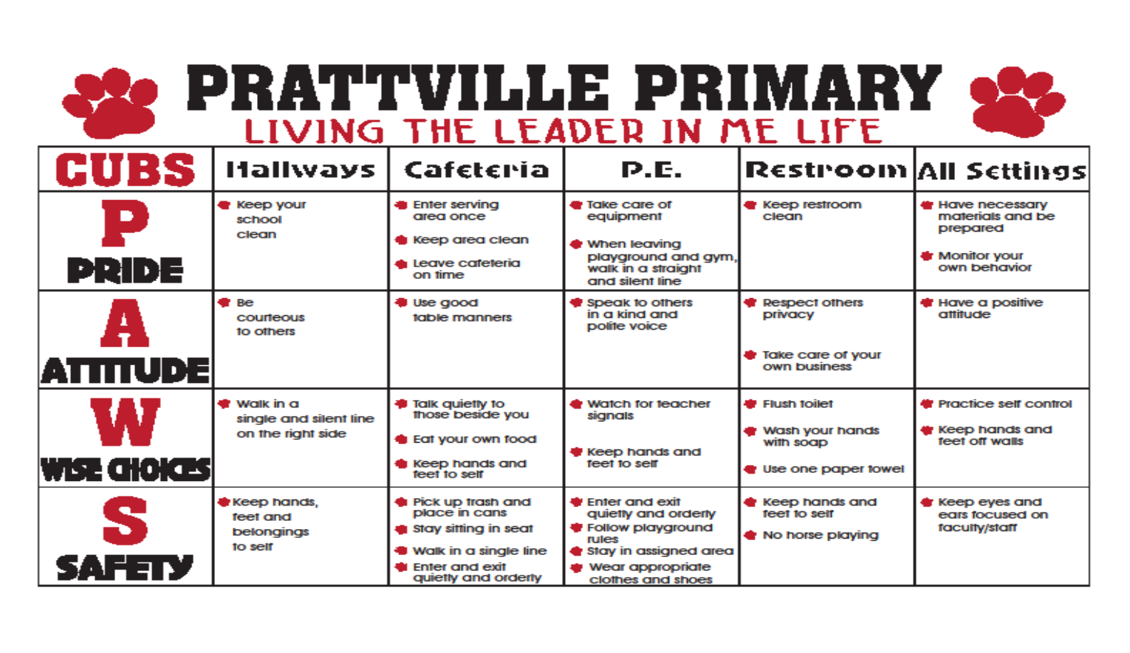
School Expectations

Slide 13
Together We Can “Solve” Anything
“Together may we give our children the roots to grow and the wings to fly.”
I look forward to working together to make 2nd grade an awesome year for your child. I hope it’s a year full of academic growth, personal accomplishments, fun memories, and time to develop a deeper love of learning.

