Slide 1

Military-Connected Students: Supporting Transitions, Understanding MIC3, and Alabama Purple Star
A practical guide for educators and school leaders

Slide 2
Today's Objectives & Agenda
Define who our military-connected students are
Explore common challenges they face
Understand the Military Interstate Children's Compact Commission (MIC3)
Review key MIC3 rules: enrollment, placement, eligibility, graduation
Explain Alabama's Purple Star School designation
Plan next steps with interactive scenarios & action items

Slide 3
Who Are Military-Connected Students?
Shared characteristics & diverse experiences
Children of active-duty, National Guard/Reserve, and veterans
Students impacted by frequent moves and deployments
Attend public, charter, private, and DoDEA schools
Diverse cultures, strengths, and needs across grade levels

Slide 4
Why This Matters for Schools
Student-centered, relationship-first supports pay off
High mobility can disrupt academics, services, and peer networks
Deployment cycles shape attendance, behavior, and well-being
Consistency in policy (MIC3) reduces barriers and delays
Purple Star recognizes schools that are ready to support these learners

Slide 5
Challenges Military-Connected Students Face
Academic continuity: credits, course sequences, special programs
Social-emotional health: stress, separation, reintegration
Extracurricular eligibility and participation
Enrollment documentation, records transfer, timelines
Graduation requirements when moving in junior/senior year

Slide 6
Academic Continuity
Course & credit mismatches
Placement in AP/IB/Honors/CTE
Gifted/EL/Special Education continuity
Assessment and grading differences
Schedule/sequence conflicts
Transcript delays & record access
Different graduation plans
Attendance coding variations

Slide 7
Social-Emotional & Belonging
New school culture & norms
Peer connections & activities
Family stress during deployment
Counseling & mental health access
Transitions for siblings
Reintegration after deployment
Loss & grief supports
Staff training and awareness

Slide 8
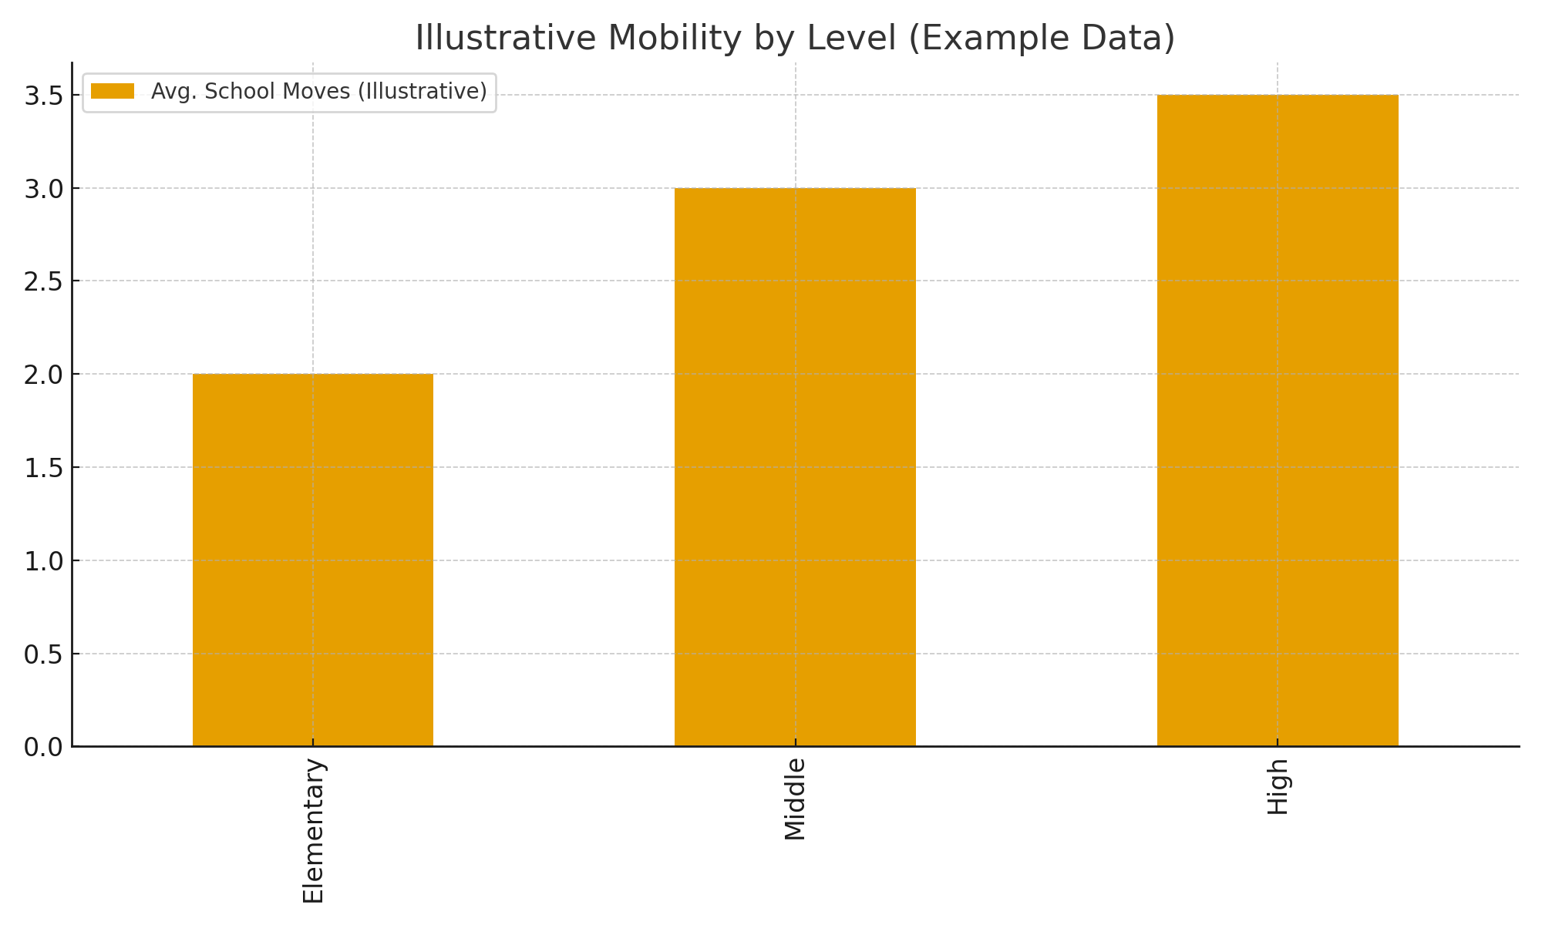
Illustrative Mobility by Level (Example Data)
Sample data for discussion only.

Slide 9
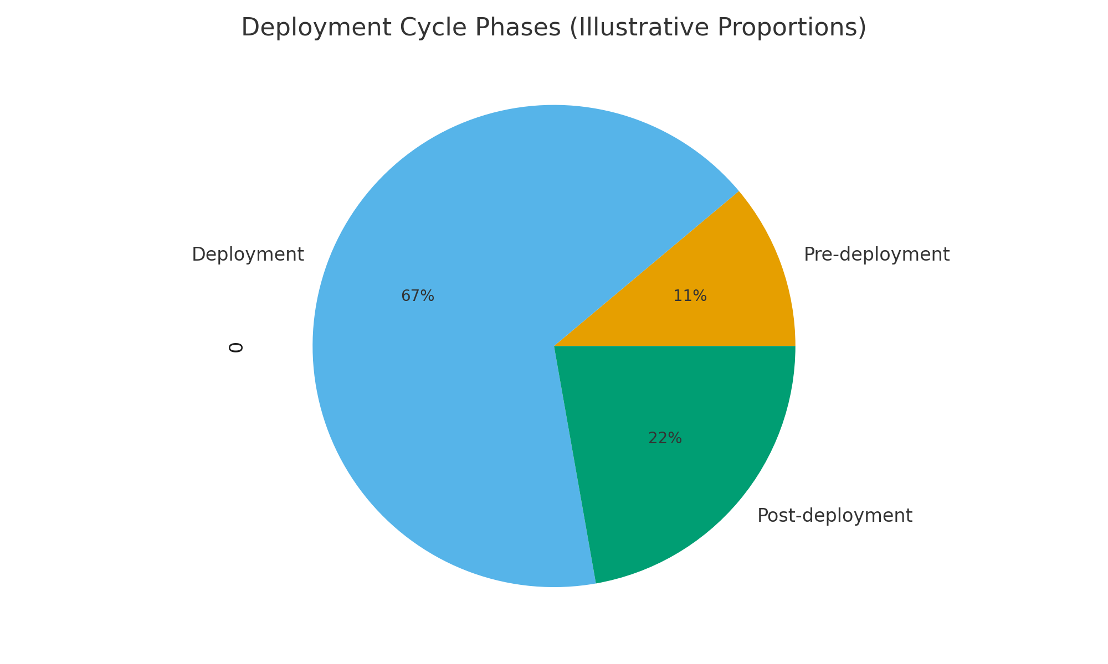
Deployment Cycle Phases (Illustrative Proportions)
Use this to frame supports across phases; proportions vary by unit and orders.

Slide 10
MIC3: What Is the Compact?
An interstate agreement adopted by all 50 states & D.C.
Provides consistency for military-connected students during transitions
Addresses enrollment, placement, attendance, eligibility, and graduation
Implemented by a State Council & State Commissioner

Slide 11
MIC3 Eligibility & Coverage
Children of active-duty uniformed service members (including NG/Reserve on orders)
Covers transitions due to official military moves
Typically excludes DoD civilian/contractor-only moves and children of retirees (with exceptions at state level)
Applies to public schools; many charters also participate under state law

Slide 12
Enrollment & Records Transfer
Immediate enrollment with unofficial records when official ones are pending
Accept immunization schedules; allow time to meet requirements
Kindergarten/First Grade entrance age reciprocity when feasible
Expedited records transfer between schools

Slide 13
Placement, Programs & Attendance
Honor previous placements: AP/IB/Honors, Gifted/EL, SPED (temporary placement)
Provide comparable services pending evaluations
Flexible attendance for deployment-related events (command-approved)
Facilitate extracurricular tryouts and participation

Slide 14
Eligibility & Extracurriculars
Allow participation if the student meets general standards
Provide reasonable flexibility on tryouts/practices missed due to transition
Remove barriers related to local residency-only timelines when possible
Encourage inclusion so students reconnect quickly

Slide 15
Graduation Protections
Waive specific courses if similar content already completed
Accept alternatives to meet requirements (end-of-course exams, online options)
If on-time graduation not possible in the receiving state, options include transfers or alternative pathways
Work collaboratively with sending school counselors

Slide 16
Problem-Solving under MIC3
Start at school level with counselors/administrators
Engage district MIC3 point of contact
State Commissioner/State Council can assist
Document decisions and timelines for families

Slide 17
Interactive: MIC3 Placement Scenario
Interactive Prompt
A new student arrives mid-semester with documentation showing
AP Biology placement at the previous school.
What is your immediate action under MIC3?
1. Place the student in AP Biology and review prerequisites
2. Delay placement until the next term
3. Enroll in regular Biology until local assessments are finished
Follow-up: Discuss how you would communicate with the family and teachers
within 48 hours.

Slide 18
Alabama Purple Star School Program
State-recognized designation for military-friendly schools
Signals readiness to support military-connected students and families
Aligned with MIC3 and best practices for transitions
Annual application and recognition process

Slide 19
Alabama Purple Star
Core Requirements
Designate a school military liaison/POC
Maintain a dedicated webpage with resources for military families
Provide staff training on military student supports
Implement student-led transition supports/peer ambassadors
PLUS: Complete at least one optional activity (community partnerships, events, etc.)
Month of the Military Child & Purple Up! Events
Recognize military holidays & community partners
Partner with installation School Liaison Program
Host deployment/reintegration family nights
Create welcome videos and digital school tours

Slide 20
ECPS Military-Connected Students by School

Slide 21
Interactive Exit Ticket
Interactive Prompt
What is one change you will implement this month to better
support military-connected students?
Follow-up: Share in pairs, then add to a collaborative board (Padlet/Google Jamboard/Slides Q&A).

