Slide 1
Rocky Hill Public Schools
2025 – 2026 Budget

Slide 2
Board of Education
Steven Slattery, Chairman
Amber Tucker, Vice Chair
Maria Mennella, Secretary
Jennifer Baron-Morfea
Jay Chhabra
Brian Clements
Tom Cosker
Sean Gavin
Jessica Loffredo
Superintendent of Schools
Mark F. Zito, Ed.D.
Assistant Superintendent for Finance & Operations
Charles O. Zettergren

Slide 3
2025-2026 Budget Assumptions
Continue to provide high-quality educational programming/rigorous and engaging curriculum
Continue to improve teaching and learning
Maintain staffing levels to conform with Board of Education guidelines
Maintain appropriate levels of instructional supplies
Maintain safe and clean facilities, furniture, fixtures, and equipment
Continue to improve access to educational technology
Continue to meet all special education legal mandates

Slide 4
Major Factors Driving the Board’s Adopted Budget Increase
Salaries
Benefits
Professional Services
Transportation
Tuition

Slide 5
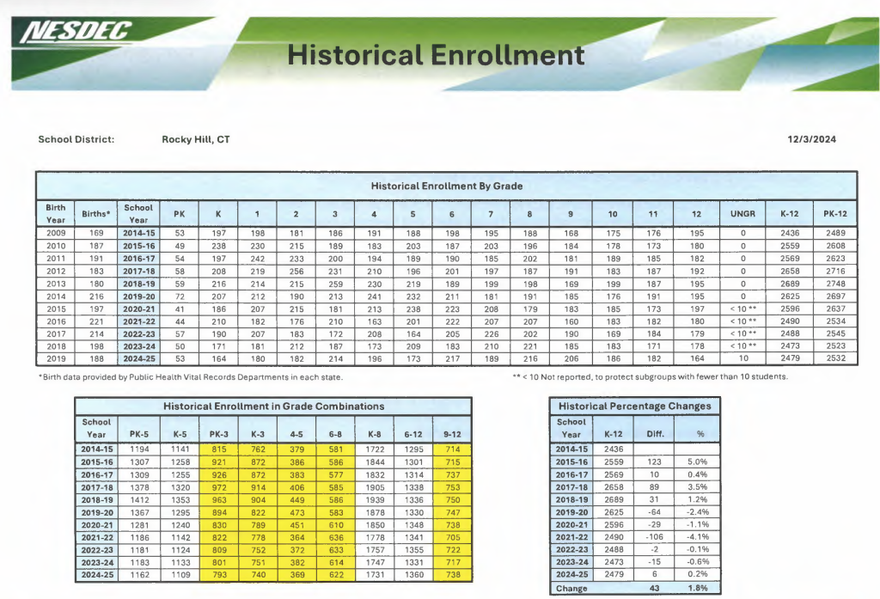
Historical Enrollment

Slide 6
Current Enrollment
October 1, 2023: 2,530
October 1, 2024: 2,532
Increase of 2 students
May 1, 2025: 2,542
Increase of 10 students from October 1, 2024
October 1, 2014: 2,489 - Very stable numbers over the past ten years.

Slide 7
Demographic Changes – Student Population
Special Education – Teachers and Related Services Staff (e.g., social workers, school psychologists, speech, physical therapy, occupational therapy, BCBA, paraeducators).
EL/ML – Teachers and Related Tutor Support Staff
Special Education EL/ML
October 1, 2012 :231 2013 : 108
October 1, 2017 :307 2019 : 214
October 1, 2021 :358 2020 : 202
October 1, 2022 :388 2022 : 217
October 1, 2023 :389 2023 : 261
October 1, 2024 :417 2024 : 290
Special Education: Increase of 80% over the past twelve years – significant impact on staffing needs.
EL/ML: Increase of 168% over the past eleven years - significant impact on staffing needs.
Overall District-Wide Enrollment has remained stable; however, we have noted a sharp increase in students needing special education and/or EL/ML services.

Slide 8
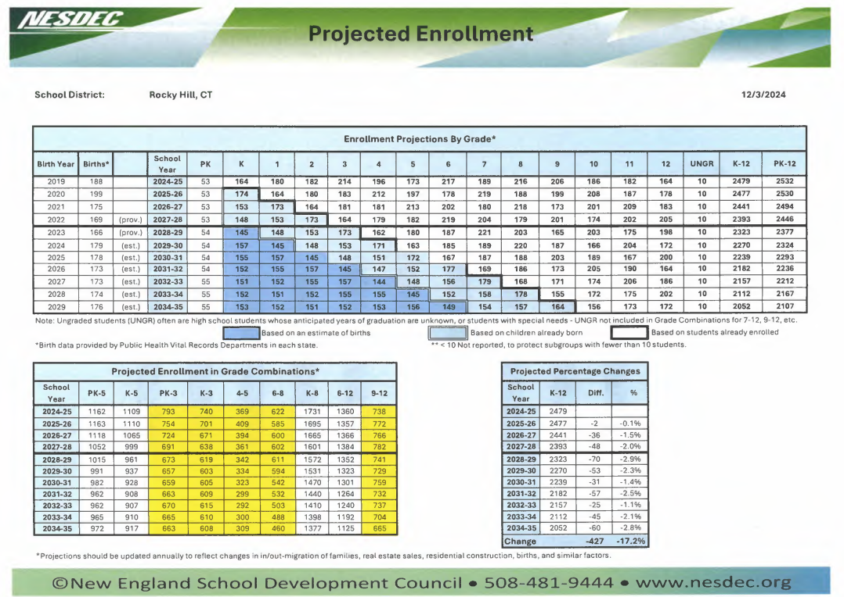
Projected Enrollment

Slide 9
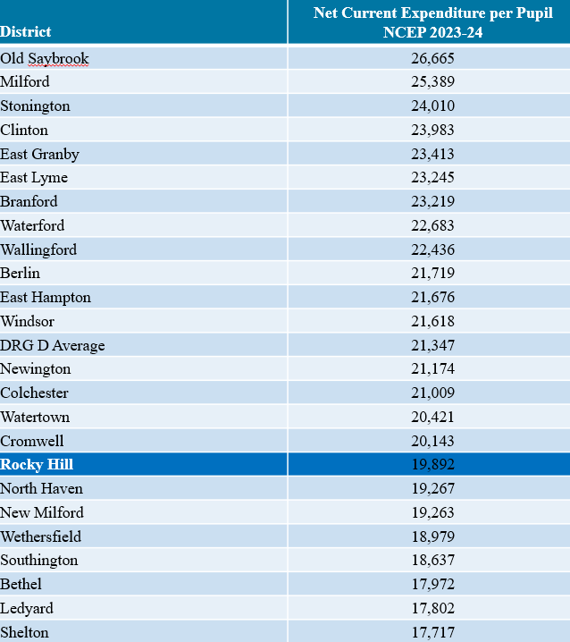
Taxpayers Getting Great Results For Their Dollar
NCEP Comparison DRG D
•The average spending per pupil (NCEP) for districts in DRG D is $21,347.
•Rocky Hill ranks 17th in spending out of 24 DRG D towns with NCEP of $19,892.
•Rocky Hill would need to spend an additional $1,455 per pupil to meet the DRG D average spending.

Slide 10
Taxpayers Getting Great Results For Their Dollar District Performance Index With NCEP Comparison
DRG D - Math
District | 2021-22 |  | 2022-23 |  | 2023-24 |  | NCEP 2023-24
 | Math Count | Performance Index | Math Count | Performance Index | Math Count | Performance Index
Rocky Hill | 1299 | 72.9 | 1269 | 73.6 | 1264 | 73.6 | $19,892
Stonington | 915 | 70.4 | 875 | 71.9 | 922 | 71.9 | $24,010
East Lyme | 1267 | 68.7 | 1252 | 68.9 | 1162 | 70.1 | $23,245
Southington | 3201 | 68 | 3201 | 68.8 | 3184 | 69.9 | $18,637
Colchester | 1071 | 69.6 | 1049 | 71.6 | 1051 | 69.4 | $21,009
North Haven | 1570 | 67.4 | 1654 | 68.5 | 1670 | 69.4 | $19,267
Old Saybrook | 550 | 67.5 | 529 | 66.7 | 488 | 68.8 | $26,665
Berlin | 1346 | 65.4 | 1322 | 68.8 | 1373 | 68.6 | $21,719
Bethel | 1630 | 64.6 | 1623 | 65.9 | 1666 | 68.5 | $17,972
Waterford | 1230 | 64.9 | 1183 | 65.9 | 1168 | 67.3 | $22,683
East Granby | 462 | 65.4 | 435 | 66.9 | 445 | 67.1 | $23,413
Shelton | 2378 | 66.1 | 2369 | 66.4 | 2389 | 66.8 | $17,717
Clinton | 785 | 63.1 | 700 | 64.3 | 718 | 65.9 | $23,983
East Hampton | 925 | 62.8 | 939 | 63.3 | 906 | 65.6 | $21,676
Branford | 1324 | 61.7 | 1326 | 63.9 | 1290 | 65.1 | $23,219
Milford | 2669 | 63.4 | 2671 | 63 | 2587 | 64.9 | $25,389
Wethersfield | 1869 | 61.8 | 1872 | 62.4 | 1826 | 64.2 | $18,979
Cromwell | 1030 | 63.9 | 1031 | 63.8 | 1019 | 63.7 | $20,143
Newington | 1969 | 60.7 | 1981 | 61.7 | 1964 | 61.5 | $21,174
Wallingford | 2633 | 59.1 | 2587 | 59.9 | 2524 | 61.1 | $22,436
Watertown | 1309 | 62.1 | 1323 | 61.7 | 1312 | 60.7 | $20,421
Ledyard | 1230 | 60.1 | 1218 | 60.6 | 1216 | 60.1 | $17,802
Windsor | 1568 | 55.1 | 1567 | 55.4 | 1533 | 57.8 | $21,618
New Milford | 1776 | 58.2 | 1756 | 56.8 | 1748 | 56.3 | $19,263
The average spending per pupil (NCEP) for districts in DRG D is $21,347.
Rocky Hill ranks 17th in spending out of 24 DRG D towns.
Rocky Hill would need to spend an additional $1,455 per pupil to meet the DRG D average spending.

Slide 11
Taxpayers Getting Great Results For Their Dollar District Performance Index With NCEP Comparison
DRG D - ELA
District | 2021-22 |  | 2022-23 |  | 2023-24 |  | NCEP 2023-24
 | ELA Count | Performance Index | ELA Count | Performance Index | ELA Count | Performance Index
Rocky Hill | 1300 | 76.5 | 1270 | 75.5 | 1265 | 75.3 | $19,892
East Granby | 462 | 72.3 | 436 | 72 | 447 | 74.1 | $23,413
Stonington | 917 | 75 | 875 | 74.5 | 921 | 73.8 | $24,010
East Lyme | 1268 | 72.5 | 1257 | 71.4 | 1167 | 73.2 | $23,245
Old Saybrook | 555 | 72.6 | 530 | 72.6 | 491 | 73.1 | $26,665
North Haven | 1574 | 72.2 | 1658 | 71.3 | 1679 | 72.7 | $19,267
Southington | 3210 | 70.3 | 3207 | 70.4 | 3193 | 71.2 | $18,637
Berlin | 1355 | 68.7 | 1330 | 70.5 | 1374 | 70.3 | $21,719
Colchester | 1072 | 70.2 | 1049 | 70.7 | 1052 | 70.2 | $21,009
East Hampton | 931 | 68.3 | 944 | 69.3 | 910 | 70.1 | $21,676
Bethel | 1649 | 68.5 | 1625 | 68.4 | 1667 | 69.1 | $17,972
Wethersfield | 1873 | 68.3 | 1876 | 68.1 | 1828 | 68.9 | $18,979
Waterford | 1235 | 69.3 | 1185 | 68.1 | 1171 | 68.1 | $22,683
Milford | 2671 | 67.9 | 2672 | 66.6 | 2595 | 67.8 | $25,389
Cromwell | 1032 | 67.8 | 1039 | 66.4 | 1021 | 67.5 | $20,143
Branford | 1326 | 65.4 | 1327 | 66.1 | 1300 | 67.4 | $23,219
Clinton | 785 | 66.5 | 701 | 65.7 | 720 | 66.3 | $23,983
Shelton | 2382 | 69.6 | 2374 | 67.6 | 2390 | 65.8 | $17,717
Newington | 1981 | 65.7 | 1990 | 65.2 | 1971 | 64.8 | $21,174
Wallingford | 2645 | 65.3 | 2600 | 64.1 | 2536 | 64.5 | $22,436
Watertown | 1313 | 67.2 | 1324 | 64.4 | 1316 | 64 | $20,421
Ledyard | 1231 | 64.8 | 1221 | 62.9 | 1220 | 63 | $17,802
New Milford | 1788 | 63.2 | 1766 | 61 | 1756 | 61.6 | $19,263
Windsor | 1577 | 59.3 | 1581 | 59.5 | 1543 | 60.7 | $21,618
The average spending per pupil (NCEP) for districts in DRG D is $21,347.
Rocky Hill ranks 17th in spending out of 24 DRG D towns.
Rocky Hill would need to spend an additional $1,455 per pupil to meet the DRG D average spending.

Slide 12
Taxpayers Getting Great Results For Their Dollar District Performance Index With NCEP Comparison
DRG D - Science
District | 2021-22 |  | 2022-23 |  | 2023-24 |  | NCEP 2023-24
 | Science Count | Performance Index | Science Count | Performance Index | Science Count | Performance Index
Stonington | 392 | 70.3 | 389 | 74.1 | 418 | 75.6 | $24,010
East Granby | 212 | 73.9 | 194 | 73.7 | 176 | 75.5 | $23,413
Bethel | 738 | 71.2 | 716 | 72.4 | 754 | 73.1 | $17,972
Rocky Hill | 543 | 71.2 | 514 | 74.9 | 553 | 72.6 | $19,892
Old Saybrook | 244 | 66.8 | 238 | 68.2 | 231 | 72 | $26,665
East Lyme | 613 | 74.2 | 560 | 71.3 | 530 | 71.5 | $23,245
North Haven | 672 | 68.4 | 717 | 71.1 | 699 | 71.1 | $19,267
Berlin | 608 | 65.8 | 584 | 68.7 | 629 | 70 | $21,719
Colchester | 474 | 69.1 | 460 | 71.5 | 430 | 69.6 | $21,009
Southington | 1425 | 69.3 | 1396 | 69.9 | 1372 | 69.3 | $18,637
East Hampton | 397 | 65.2 | 412 | 67.3 | 385 | 68.7 | $21,676
Waterford | 548 | 66.8 | 514 | 68.1 | 520 | 67.5 | $22,683
Wethersfield | 830 | 62 | 815 | 61.3 | 810 | 66.5 | $18,979
Newington | 885 | 61.7 | 854 | 64.3 | 893 | 65.8 | $21,174
Cromwell | 444 | 64.8 | 438 | 67.2 | 410 | 65.7 | $20,143
Clinton | 374 | 66.1 | 319 | 66.7 | 330 | 65.6 | $23,983
Ledyard | 525 | 64.7 | 531 | 66.3 | 524 | 65.3 | $17,802
Wallingford | 1141 | 64.9 | 1134 | 63.8 | 1122 | 64.9 | $22,436
Watertown | 576 | 64.5 | 563 | 64.1 | 550 | 63.5 | $20,421
Branford | 580 | 61.1 | 563 | 62.4 | 580 | 62.7 | $23,219
Milford | 1147 | 63.6 | 1199 | 62.8 | 1117 | 62.7 | $25,389
Windsor | 703 | 58.5 | 735 | 57.6 | 692 | 62 | $21,618
Shelton | 1000 | 65.1 | 995 | 63.9 | 1072 | 61.2 | $17,717
New Milford | 839 | 63.6 | 771 | 60.5 | 788 | 57.8 | $19,263
The average spending per pupil (NCEP) for districts in DRG D is $21,347.
Rocky Hill ranks 17th in spending out of 24 DRG D towns.
Rocky Hill would need to spend an additional $1,455 per pupil to meet the DRG D average spending.

Slide 13
Taxpayers Getting Great Results For Their Dollar District Performance Index With NCEP Comparison DRG B - Math
District | 2021-22 |  | 2022-23 |  | 2023-24 |  | NCEP 2023-24
 | Math Count | Performance Index | Math Count | Performance Index | Math Count | Performance Index
Woodbridge | 481 | 79.9 | 476 | 80.8 | 478 | 81.7 | $20,280
Madison | 1237 | 74 | 1245 | 77.2 | 1238 | 78.4 | $24,833
Greenwich | 4493 | 74.2 | 4332 | 75.7 | 4333 | 76.7 | $27,670
Cheshire | 2101 | 73.9 | 2095 | 76.5 | 2171 | 76 | $20,157
Glastonbury | 2941 | 74.1 | 2916 | 75.3 | 2972 | 75.9 | $20,911
Farmington | 2102 | 73.5 | 2134 | 76.4 | 2159 | 75.8 | $19,579
Orange | 673 | 73.3 | 706 | 73.4 | 697 | 75.2 | $20,494
Trumbull | 3474 | 73.6 | 3557 | 74.5 | 3611 | 74.9 | $19,316
Simsbury | 2064 | 72.8 | 2142 | 74.4 | 2157 | 74.7 | $20,516
South Windsor | 2561 | 72.9 | 2575 | 73.9 | 2613 | 74.2 | $18,022
Guilford | 1664 | 73.4 | 1643 | 73.7 | 1604 | 73.7 | $21,755
Rocky Hill | 1299 | 72.9 | 1269 | 73.6 | 1264 | 73.6 | $19,892
Newtown | 2036 | 71.8 | 2047 | 72.3 | 2052 | 73.1 | $21,607
Fairfield | 4797 | 71.8 | 4834 | 72.1 | 4718 | 72.9 | $23,635
Avon | 1623 | 72 | 1657 | 71.7 | 1636 | 72.5 | $20,452
District 05 | 1005 | 71.1 | 1044 | 72.3 | 1020 | 72 | $21,861
District 15 | 1811 | 68.3 | 1853 | 69.2 | 1833 | 70.8 | $23,309
Monroe | 1702 | 69.1 | 1715 | 70.8 | 1741 | 70.3 | $18,863
West Hartford | 4546 | 68.7 | 4579 | 69.4 | 4593 | 70.2 | $20,706
New Fairfield | 1084 | 69.4 | 1110 | 70.8 | 1099 | 70.1 | $21,806
Brookfield | 1280 | 64.6 | 1294 | 66.9 | 1297 | 66.6 | $19,832
Granby | 885 | 65.3 | 905 | 66 | 897 | 66.3 | $20,673
The average spending per pupil (NCEP) for districts in DRG B is $21,251.
Rocky Hill would rank 17th in spending.
Rocky Hill would need to spend an additional $1,359 per pupil to meet the DRG B average spending.

Slide 14
Taxpayers Getting Great Results For Their Dollar District Performance Index With NCEP Comparison DRG B - ELA
District | 2021-22 |  | 2022-23 |  | 2023-24 |  | NCEP 2023-24
 | ELA Count | Performance Index | ELA Count | Performance Index | ELA Count | Performance Index
Woodbridge | 481 | 84.5 | 474 | 84.5 | 479 | 84.2 | $20,280
Madison | 1237 | 75.7 | 1246 | 77.7 | 1238 | 79.3 | $24,833
Orange | 673 | 78.3 | 706 | 77.3 | 700 | 78.8 | $20,494
Simsbury | 2067 | 77.1 | 2145 | 76.8 | 2157 | 78.6 | $20,516
Greenwich | 4502 | 77.6 | 4339 | 77.9 | 4342 | 78.3 | $27,670
Cheshire | 2106 | 76.6 | 2100 | 78.2 | 2173 | 78 | $20,157
Farmington | 2109 | 77.8 | 2142 | 78.5 | 2162 | 77.5 | $19,579
Glastonbury | 2943 | 76.5 | 2919 | 76.6 | 2973 | 76.8 | $20,911
Avon | 1626 | 76.6 | 1658 | 75.7 | 1638 | 76.6 | $20,452
Guilford | 1665 | 76.4 | 1644 | 76.1 | 1605 | 76.6 | $21,755
Trumbull | 3479 | 76.9 | 3560 | 77 | 3611 | 76.6 | $19,316
Monroe | 1708 | 76.8 | 1720 | 75.9 | 1745 | 75.7 | $18,863
Fairfield | 4809 | 76 | 4836 | 75.9 | 4721 | 75.6 | $23,635
South Windsor | 2564 | 76.1 | 2591 | 74.9 | 2618 | 75.5 | $18,022
Rocky Hill | 1300 | 76.5 | 1270 | 75.5 | 1265 | 75.3 | $19,892
District 05 | 1010 | 75 | 1049 | 74.8 | 1021 | 74.7 | $21,861
Granby | 885 | 71.8 | 909 | 71.6 | 897 | 73.1 | $20,673
West Hartford | 4573 | 73.6 | 4595 | 72.4 | 4605 | 73.1 | $20,706
Newtown | 2038 | 74.4 | 2050 | 73.7 | 2058 | 72.8 | $21,607
New Fairfield | 1085 | 72.7 | 1115 | 71.2 | 1100 | 71.4 | $21,806
Brookfield | 1282 | 68.9 | 1302 | 70.2 | 1301 | 71.1 | $19,832
District 15 | 1827 | 69.7 | 1856 | 70 | 1836 | 70.2 | $23,309
The average spending per pupil (NCEP) for districts in DRG B is $21,251.
Rocky Hill would rank 17th in spending.
Rocky Hill would need to spend an additional $1,359 per pupil to meet the DRG B average spending.

Slide 15
Taxpayers Getting Great Results For Their Dollar District Performance Index With NCEP Comparison DRG B - Science
District | 2021-22 |  | 2022-23 |  | 2023-24 |  | NCEP 2023-24
 | Science Count | Performance Index | Science Count | Performance Index | Science Count | Performance Index
Woodbridge | 121 | 82.3 | 128 | 86.7 | 117 | 81.9 | $20,280
Greenwich | 1989 | 77.2 | 1861 | 78.8 | 1942 | 80.1 | $27,670
Simsbury | 885 | 78.4 | 933 | 78.5 | 890 | 79.4 | $20,516
South Windsor | 1077 | 72.7 | 1076 | 74.8 | 1119 | 78.4 | $18,022
Granby | 364 | 78.2 | 424 | 74.8 | 386 | 77.3 | $20,673
Orange | 177 | 77.4 | 172 | 73.2 | 161 | 77.3 | $20,494
Farmington | 918 | 77.8 | 928 | 79.6 | 905 | 77 | $19,579
Trumbull | 1541 | 76.3 | 1517 | 77.5 | 1591 | 76.8 | $19,316
Cheshire | 910 | 73 | 889 | 75.3 | 943 | 75.4 | $20,157
Madison | 556 | 69.5 | 577 | 73.9 | 534 | 75.3 | $24,833
District 15 | 790 | 64.8 | 786 | 66.9 | 803 | 73.1 | $23,309
Rocky Hill | 543 | 71.2 | 514 | 74.9 | 553 | 72.6 | $19,892
West Hartford | 2030 | 71.5 | 2029 | 71.4 | 2034 | 72.3 | $20,706
Glastonbury | 1301 | 73.4 | 1276 | 74.6 | 1296 | 71.9 | $20,911
Fairfield | 2135 | 71 | 2128 | 70.8 | 2031 | 71.6 | $23,635
Avon | 706 | 76.9 | 678 | 74.9 | 710 | 71.3 | $20,452
Monroe | 739 | 71.5 | 751 | 71.2 | 772 | 71.1 | $18,863
Guilford | 746 | 74.4 | 732 | 72 | 750 | 71 | $21,755
Brookfield | 585 | 65.1 | 585 | 65.9 | 566 | 70.3 | $19,832
Newtown | 903 | 68.9 | 897 | 72.7 | 926 | 69.6 | $21,607
District 05 | 664 | 70.3 | 697 | 67.9 | 675 | 68.8 | $21,861
New Fairfield | 464 | 69.4 | 497 | 69 | 489 | 66.3 | $21,806
The average spending per pupil (NCEP) for districts in DRG B is $21,251.
Median Household Incomes for 2023 - US Census Bureau
Simsbury $153,715
Glastonbury $150,290
South Windsor $143,025
Rocky Hill $100,061

Slide 16
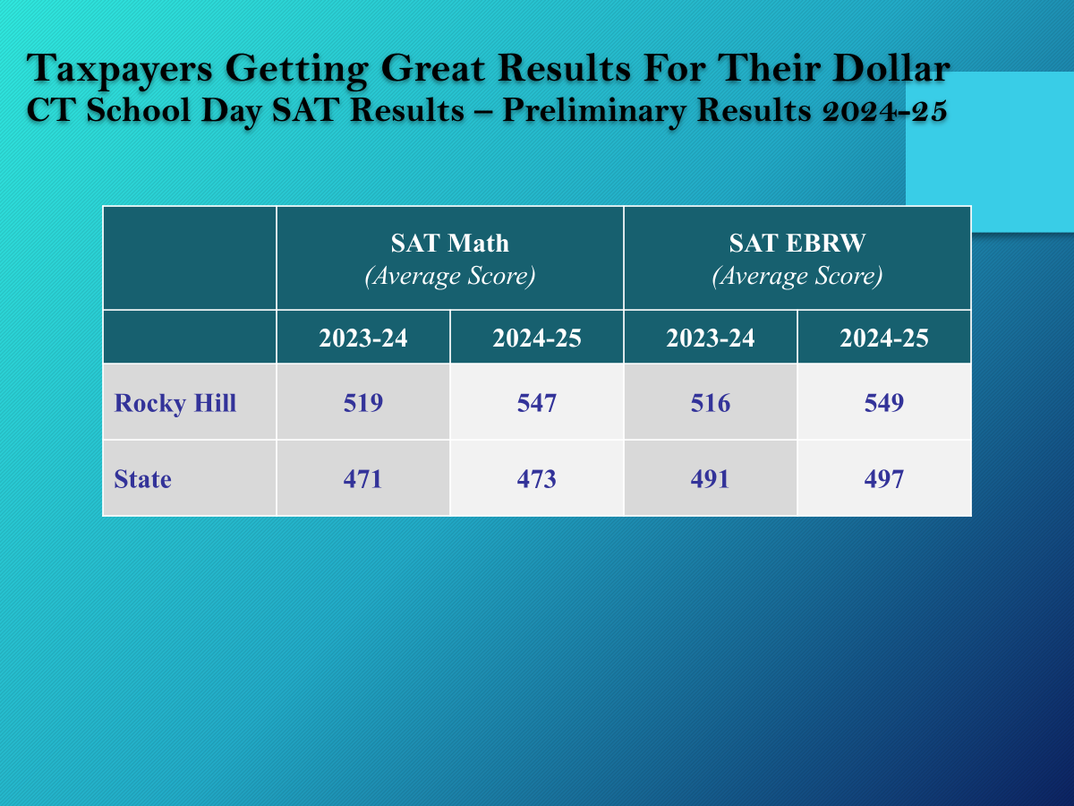

Slide 17
Special Ed Expenditures DRG D
 |  | Total | Sp.Ed |  | Sp.Ed
 |  | Expenditures | Expenditures |  | Transportation
Rank | District | 2023-24 | 2023-24 | Sp.Ed % | Expenditures | Transp. %
1 | Old Saybrook | $28,896,093 | $6,284,110 | 21.75% | $999,129 | 3.46%
2 | Wethersfield | $76,338,014 | $17,115,473 | 22.42% | $1,794,353 | 2.35%
3 | North Haven | $65,274,020 | $14,672,955 | 22.48% | $2,337,374 | 3.58%
4 | Rocky Hill | $54,844,494 | $12,342,794 | 22.51% | $1,646,113 | 3.00%
5 | Newington | $89,265,932 | $20,355,569 | 22.80% | $3,073,769 | 3.44%
6 | East Lyme | $59,664,541 | $13,671,204 | 22.91% | $1,505,995 | 2.52%
7 | Colchester | $46,880,928 | $11,492,445 | 24.51% | $1,723,033 | 3.68%
8 | Branford | $67,322,360 | $16,556,545 | 24.59% | $2,681,902 | 3.98%
9 | New Milford | $75,385,438 | $18,790,848 | 24.93% | $4,173,387 | 5.54%
10 | Bethel | $61,050,899 | $15,241,475 | 24.97% | $2,133,207 | 3.49%
11 | Milford | $139,785,393 | $34,923,234 | 24.98% | $3,353,284 | 2.40%
12 | Stonington | $46,352,585 | $11,807,225 | 25.47% | $1,865,559 | 4.02%
13 | Berlin | $60,645,571 | $15,594,038 | 25.71% | $2,117,413 | 3.49%
14 | East Granby | $21,211,065 | $5,496,496 | 25.91% | $527,672 | 2.49%
15 | Waterford | $59,212,364 | $15,753,631 | 26.61% | $1,843,635 | 3.11%
16 | Clinton | $36,789,695 | $10,076,417 | 27.39% | $1,108,184 | 3.01%
17 | Cromwell | $40,913,820 | $11,220,242 | 27.42% | $1,141,820 | 2.79%
18 | Wallingford | $126,325,781 | $35,367,348 | 28.00% | $3,690,573 | 2.92%
19 | Ledyard | $46,323,137 | $12,969,682 | 28.00% | $1,668,032 | 3.60%
20 | Windsor | $88,550,325 | $25,086,053 | 28.33% | $2,980,480 | 3.37%
21 | Shelton | $87,207,966 | $26,097,376 | 29.93% | $4,933,889 | 5.66%
22 | Southington | $120,031,034 | $36,736,864 | 30.61% | $2,900,668 | 2.42%
23 | Watertown | $56,877,618 | $17,776,481 | 31.25% | $1,574,595 | 2.77%
24 | East Hampton | $39,589,543 | $12,432,848 | 31.40% | $1,013,145 | 2.56%
SOURCE: Preliminary 2023-2024 Education Financial System EFS

Slide 18
Board of Education Adopted Budget 2025 - 2026
$56,141,771
Dollar Increase Percentage Increase
$2,609,532 4.87%

Slide 19
Factors Driving the 4.87% Increase
Salaries | $1,630,435 | 3.05%
Benefits | $647,380 | 1.21%
Professional Services | $81,372 | .15%
Transportation | $91,685 | .17%
Tuition | $168,119 | .31%
All Other | $(9,459) | (.02%)
Total Increase | $2,609,532 | 4.87%

Slide 20
Staffing Changes
 | 2024-25 Budget | 2025-26 Proposed Budget |  | $ Increase | % Increase
Budget Prior To Positions | $53,532,239 | $ 56,617,694 |  | $3,085,455 | 5.76%
Add:
1.0 FTE Athletic Trainer |  |  | $ 111,713 | $3,197,168 | 5.97%
Less:
3.0 FTE Classroom Teachers |  |  | $ (281,135) | $2,916,033 | 5.45%
Teacher Retirements |  |  | $ (100,000) | $2,816,033 | 5.26%
2.0 FTE Behavior Specialists |  |  | $ ( 94,778) | $2,721,255 | 5.08%
Lunchroom Aides |  |  | $ ( 14,323) | $2,706,932 | 5.06%
Summer Program Salaries |  |  | $ ( 10,000) | $2,696,932 | 5.04%
Building Subs |  |  | $ ( 87,400) | $2,609,532 | 4.87%

Slide 21
Where the Money Goes
 | 2025-26 | %
 | BOE Proposed | Total
Salaries | $37,759,277 | 67.257%
Benefits | $8,567,838 | 15.261%
Prof Serv | $936,886 | 1.669%
Prop Serv | $1,088,003 | 1.938%
Transp | $2,547,787 | 4.538%
Tuition | $1,321,324 | 2.354%
Purch Serv | $1,111,810 | 1.980%
Supplies | $2,013,977 | 3.587%
Equip & Furn | $703,545 | 1.253%
Dues | $91,324 | 0.163%
 | $56,141,771 | 100.00%

Slide 22
What if Rocky Hill spent the State of CT or DRG D Mean PPE on our students?
23-24 State of CT | Mean PPE = | $22,837
23-24 DRG D | Mean PPE = | $21,347
23-24 Rocky Hill | Mean PPE = | $19,892
State of Connecticut Difference = $7,456,740
DRG D Difference = $3,684,060
For 2023-24, Rocky Hill’s AENGLC was #77 out of 169 CT municipalities. This is a ranking of Rocky Hill’s relative wealth, which places Rocky Hill in the top 46% of wealth on a statewide basis.
For 2023-24, Rocky Hill’s PPE was #119 out of 166 CT school districts. Rocky Hill’s ranking in terms of how much is spent per child places Rocky Hill in the bottom 28% of educational spending on a statewide basis.
The Bottom Line – Rocky Hill taxpayers receive an excellent return on their educational investment. The public schools produce above average results at a significantly below average cost.

Slide 23
DRG D Per Pupil Expenditure
 | NCEP
DRG D Towns | 2023-24
OLD SAYBROOK | 26,665
MILFORD | 25,389
STONINGTON | 24,010
CLINTON | 23,983
EAST GRANBY | 23,413
EAST LYME | 23,245
BRANFORD | 23,219
WATERFORD | 22,683
WALLINGFORD | 22,436
BERLIN | 21,719
EAST HAMPTON | 21,676
WINDSOR | 21,618
NEWINGTON | 21,174
COLCHESTER | 21,009
WATERTOWN | 20,421
CROMWELL | 20,143
ROCKY HILL | 19,892
NORTH HAVEN | 19,267
NEW MILFORD | 19,263
WETHERSFIELD | 18,979
SOUTHINGTON | 18,637
BETHEL | 17,972
LEDYARD | 17,802
SHELTON | 17,717
Average DRG D | 21,347
Would require $3,684,060 of additional funding to reach the DRG average PPE amount.

Slide 24
Capital Improvement Program History
 | BOE | Council
 | Approved | Adopted
Budget Year | Budget | Budget
2024-2025 | $1,522,500 | $600,000
2023-2024 | $1,200,000 | $200,000
2022-2023 | $1,900,000 | $200,000
2021-2022 | $1,600,000 | $450,000
2020-2021 | $2,600,000 | $1,050,000
2019-2020 | $938,920 | $668,000
2018-2019 | $1,950,000 | $911,000
2017-2018 | $2,035,000 | $1,390,000
2016-2017 | $1,960,300 | $1,510,300
2015-2016 | $1,413,055 | $1,303,055

Slide 25
Pending Infrastructure Projects
West Hill School Roof, almost 30 years old $1.6 million
Stevens Doors, Windows, K Classroom Upgrades $1.4 million
Stevens HVAC Replacement $2.2 million
GMS Front Canopy $ .8 million
GMS Tech Ed and Media Center $ .7 million
Tennis Court Upgrade $ .9 million
Pending Major Capital Projects Total $7.6 million

Slide 26
Importance of Funding the CIP in a Consistent and Dedicated Manner
Maintain indoor air quality
Improved energy efficiency and reduced costs
Maintain safe, high-quality teaching and learning spaces while minimizing property damage resulting from leaks and equipment failures
Avoid costly emergency repairs to HVAC equipment and roofing systems

Slide 27
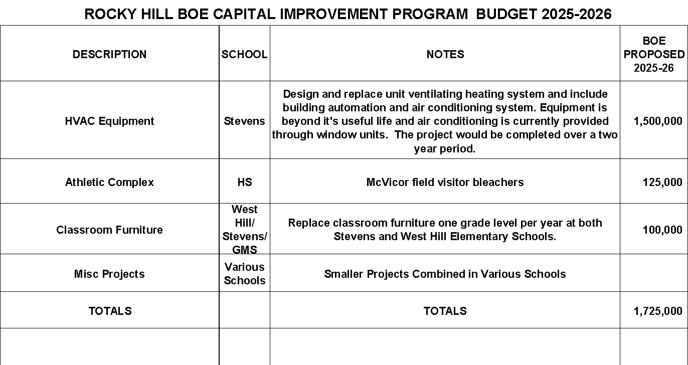
Capital Improvement Program Budget 2025-26

Slide 28
Rocky Hill Public Schools: Some Recent Highlights
West Hill School and Stevens School each recently designated by the Connecticut State Department of Education as a “School of Distinction” based on high academic performance.
RHHS – Two students qualified for 2025 ARML National Math Competition at Penn State University. These two students are on Team Connecticut.
RHHS – Marching Band placed 1st in two regional band competitions - held at Cheshire HS and Bunnell HS. Marching Band has a robust membership of 59 students.
RHHS – Marching Band placed 6th overall in New England, and 12th at the national finals held at MetLife Stadium in New Jersey.

Slide 29
Recent Highlights, Continued
RHHS – Math Team placed third in the Capitol Region Math League and was ranked as the #2 small public high school at the state competition.
RHHS – Eleven students in the class of 2024 qualified for the Seal of Biliteracy high school diploma, 34 students took the test on 4/26/25, results pending.

Slide 30
Recent Highlights, Continued
Dream Cafe - Hugely Successful! Year one, $41,968 in revenue - a self-funded operation for consumables (food, beverages, supplies)
GMS – National Banner School for Special Olympics for 2025 (one of only five schools in the state - two in Rocky Hill including RHHS).

Slide 31
Recent Highlights, Continued
RHHS – 2024 Boys’ Cross Country - Class M State Champions
RHHS - 2024 Boys’ Cross Country - Brian Smith, Class M Individual State Champion
RHHS = 2024 Boys’ Golf - Tyson Asadorian, Division 2 State Champion
RHHS – 2024 Girls’ Basketball - State Semifinals in Class MM
RHHS – 2024 CCC Sportsmanship Award – Girls’ Tennis

Slide 32
Rocky Hill High School – Recent College Admissions CSDE, Most Recent Data 2023-24 Rocky Hill: 94.8% State of Connecticut: 88.4% (4-Year Grad Rate)
American University | Georgetown University | Gettysburg College
UMASS - Amherst | University of Saint Joseph | Santa Clara University
Yale University | University of Utah | Sacred Heart University
Connecticut College | Nichols College | Stonehill College
Trinity College – Dublin, IRL | Marist College | UCONN – Storrs
Coastal Carolina University | West Virginia University | Lehigh University
University of Notre Dame | University of Toronto | University of Rhode Island
Quinnipiac University | University of Tennessee | Bryant University
PENN STATE | University of Hawaii at Manoa | Saint Anselm College
Hofstra University | Springfield College | Clark University
Marist College | University of Hartford | College of the Holy Cross
Syracuse University | Central Connecticut State University | UMASS - Boston

Slide 33
2024-2025 Overall Budget Summary
2025-26 BOE Request | $56,141,771
2024-25 BOE Budget | $53,532,239
Overall Increase | $2,609,532 | 4.87%

Slide 34
Education Cost Sharing (ECS) Entitlements
& Returned Health Insurance Funds
The town receives grant funding from the state to support education via the Education Cost Sharing grant.
2024-25 2025-26 Increase
Rocky Hill Grant Amount/Projected $7,541,437 $8,574,212 $1,032,775
Source: Connecticut State Department of Education
Bureau of Fiscal Services
June 30, 2025: Estimated $1.6 million returning to Town following the close-out on CIGNA and transition to Anthem SPP

Slide 35

2025-26 BOE Budget
Continues to offer Rocky Hill with a high-quality school district at a significantly below average cost
Supports the Board of Education’s goal of providing all students with an outstanding education
Respectful to Taxpayer
High Quality Education

