Slide 1


Huntington Middle School
Annual Title I Parent Meeting
Tuesday, August 25, 2026 5:00PM

Slide 2
Huntington Middle School Administrators
Dr. Marlon J. Robinson, Principal
Dr. Torris Woolfolk, Asst. Principal for Discipline
Mrs. Stephanie Wilson, Asst. Principal for Instruction
Mrs. Tamara Wildes, Asst. Principal for Instruction

Slide 3
Huntington Middle School Counselors
Ms. Ronda Robert - All 7th Graders & ½ of 6th Graders
Ms. Sonja Gibson - All of 8th Graders & ½ of 6th Graders

Slide 4
School Vision and Mission
Vision
  To become an institution that produces students who are academically, emotionally, and socially prepared to succeed in all facets of life.
Mission
  In partnership with students, parents, and the community, is committed in thoughts, words, and deeds to empower our students to become lifelong learners, and productive, responsible citizens.

Slide 5
What is a Title I school?
Title I of the Elementary and Secondary Education Act of 1965 (20 U.S.C. 6301 et seq.) is amended to read as follows:
  Title I: Improving the Academic Achievement of the Disadvantaged
Title I funds aim to bridge the gap between low-income students and other students. The U.S. Department of Education provides supplemental funding to local school districts to meet the needs of at-risk and low-income students.
Title I is the nation’s oldest and largest federally funded program, according to the U.S. Department of Education.

Slide 6
How does our School Spend Title I Money?
Instructional Supplies
Technology
Professional Development
Personnel
  Family Engagement Liaison
  Academic Support

Slide 7

How does our school participate in the Title I program?
We follow all Federal and State Regulations as directed by Dana Morris, Houston County’s
Director of Federal Programs

Slide 8
What are our school’s Title I requirements?
Schoolwide Title I School
  Title I funds can be used with students
    Examples
      Math and ELA Instructional Resources
      Professional Learning for staff
      Consumable supplies (paper, notebooks, pencils)
      Personnel
  Report School Status to Parents
  Provide Opportunities for Parental Capacity Building
  Maintain Highly Qualified Staff

Slide 9

Huntington Middle Schoolwide Goals
To have 50 % of the lowest 25% of students reading at or above the appropriate grade level Lexile by May 26, 2027. Monitoring will take place three time during the school year.
To have 50 % of the students meet or exceed grade level targets in all academic content areas.
Notes:
We will pilot this new parent teacher conference with one 6th grade team and one 8th grade team.

Slide 10
HMS Student Programs/Supports
HMS Schoolwide Program
Use of Assessments
  Formative and Summative Assessments
Professional Learning for Staff
Reading and Writing Across the Curriculum
Response to Intervention (RTI)
Positive Behavior Interventions and Supports (PBIS)
Technology

Slide 11
What curriculum does our school use?
GA Standards (GS)
  Math
  ELA/Reading
  Science
  Social Studies
For additional information: https://case.georgiastandards.org

Slide 12
Student Assessments
Local assessments
  Formative Assessments Daily and Weekly
  Summative Assessments
  MAP Assessment
State Assessments
  Grades 6 & 7 End of Grade (EOG) in ELA and Math
  Grade 8 EOG in ELA, Math, Science and Social Studies
  ACCESS for English Language Learners

Slide 13
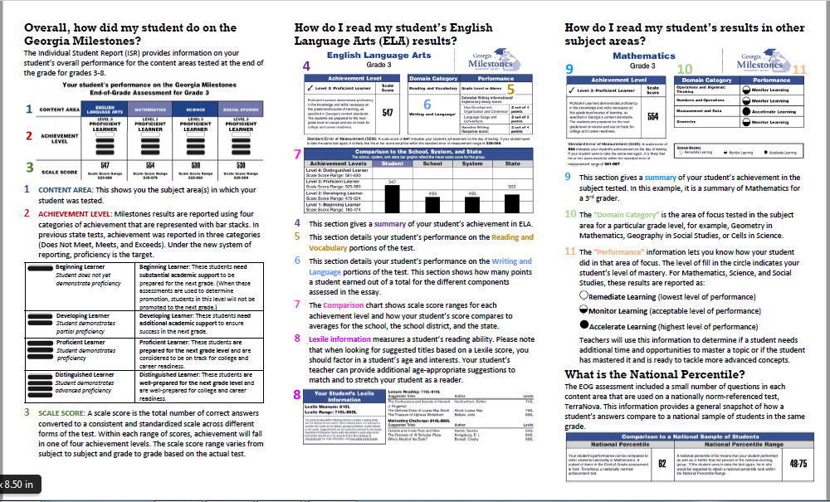
Measuring Student Progress

Slide 14
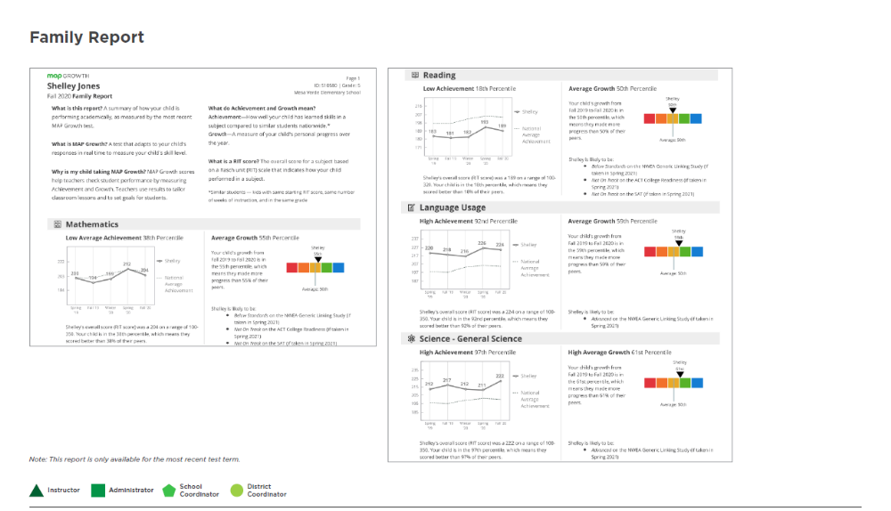
MAP Scores Family Report

Slide 15
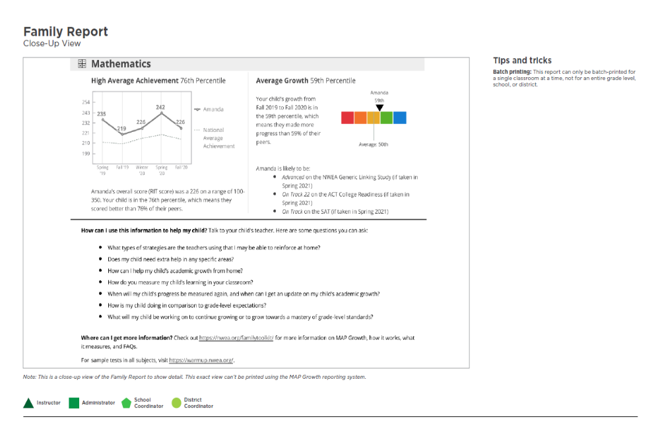
MAP Scores Family Report cont

Slide 16


Slide 17
Title I Parent Engagement Plan
What is required by Law for Parent Engagement
The Parent Engagement Plan
  Details how we will provide ongoing Capacity Building opportunities for our Parents to assist in their support of student academic achievement
  Includes a variety of ways that we will encourage Parent Engagement to include, opportunities for parents to assist in the planning and participating in activities and events to promote student learning at school and at home.
Notes:
These policies will be uploaded to our district and school websites.

Slide 18
School-Home Compact
The Compact
  Is an agreement that parents/guardians, teachers, and students develop together which explains how all stakeholders will work together to make sure all students achieve academic success
  Will be referenced throughout the school year in the Learning at Home process and Parent-Teacher Conferences

Slide 19
Parent Engagement cont.
The Family-School Engagement Plan and Compact will be distributed in our Title I Parent Handbook, available on our website, in our main office and Parent Resource Center.
The District Parent Engagement Plan is available on the district website @ www.hcbe.net
These documents are reviewed and updated with all stakeholder’s input at family events and activities. All stakeholders are invited to provide their thoughts at anytime to Rhondrea Davis (Allen), FEL rhondrea.allen@hcbe.net
478-542-2240 ext. 1910

Slide 20
Highly Professional Teachers and Parent’s Right to Know
Highly Professional
  The definition of “highly qualified” was established for teachers of core academic subjects
  All teachers of core academic subjects must have met the federal requirements regarding the highly qualified status
  HMS staff is 100% highly qualified under the guidelines of Title II-A
Right to Know
  The Elementary and Secondary Education Act of 1965 (ESEA) gives you the “right to know” about the qualifications of your child’s teachers and paraprofessionals including their training and credentials
  We are happy to provide this information to you and will do so at your request, as quickly as possible.

Slide 21
What opportunities does the school provide for parent involvement?
Capacity Building Parent Events
    Coordinate various opportunities for Parents/Guardians to:
      Appreciate and understand what their children are learning
      Work with their children to improve their academic achievement
      Receive information on GPS
      Monitor their child’s progress and work with educators to improve the achievement of their children
      Understand State and Local Academic Assessments and how parents can use assessment results to support their children

Slide 22
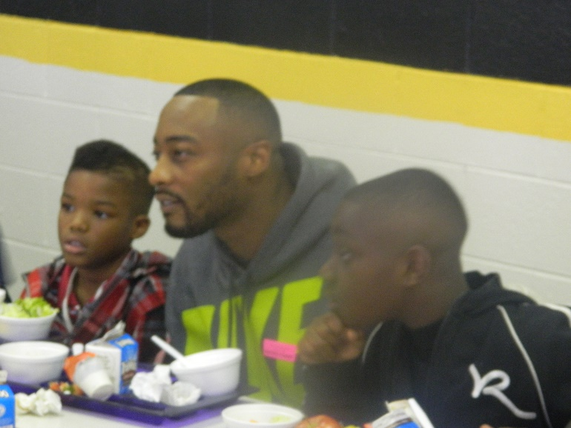

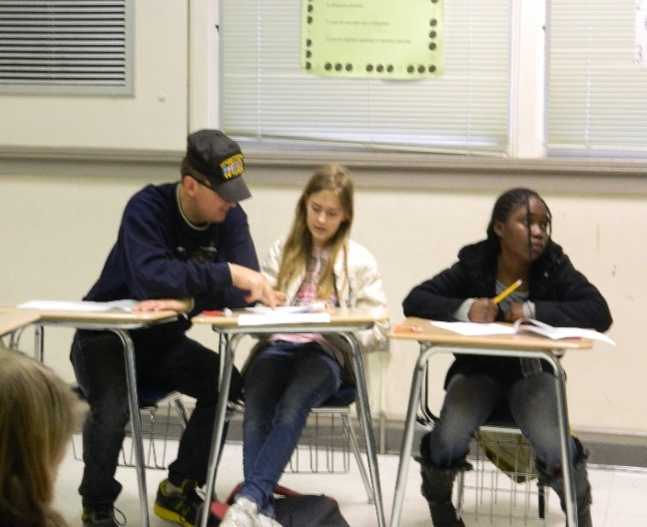

Volunteer Opportunities
  Mentors
  Fundraisers
  Media Center
  Guest Speakers
  Career Days
  Field trips
  Clerical Assistance
  Community Outreach

Slide 23
Parent’s Shared Decision Making Opportunities
Action Team for Partnership~Parent Forum
School Council Meetings
Title I Survey (fall and spring)
Document Revisions
  School-wide Plan
  School-Home Compact
  Parent Involvement Plan
Teacher-Parent Conferences

Slide 24
Parent Resource Center
Visit our Parent Resource Center
Located in the Front Lobby
Monday-Friday 7:30am – 3:30pm
    Tutoring Info
    Resource Guides
    Insightful articles
    Parenting Guides
    School & Community event information
    College and Career Readiness
    Transitions
Parent Engagement Program
State and Federal Parent Involvement Resources
Computer w/internet available for your use

Slide 25
How responsive will the school be to my questions when staff is contacted?
Response within 24 hours
HMS Staff Contact Information
Staff members have email links on the HMS Web Page
E-mail addresses: firstname.lastname@hcbe.net
Parents can leave a message through the school office

Slide 26
Liaisons & Connections
The McKinney-Vento Act requires schools to educate homeless children: Patricia Lane
The Houston County School System offers a Spanish-speaking liaison for families: Dalymarie Torres-Gonzalez and Roslyn Rodriguez
School Social Worker: Kali McCalvin
Migrant Education: Aricelli Ulmer

Slide 27
Local Board Policy: Requirements
House Bill 250 states that each local board of education shall adopt a policy that prohibits bullying of a student and shall require such prohibition to be included in the student code of conduct for schools in that system.
Each Student Code of Conduct shall also contain provisions that address any off-campus behavior.
Cell phones
BOE sites and computer communication
Any teacher or other school employee who has reliable information that would lead a reasonable person to suspect that someone is a target of bullying shall immediately report it to the principal.
Notes:
Now I would like to talk about Bullying. House Bill 250 states that each local Board of Education shall adopt a policy prohibiting bullying of a student and requires the policy to be included in the Student Code of Conduct.
The Student Code of Conduct also contains provisions that address any off-campus behavior through cell phone and computer communication.
Any school employee who has reliable information to suspect that a student is a target of bullying is required to immediately report it to the principal.

Slide 28
What is Bullying…. in Georgia
Any willful attempt or threat to inflict injury on another person, when accompanied by an apparent present ability to do so.
Any intentional display of force that would give the victim reason to fear or expect immediate bodily harm.
Notes:
What is Bullying? In the state of Georgia Bullying is classified as:
1. Any willful attempt or threat to inflict injury on another person, when accompanied by an apparent present ability to do so. And
2. Any intentional display of force that would give the victim reason to fear or expect immediate bodily harm.

Slide 29
What is Bullying (continued)
3. Any intentional written, verbal or physical act, which a reasonable person would perceive as being intended to threaten, harass, or intimidate.
THAT…
  Causes another person substantial physical harm or visible bodily harm.
  Affects the student’s education.
  Is so severe, persistent, or pervasive that it creates an intimidating or threatening educational environment.
  Has the effect of substantially disrupting the orderly operation of the school.
Notes:
And number 3 is :
Any intentional written, verbal or physical act, which a reasonable person would perceive as being intended to threaten, harass, or intimidate that causes another person substantial physical or visible bodily harm;
Affects the student's education;
Is so severe, persistent, or pervasive that it creates an intimidating or threatening educational environment;
And has the effect of disrupting the orderly operation of the school

Slide 30
What is Bullying (continued)
Bullying also involves acts which occur through the use of electronic communication, whether or not such electronic act originated on school property or with school equipment, if the electronic communication
is directed specifically at students or school personnel,
is maliciously intended for the purpose of threatening the safety of those specified or substantially disrupting the orderly operation of the school, and
creates a reasonable fear of harm to the student’s or school personnel’s person or property or has a high likelihood of succeeding in that purpose.
Electronic communication includes, but is not limited to, any transfer of signs, signals, writings, images, sounds, data, or intelligence of nature transmitted in whole or in part by a wire, radio, electromagnetic, photo electronic, or photo optical system.
Notes:
Bullying also includes acts through electronic communication or Social Media. Whether or not such electronic act originated on school property or with school equipment. If said communication is:
Directed specifically at students or school personnel
Is maliciously intended to threaten the safety of persons specified or disrupts the orderly operation of the school, and
Creates a reasonable fear of harm to the student or school personnel’s person or property
It is important to remember that electronic communication includes the transfer of signs, signals, writings, images, sounds, and photos

Slide 31
Mandatory Consequence
Acts of bullying shall be punished by a range of consequences through the progressive discipline process. Such consequences shall include, at a minimum, counseling and disciplinary action as appropriate under the circumstances. However, Georgia law mandates that upon a finding by the disciplinary hearing officer, panel or tribunal that a student in grades 6-12 has committed the offense of bullying for the third time in a school year, the student shall be assigned to an alternative school.
Notes:
Acts of bullying shall be punished by a range of consequences through the progressive discipline process. Consequences include, at a minimum, counseling and disciplinary action appropriate under the circumstances.
Georgia law mandates that upon a finding by the disciplinary hearing officer, panel or tribunal that a student in grades 6-12 has committed the offense of bullying for the third time in a school year the student shall be assigned to an alternative school.

Slide 32
2026-2027 Handbook Sign-off
All handbook sign-offs were due Friday, August 28, 2026.
Parents who have not complete the handbook sign-off may do so today in the Computer Lab, Room 401.
Students are ineligible to participate in field trips, extracurricular activities and/or athletics until the handbook sign-off process has been completed.

Slide 33
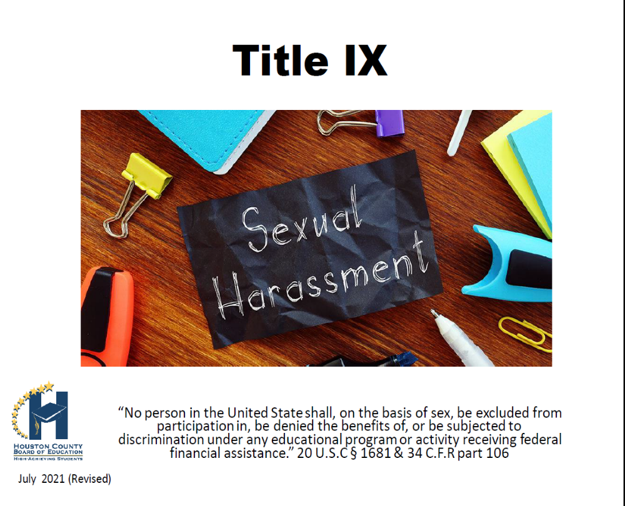

Slide 34
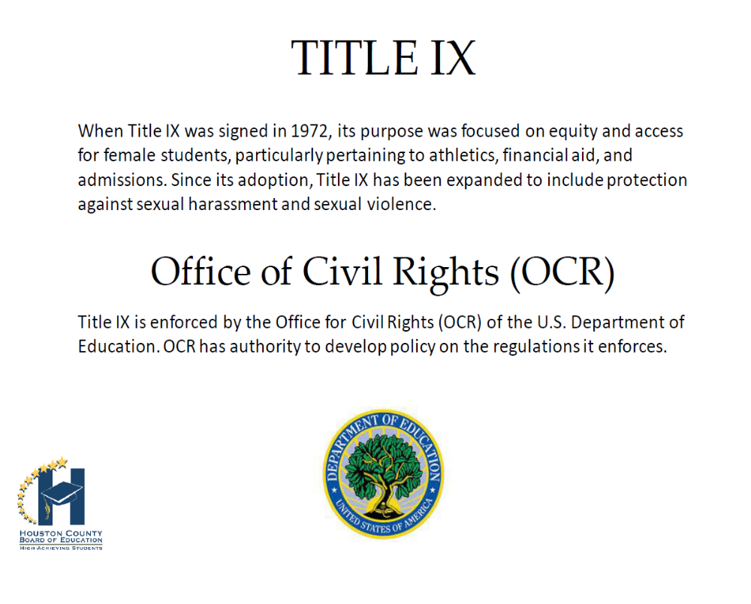

Slide 35
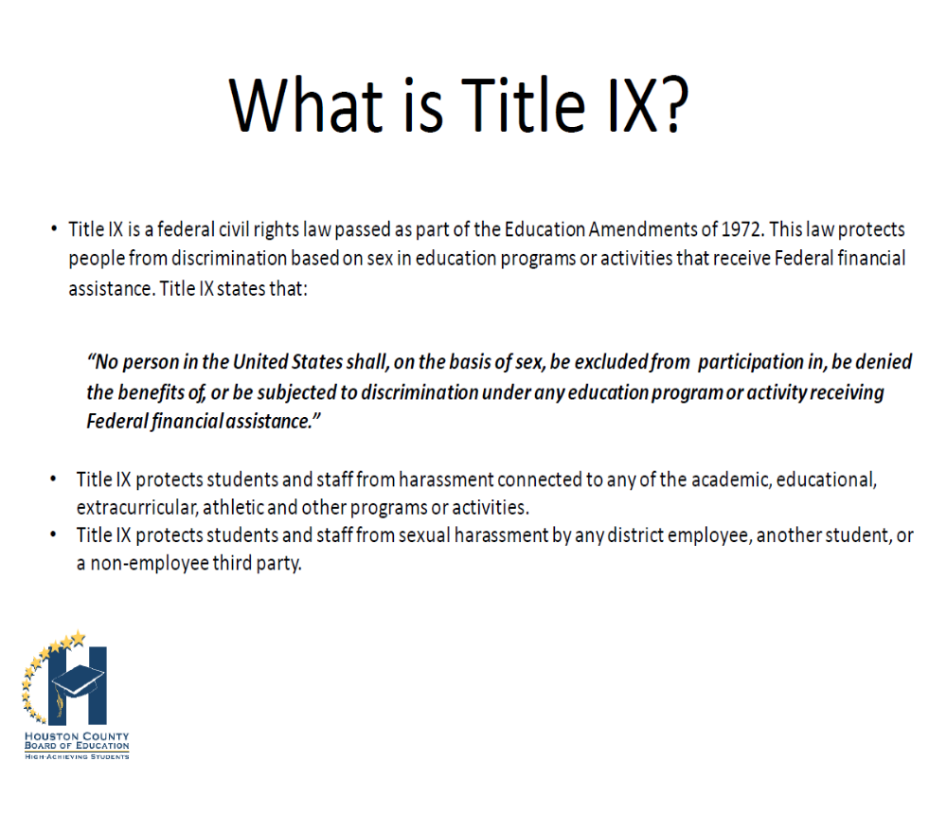

Slide 36


Slide 37
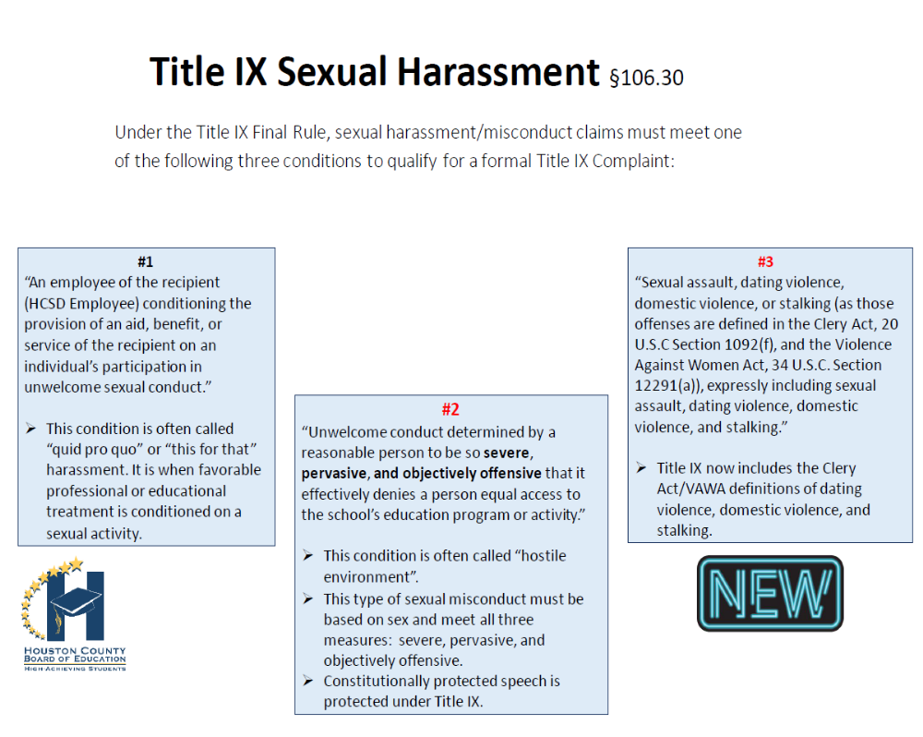

Slide 38
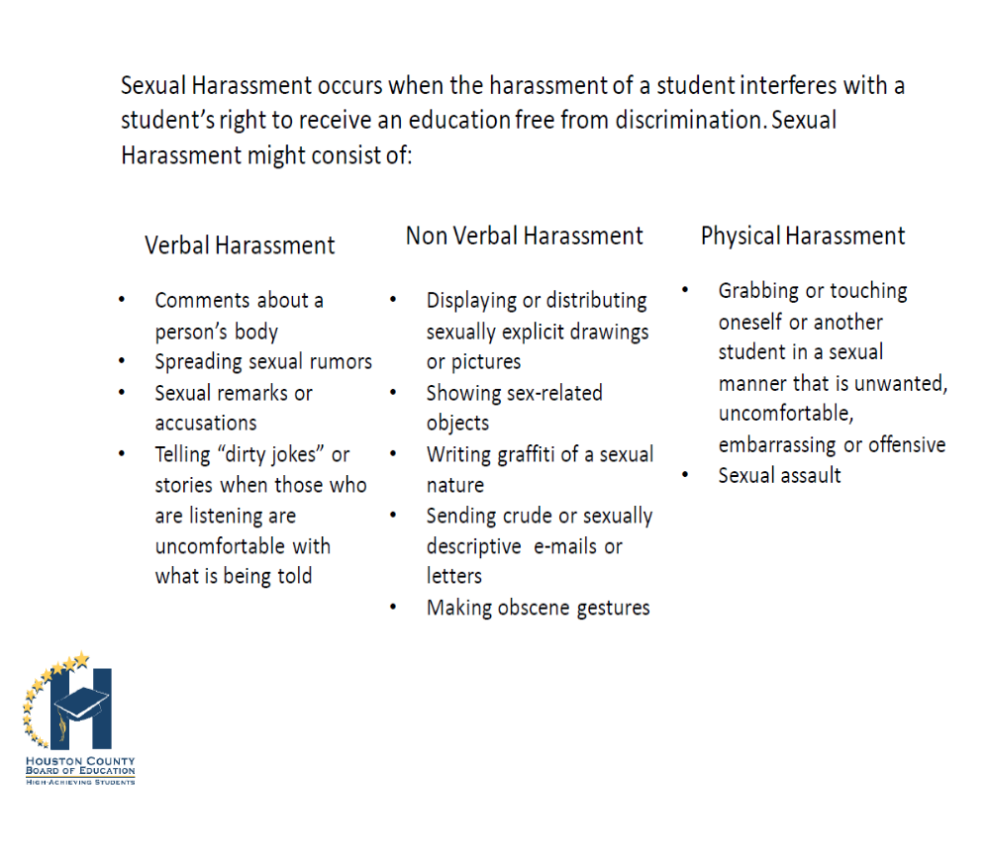

Slide 39
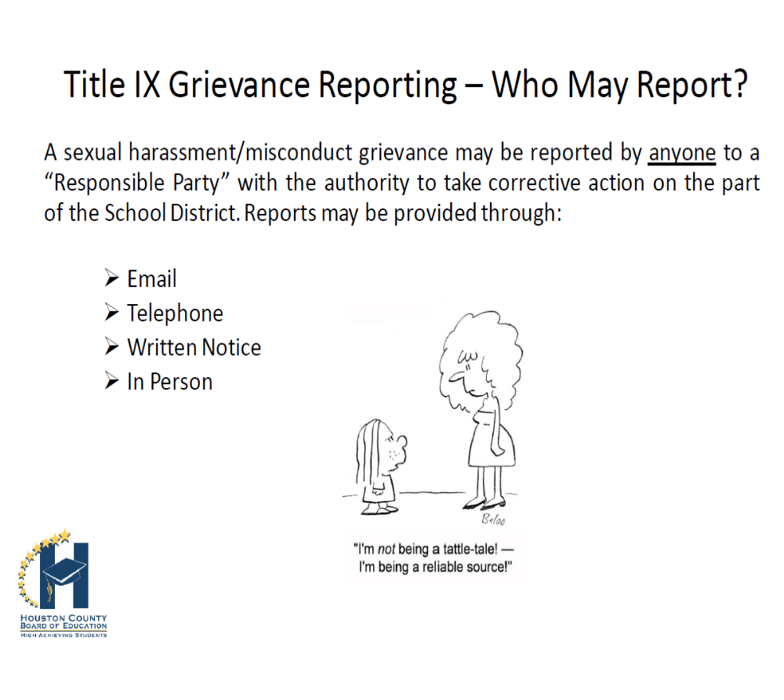

Slide 40



Conclusion
Each Adult Present with Student(s)
Please be sure to Sign In & complete our
Exit Survey

Slide 41

OPEN HOUSE
MIDDLE SCHOOL 101

Slide 42
Learning Objective
By the end of this lesson, you will be able help your student navigate middle school.

Slide 43
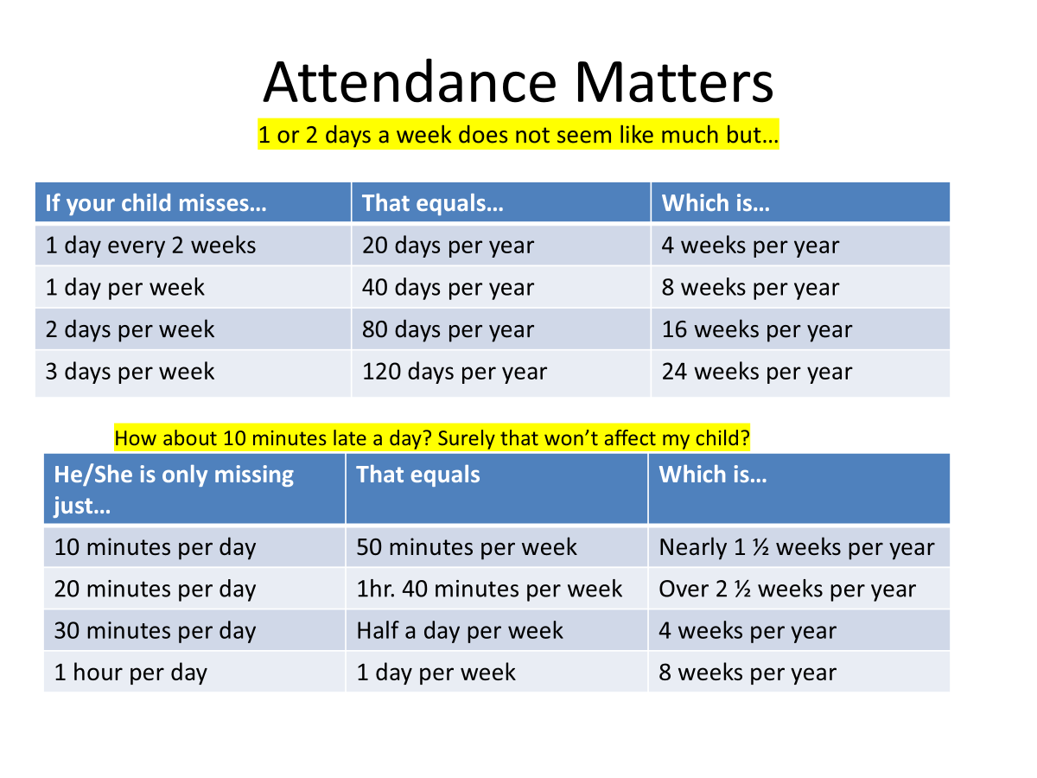
Attendance Matters
Quick
Fact
Absenteeism in the first month of school can predict poor attendance throughout the school year. Half the students who miss 2-4 days in September go on to miss nearly a month of school.

Slide 44




Dress Code

Slide 45



Social Media
•Sharing information and images via social media is a part of daily life for many children and teens. Social media allows kids to communicate with one another, and to document and share what they are doing in real time. But we must be aware of all the content and photos being shared. Our students need to think before they post.
•Posting information on social media has drawbacks such as the students teasing and taunting which then leads to getting into verbal and physical altercations, that most like problems at school.
•We want to make sure the students are safe from harassment and any other inappropriate content.

Slide 46
Reach Scholarship Opportunities
The Reach Scholarship is a mentorship and scholarship program that provides scholars with the academic, social, and financial support needed to graduate from high school, gain access to college and achieve post-secondary success. Upon successful completion of the program, qualifying students earn a $10,000 scholarship towards the cost of attendance at a HOPE-eligible postsecondary institution.
Eligibility Requirements
*Currently be a rising 8th grader
*Demonstrate and provide proof of financial need
*Be a legal U.S. Citizen
*Have good attendance and behavior
*At least a 2.5 GPA
*Have a crime and drug-free record
*Parental/Guardian support

Slide 47
Infinite Campus
Project Aware
HCSD Mobile App
Resources
LINDSEY SUPPORT CENTER
MALE MENTORING PROGRAMS
Teachers and school counselors

Slide 48

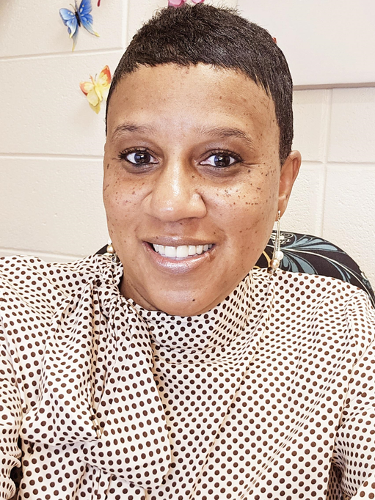
Contact Us
Mrs. Ronda Roberts
Mrs. Sonja Gibson
Mrs. Roberts serves the following students:
All 6th Grade Students
8th Grade- Aces & Diamonds Teams
Mrs. Gibson serves the following students:
All 7th Grade Students
8th Grade- Legend & Diamonds Teams
Contact Information:
ronda.roberts@hcbe.net
478-542-2240 ext. 1904
Contact Information:
sonja.gibson@hcbe.net
478-542-2240 ext. 1908

Slide 49


Lexile: Understanding Reading Measures

Slide 50


What is the Lexile Framework?
An educational tool that educators use to link texts and readers under a common metric known as Lexile
Allows educators to assess both the reading ability of a students and the complexity of the text.
Most commonly-used reading measure.
  Over 19 million students receive Lexile scores through commercial and state assessments
  Over 100,000 books and tens of millions of articles have Lexile measures
Reading Ability
Text Complexity

Slide 51

How Does Knowing My Lexile Help?
Personalized reading
  Be sure students don’t read more than 50L measures below their levels and more than 100L measures above their levels.
Monitor your growth
Preparedness

Slide 52
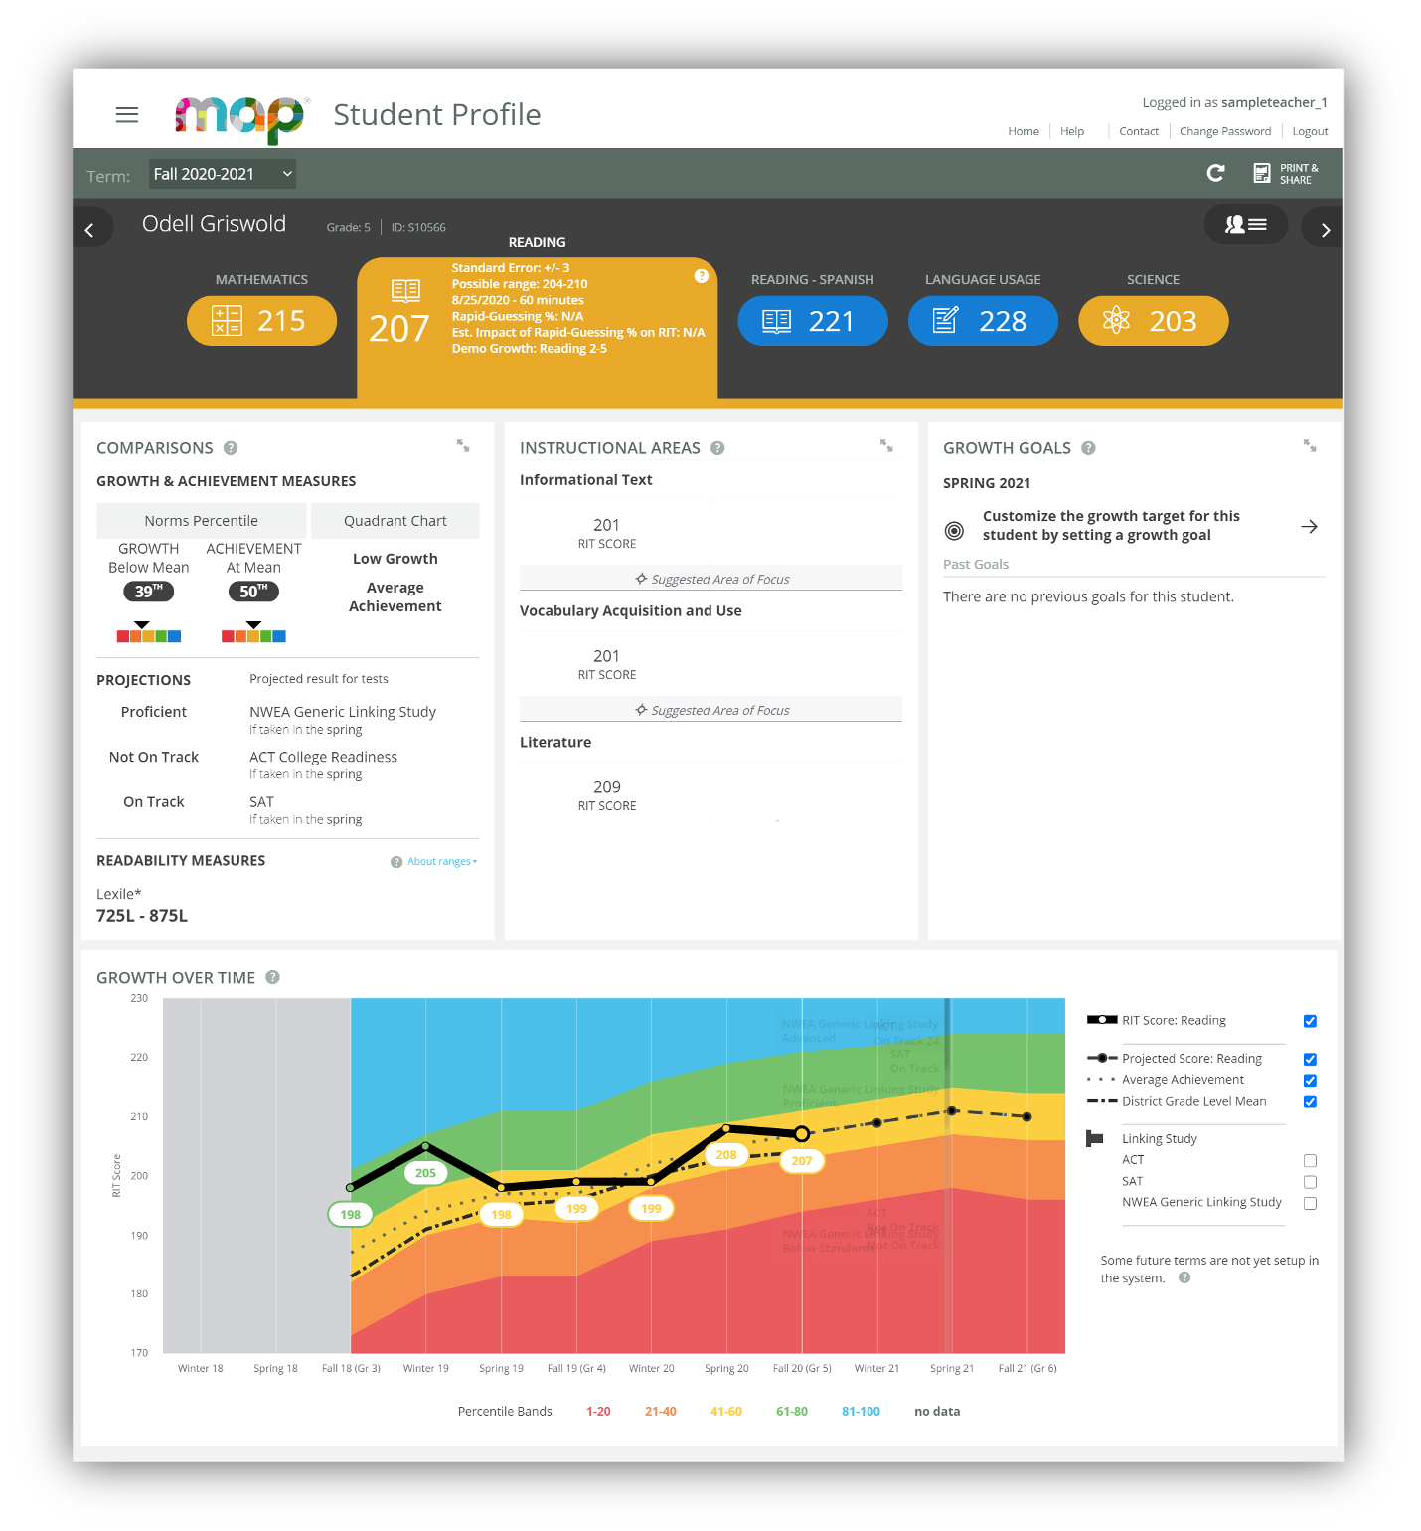
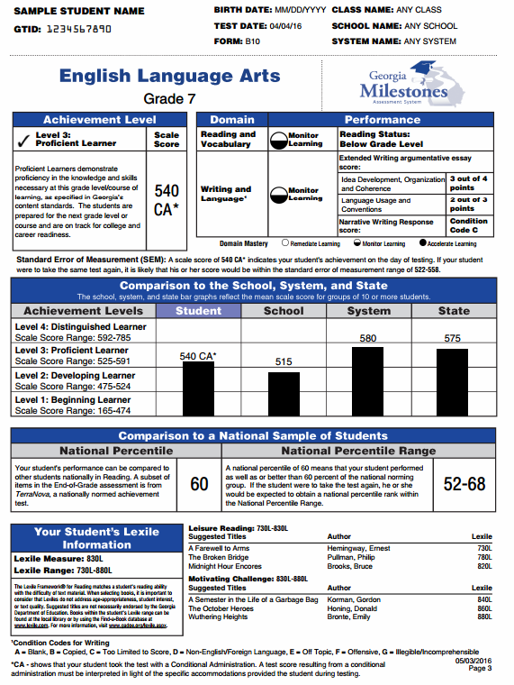
Finding My Child’s Lexile Score:
MAP ASSESSMENT
Teachers provide parents with individual student reports that contain Lexile scores.
Measure of Academic Progress
Georgia Milestones
GEORGIA
MILESTONES

Slide 53
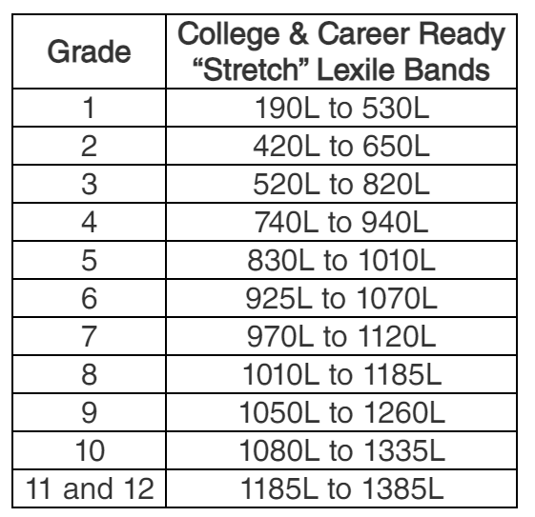
Lexile Stretch Bands
These grade and Lexile bands are the basis for determining at what text complexity level students should be reading—and at which grades—to make sure they are ultimately prepared for the reading demands of college and careers.

Slide 54

How Can I Help My Student Reach Their Reading Goal?
Know your child’s Lexile measure and ensure they are reading between those levels.
  Be sure students don’t read more than 50L measures below their levels and more than 100L measures above their levels.
Encourage your child to read for 25-30 minutes at home.
Encourage progress and track improvements.
Celebrate your child’s reading accomplishments.

Slide 55







READ EVERYDAY!

Slide 56
Resources
GADOE- https://www.gadoe.org
Lexile Stretch Bands: https://hub.lexile.com/lexile-grade-level-charts/

