Slide 1
PUBLIC MEETING FOR TAXES PAYABLE IN 2022
Presented for Jackson County Central ISD 2895
Maria Bezdicek, Business Manager
Barry Schmidt, Superintendent
December 5th, 2022

Slide 2
Agenda Factors Affecting Taxes
Big Picture
Your Property Classification and Value
School District Factors Affecting Pay ’23
Putting it All Together and Questions

Slide 3
Big Picture

Slide 4
Why have a Truth in Taxation Meeting?
Truth in Taxation Law, passed in 1989
Two major requirements:
Tax Statements Counties must send out proposed property tax statements in November based on proposed tax levies set by all taxing jurisdictions (counties, cities, townships, school districts, etc.)
Public Hearing Most taxing jurisdictions must hold a public hearing prior to certifying the final levy and discuss:
Payable 2023 levy
Fiscal year 2023 budget
Public comments
This is the school district’s annual required hearing

Slide 5
Who sets the School Levy?
Components of a District Tax Levy are either:
Set By State Formula By Legislature
General Education Formula, Operating Capital, Career & Technical, Reemployment, etc.
Voter Approved as Authorized by the State
Operating Referendum or Building Bonds

Slide 6
Background on Property Tax Levies

Slide 7
PROPERTY TAX BACKGROUND
Includes taxes for cities, townships, counties and schools where the property is located
Each jurisdiction sets its own levy and follows specific limits set by state law
County sends out the bills, collects the taxes and distributes revenue back to each jurisdiction
Key steps in the process are summarized on the next slides

Slide 8
How is my property tax determined?

Slide 9
FACTORS THAT CAUSE PROPERTY TAX CHANGES
● Voter approved referendums
● Changes in enrollment
● Legislative changes
● Changes in market values
● Changes in class rates/history

Slide 10
State Aid Impact
(Data source, MN Department of Management and Budget-Price of Government, 2022)
Notes:
In FY 2022, of all payments Minnesotans made in taxes, fees and charges, the state collected 62 percent. Counties, cities, and townships collected about 30 percent, while school districts collect about 8 percent. However, once intergovernmental aids are considered, the state spent only 36 percent of the total while non-school local governments spent 37 percent, and school districts spent 27 percent.

Slide 11
LEGISLATIVE CHANGES THAT AFFECT THE 2022 LEVY
Long Term Facility Maintenance (LTFM)
Increased Education Formula
Simplified Categories

Slide 12
LEGISLATIVE CHANGES THAT AFFECT THE 2022 LEVY
Added Long Term Facilities Maintenance Revenue for FY17
Based on Commissioner’s School Facilities Working Group recommendations
Reduces disparities in opportunities to fund costs of facilities maintenance projects
A 10-year, board approved plan is required to receive revenue
Replaces the health & safety and deferred maintenance revenue programs
FY22 : 2.45% ($6728) FY 23: 2% ($6863)
Notes:
Our Current LTFM Dollars : Just under $480,000. per year: We will get less once the new building is built: Small Decrease!

Slide 13
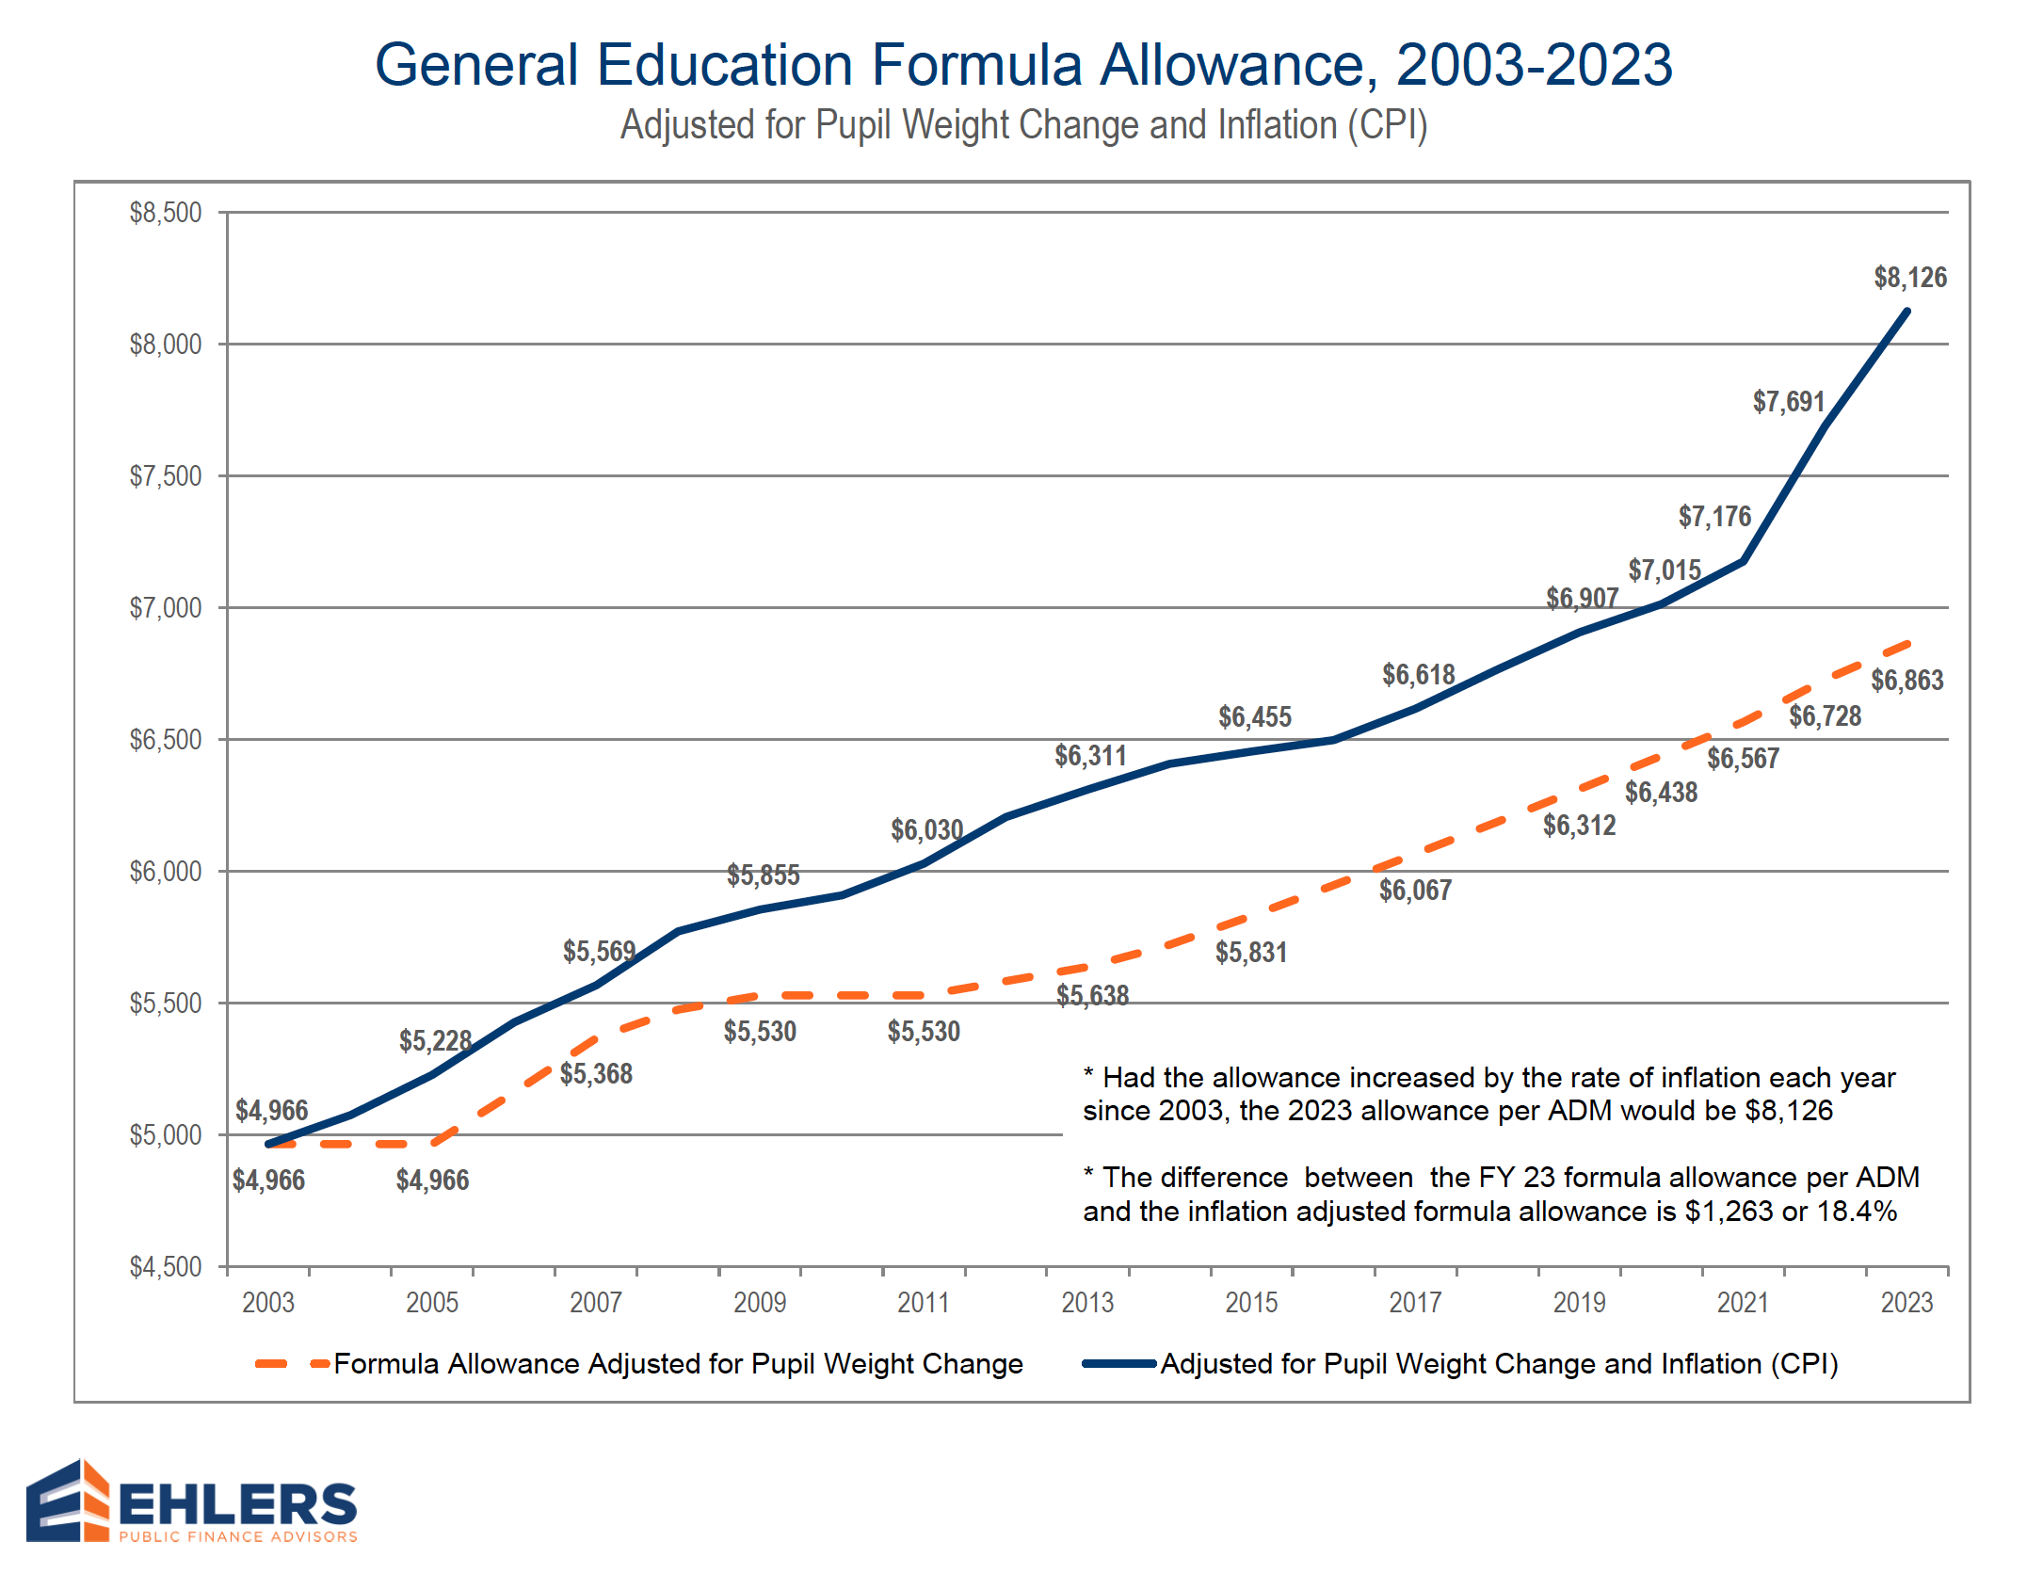
Funding trails inflation by $1263 per pupil since 2003
Notes:
This shows that your General Education Formula Allowance has been increasing but is not keeping up with inflation.

Slide 14
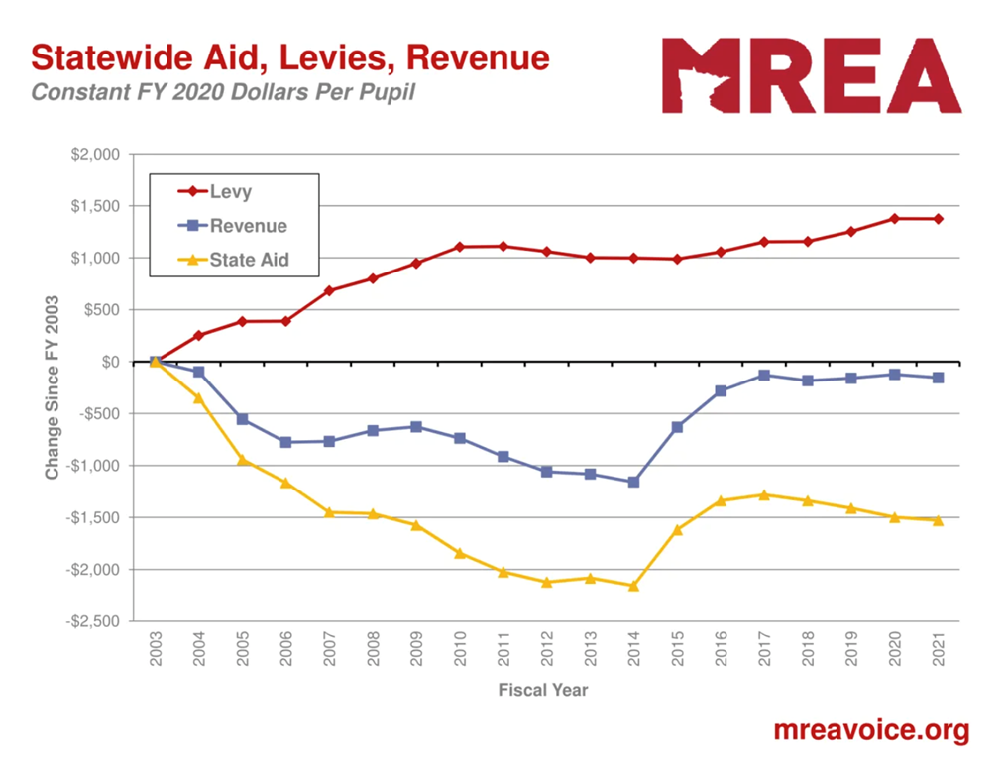
Notes:
All we have done is get back to an inflation neutral position, and notice it falls off because only zero and zero are forecasted in the state budget every biennium.

Slide 15
SIMPLIFYING CATEGORIES
Operating Referendum Revenue now 100% Voter Approved
$300 Op Ref revenue transferred to LOR beginning in Pay ’20, Op Ref Revenue reduced $300
Local Optional Revenue now 100% School Board Authorized up to $724 per pupil
No tax impacts from the change
Notes:
All Op Ref amounts reduced including Tiers for equalization and caps.

Slide 16
Ag2School Tax Credit
Permanent law enacted in 2017
Affects all existing Fund 7 debt levies, except OPEB bonds
Reductions for farmers and timber owners
Scheduled to scale to 70% in 2023
The revenue for Ag2School comes from state income, sales and other tax revenue

Slide 17
Increase in Pay 2023 70% Ag Tax Credit on Bonds
Payable Year | Percent Increase | Total Credit Percent
2021 | 5% | 55%
2022 | 5% | 60%
2023 | 10% | 70%
Notes:
Ag2School was part of the 2019 tax bill and the $650 billion 2017 Tax bill signed into law. It had been part of the 2016 tax bill which was vetoed by the Governor.
MREA had been working on a credit for farmland since 2015 along with a coalition of farm groups including the Farm Bureau, Farmers Union, Corn Growers, and Soybean Growers. This was a multi year, bipartisan effort.
This credit is on Ag land classified 2a, b, d, and privately owned timber land
Farm and Private Timber lands taxes went down in 296 school districts beginning in 2018
This is on all existing Fund 7 debt levies excluding OPEB bonds

Slide 18
BASIC EDUCATION FORMULA
Supreme Court in 1993 upheld right to “general and uniform system of education”
Led state to provide basic school funding:
100% of basic education formula
Using equalization factors for various property tax-supported formulas to provide basic education regardless of wealth
Since started in 2003, state funding for schools has not kept up with inflation.
Notes:
In fact, adjusted for inflation, the Basic Formula has lost over $600 in buying power since 2003, as can be seen next chart

Slide 19
Underfunding of Special Education
MDE reports the FY 2018 cost of providing special education programs was underfunded by $822 million, or an average of 40% underfunded
Primary options to bridge special education funding gap are to cut regular program budgets or increase referendum revenue, most districts have done both
Translating into a statewide average funding shortfall of $5,705 per special education
Underfunding of special education costs requires a transfer from regular program resources to support an underfunded program mandated by state and federal law

Slide 20
Result: Growing Dependence on Referendum Revenue
In 1992-93, 65% of districts had operating referendum revenue averaging $332 per pupil
For 2020-21, all Minnesota districts have referendum revenue and/or local optional revenue levy authority averaging $1,475 per pupil
JCC Operating and LOR is $1184 per pupil
Referendum revenue including Local Optional Revenue (LOR) provides 13.2% of General Fund operating revenue
Of this amount, $751 is a voter approved operating referendum, and $724 is Local Optional Revenue (LOR)

Slide 21
Property Classifications and Value

Slide 22
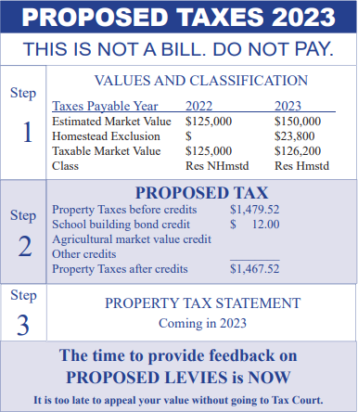
Know Your Valuation
Property classification and market value
Sent Spring 2022; cannot change value
Watch for 2023 statement in SPRING and where to appeal
Notes:
Taxpayers may come to the meeting and want to have a change in their taxes this year. This slide shows the process. To change taxation, they need to do it in the spring of the year when the valuation notice comes out. Most local and county appeals take place in April, May, June after the notice is given out.

Slide 23
Effective Tax Rates
Property Classification Rates set in statute by Legislature and Governor and result in range of Effective Tax Rates:
Property Classification | 2022 Estimate
Farm | 0.54%
Seasonal Rec | 0.95%
Residential Homestead | 1.22%
Apartment | 1.56%
Public Utility | 2.82%
Commercial-Industrial | 3.17%
(Source:Tim Strom,Jared Swanson House Research)
Notes:
The Effective Tax Rates are statewide averages of the property classification. Note that Farm is among the lowest, and Commercial Industrial is the highest rate. So, in general farmers are getting a break relative to the value of their property.
Even at a lower rate, increases in value translates to higher property taxes. You multiply the Market Value of a property by its Effective Tax Rate to get its Net Tax Capacity (NTC).

Slide 24
Share of Tax Liability
Property Classification | Market Value Share (2021 Assessment) | Share of Net Taxes (Payable in 2022)
Farms | 17.1% | 6.6%
Seasonal Rec Residential | 3.9% | 2.6%
Commercial and Industrial | 13.9% | 31.1%
Residential Homes | 58.5% | 52.1%
Other Residential | 6.6% | 7.6%
(Source: Tim Strom- House Legislative Analyst )
Notes:
You can see the dramatic difference classification make. The two biggest disparities are Farms(farms are productive ag land) and Commercial and Industrial. Commercial has a 13.9% of the market share but pays 31.1% of the taxes. On the flip side Farms have 17.1% of the market value but pay only 6.6% of the taxes.
This slide shows net property taxes paid to all jurisdictions- city, county, schools, townships.
The “Other Residential” category includes apartments, student housing (fraternities, sororities, etc.), and the land underneath manufactured homes located in manufactured home parks.

Slide 25
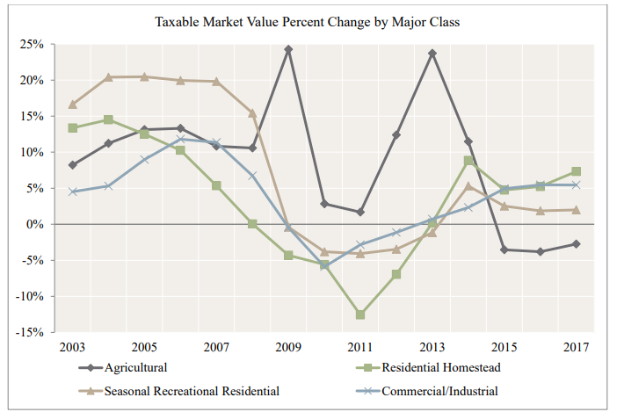
Impact on Your Tax Bill
MARKET VALUE CHANGES
Market values by property classifications trending in different directions
What’s happening statewide to your property tax classification?
(Source: MN Dept. of Revenue)
Notes:
After growing in value for 11 years, farm land has declined in value the last three years, but 5% or less each year. Residential homes, after declining in the Great Recession and losing taxable value due to the exclusion in 2011, have been growing the fasted in value statewide of these four major categories of property value.
County Assessors are required to do 12 and 18 month sales studies of recorded sales and apply the changes to the values of property in that classification in their county. This is how Market Values Change between visits to a property by a county appraiser. County Assessors are to stay within 90% of sales. Their valuation to actual sales ratio is called the Sales Ratio. The sales ratio is divided into the Net Tax Capacity (NTC) to get your Adjusted Net Tax Capacity (ANTC). ANTC is used on most school property tax formulas (the large exception is the operating referendum) to equalize the effects of County Assessor practices across the 87 counties of the state.
After surging for 19 years 2.5 times faster than residential values meant for levies on ANTC, more of the relative burden was shifting from town to farm, and the property tax wealth of the district for debt service and ANTC equalization is increasing for school districts in farm country. That means less state equalization aid and more local tax burden for previously passed bond referendums if equalization was present at the time of the election.
Ag values declined for the first time in twenty years from 2013 to 2016.
In 2011 residential homes dropped 12.7% in value, their largest one year decline. That was the year that the homestead exclusion replaced the homestead credit.

Slide 26
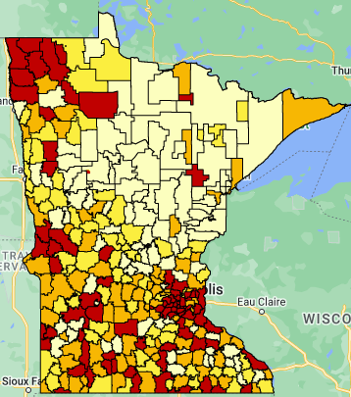
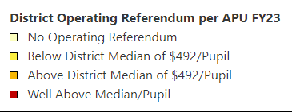
Referendum Picture
How does our district compare in Operating Referendum Revenue?
MNREA Maps (mreavoice.org)
Our District: $460 per APU
Median district: $492
Upper Quartile of Referendums>$990
94 districts: $0
Notes:
This data does not reflect the referendums elections passed this November 2022.
For interactive maps to look up your district open the link on the slide. The number on the left after you click on your district is you amount per pupil
For your Referendum authority look at line 202 for per pupil. Your total projected revenue would be line 203 on Page 4

Slide 27
Property Wealth Picture
How does our district compare in Referendum Market Value per Residential Pupil Unit?
MNREA Maps (mreavoice.org)
Our District: $409,890 per RPU
Median District: $507,593/RPU
Notes:
Click on the titles to go to interactive maps to look up your district and others.
For your RMV/RPU: Levy report line 233 p 5
Levy ratios for Tier 1 line 253, Tier 2 line 254 Pg 6. The aid is the inverse of the levy ratios
To go to interactive maps to look up your district and others. Click on the link in the slide . You may notice the numbers being slightly different on the map vs. MDE. MDE numbers were updated on Oct. 4th of 2022 the numbers MREA uses were from the latest forecast in Feb. 22. They should be close unless the RPU or RMV changed significantly for your districts
-Remember that this is a TNT for next year, so MDE uses FY24 RPU with 2021 Market values to get RMV/ RPU in their 2022 payable 23 Levy Limitation and Certification data

Slide 28
Information on School Funding & District Budget

Slide 30
JACKSON COUNTY CENTRAL
FUND BALANCE PROJECTIONS
September 27, 2022
9/27/2022 |  | Actuals | Actuals |  | Orig Budget | Orig Budget
 | FUND BALANCE | Revs & Transfers | Exp. & Transfers | FUND BALANCE | Revs & Transfers | Exp. & Transfers | FUND BALANCE
FUND | 7/1/2021 | 2021-22 | 2021-22 | 6/30/2022 | 2022-23 | 2022-23 | 6/30/2023
GENERAL UNAPPR. | $2,368,422.98 | $13,783,226.84 | $13,752,156.19 | $2,399,493.63 | $13,379,870.00 | $13,769,200.00 | $2,010,163.63
Student Activities | $73,564.22 | $114,466.46 | $151,430.19 | $36,600.49 | $77,600.00 | $93,250.00 | $20,950.49
Assigned funds-General | $62,637.75 | $96,957.36 | $95,166.01 | $64,429.10 | $0.00 | $5,000.00 | $59,429.10
Assigned funds-Cap. Out. | $21,342.26 | $28,000.00 | $6,205.85 | $43,136.41 | $0.00 | $30,000.00 | $13,136.41
Safe Schools | $33,247.25 | $46,710.72 | $43,597.33 | $36,360.64 | $45,800.00 | $17,000.00 | $65,160.64
Staff Development | $85,807.82 | $168,111.19 | $200,735.80 | $53,183.21 | $165,000.00 | $211,910.00 | $6,273.21
Integration | $0.00 | $113,914.62 | $113,914.62 | $0.00 | $99,800.00 | $79,320.00 | $20,480.00
Third Party Pay | $0.00 | $92,460.23 | $44,607.53 | $47,852.70 | $40,000.00 | $45,390.00 | $42,462.70
Long Term Facilities | $276,304.50 | $490,374.40 | $277,915.20 | $488,763.70 | $461,300.00 | $464,000.00 | $486,063.70
Learning & Dev. | $0.00 | $244,914.61 | $236,389.95 | $8,524.66 | $240,000.00 | $344,560.00 | ($96,035.34)
Basic Skills-Ext. Year | $25,231.67 | $0.00 | $9,199.91 | $16,031.76 | $0.00 | $5,000.00 | $11,031.76
Capital Outlay | $272,655.43 | $287,456.41 | $199,825.23 | $360,286.61 | $304,500.00 | $205,000.00 | $459,786.61
GENERAL FUND BAL. | $3,219,213.88 | $15,466,592.84 | $15,131,143.81 | $3,554,662.91 | $14,813,870.00 | $15,269,630.00 | $3,098,902.91
Food Service Fund | $401,496.60 | $1,096,583.34 | $956,852.65 | $541,227.29 | $700,000.00 | $809,900.00 | $431,327.29
Comm. Ed. Unappr. | $24,252.96 | $32,792.49 | $53,150.93 | $3,894.52 | $50,000.00 | $59,790.00 | ($5,895.48)
Comm. Ed. Appr. | $44,600.50 | $444,739.56 | $373,145.26 | $116,194.80 | $380,090.00 | $374,590.00 | $121,694.80
ECFE | $9,048.97 | $57,673.00 | $67,044.29 | ($322.32) | $58,500.00 | $76,140.00 | ($17,962.32)
Learning Readiness | $15,907.61 | $151,341.78 | $208,304.22 | ($41,054.83) | $144,830.00 | $154,050.00 | ($50,274.83)
Swimming Pool | $37,574.81 | $189,108.15 | $181,985.24 | $44,697.72 | $182,500.00 | $186,600.00 | $40,597.72
Community Ed Fund | $131,384.85 | $875,654.98 | $883,629.94 | $123,409.89 | $815,920.00 | $830,370.00 | $88,159.89
Debt Redemption | $432,928.97 | $2,363,409.43 | $2,377,987.50 | $418,350.90 | $2,135,000.00 | $2,123,000.00 | $430,350.90
TOTALS | $4,185,024.30 | $19,802,240.59 | $19,349,613.90 | $4,637,650.99 | $18,464,790.00 | $19,032,900.00 | $4,048,740.99

Slide 31
BUDGET INFORMATION
All school districts’ budgets are divided into separate funds, based on purposes of revenue, as required by law.
Our district currently has 5 funds
General Fund
Food Service Fund
Community Service Fund
Debt Service Fund
Building Fund

Slide 32
2021-22 Actual Revenue and Expense
 | FY 22 Beginning Balances | FY 22 Revenues | FY 22 Expenses | FY 22 Ending Balance
General Fund-Restricted, Committed , Assigned | 857,228 | 1,539,549 | 1,764,553 | 632,224
General Fund-Other | 2,278,083 | 13,927,044 | 13,366,591 | 2,838,536
Food Service | 401,497 | 1,096,583 | 956,853 | 541,228
Comm Ed | 131,386 | 875,655 | 883,630 | 123,411
Debt Service | 432,929 | 2,363,409 | 2,377,988 | 418,351
Building Fund | 29,023,226 | 253,932 | 18,398,809 | 10,878,349
TOTALS | 33,124,349 | 20,056,173 | 37,748,423 | 15,432,099

Slide 33
2021-2022 Revenue by Source

Slide 34
Referendum Market Values 2006-2020
for the JCC School District
Notes:
This information is provided by the MN Dept of Revenue
Referendum Market Value means-the market value of all taxable property except seasonal rec and ag (except for ag homestead-house, garage and 1 acre)-MN Statute 126C.01
Referendum aid/levy breakdown is based on referendum market value, so a higher amount means more levy and less state aid.
The referendum market values for the JCC district as has gone from
272,884,350 in 2005 to $581,329,640 in 2019
This is an increase of $308,445,290 45%

Slide 35
2021-2022 Revenue by Fund

Slide 36
2021-2022 Expenditures by Program

Slide 37
Comments & Questions

