Slide 1
Miss Myers
August Assessments
SUNDAY | MONDAY | TUESDAY | WEDNESDAY | THURSDAY | FRIDAY | SATURDAY | NOTES
Strive for progress, not perfection. |  |  |  | 1 | 2 | 3 | Minor Grade
4 | 5 | 6 | 7 | 8 | 9 | 10
11 | 12 | 13 | 14 | 15 | 16 | 17
18 Unit 1 Lesson 1 (The Origami Master) | 19 | 20 | 21 Practice Comprehension Quiz and Reading Skills Test (1.1) | 22 | 23 Spelling Test (1.1) | 24
25 Unit 1 Lesson 2 (Little Havana) | 26 | 27 | 28 | 29 | 30 Comprehension Quiz & Spelling Test (1.2) | 31
August 2024

Slide 2
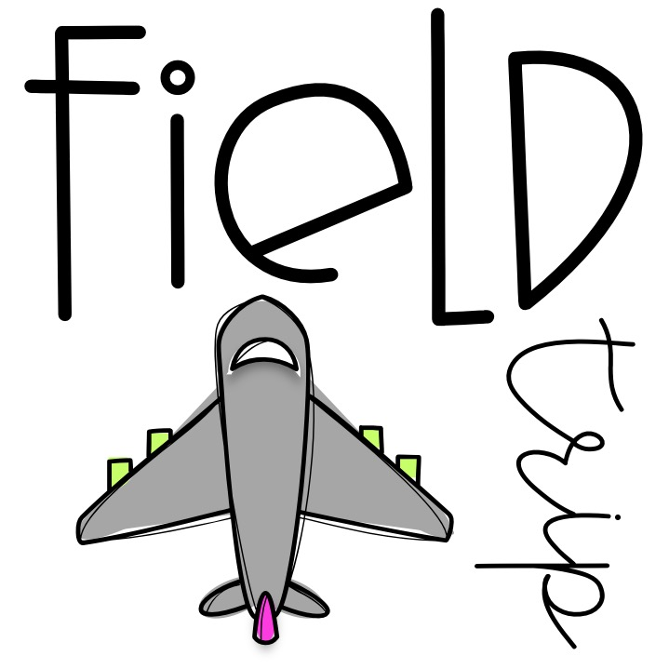
Miss Myers
September Assessments
SUNDAY | MONDAY | TUESDAY | WEDNESDAY | THURSDAY | FRIDAY | SATURDAY | NOTES
1 Unit 1 Lesson 3 (Damon and Pythias) | 2 | 3 | 4 | 5 | 6 Reading Skills Test& Spelling Test (1.3) | 7 | Major Grade Minor Grade
8 Unit 1 Lesson 4 (Bummer and Lazarus) | 9 | 10 | 11 | 12 | 13 Comprehension Quiz & Spelling Test (1.4) | 14
15 Unit 1 Lesson 5 (The Prairie Fire) | 16 | 17 | 18 | 19 Grammar Unit 1 & Oral Reading Fluency Unit 1.5 | 20 Reading Skills Test & Spelling Test (1.5) | 21
22 Teacher’s Choice (Unit 1 Lesson 6 The White Spider’s Gift) | 23 | 24 | 25 | 26 | 27 Lanark | 28
29 Unit 2 Lesson 1 (Storm Chasers) | 30 | The best way to predict your future is to create it. - Abraham Lincoln | A book is a dream that you hold in your hands.
September 2024

Slide 3
Miss Myers
October
Assessments
SUNDAY | MONDAY | TUESDAY | WEDNESDAY | THURSDAY | FRIDAY | SATURDAY | NOTES
I’m not telling you it’s going to be easy. I’m telling you it’s going to be worth it. - Art Williams |  | 1 | 2 | 3 | 4 Reading Skills Test Spelling & Dictation Tests (2.1) | 5 | Major Grade Minor Grade Altruismo’s Socktober Sock Drive October 1 - 25
6 Teacher Choice (Unit 2 Lesson 6 Einstein Anderson and the Hurricane Hoax) | 7 | 8 | 9 | 10 Opinion Writing Piece Completed (in class) | 11 | 12
13 Unit 2 Lesson 2 (Seasons of Change) | 14 | 15 | 16 | 17 | 18 Comprehension Quiz & Spelling Test (2.2) | 19
20 Unit 2 Lesson 3 (Tornadoes!) | 21 | 22 | 23 | 24 | 25 Reading Skills Test& Spelling Test (2.3) | 26 Miss Myers is getting married!
27 Teacher Choice (Halloween Activities) | 28 | 29 | 30 | 31
October 2024

Slide 4
Mrs. Couper
November
Assessments
SUNDAY | MONDAY | TUESDAY | WEDNESDAY | THURSDAY | FRIDAY | SATURDAY | NOTES
The best thing about learning is no one can take it away from you. - B.B. King |  |  |  |  | 1 | 2 | Major Grade Minor Grade House Can Food Drive November 18 - 22
3 Unit 2 Lesson 4 (Get the Facts) | 4 | 5 | 6 | 7 | 8 Comprehension Quiz & Spelling Test (2.4) | 9
10 Unit 2 Lesson 5 (Hot Enough to Fry an Egg) | 11 | 12 | 13 | 14 Grammar Unit 2 & Oral Reading Fluency Unit 2.5 | 15 Reading Skills Test& Spelling Test (2.5) | 16
17 Unit 3 Lesson 1 (A New Life for Mei) | 18 | 19 | 20 | 21 | 22 Reading Skills Test Spelling, & Dictation Tests (3.1) | 23
24 | 25 | 26 | 27 | 28 | 29 | 30
November 2024

Slide 5
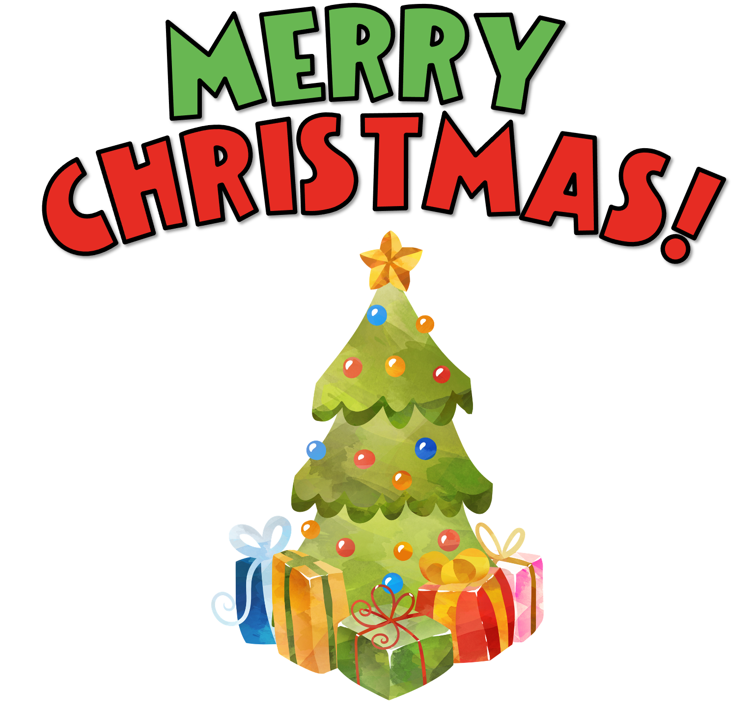
Mrs. Couper
December
Assessments
SUNDAY | MONDAY | TUESDAY | WEDNESDAY | THURSDAY | FRIDAY | SATURDAY | NOTES
1 Unit 3 Lesson 2 (The Harlem Renaissance) | 2 | 3 | 4 | 5 Comprehension Quiz & Spelling Test (3.2) | 6 Majestic C. | 7 | Major Grade Minor Grade Reveur’s Toy Drive December 2 - 13
8 Teacher’s Choice (Christmas Activities) | 9 Informative Writing Piece (Comp. in class) | 10 | 11 | 12 | 13 | 14
15 Teacher’s Choice (Christmas Activities) | 16 | 17 | 18 | 19 | 20 | 21
22 | 23 | 24 | 25 | 26 | 27 | 28
29 | 30 | 31 | You are the light that makes the season bright.
December 2024

Slide 6
Mrs. Couper
January
Assessments
SUNDAY | MONDAY | TUESDAY | WEDNESDAY | THURSDAY | FRIDAY | SATURDAY | NOTES
Mistakes are proof that you are trying. |  |  | 1 | 2 | 3 | 4 | Major Grade Minor Grade Amistad’s Love Box Donations January 6 - 24
5 Unit 3 Lesson 3 (The Overlanders) | 6 | 7 | 8 | 9 | 10 Reading Skills Test& Spelling Test (3.3) | 11
12 Unit 3 Lesson 4 (The Cherokee: Gold and Tears) | 13 | 14 | 15 | 16 | 17 Comprehension Quiz & Spelling Test (3.4) | 18
19 Unit 3 Lesson 5 (The Dancing Bird of Paradise) | 20 | 21 | 22 | 23 ORF Unit 3.5 | 24 Weekly Reading & Spelling Test (3.5) | 25
26 Unit 4 Lesson 1 (The Country / City Mouse) | 27 | 28 | 29 | 30 | 31 Weekly Reading Dictation, & Spelling Tests (4.1)
January 2025

Slide 7
Mrs. Couper
February
Assessments
SUNDAY | MONDAY | TUESDAY | WEDNESDAY | THURSDAY | FRIDAY | SATURDAY | NOTES
Do what you love and love what you do. |  |  |  |  |  | 1 | Major Grade Minor Grade Amistad’s Love Boxes Deliveries to Local Assisted Living Facilities Feb. 7
2 Unit 4 Lesson 2 (A Saguaro’s Story) | 3 | 4 | 5 | 6 | 7 Comprehension Quiz & Spelling Test (4.2) | 8
9 Teacher’s Choice (Valentine’s Day Activities) | 10 | 11 | 12 | 13 | 14 | 15
16 Unit 4 Lesson 3 (Einstein Anderson and the Mighty Ants) | 17 | 18 | 19 | 20 Reading Skills Test & Spelling Test (4.3) | 21 McWane | 22
23 Unit 4 Lesson 4 (Amazing Animals) | 24 | 25 | 26 | 27 | 28 Comprehension Quiz & Spelling Test (4.4)
February 2025

Slide 8
Mrs. Couper
March
Assessments
SUNDAY | MONDAY | TUESDAY | WEDNESDAY | THURSDAY | FRIDAY | SATURDAY | NOTES
Dare to be remarkable! |  |  |  |  |  | 1 | Major Grade Minor Grade Isibindi’s Coin Drive March 3 - 14
2 Teacher’s Choice (ACAP Test Prep) | 3 | 4 | 5 Narrative Writing Piece (Completed in class) | 6 | 7 | 8
9 ACAP Testing TBA | 10 | 11 | 12 | 13 | 14 | 15
16 ACAP Testing TBA | 17 | 18 | 19 | 20 | 21 | 22
23 | 24 | 25 | 26 | 27 | 28 | 29
30 Unit 4 Lesson 5 (Ecosystem Invd.) | 31
March 2025

Slide 9
Mrs. Couper
April
Assessments
SUNDAY | MONDAY | TUESDAY | WEDNESDAY | THURSDAY | FRIDAY | SATURDAY | NOTES
 |  | 1 | 2 | 3Grammar Unit 4 | 4 Reading Skills Test Oral Reading Fluency Unit 4.5, & Spelling Test (4.5) | 5 | Major Grade Minor Grade
6 Unit 5 Lesson 1 (The Road to Democracy) | 7 | 8 | 9 | 10 | 11 Reading Skills Test Dictation & Spelling Test (5.1) | 12
13 Unit 5 Lesson 2 (Every Vote Counts) | 14 | 15 | 16 | 17 Comprehension Quiz & Spelling Test (5.2) | 18 | 19
20 Unit 5 Lesson 3 (How Congress Works) | 21 | 22 | 23 | 24 | 25 Reading Skills Test & Spelling Test (5.3) | 26
27 Unit 5 Lesson 4 (The United States Capitol) | 28 | 29 | 30 | “The things that make me different are the things that make me.” -Winnie the Pooh
April 2025

Slide 10
Mrs. Couper
May
Assessments
SUNDAY | MONDAY | TUESDAY | WEDNESDAY | THURSDAY | FRIDAY | SATURDAY | NOTES
A book is a dream that you hold in your hands. |  |  |  | 1 Comprehension Quiz & Spelling Tests (5.4) | 2 Camp B&E | 3 | Major Grade Minor Grade
4 Unit 5 Lesson 5 (Marching with Aunt Susan) | 5 | 6 | 7 Poetry Writing Piece (Completed in class) | 8 | 9 Grammar Unit 5 | 10
11 Teacher’s Choice | 12 | 13 | 14 | 15 | 16 | 17
18 Teacher’s Choice (End of Year Activities) | 19 | 20 | 21 | 22 | 23 | 24
25 | 26 | 27 | 28 | 29 | 30 | 31
May 2025

