Slide 1
FRESHWATER- RIVERS AND LAKES
Q4 WEEK 1

Slide 2
A. RIVERS, CREEKS, AND STREAMS
Any naturally flowing channel of water
Tributary- small creeks and streams throughout a watershed that feed the main river
Tributaries feed rivers, rivets empty into larger bodies of water, like bays, oceans, and gulfs.
The area drained by a river is called a watershed.
Watersheds are covered with people, animals, forests, cities, roads, and many other things.

Slide 3
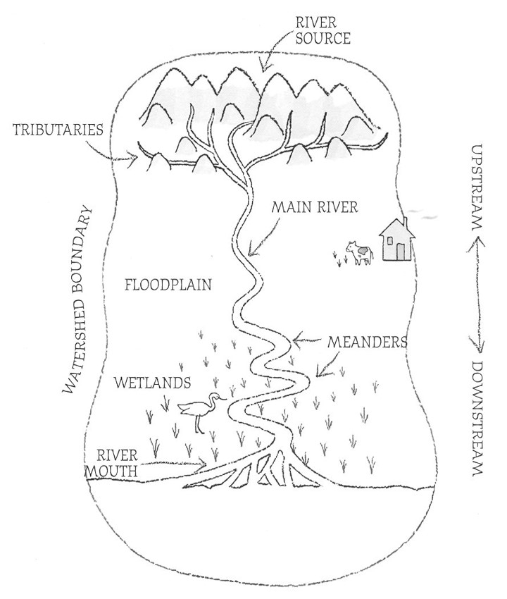

Slide 4
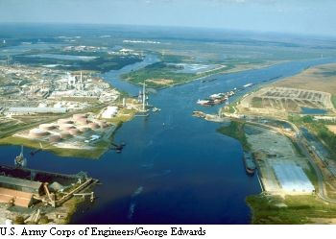

Slide 5
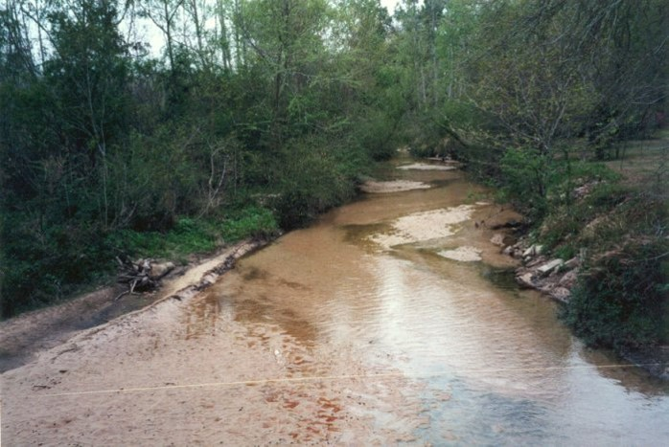

Slide 6
b. Lakes and ponds
Lakes are large and can last 100’s of years.
Ponds are small and seasonal and may dry up when there is not much rain or snowmelt.
Lakes and ponds are fed by precipitation, snowmelt, rivers, streams, and groundwater.
Many people, including those in mobile, get their drinking water from a lake.

Slide 7
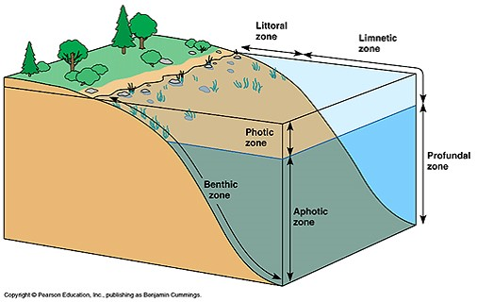

Slide 8
c. Important freshwater in mobile and Baldwin county
Mobile bay watershed- covers most of our state
Dog river and dog river watershed- covers most of the city of mobile
Mobile-tensaw river delta- from causeway north 45 miles
Big creek lake- drinking water supply, mobile
3 mile creek- old drinking water supply for city of mobile

