Slide 1
Welcome to Third Grade!
Pine Level Elementary School 2024-2025

Slide 2
Welcome Third Graders!
Third Grade is a year when students are able to build upon the foundation of readiness and math skills and concepts they learned in second grade. They will also be encouraged to become more independent and responsible.
The information in this presentation will make you aware of various skills for language arts and math as well as personal and social responsibilities that students should have as they enter third grade.
Thank you for taking the time to review this presentation. We hope the information will be useful to you and your child.

Slide 3
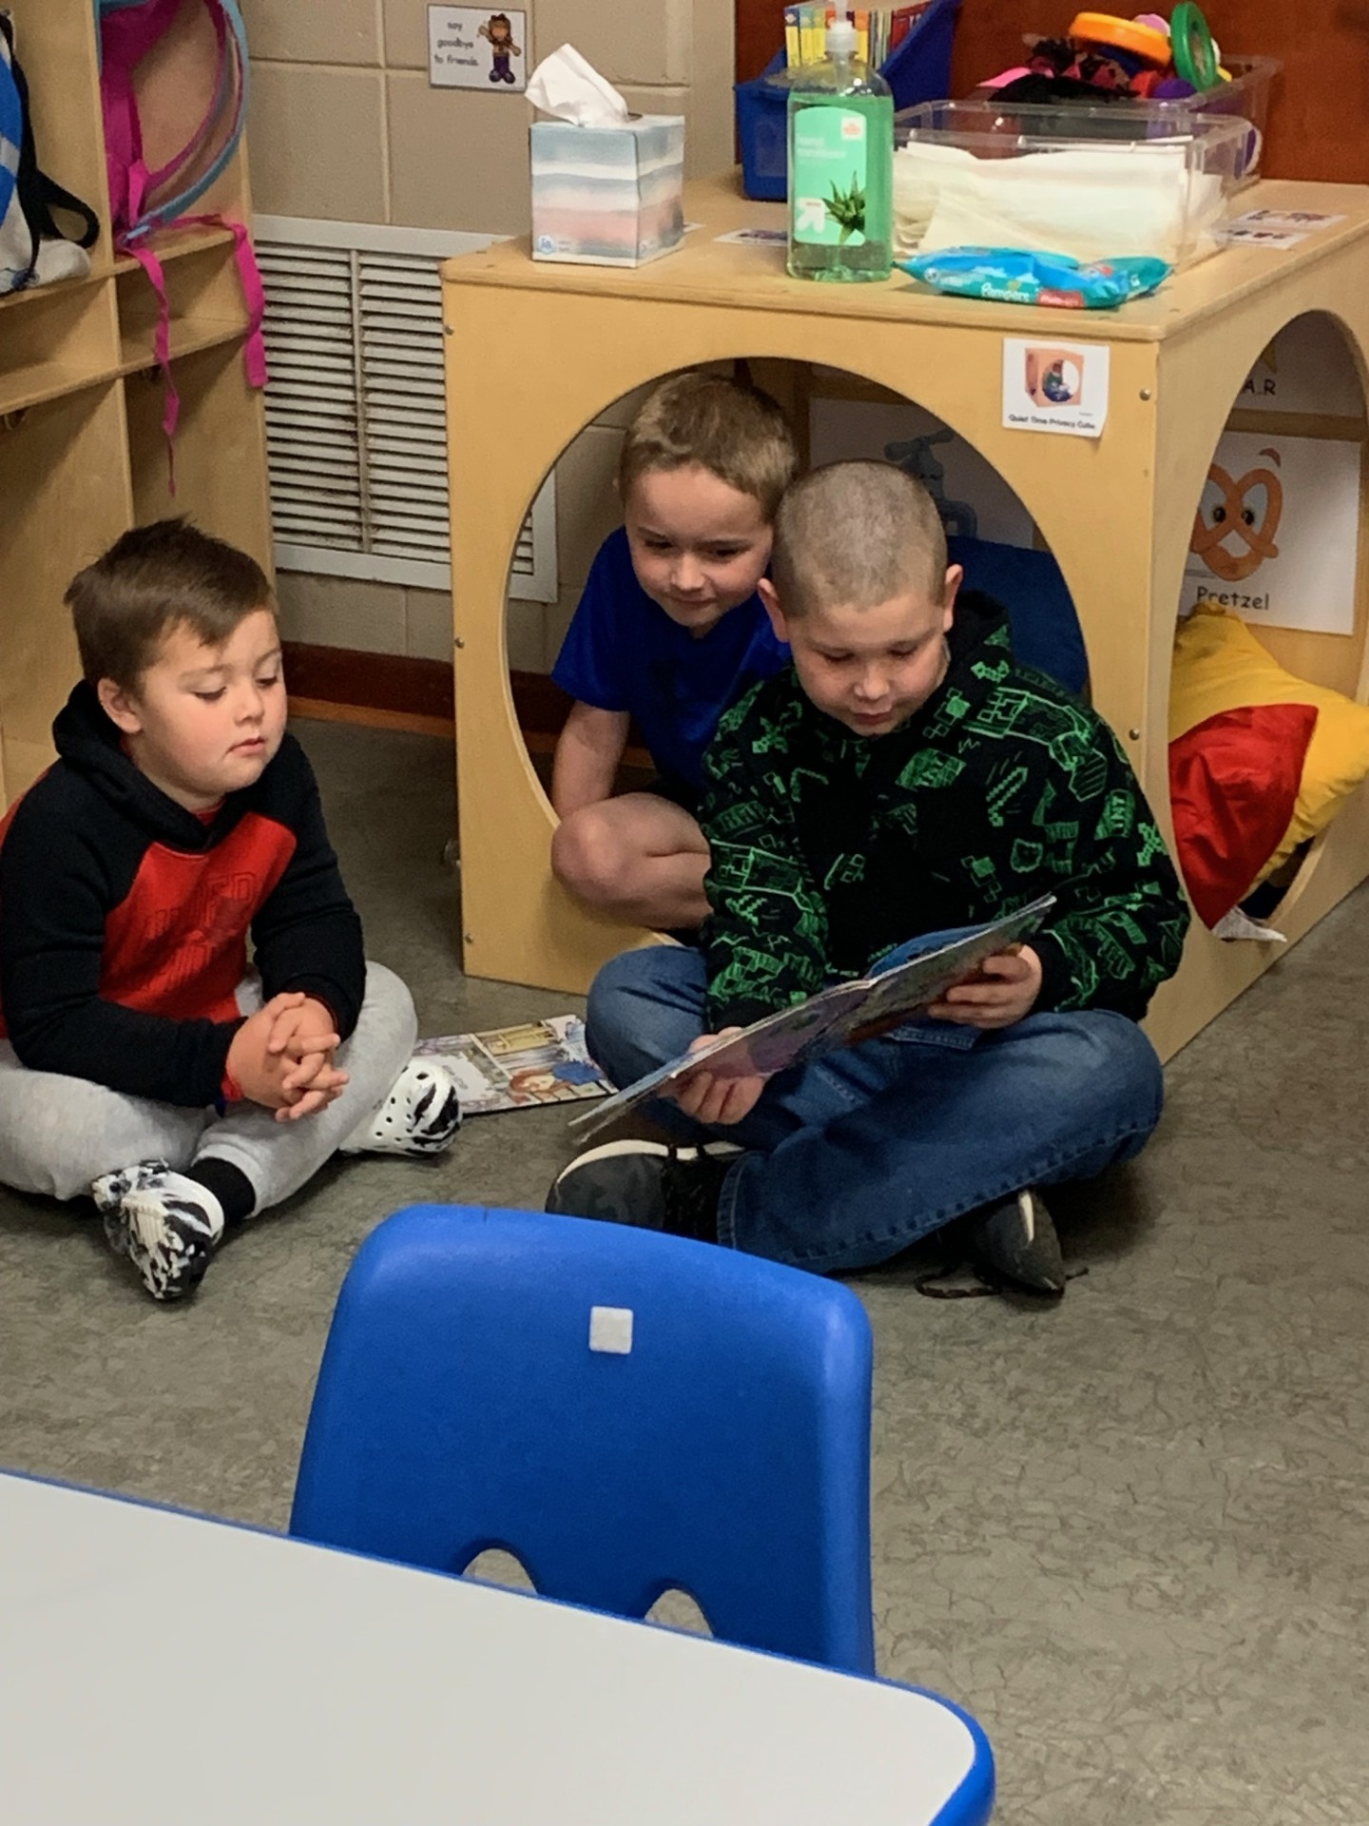
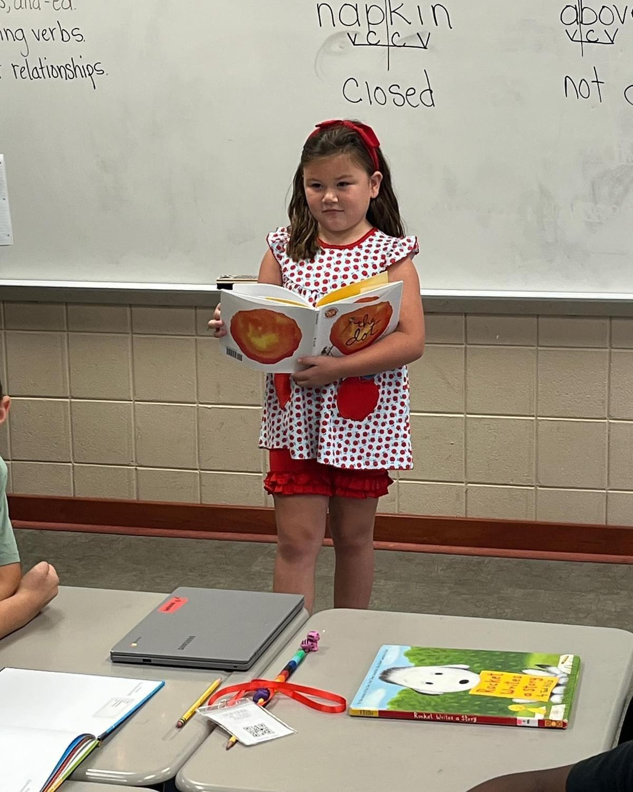
Language Arts
Shows an understanding of the lesson by asking and answering questions about it (who, what, where, when, why, and how)
Reads and spells the first two hundred Fry words
Begins to read and spell the third and fourth hundred Fry words
Knows and can name the characters, setting, and plot of a story/book during and after reading, can compare and contrast stories, determines main idea and details

Slide 4
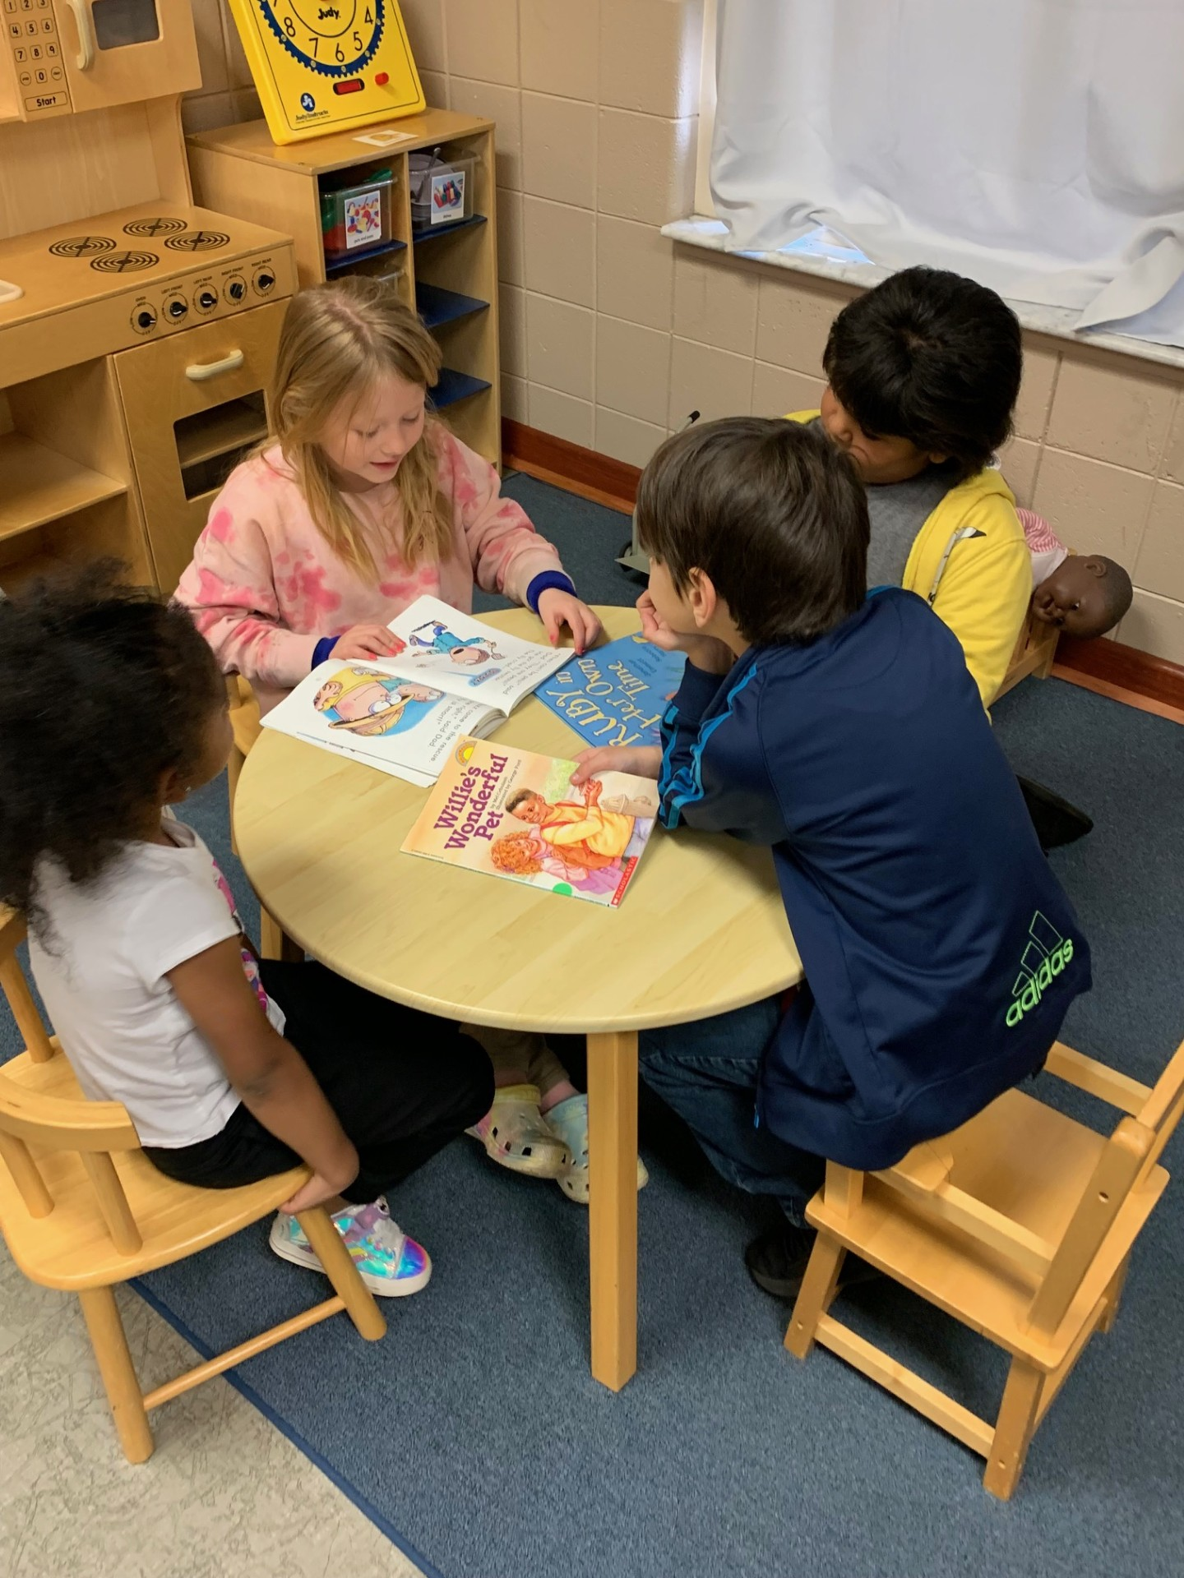
Language Arts (continued)
Reads fiction and non-fiction daily
Can write a simple sentence and compound sentence with a capital letter and end punctuation
Can form upper and lowercase letters correctly
Can retell a story after reading
Reads with expression while pausing at commas and stopping at periods
Can read for 20-30 minutes in one sitting without pause

Slide 5
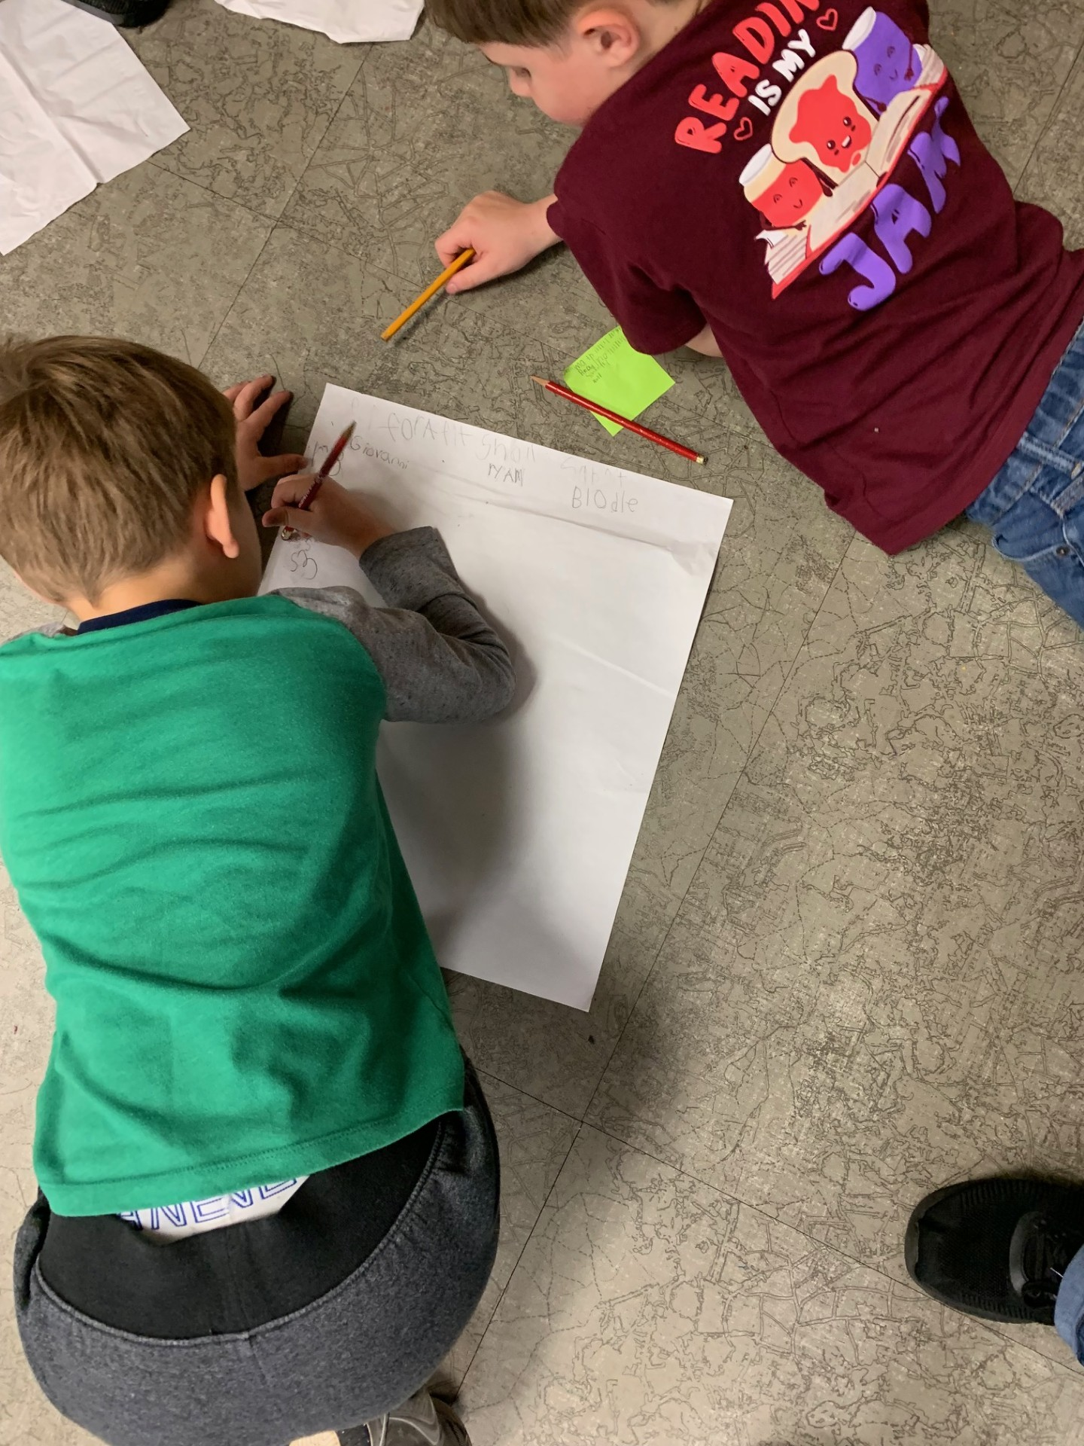
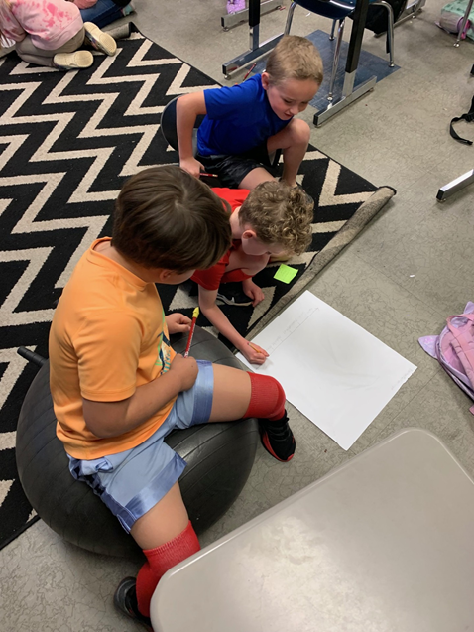
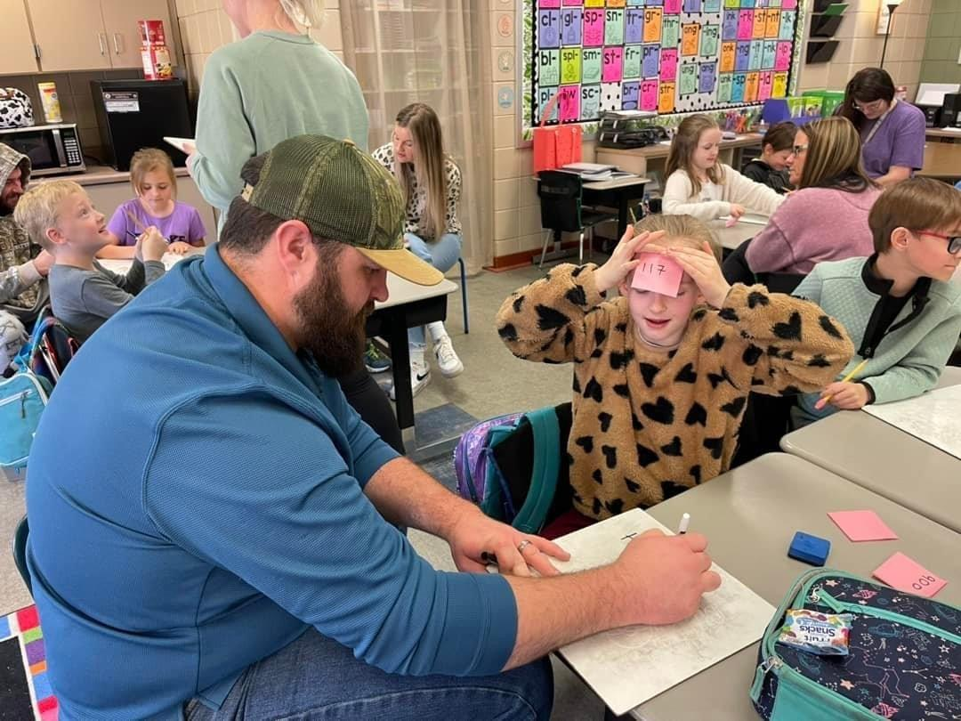
Math
Knows all addition and subtraction facts with limited to no use of fingers or manipulatives
Skip counts to 100 by 2’s, 5’s, and 10’s
Is working to memorize the multiplication facts
Tells time to the minute
Knows place value and read numbers to the ten thousands place
Rounds to the nearest tens and hundreds

Slide 6
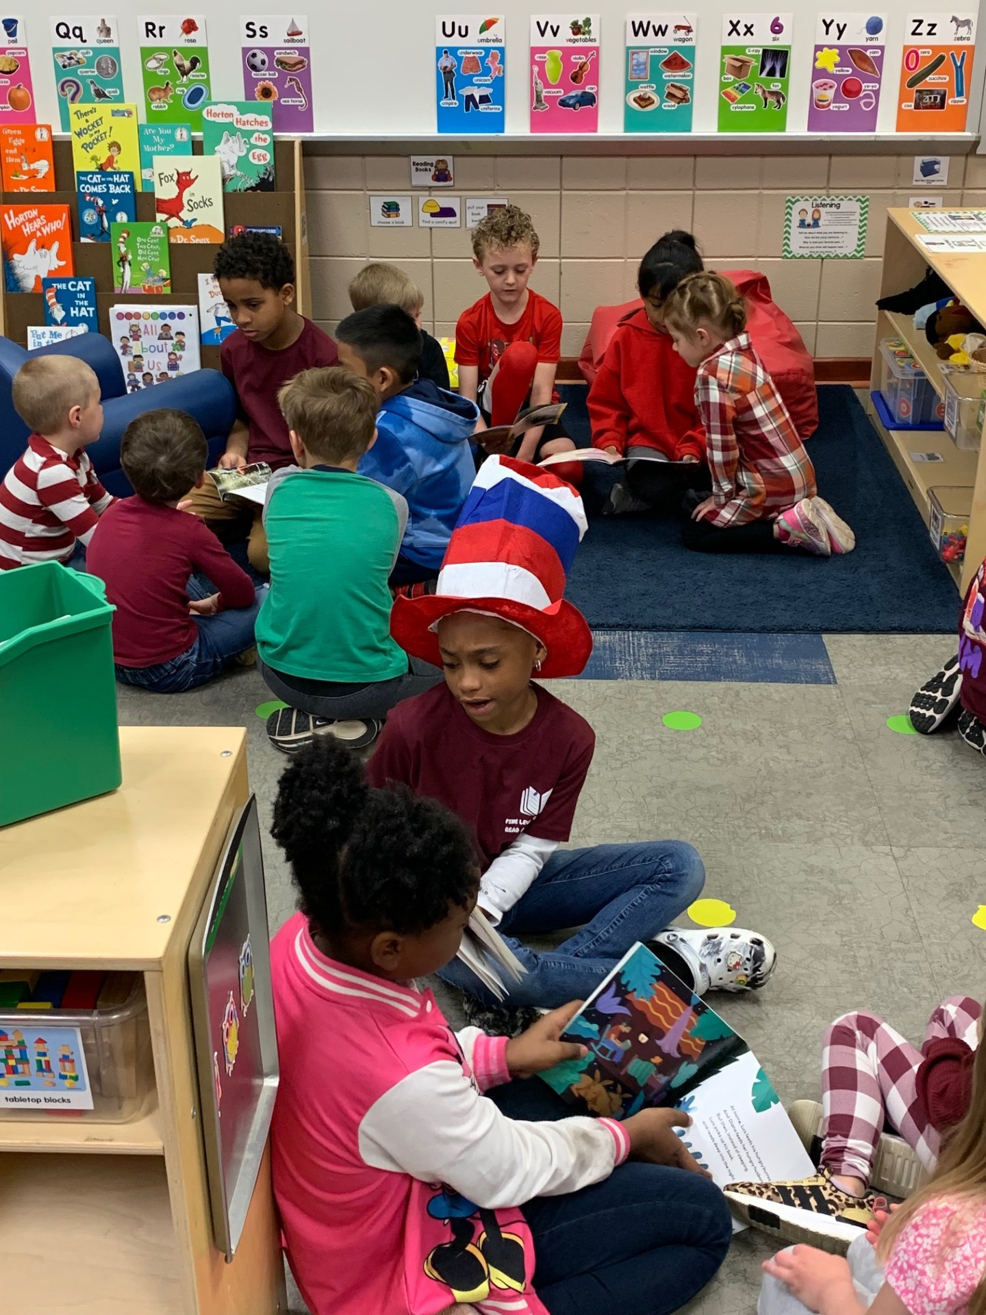
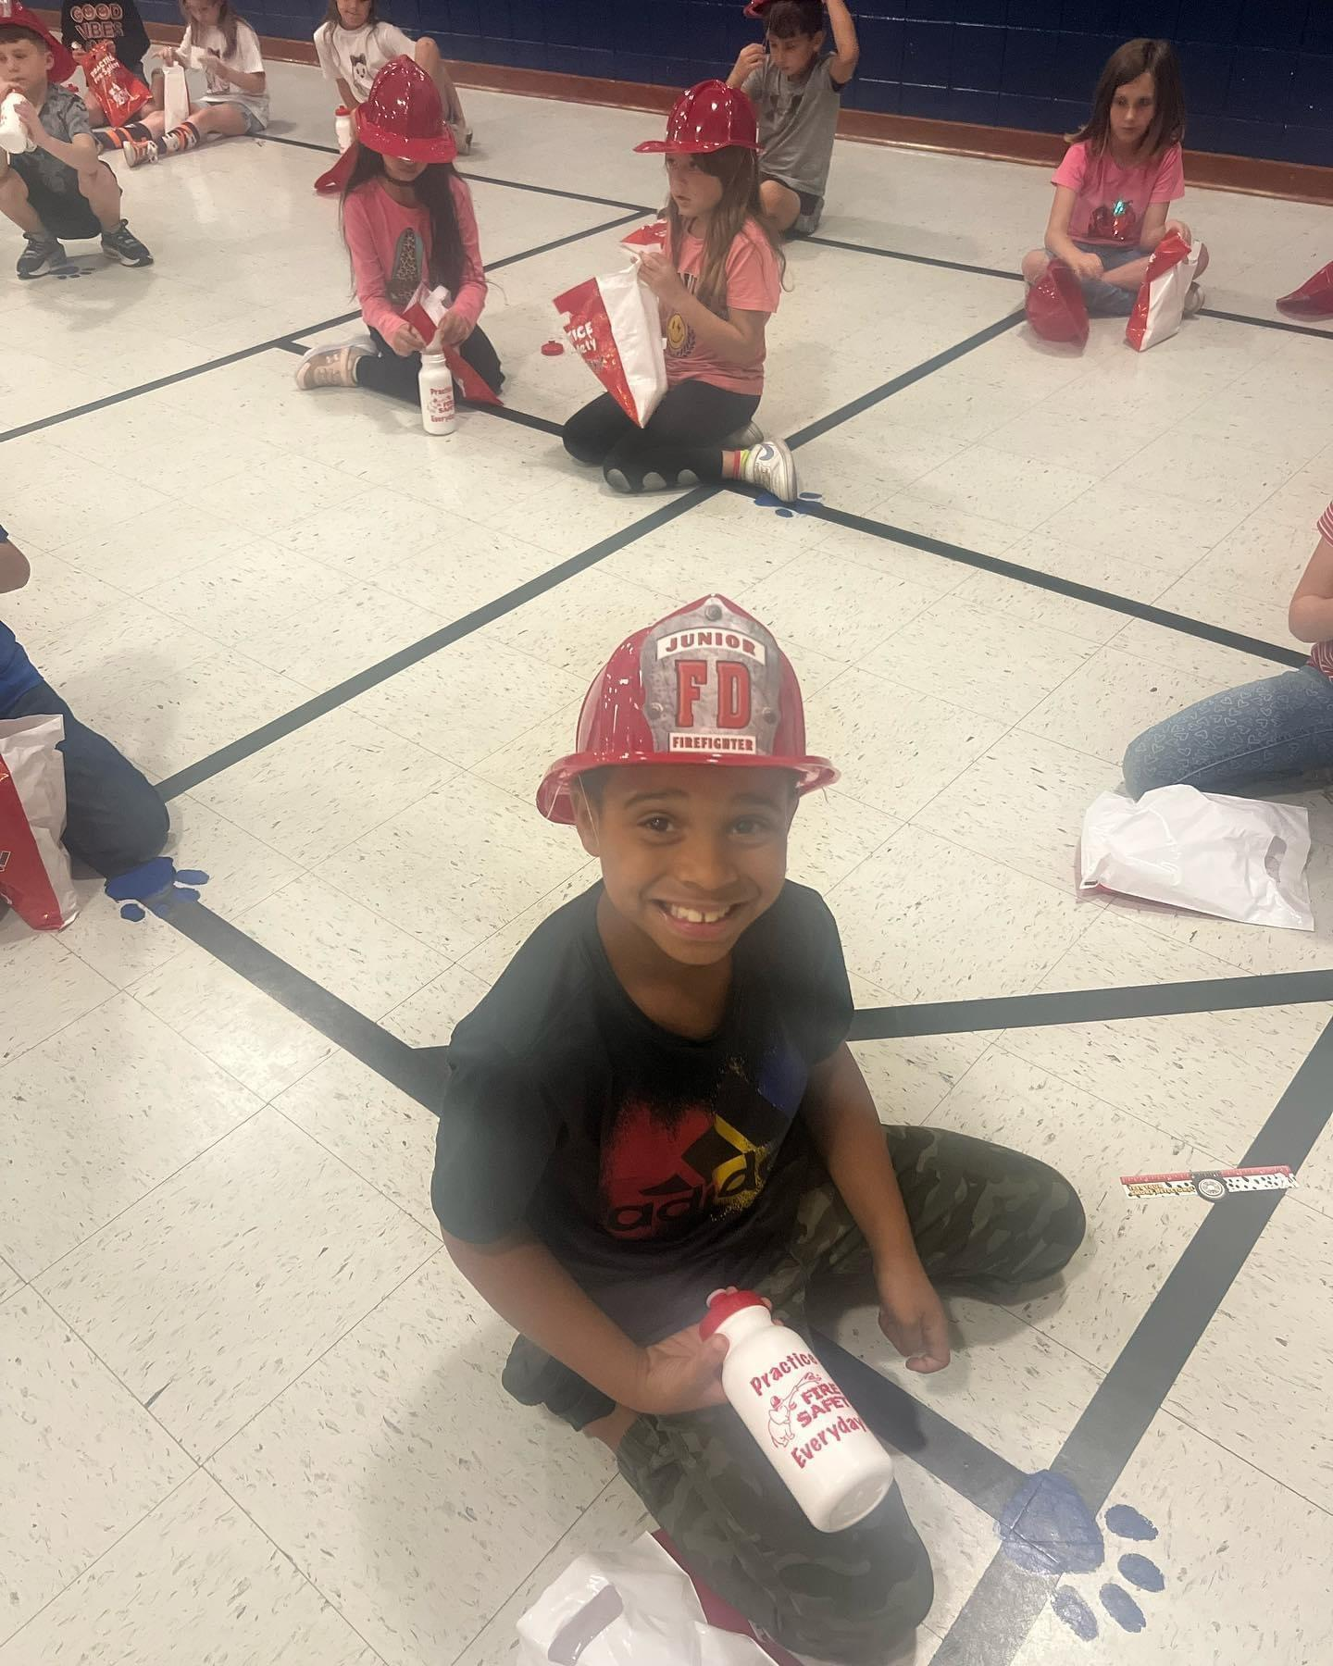
Personal and Social Responsibilities
Can state full name, address, home phone, and parents’ cell phone numbers and birthday (month/day/year)
Treats others kindly and with respect
Has a good attitude and is responsible for their learning
Listens and follows directions
Completes assignments in class and home
Can converse with others using the rules of listening, asking questions and waiting their turn
Can remain on task during independent work
Sets personal goals

Slide 7
Parent Expectations and Suggestions
Speak positively about our school and staff. If you are excited about learning, your child will be, also.
Communicate with the teacher and sign weekly folder
Take time each day to talk with your child about his/her day
Help with homework
Make sure your child is prepared to come to school with needed items and supplies
Make sure your child gets plenty of rest each night
Make attendance at school a priority. However, please be aware of any symptoms your child might have that would indicate illness. Keep your child home if he/she has a fever.

Slide 8
Expectations and Suggestions (continued)
Read to and have your child read independently each day. Encourage them to tell you about the reading.
Take time each day to talk to your child about anything and everything
Watch the news together and discuss it
Urge your child to use logical arguments to defend hid/her opinion
Involve your child in activities and games that require listening and following directions
Encourage work values such as effort, persistence, and initiative
Encourage responsibility by having them put away personal belongings and assist with simple chores

Slide 9
Back to School Event
Tentative Back to School Event: August 5th - 2:00-6:00 pm
First Day of School: August 7th
Open House: TBD

