Slide 1
Welcome to
Curriculum Night!

Slide 2
Grading Policies
Reading:
Major Grades: Weekly Skills test and Unit test (usually Fridays)
Minor Grades: Read the Words (usually Fridays), Fluency and Phonics/High Frequency page (usually Thursdays)
Language Arts:
Spelling test (usually Fridays)
Grammar daily grade (usually Thursdays)
Math:
Major Grades: Topic test (day varies)
Minor Grades: Weekly skill sheet (day varies)
Science and Social Studies:
S (satisfactory), N (needs improvement), U (unsatisfactory)
Autauga County Retention Policy: Regular education students in grades one (1) through two (2) will be retained if they do not pass both Reading and Mathematics in a given school year. A yearly numerical average of 60% or above constitutes a passing grade.

Slide 3
Correspondence
Take-Home Binder:
Please initial your child’s behavior square DAILY.
All correspondence will be sent home in the front pocket of your child’s binder. Please empty it daily. My weekly newsletter will be linked in the Remind and posted on my website. On it, you will find curriculum information, important dates and information, and homework assignments. Homework is also placed in student’s binders every Friday to begin review over the weekend. Homework is due on Friday.
Please send all money, field trip forms, notes, etc. in the zipper pouch in your child’s binder. I am training them to look for correspondence in their binders. I suggest giving them a “heads up” when placing something in their binder. It helps them remember to place it on my desk in the mornings.
Tuesday Folder:
Graded papers are placed in the folder every Tuesday.
Please sign by the date received on the back of the folder.

Slide 4
Technology
Lexia-
It is a literacy program used daily in the classroom.
Students may use it at home INDEPENDENTLY. Usernames and passwords were sent home in Tuesday folders today.
Students are working on their reading level. They have a weekly minutes goal.
They will be rewarded if they meet their weekly minutes or pass a level.
Reflex Math and Happy Numbers
Math programs used weekly in the classroom.
Students may use it at home INDEPENDENTLY. Usernames and passwords were sent home in Tuesday folders today.
Students are building their math facts fluency.
Powerschool-
Grades are entered weekly.
You may check your child’s grades and average in each subject.

Slide 5
Accelerated Reader
Start date is TBD.
Students will check out books from the library on their reading level.
Once they have read the book thoroughly, they may take a quiz on the computer at school. Students must read the book at least 3 times because some of the questions ask specific details.
Students may read the book with their parents or independently.
Each nine weeks the students will have a goal.
If your child meets their goal, they will be rewarded.

Slide 6
Attendance
Prattville Primary expects families to ensure their children are in school and on time every day, all day. This is an important life skill! Missed instruction can affect your child’s overall success in first grade.
If your child is absent, please send in a written excuse or doctor’s excuse within three days.
Check outs may not occur after 2:40. All parents must present identification when entering the school building.
Please remember if your student is tardy, they will not be able to purchase a snack from school. You must send one from home.

Slide 7
Snack and Lunch
The snack cart visits classrooms daily from 7:45am-8:05am. Each item is 75 cents. We sell water, juice, chips, goldfish and fruit snacks.
On Fridays, we will sell a special snack for $1. Please look on the newsletter and Remind for what the special snack is.
We will continue to sell regular snacks from the Snack Cart. These snacks will be eaten at our regular scheduled time.
Birthday celebrations- Please let me know in advance if you plan on providing a special snack for your child’s birthday. It helps me plan the day. Parents may only send in one special treat per child. The treats should be store bought or individually wrapped. Parents are asked to send the treats with the student or drop them off in the office. No presents, balloons, etc. will be allowed. Parents are not allowed to join us for the birthday snack.
Lunch: Please discuss with your child whether they are getting lunch at school or one is provided from home.
Our campus still remains closed to all visitors at this time. This includes lunch.

Slide 8
Leader in Me
August 30-September 10: Habit 1 Be Proactive
September 13-24: Habit 2 Begin with the End in Mind
September 27-October 8: Habit 3 Put First Things, First
October 11-22: Habit 4 Think Win-Win
October 25-November 5: Habit 5 Seek First to Understand, Then to be Understood
November 8-19: Habit 6 Synergize
November 29-December 17: Habit 7 Sharpen the Saw
Please check out the Leader in Me PowerPoint on the PPS website.
Students may earn a Positive Office Referral for living out the Leader in Me lifestyle!

Slide 9
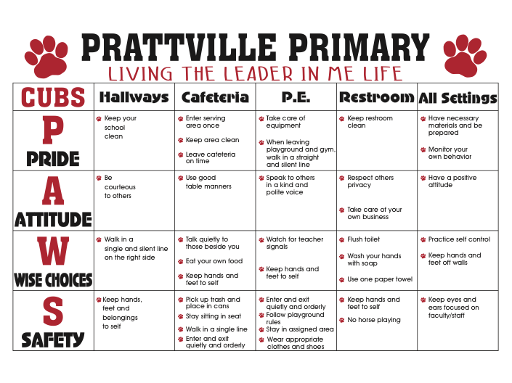
School Wide Expectations

Slide 10
Important Resources
Mrs. Coker- school nurse
Please contact her for any health concerns
Mrs. Hardy- school guidance counselor
Mrs. Hardy focuses on services that address academic, career, and social/emotional development.
Children may face difficulties, which can prevent them from doing their best in school. These difficulties can include school adjustment issues, family change, fears, grief, or difficulties with friendships. Having support through tough times can be essential to a child’s educational success. Please contact Mrs. Hardy for assistance
Mrs. Schooley- parent resource center
If your child is struggling, we have many learning resources in our Parent Resource Center. You may check them out to use at home. Please contact me or use the link on our website if you would like to utilize this resource. Mrs. Schooley is happy to help us!

Slide 11
THANK YOU for coming!

