Slide 1
2024-2025 Annual Title I & Family Engagement Meeting
West Elementary School, Morristown, TN
September 19, 2024, 6:00 pm
Gymnasium
Brandon Olson, Principal
423-586-1263
l
423-586-1263
Rev. 09/18/2023

Slide 2
Why are we here?
The Every Student Succeeds Act (ESSA) requires that each Title I school hold an annual meeting of Title I families in order to:
inform you of your school’s participation in Title I,
explain the requirements of Title I, and
explain your rights as parents and family members to be involved.

Slide 3
What will I learn?
What is a Title I school?
What are my rights?
What can Title I funds be used for?
How does our school use Title I funds?
What is the SIP?
What are our schoolwide program goals?
How is parent and family engagement funded?
What is the Parent and Family Engagement Policy?
What is the School-Parent Compact?
What curriculum does our school use?
What tests will my child be taking?
How can I be involved?
Who can I contact for help?

Slide 4
What is a Title I school?
Title I was passed in 1965 under the Elementary and Secondary Education Act (ESEA). It is the largest federal assistance program for our nation’s schools.
Title I schools receive extra funding (Title I dollars) from the federal government. These dollars are used to:
identify students experiencing academic difficulties and provide assistance to help these students;
purchase additional staff, programs, materials, and/or supplies; and
conduct parent and family engagement meetings, trainings, events, and/or activities.

Slide 5
What are my rights?
The families and parents of Title I students have a right, by law, to:
be involved in decisions made at both the school and district level;
be provided with information on your child’s level of achievement on tests in reading/language arts, writing, mathematics, and science;
request and receive information on the qualifications of your child’s teacher and paraprofessionals who are working with your child by contacting the school office at (423) 586-1263; and
request opportunities for regular meetings to formulate suggestions and to participate, as appropriate, in decisions about the education of your child. The school is required to respond to any such suggestions as soon as practicably possible.

Slide 6
What can Title I funds be used for?
In general, Title I funds may be used for:
smaller class sizes,
additional teachers and paraprofessionals,
additional training for school staff,
extra time for instruction (before and/or after school programs),
parent and family engagement activities, and/or
a variety of supplemental teaching materials, equipment, and technology.

Slide 7
How does our school use Title I funds?
In 2024-2025, our school was allotted approximately $53,000 in Title I funding, after personnel.
We developed a Schoolwide Program, which means we plan to spend our funds on the following:
Supplemental staff:
1 Instructional Coach - Math
1 Instructional Facilitator - Reading
1 Reading Interventionist
2 teacher assistants
Programs/Technology/Materials/Supplies:
School-level supplies (ie - copy paper, anchor charts)
Various teacher classroom resources and supplies, as requested by the teacher
Books for classrooms and library
Teacher Professional Development:
Literacy acceleration
Ron Clark Academy
Math and ELA vertical planning
Small group instruction
Student-centered learning

Slide 8
What is the SIP?
The SIP is the School Improvement Plan. It includes:
the identification of the school planning team and how they will be engaged in the planning process;
a needs assessment and summary of academic and non-academic data;
prioritized goals, strategies, and action steps to help address the academic and non-academic needs of students;
teacher and staff professional development needs; and
budgets and the coordination of resources.
The school must include family representatives on our school planning team.
If you have an interest and willingness to serve on the 2024-2025 SIP team, or next year, please contact Mr. Olson.

Slide 9
What are our schoolwide program goals?
Improve the overall growth and achievement of our K-5 students.
Improve the overall growth and achievement of our English Language Learner and Students with Disabilities populations.
Provide correct Professional Development opportunities for our staff

Slide 10
How is parent and family engagement funded?
Any district with a Title I allocation exceeding $500,000 is required by law to set aside 1% of it’s Title I allocation for parent and family engagement.
Of that 1%, 10% may be reserved at the district for system-wide initiatives related to parent and family engagement. The remaining 90% must be allocated to all Title I schools in the district.
You, as Title I parents and family members, have the right to be involved in how this money is spent.
This year, we received $3,005 to spend on Parent Involvement Activities

Slide 11
How is parent and family engagement funded?
In 2024-2025, we received approximately $3,005 in parent and family engagement funding. We plan to use these funds for:
Parent and Family Engagement Meeting and Events
Parent-Teacher Conferences (October 1 and 3, 2024)
Music Department Showcases
Family Movie Nights (in the gym) - in the planning process
Parents Night Out events - in the planning process
Family Game Night
Family Literacy Night
Materials/Supplies
Take home materials from the family engagement events
Books, STEM-type activities

Slide 12
What is a Parent and Family Engagement Policy?
These plans address how the district and school will implement the parent and family engagement requirements of ESSA. Components should include:
how parents and families can be involved in decision-making and activities;
how parent and family engagement funds are being used;
how information and training will be provided to families; and
how the school will build capacity in families and staff for strong parent and family engagement.
You, as a Title I parent or family member, have the right to be involved in the development of these plans.
Link to Family Engagement Plan:
https://content.myconnectsuite.com/api/documents/506f3e914b0f41d183f1cc94fbf8ef5a.pdf

Slide 13
What is a School-Parent Compact?
A school-parent compact is a written commitment that outlines how the entire school community – teachers, families, and students will share the responsibility for improved academic achievement.
The compact must describe how the school will:
provide high-quality curriculum and instruction;
hold parent-teacher conferences, annually in elementary schools;
provide parents with reports on their child’s progress;
provide parents reasonable access to staff.
provide parents opportunities to volunteer; and
ensure regular two-way meaningful communication between family members and staff, to the extent practicable, in a language family members can understand.
You, as a Title I parent or family member, have the right to be involved in the development of the compact.
https://docs.google.com/document/d/1d_vr1dJWAjZJSHw3CU21gtFtKKgKtM42/edit

Slide 14
What is a School-Parent Compact?
Once updated with parent input, the school-parent compact will be shared with all parents/guardians of the school. In addition, copies of the compact can always be found in the school office.

Slide 15
What curriculum does our school use?
The Tennessee Academic Standards provide a common set of expectations for what students will know and be able to do at the end of a grade for each subject area.
Tennessee's academic standards form the framework for everything taught at West Elementary School.
ELA instruction is HMH & CKLA; Math instruction is McGraw Hill.
For more information about Tennessee’s academic standards, see:
https://www.tn.gov/education/districts/academic-standards.html

Slide 16
What tests will my child be taking?
Grades PK-5: aimsWebPlus testing 3 times per year.
Grades 2-5: Paper testing in April 2025 (ELA, Math, & Science)
Grades K-5: Mastery Connect Benchmark testing 3 times per year
All students are expected to score in the “green” or above on AimsWeb
Grades 2-5 children are expected to perform “Meets” or “Exceeds” in all tested subject areas (Math, ELA, Science). Social Studies not currently tested

Slide 17
How can I be involved?
We need you! Research has proven that family engagement in education has more impact on student achievement than any other factor (John Haddie, 2015).
To get involved with the 2024 – 2025 SIP or to get involved with the Parent and Family Engagement Policy, please contact the office and/or administration.
To get involved with the School Parent Compact, please contact the office and/or administration.
SIP information is optional as all families do not have to be involved.

Slide 18
How can I be involved?
As a parent/guardian, it is vital to the success of your student to:
encourage attendance;
monitor grades and schoolwork on an online system or portal (Parent Portal and Remind);
attend family events and meetings;
speak positively about education and the role it plays in determining future success
join family groups and committees (e.g., PTA/PTO, advisory councils, etc.); and
read school/classroom newsletters or websites
Be active in your student’s life;
Ask your student how his/her day went
Read at least 20 minutes per night with each child

Slide 19
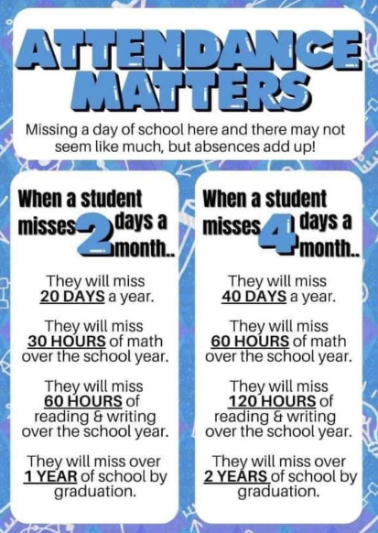
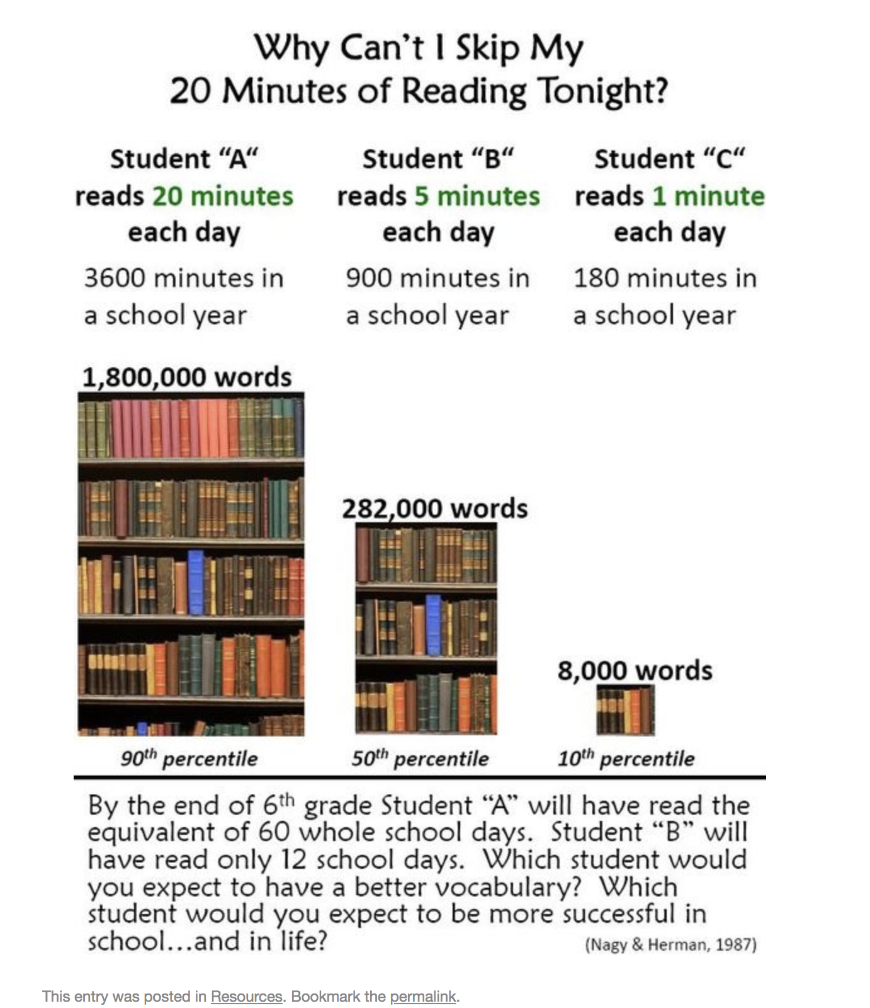

Slide 20
Who can I contact for help?
For general questions, call the front office at: (423) 586-1263
To reach the principal, Brandon Olson, call: (423) 586-1263
To reach the school counselor, Pamela Yount, call: (423) 586-1263
To reach our family liaison, Bob Schwalb, call: (423) 586-1263 (Tues/Thur)
To reach your child’s teacher, call the front office or view our staff directory at: wes.hcboe.net
To reach our Transportation Department, call: (423) 586-2103
To reach the Central Office/Superintendent, call (423) 586-7700

Slide 22
WE JUST WANT TO SAY…
THANK YOU!
Do you have any questions for us?
Notes:
Be sure to thank families for their time.
Move this slide to the end if additional slides are added.

