Slide 1







Voices for the Vision
Shared Decision Making
Parent Meeting
Tuesday, March 24th, 2026
Notes:
Sign in
grab a packet
Hannah Mericle-FEL
Thanks for coming
meeting to hear your thoughts about how to better improve the family engagement here at LRPS

Slide 2





Agenda
  Welcome and Introductions
  Parent Feedback Form
  Our FE Program Highlights
  Achievement Data
  2026 Parent Survey Results
  Family Engagement Plan
  School-Family Compact
  Program Supports and Use of Funds
Notes:
a few things to go over
fe program highlights
survey results

Slide 3

Parent Feedback Form
  Paper Copy or QR Code
  Please fill out your responses as we go through the presentation
Your input directly impacts our goals and events for the upcoming school year!

Slide 4

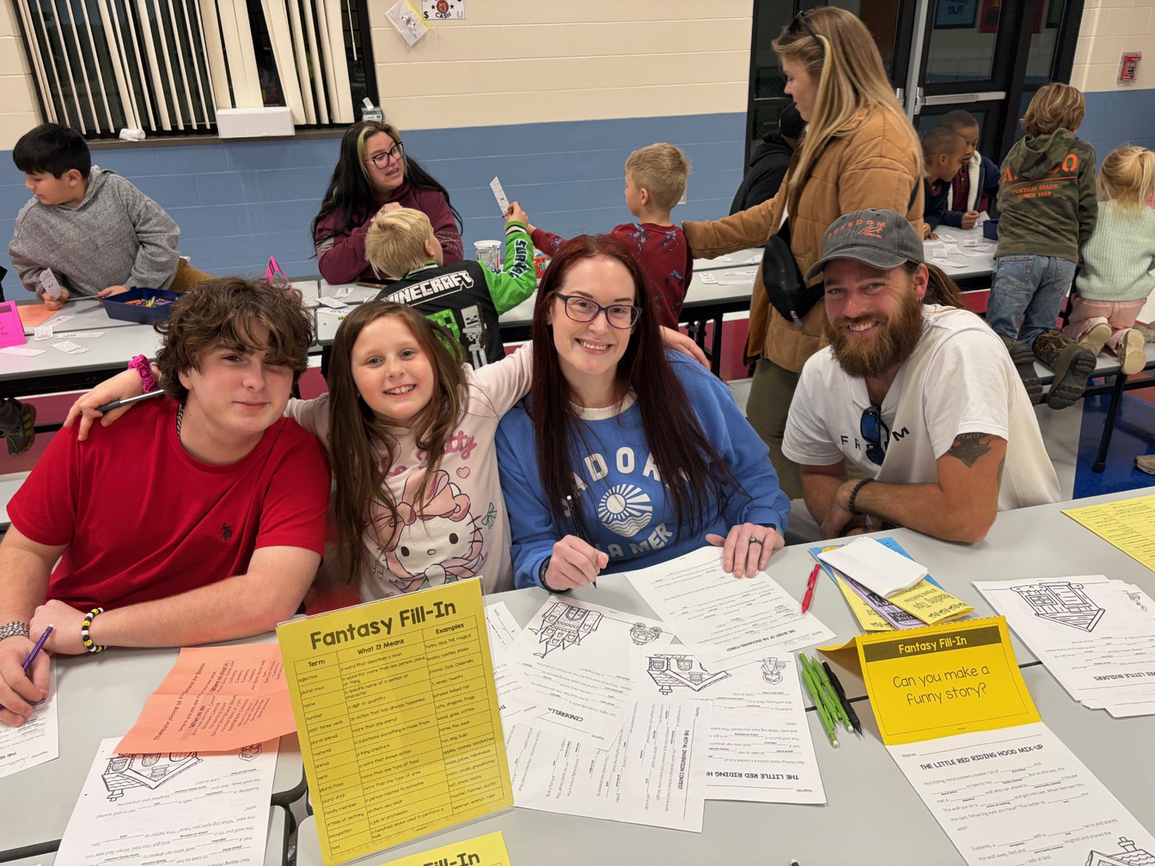

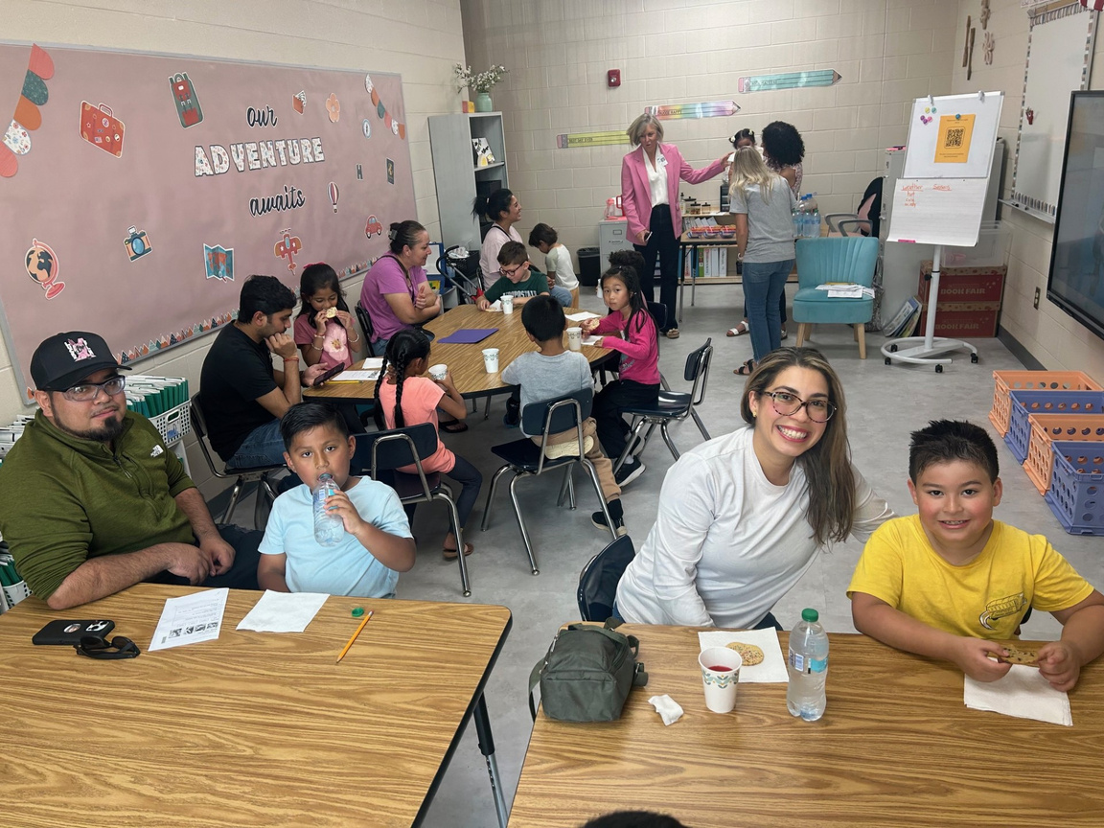
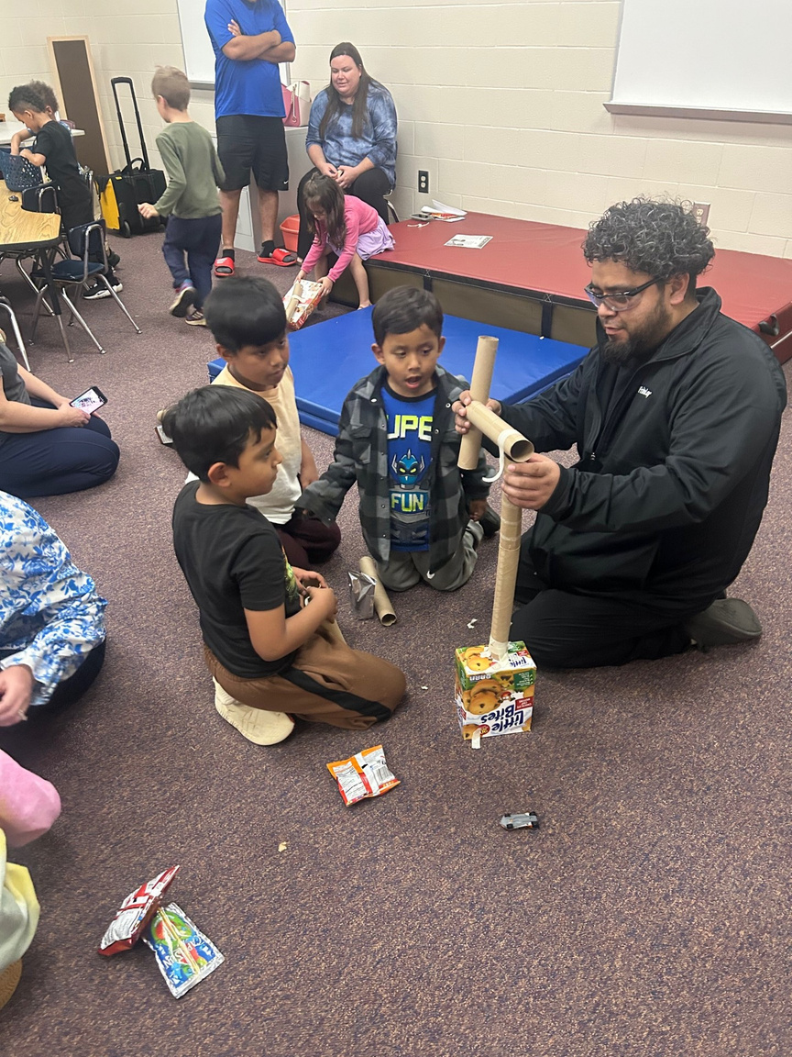
A Glimpse at Family Engagement at Langston
Bananas for Books
STEM Night
ESOL Parent Meeting

Slide 5
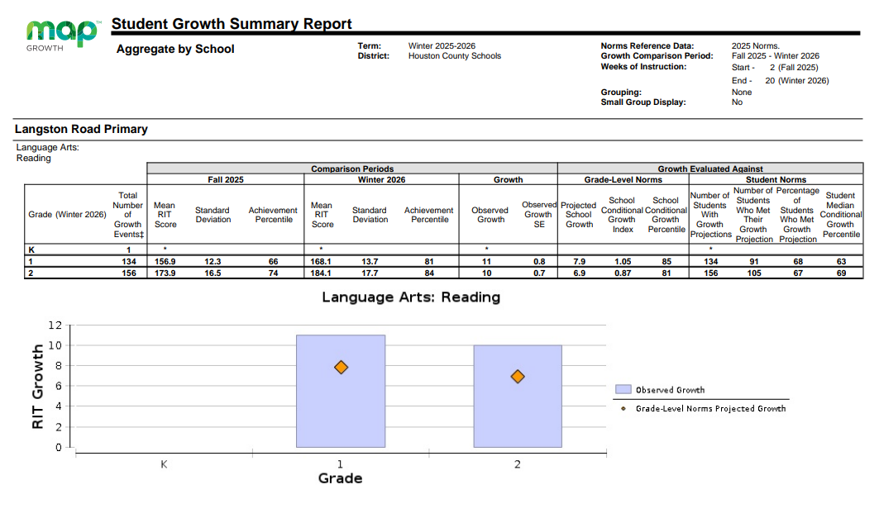
Achievement Data
Notes:
pages 3 and 4 in packet
Map testing results
LA Fall to winter this year.
Orange diamond is estimated growth. Blue is our actual growth. Kinder did not test in the fall so they don't have a comparison. They will have one from Winter to Spring.

Slide 6
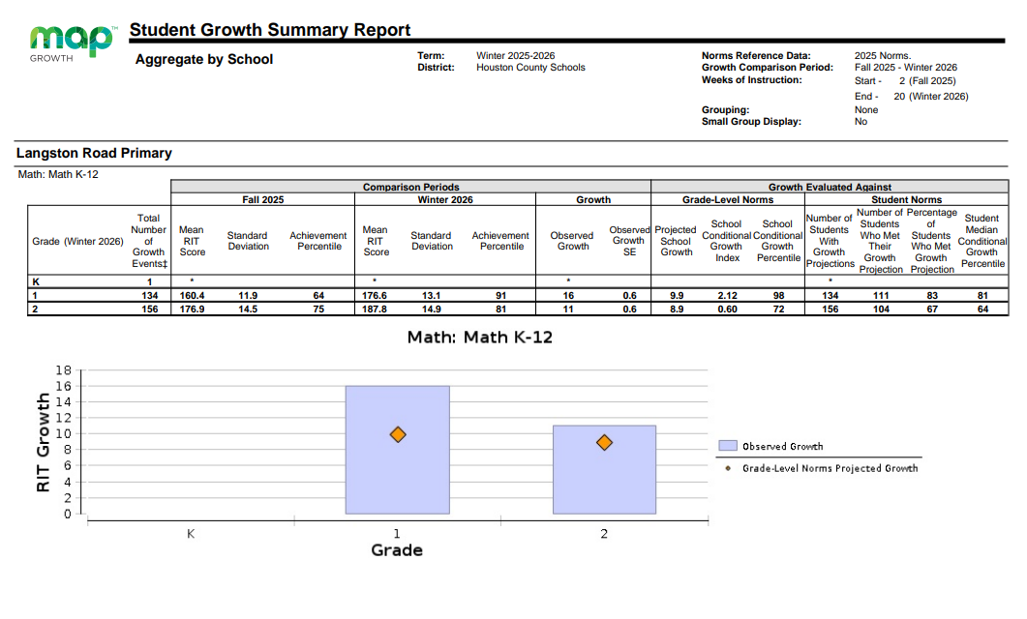
Achievement Data
Notes:
Math Fall to winter this year.
Orange diamond is estimated growth. Blue is our actual growth. Kinder did not test in the fall so they don't have a comparison. They will have one from Winter to Spring.

Slide 7

2025-2026 Parent Satisfaction Survey Results
Current Students: 552
Surveys Completed:
137
Notes:
took in February
half sheet pink paper sent home

Slide 8

2025-2026 Parent Satisfaction Survey Results
88%
57%
84%
All/Most of the time
All/Most of the time
All/Most of the time
My child’s school
encourages
family
engagement
Parents attend
family
engagement
events
Parents are informed
of grade-level standards and academic requirements
Notes:
we would love to increase these numbers

Slide 9
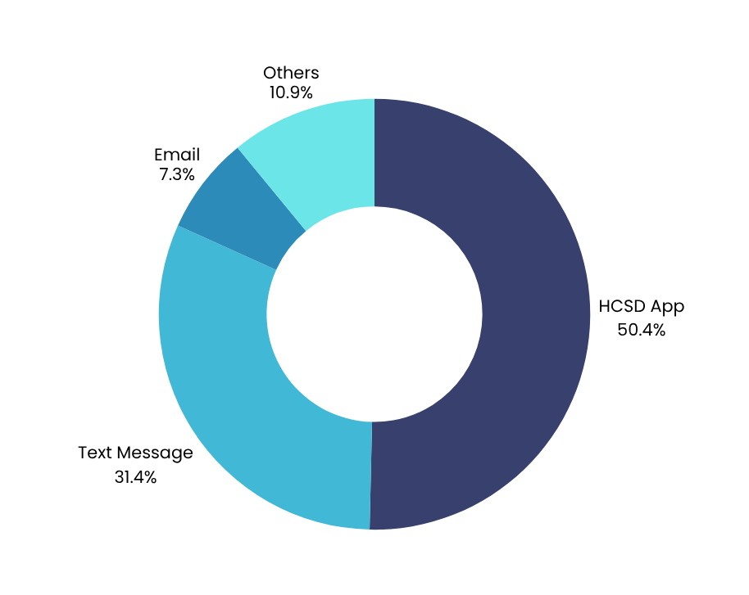
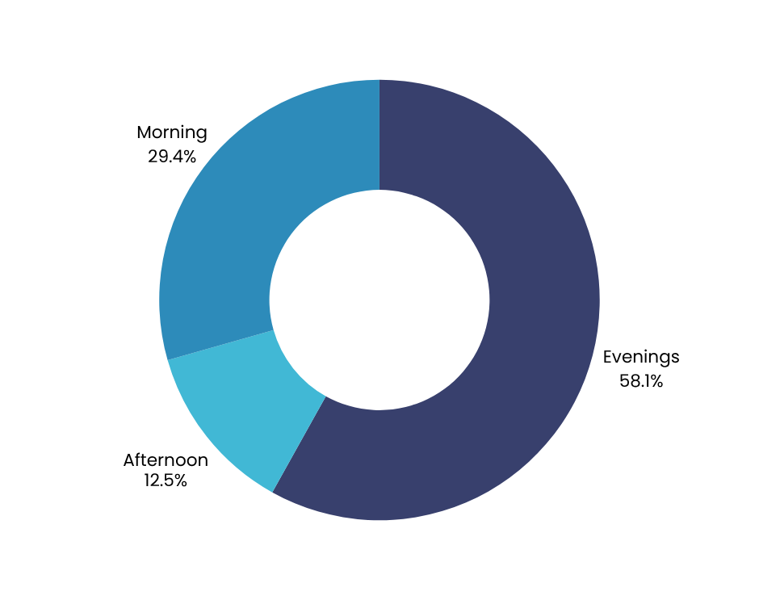

2025-2026 Parent Satisfaction Survey Results
Preferred Methods of Communication
Preferred Times of Events/Activities
Notes:
hcsd app- we've had growing pains. this is the first year having it.
evenings-some events during the day like grandparents day and esol meeting

Slide 10
2025-2026 Parent Satisfaction Survey Results
Most Requested Additional Supports
  Homework/resources for parents at home
  More one-on-one time
  More paper materials/less screens

Slide 11

Family Engagement Plan
Were you able to attend any of these family engagement events this year?
If so, what ways can we improve the event(s)?
What other academic-based or family-fun activities would you like us to consider offering?
Notes:
blue page in packet
last bullet is Question 4 on parent feedback form

Slide 12




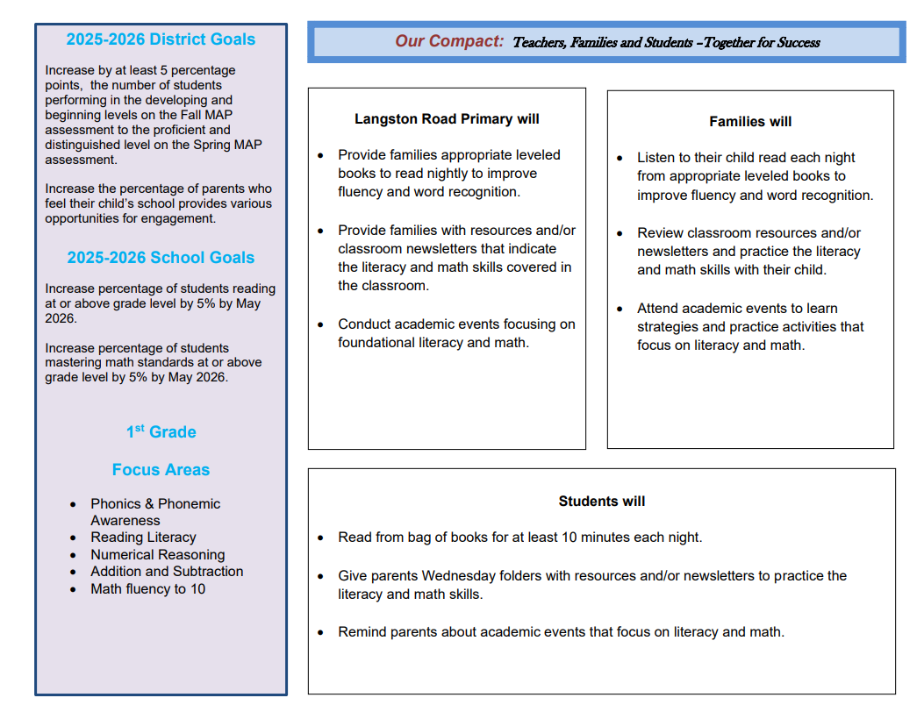


School-Family Compact
In what subject area(s) does your child have the most difficulty?
What can the school do to better support you and your child in that area?
What are some things you and your child are willing to do in order to see improvement in that area?
Notes:
In the Title 1 handbook
how we as the school, thee parents and the students work together to help them succeed.
Increase reading at or above grade level by 5%. Increase mastering math standards by 5%
questions 5-7 on feedback form

Slide 13



Program Supports and Use of Funds
  How can we use Title 1 funds to increase/improve family engagement and participation?
  Do you agree or disagree for Title 1 schools to use a portion of their funds to support a district level project?
  Are you interested in joining a Parent Action Team or working with school staff on Professional Development?
Notes:
question 8a:
question 8b: storywalk in downtown perry
If interested in PAT, write on bottom of page or in comment section of online form

Slide 14
Thank you!
Hannah Mericle
Family Engagement Liaison
Number
478-988-6148 EXT 9505
Email
hannah.mericle@hcbe.net
Web
lrps.hcbe.net/familyengagement

