Slide 1
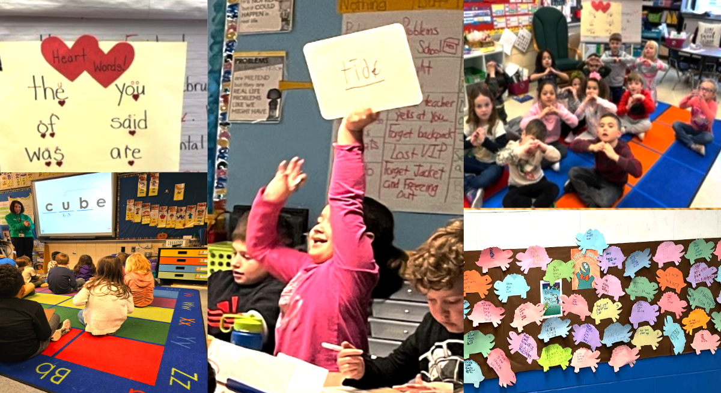
Superintendent’s Proposed 2025-26 Budget
New Milford Board of Education
January 14, 2025

Slide 2
Purposes,
Goals &
Indicators of Progress

Slide 3
Purposes of This Presentation and These Hearings:
1. To provide an overview of the 2025-26 Superintendent’s Proposed Budget;
2. To demonstrate the impact of fixed costs on the Superintendent’s Proposed Budget;
3. To serve as a springboard for questions and dialogue about organizational needs;
4. To showcase the efforts and work of each school and department;
5. To hear common themes of the district’s direction across schools and departments = “the work”

Slide 4
From the Connecticut Association of Boards of Education’s
School Governance Position Statement, 2016:
Superintendent of School’s Responsibilities:
To prepare, advocate for, and implement the annual budget that addresses district goals and meets the needs of all students; and report regularly to the Board on the status of the budget;
Board of Education’s Responsibilities: To adopt, advocate for, and oversee the school budget, which is responsive to district goals and meets the needs of all students

Slide 5
New Milford Public Schools Mission Statement
The mission of the New Milford Public Schools, a collaborative partnership of students, educators, family and community, is to prepare each and every student:
To compete and excel in an ever-changing world;
To embrace challenges with vigor;
To respect and appreciate the worth of every human being,
and contribute to society by providing effective instruction and dynamic curriculum, offering a wide range of valuable experiences, and inspiring students to pursue their dreams and aspirations.

Slide 6
Schools and departments receive budget templates - October;
Enrollment projects are finalized - October;
Schools and departments submit their proposed budgets to the Business Office;
Superintendent and Director of Fiscal Services meet with each school and department - November;
Preliminary budget rollover into MUNIS - December;
Superintendent and Cabinet decide what is included in the proposed budget - January;
Decisions are communicated to each school and department
Budget books are created and delivered - January
Budget Development Process

Slide 7
Board of Education Goals
Student Achievement:
Increase the achievement of every student through high quality curriculum, instruction, assessment, and programming.
Family and Community Engagement:
Increase families' engagement in their children's learning through consistent communication and the development of trusting relationships; increase community partnerships through ongoing outreach and opportunities.
Budget Development and Fiscal Management:
Practice fiscally responsible, transparent budget development and ongoing fiscal management that addresses district priorities and maximizes available resources.
District and School Environment:
Promote safe school environments that are physically, socially, and emotionally conducive to teaching and learning.
District Workforce:
Hire, develop, and retain passionate and exceptional staff who will contribute to a collaborative, caring, and innovative culture, defined by continuous improvement.

Slide 8
District Priorities
Support PK-12 students to meet their academic growth targets;
Build and strengthen relationships with students, families, and the broader community;
Foster a safe, welcoming, and respectful school climate to support teaching and learning.

Slide 9
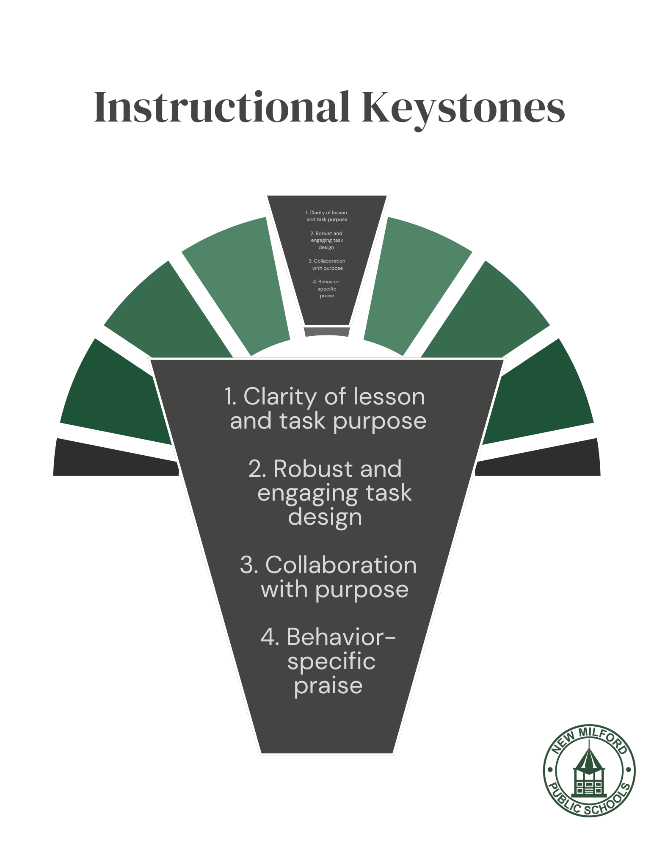
District-Wide Concepts Around Our Work
Ideas We Live By

Slide 10
District Accountability Indicators
English/Language Arts Performance
Mathematics Performance
Science Performance
English/Language Arts Academic Growth
Mathematics Academic Growth
Progress Toward English Proficiency
On Track to High School Graduation
Four Year Graduation Rate
Six Year Graduation Rate for High Needs Students
Chronic Absenteeism Rate
Arts Access
Physical Fitness
Preparation for College and Career Readiness
Post-Secondary Entrance

Slide 11
Fixed Costs

Slide 12
2025-26 Fixed Costs
Contractual Salary Increases for All Bargaining Units | +$1,587,688
Contractual Benefits for All Bargaining Units | +$675,218
Bus Contract | +$176,651
Utilities | +$17,532
Other Insurance (Student Accident, Cyber, Liability for Auto and Property) | +$24,583
2025-26 Fixed Costs | +$2,481,672 = 3.38% over the 24-25 budget
Fixed Costs are required items and elements that carry forward from one year to the next.
78.3% of the entire budget is Employee Salaries and Benefits

Slide 13
Summary of 2025-26 Dollar Amounts and Percentages
Fixed Costs | +$2,481,672 = 3.38% increase over the 24-25 budget
Requests | +$408,456 = 0.55% increase over the 24-25 budget
Total Increase | +$2,890,128 = 3.93% increase over the 24-25 budget
2024-25 Superintendent’s Proposed = 4.46% BOE Adopted =3.87% BOF Adopted = 3.87% | 2023-24 Superintendent’s Proposed = 5.03% BOE Adopted = 4.88% BOF Adopted = 4.37%

Slide 14
2025-26 Proposed Additions and Reductions

Slide 15
Salary Reductions from the Current 2024-25 Budget
FTE Reductions | Salary Amount
-2.0 Certified Staff Grades K-5 | $149,250 ($74,625 x 2)
-5.0 Certified Staff Grades 6-12 | $373,125 ($74,625 x 5)
-3.0 Paraprofessionals Grades K-12 | $75,000 ($25,000 x 3)
Total Reduction = 10.0 FTE | Reduced Salary Amount = $597,375

Slide 16
Fewer Students in the District?
Why Proposed Additions?

Slide 17
High Needs Students Over Time

Slide 18
High Needs Students by School in 2024-25
 | Free & Reduced Lunch | Multilingual Learners | Students with Disabilities
Hill and Plain | 40% | 16% | 15%
Northville | 31% | 8% | 16%
Sarah Noble | 35% | 11% | 19%
Schaghticoke | 33% | 9% | 19%
NMHS | 29% | 6% | 14%

Slide 19
Our Personnel Requests for 2025-26
1.0 Armed School Security Officer at NMHS | Provides an armed security coverage where monitors do not; Female officer potential
1.0 Career and Technical Education Teacher at NMHS | Restored position that was reduced in 2024-25; Increases trades-based courses
1.0 Social Worker at SMS | Replaces Effective School Solutions with our own employee; more coverage for student needs; Savings
1.0 Multilingual Learners Teacher at SMS | Increase in student needs
1.0 Special Education Teacher at SMS | Increased need for support for student mental health and testing
1.0 Special Education Teacher at SNIS 1.0 Interventionist from Title I to General Fund | Increase in severity of student needs, Assistance with PPT meeting coverage; Grant funds should not supplant the general fund
0.5 School Psychologist at SNIS | Increase in student needs and number of PPT meetings
0.5 School Psychologist at HPS | Increase in number and severity of mental health and academic needs; increased testing
0.4 Assistant Principal at HPS | Makes the current 0.6 position 1.0; Increased student need
1.0 Central Office Secretary | Split between the assistant superintendent’s office and central registration/registry

Slide 20
What did not make it into the 2025-26 proposed budget?
K-3 Literacy Curriculum Materials
Required to implement the state’s right to read legislation
(K-2: $161,855; Grade 3: $93,000)
We will use part of our 2% set-aside funding and end–of-year funds from the insurance line for these materials.
Requested Personnel Not Included:
6.0 Kindergarten general education paraprofessionals
0.4 School psychologist - HPS
0.5 Nurse paraprofessional - HPS
0.5 Nurse paraprofessional - NES
1.0 Music teacher - SMS
0.6 Assistant principal - SMS
0.5 Speech and language pathologist - SMS
0.5 Library clerk - SMS
1.0 Math and Reading Interventionist - SMS
1.0 Social Studies teacher - NMHS
1.0 Social Worker - NMHS
0.6 Speech and language pathologist - LHTC

Slide 21
District Accountability Indicators
English/Language Arts Performance
Mathematics Performance
Science Performance
English/Language Arts Academic Growth
Mathematics Academic Growth
Progress Toward English Proficiency
On Track to High School Graduation
Four Year Graduation Rate
Six Year Graduation Rate for High Needs Students
Chronic Absenteeism Rate
Arts Access
Physical Fitness
Preparation for College and Career Readiness
Post-Secondary Entrance

Slide 22
24-25 vs. 23-24 District Accountability Indicators
Year over Year Increases in: | Year over Year Decreases in:
+Overall District Performance +Overall English Language Arts +English/Language Arts: High Needs +Math: High Needs +Growth Target Met: English/Language Arts Overall +Growth Target Met: English/Language Arts: High Needs +Growth Target Met: Math Overall +Growth Target Met: Math: High Needs +Progress Toward English Proficiency: Literacy +Progress Toward English Proficiency: Oral +Chronic Absenteeism Reduced Overall +Chronic Absenteeism Reduced: High Needs +Six-Year Graduation Rate: High Needs +Two- and four-year college entrance +Arts Access | -Overall Math Performance -Overall Science Performance -Science Performance: High Needs -College/Career Readiness:% Taking Courses -College/Career Readiness:% Passing Exams -On-Track to High School Graduation -Four-Year Graduation Rate -Physical Fitness

Slide 23
Summary Points
Honest and thoughtful budgeting practices;
Balance of addressing needs and demonstrating fiscal responsibility;
Student needs persist and continue to increase;
Maintaining our momentum: continuing to grow and improve;
Maximizing our staffing for the greatest return on the community’s investment

Slide 24
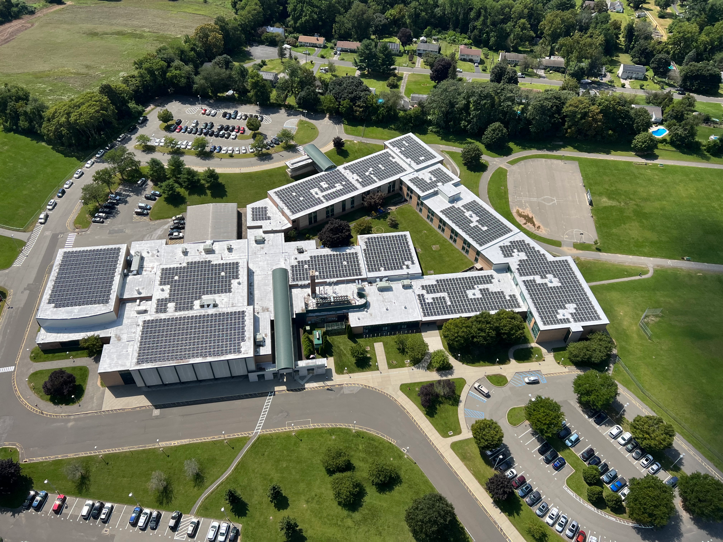
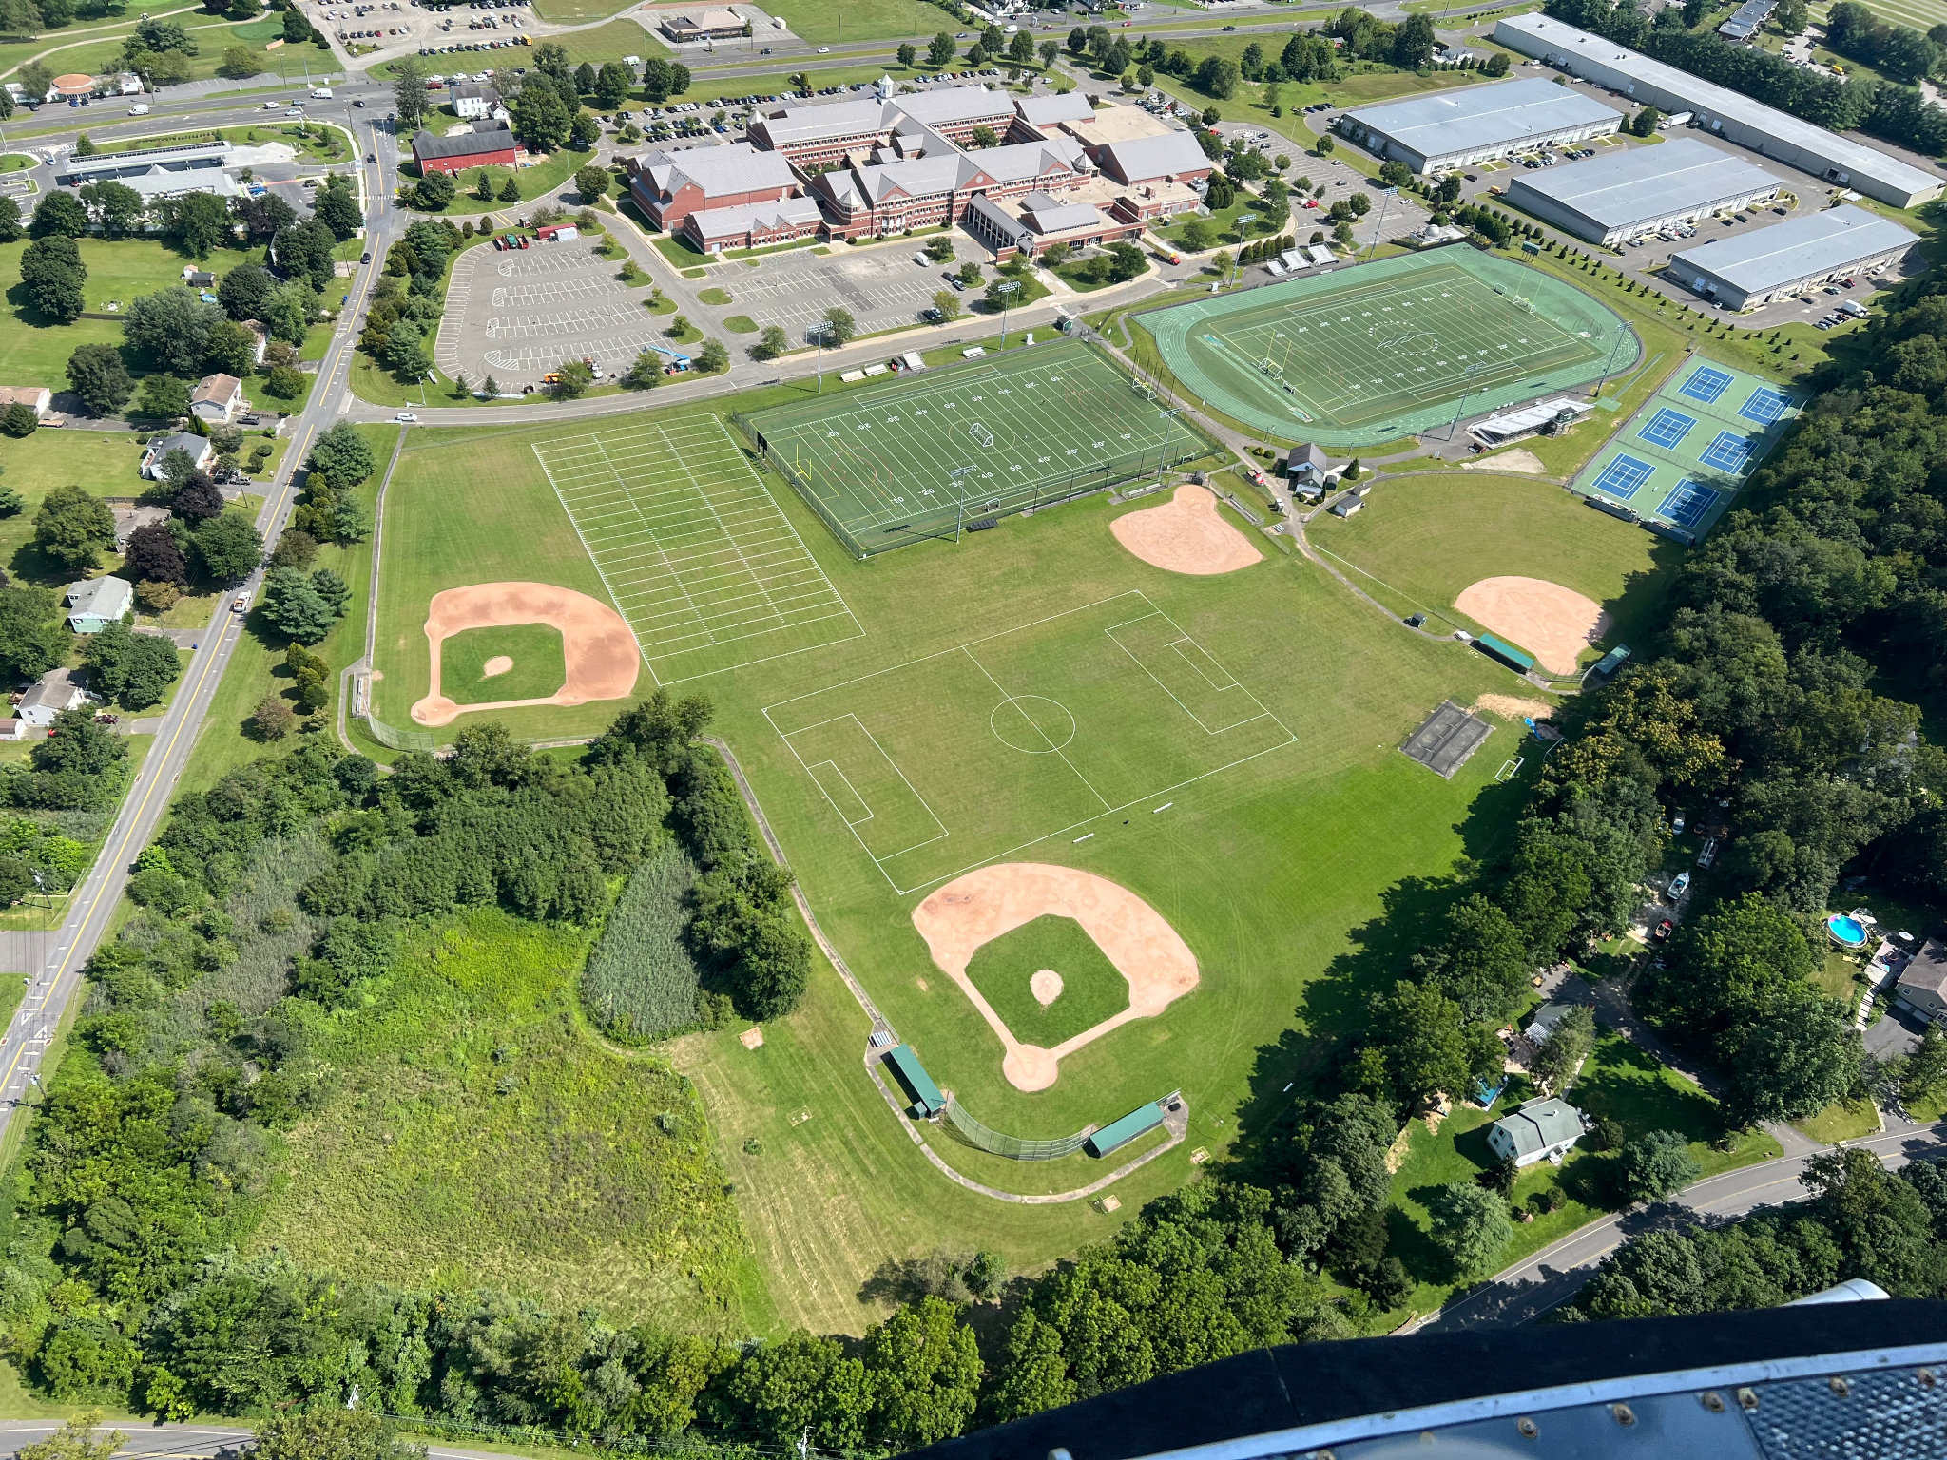
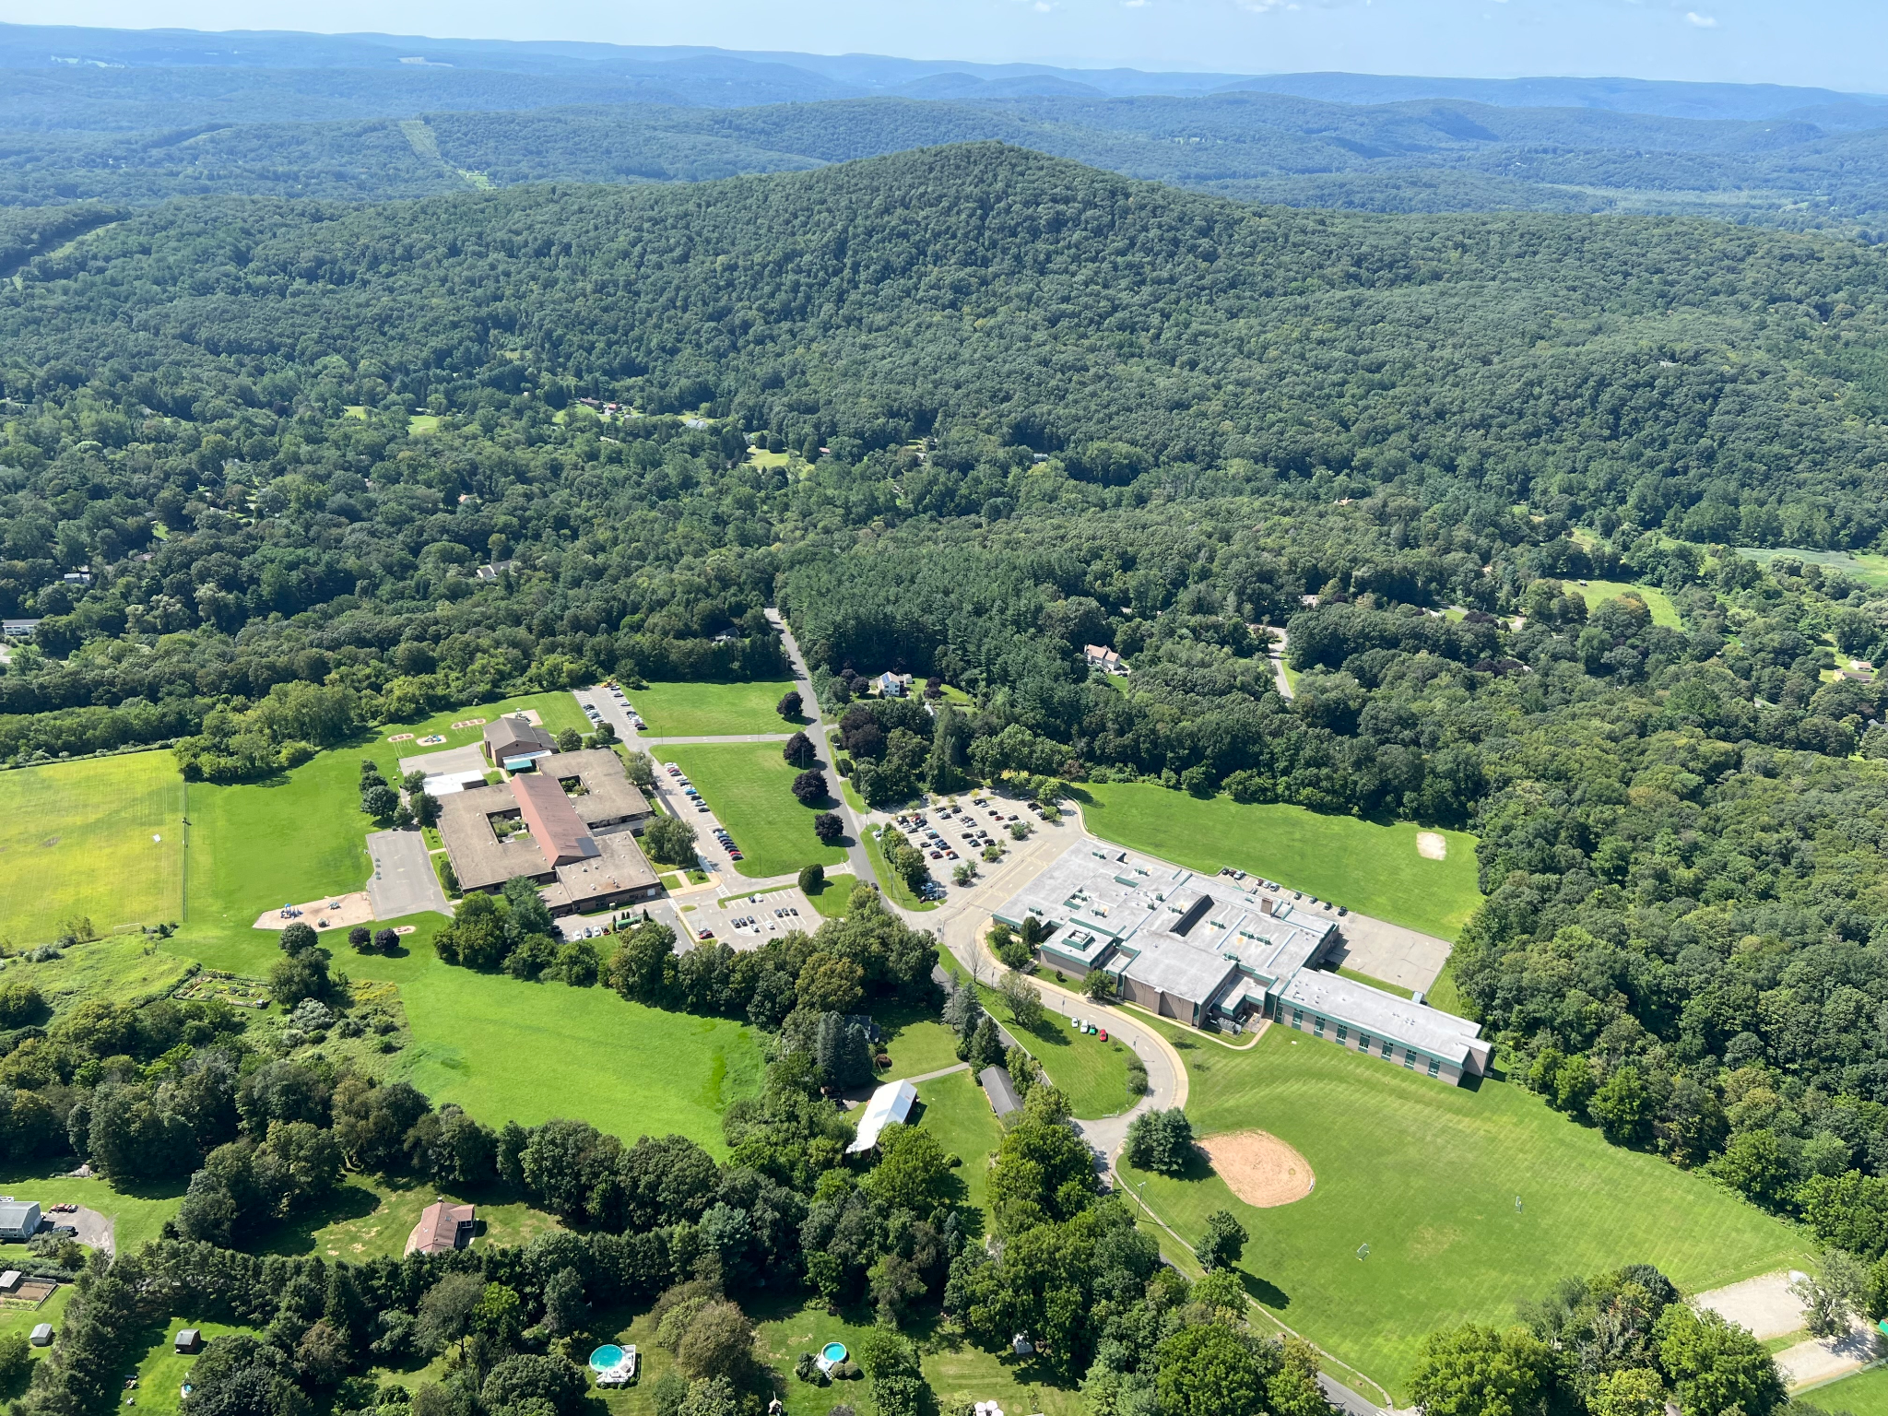
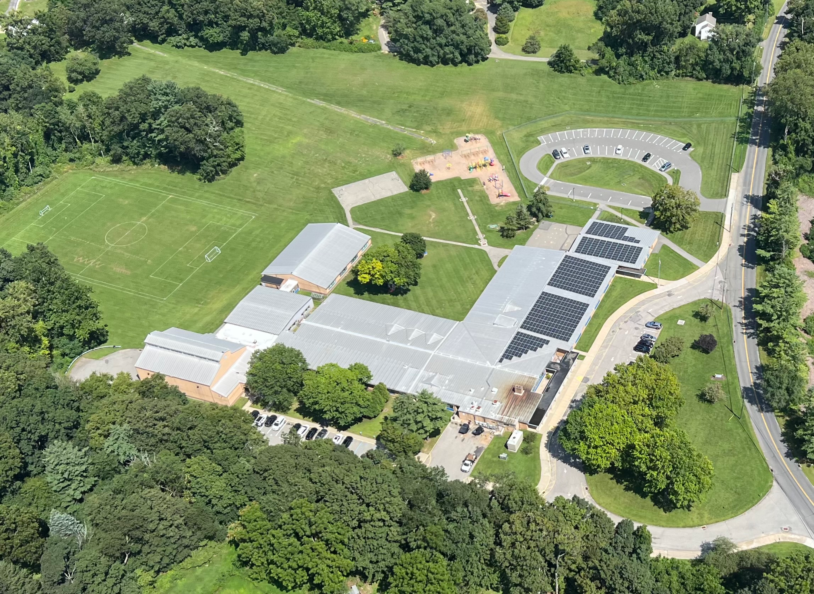
Thank You!

