Slide 1
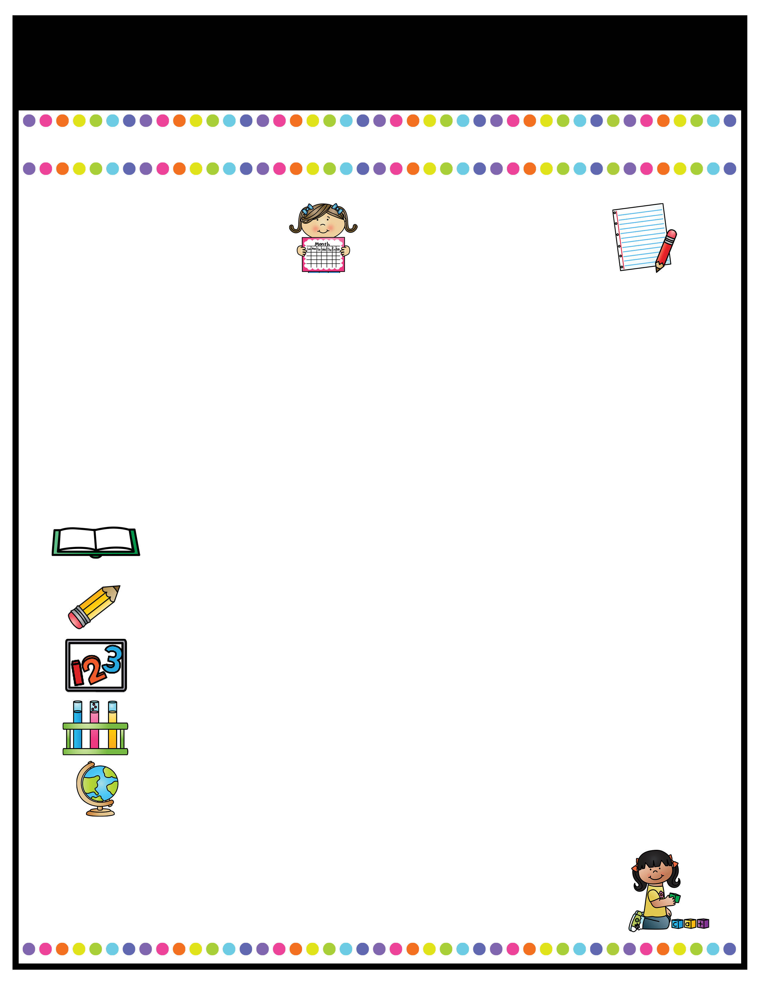
Our Classroom News
Week of: August 15 - 19th
What’s Happening
This Week
A Note From
Mrs. Cook
Math- Topic 1: Understanding Addition & subtraction
1-1: Add to
1-2: Put Together
1-3: Both Addends Unknown
1-4: Take From
1-5: Compare Situations
Science/Social Studies:
All about me, Leader In Me: Habits 1-5
Aug. 19- Sink-a-palooza money due​
Aug. 20- Sink-a-palooza 11-2:00 ​
Aug. 30- Curriculum Night​
A Peek At What We Are Learning
Language Arts: Kindergarten Review -Review of letter shape and sounds letters A-M -Developing new vocabulary- sport, sway, stew, doodle, glide, sails, cherish, lovely, drools, whines, annoys -Distinguish between Author/Illustrator -Make a class alphabet book -Introduce rules & expectations during “workshop time”
Check RED binders DAILY for notes, behavior problems, and classwork. Please sign up for my Remind if you have not done so already! This will be the main form of communication. Our "Classroom News" will come home every Monday with homework and should be completed and returned by Friday.

Slide 2

Our Classroom News
Week of:
What’s Happening
This Week
A Note From
Mrs. Jones
Type event here.
Type event here.
Type event here.
Type event here.
Type your teacher note here.
A Peek At What We Are Learning
Reading | Type your information here.
Writing | Type your information here.
Math | Type your information here.
Science | Type your information here.
Social Studies | Type your information here.
Spelling Words
Type your weekly spelling words here.

Slide 3
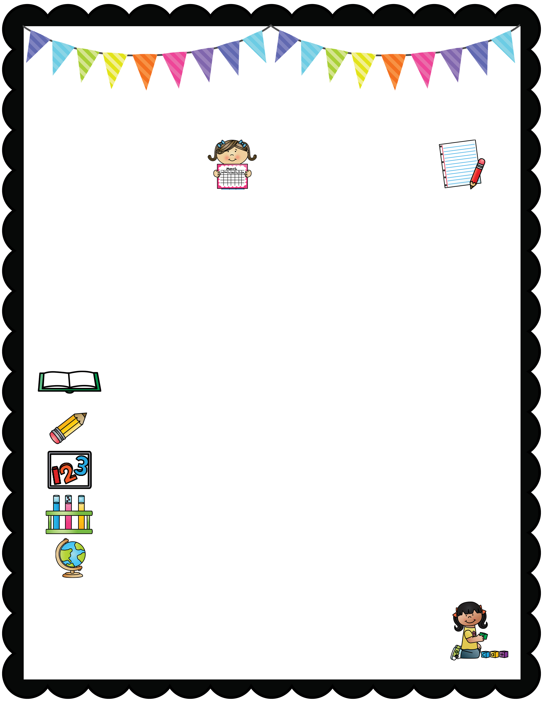
Our Classroom News
What’s Happening
This Week August 28 – Sept. 1st
A Note From
Mrs. Cook
*Topic 1 Math Test: THURSDAY, AUGUST 31st
*Tuesday folders with graded papers will come home on 8/29/23. I need the folder & papers signed AND the papers returned. The papers that come home in black binders daily are for you to keep and help your child practice.
CURRICULUM NIGHT: Tuesday, August 29th
5:30 – 6:30 pm in our classroom
Please come and learn the ins and outs of 1st grade. We will:
-Discuss how and what we grade for each subject
-Issue Power School log in information so you can view your child’s grades
-Question/Answer time
A Peek At What We Are Learning
Reading | Sounds for /p/ /l/ /b/ /o/
Writing | Handwriting Letters Qq - Zz
Math | Topic 1 Review, Topic 1 Test, Begin Topic 2: Add and Subtract up to 10
Language Arts | Common/Proper Nouns (girl/Mrs. Cook) Singular/Plural Nouns (dog/dogs)
Social Studies | LEADER IN ME (7 Habits) Science: My 5 Senses
Mark your calendars for Curriculum Night on August 29th 5:30 – 6:30pm
No school on Monday, September 4th – Labor Day Holiday

Slide 4
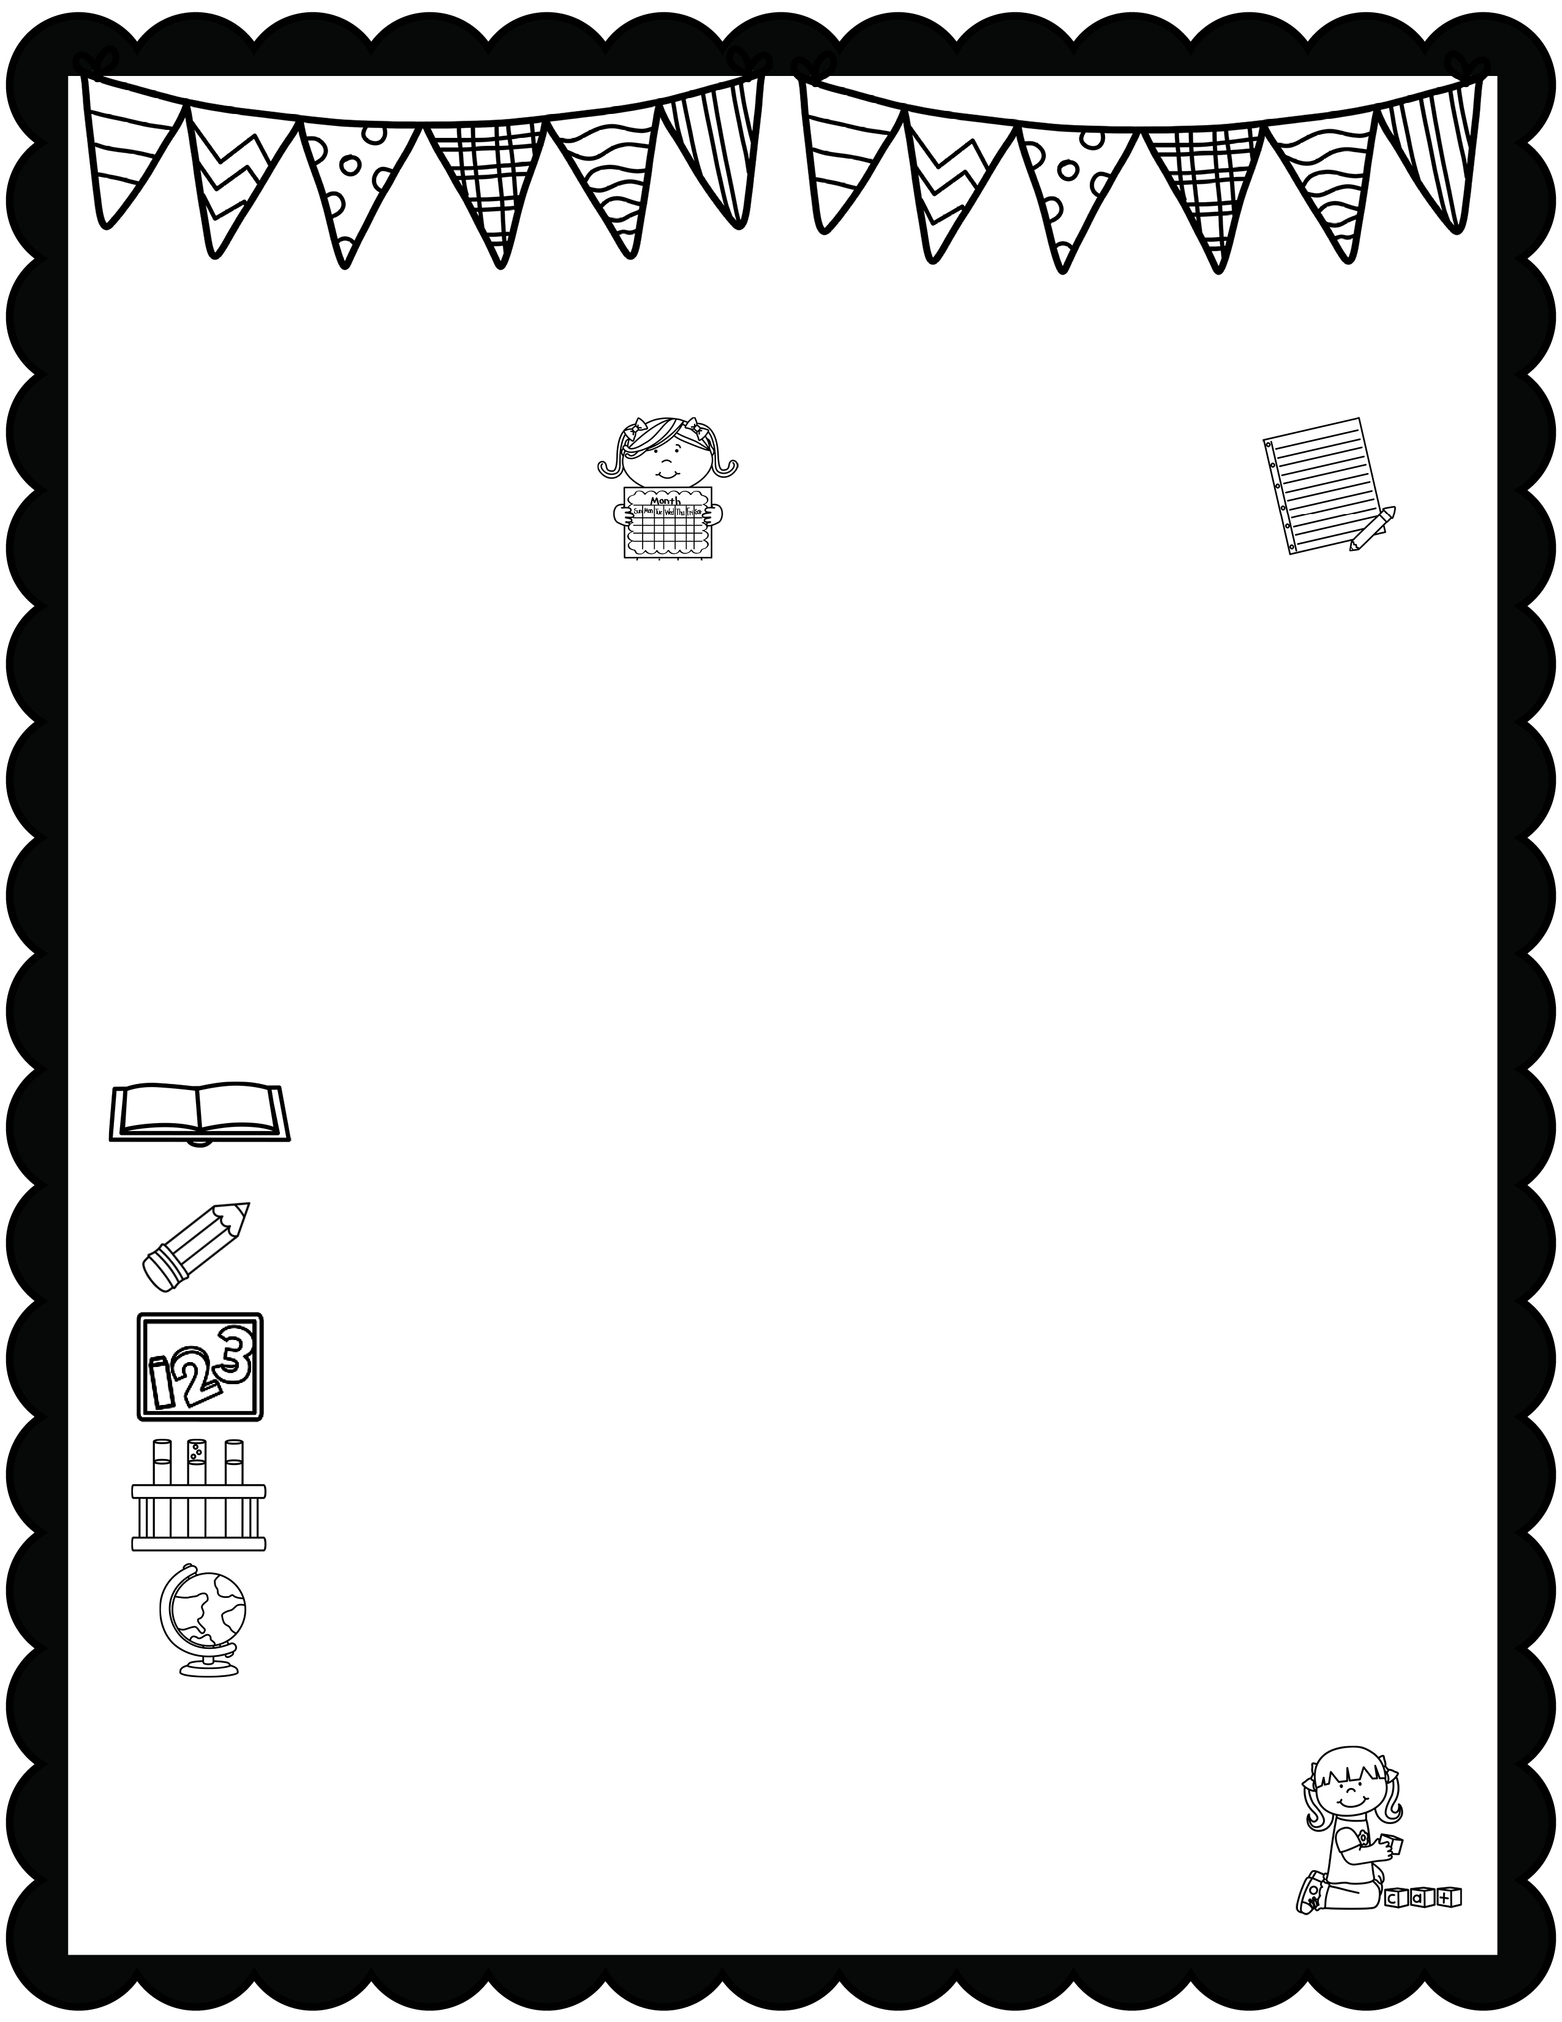
January News
What’s Happening
This Month
A Note From
Mrs. Jones
Type event here.
Type event here.
Type event here.
Type event here.
Type your teacher note here.
A Peek At What We Are Learning
Reading | Type your information here.
Writing | Type your information here.
Math | Type your information here.
Science | Type your information here.
Social Studies | Type your information here.
Spelling Words
Type your weekly spelling words here.

Slide 5

Our Classroom News
Week of:
What’s Happening
This Week
A Note From
Mrs. Jones
Type event here.
Type event here.
Type event here.
Type event here.
Type your teacher note here.
A Peek At What We Are Learning
Reading | Type your information here.
Writing | Type your information here.
Math | Type your information here.
Science | Type your information here.
Social Studies | Type your information here.
Spelling Words
Type your weekly spelling words here.

Slide 6

Our Classroom News
Week of:
What’s Happening
This Week
A Note From
Mrs. Jones
Type event here.
Type event here.
Type event here.
Type event here.
Type your teacher note here.
A Peek At What We Are Learning
Reading | Type your information here.
Writing | Type your information here.
Math | Type your information here.
Science | Type your information here.
Social Studies | Type your information here.
Spelling Words
Type your weekly spelling words here.

Slide 7

January News
What’s Happening
This Month
A Note From
Mrs. Jones
Type event here.
Type event here.
Type event here.
Type event here.
Type your teacher note here.
A Peek At What We Are Learning
Reading | Type your information here.
Writing | Type your information here.
Math | Type your information here.
Science | Type your information here.
Social Studies | Type your information here.
Spelling Words
Type your weekly spelling words here.

Slide 8

January News
What’s Happening
This Month
A Note From
Mrs. Jones
Type event here.
Type event here.
Type event here.
Type event here.
Type your teacher note here.
A Peek At What We Are Learning
Reading | Type your information here.
Writing | Type your information here.
Math | Type your information here.
Science | Type your information here.
Social Studies | Type your information here.
Spelling Words
Type your weekly spelling words here.

