Slide 1
FRESHWATER-
MOBILE BAY WATERSHED

Slide 2
A. AREA AND LOCATION
THE MOBILE BAY WATERSHED COVERS 65% OF THE STATE OF ALABAMA, PLUS PARTS OF WESTERN GEORGIA, EASTERN MISSISSIPPI, AND SOUTHERN TENNESSEE.
ALL OF THE WATER FROM THESE PLACES TRAVELS THROUGH TRIBUTARIES, ENTERS RIVERS IN ALABAMA, AND TRAVELS DOWN THROUGH THE STATE EMPTYING INTO MOBILE BAY, AND EVENTUALLY THE GULF OF MEXICO.

Slide 3
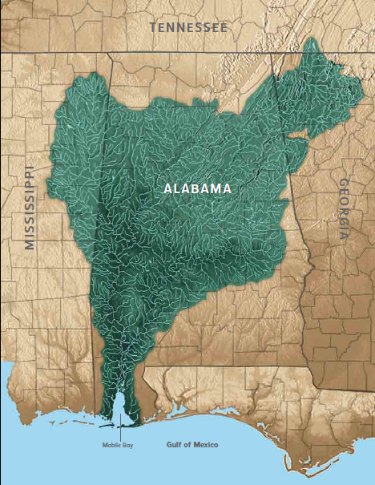

Slide 4
B. MAJOR ALABAMA RIVERS IN THE WATERSHED
MOBILE RIVER, TOMBIGBEE RIVER, BLACK WARRIOR RIVER, ALABAMA RIVER, COOSA RIVER, TALLAPOOSSA RIVER
MORE THAN 250 SMALLER RIVERS, CREEKS AND STREAMS ARE ALSO PART OF THIS HUGE WATERSHED.

Slide 5
C. ENVIRONMENTAL ISSUES
MANY EXTINCT AND ENDANGERED SPECIES DUE TO DAMS AND LOCKS ON RIVERS.
POINT SOURCE POLLUTION- SPECIFIC PLACE-FACTORIES, PLANTS
NONPOINT SOURCE POLLUTION- UNKNOWN SOURCE-EVERYWHERE- FARMS, ROADWAYS, CONSTRUCTION SITES, RUNOFF, LITTER
ALL OF THESE ISSUES WERE CAUSED BY HUMAN ACTIONS WITHIN THE WATERSHED.

Slide 6
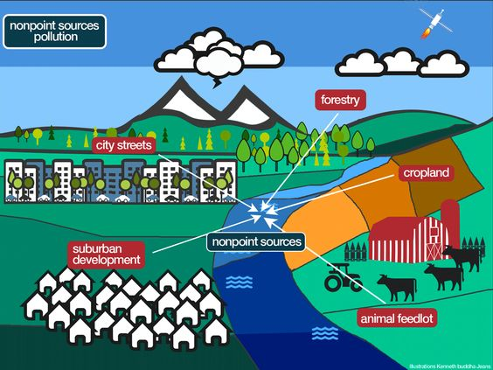

Slide 7
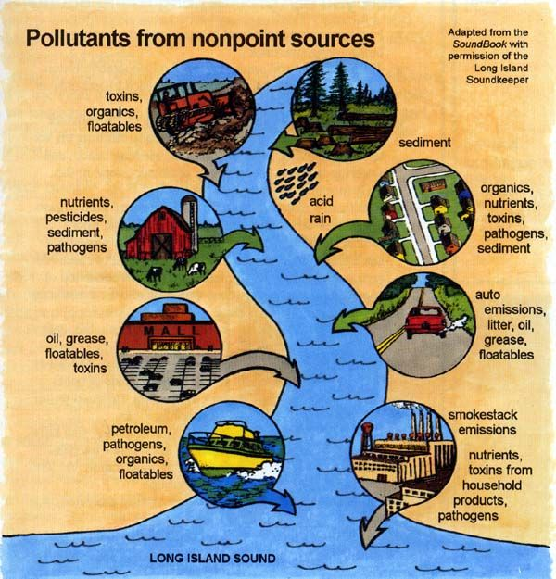

Slide 8
