Slide 1
JES SIC MEETING
September 9, 2024
Welcome
Report to the People(Mrs. Pope)
Fundraiser
Title One Presentation
JES Academic Progress
SIC Goals
Questions
Closing

Slide 2

Title One Meeting for JES
2024-2025

Slide 3
Title One
What is Title I?
Title 1 is the largest federal aid program for public schools in the United States. Title I is a federal entitlement program that gives funds to schools in need based on student enrollment, the free and reduced lunch percentage for each school, and other informative data.
Y24 Title I Allocation: $402, 421.91
Y25 Title I Allocation: $361, 314.23
  Approximately $351,000 used to hire extra teachers to reduce class sizes and provide a Parent Liaison
  Remaining $10,000 for instructional software and supplies

Slide 4
JES Title One Funds
Staff Member Salaries
IReady – resources and materials
Instructional Programs
  5K Connections-ESGI
  Reflex Math
Instructional Supplies
Professional Development
Family Engagement Opportunities
Homeless School Supplies

Slide 5
Title I School
What is a Title I School?
Being a Title I, Part A school means receiving federal funding (Title I, Part A dollars) to supplement the school’s existing programs.
These dollars can be used for the following:
  Identifying students experiencing academic difficulties and providing timely assistance to help these students meet the challenging content standards.
  Conducting parent and family engagement meetings, trainings, and activities.

Slide 6

Review the Parenting Policy for JES
Parent And Family Engagement Policy
Parents’ Right To Know
Florence County School District Five seeks the participation, input, and advice of all Title One Parents with respect to the joint development of the LEA plan and the process of school review and improvement. The coordinator of the Title One project provides oversight, technical assistance, and support to assist schools in their role of developing effective parent and family engagement. A focus is to build the schools and parent’s capacity for strong involvement. The coordinator will also oversee and integrate parent and family engagement in other programs such as Head Start and First Steps.
To determine the effectiveness of this policy, as to increase parent and family engagement and to overcome the barriers to participation as noted in the law, the coordinator of the Title One project will meet with the School Improvement Council. All parents will be invited by sending letters of invitation as well as sending messages to parents’ phones and email addresses. Teachers will also be invited. The meeting will be held on a day and time determined to be the most convenient for the majority of parents. A detailed explanation of the Title One program and its activities will be presented at the meeting. Parents will be given information concerning the school’s progress at the meeting. Information concerning dates of parent teacher conferences will also be shared. Parents having questions concerning the school or their child’s progress are welcome at the school. Parents wishing to meet with teachers or visit classrooms are asked to contact the principal of the school at 843-386 2955. The school parent compact will be reviewed at the meeting to see if changes are needed.
Comments and concerns will be solicited, and findings will be used to design strategies for school improvement and, if necessary, a review of our LEA and school parent and family engagement issues.
Parents may request information regarding the professional qualifications of a student’s classroom teachers, including:
• Whether the teacher has met State qualifications and licensing criteria for the grade levels and subject areas in which the teacher provides instruction.
• Whether the teacher is teaching under emergency or other provisional status through which state qualification or licensing criteria have been waived.
• The baccalaureate degree major of the teacher and any other graduate certification or degree held by the teacher, and the field of discipline of the certification or degree.
• Whether the child is provided services by paraprofessionals and, if so, their qualifications.
• Information on the level of achievement of the parent’s child in each of the State academic assessments as required under this part.
Please contact JES Administration at 386-2955 or Brian Goins at 386-2358 to answer any questions you may have concerning the qualifications of your child’s teacher.
Parents of Children Who Are English Language Learners
We encourage parents of children who are English Language Learners to contact JES Administration or Mrs. Lesley Huggins at 386-2955 with any concerns or ideas about their children or the schools in which they attend. We offer services that can assist you and your child.

Slide 7
Parent and Family Engagement Policy
The policy addresses how the school will implement the parent and family engagement program.
The school must convene an annual meeting.
The school must provide a flexible number of meetings.
The school must involve parents in an organized, ongoing, and timely way, in the planning, review, and improvement of the parent and family engagement program.
The school must provide timely information about parent and family engagement activities.
The school must provide information to parents about curriculum and assessment.
Title I parents have the right to be involved in the development of the school policy.

Slide 8
Parent Compact Review
Johnsonville Elementary School and the parents of students participating in activities, services, and programs funded by Title I agree that this compact outlines how they will share the responsibility for improved student academic achievement and how the school and parents will build and develop a partnership that will help children achieve the State's high standards. The school-parent compact will be in effect during the 2024-2025 school year.
School Responsibilities
Johnsonville Elementary School will support our children's learning in the following ways:
The curriculum used by teachers is revised by teachers in their grade levels to meet the needs of students on a yearly basis.
Provide high-quality curriculum and instruction in a supportive and effective learning environment that enables the participating children to meet the State's academic achievement standards as follows:
The school provides many programs to assist students in mastering standards.
Tutoring in reading is provided during the school day to assist students who are having difficulties in grades k-2.
Teachers use iReady testing to assess student weaknesses in subject areas so that additional help can be provided.
Teachers are also using technology to make instruction more interactive and exciting for students.
We encourage parents to contact their child's teacher to discuss the progress of the student.
Hold parent-teacher conferences:
Parents will be contacted by their child’s teacher through Class Dojo.
Provide parents with reports on their Child's progress:
Interim reports will be sent in the middle of each nine-week grading period via bright Bright Arrow.
Reports will be sent to parents each 9 weeks that give information on their child's progress via Bright Arrow.
Provide the opportunity for parents to consult with teachers and volunteer and observe in their child’s class:
The school welcomes parents to schedule virtual or in person appointments with teachers at the school concerning the progress of their child.
Please call the school at 386- 2955 to schedule an appointment or contact your child’s teacher through Class Dojo.

Slide 9
Parent Compact Review
Parent Responsibilities:
We, as parents, will support our children's learning in the following ways:
Monitoring attendance
Making sure homework is completed
Monitoring amount of television my child watches
Participating, as appropriate, in decisions relating to my children's education
Promoting positive use of my Child's extracurricular time
Staying informed about my child's education and communicating with the school by promptly reading all notices from the school and responding as appropriate
Serving to the extent possible on school committees and attending PTO
Student Responsibilities:
The student will:
Come to school prepared to learn
Attend school regularly and on time
Complete all class and homework assignments to the best of his/her ability
Ask for help and support when needed

Slide 10
Title One Annual Evaluation
Annual Evaluation
The content and effectiveness of the parental involvement policy and program must be evaluated annually
Data and input might include…
A. Parent questionnaires and surveys
B. Focus groups
C. Parent advisory committee input
Report findings to parents and families and use those results to revise the parental involvement policy and school-parent compact

Slide 11
Title One Annual Evaluation
Annual Evaluation - 2024 Title 1 Parent Survey Results
Of the 38 parents who completed the survey, 36 parents said that they participated in a parental involvement activity at some point during the 2023-2024 school year.
Parents also responded positively when asked to rate the effectiveness of the parental involvement activities on a scale of 1 to 3: 19 responded with 3, 16 responded with 2, 1 responded with 1, and 2 did not answer this question.
When asked if they received information from the school about their child’s test scores, 29 parents responded Yes, 5 responded No, and 4 were not sure.
Parents were also asked if they received a copy of the Parent Engagement Policy in the school handbook with 25 parents responding Yes, 2 responding No, and 11 were not sure.
When asked if they received a copy of the school/parent compact sent at the beginning of the school year 28 responded with Yes, 0 with No, and 10 were not sure.
The majority of parents agreed that the school scheduled parent/teacher conferences at convenient times with 34 saying Yes and 4 saying No.
As expected, when asked what day and time of the week is most convenient for parents to participate in parent engagement activities the results were widespread. JES administration will look at the data to ensure they can accommodate the majority of these times and days.
Overall, most of the feedback was positive for the 2023-2024 school year and great ideas were presented for next school year.

Slide 12

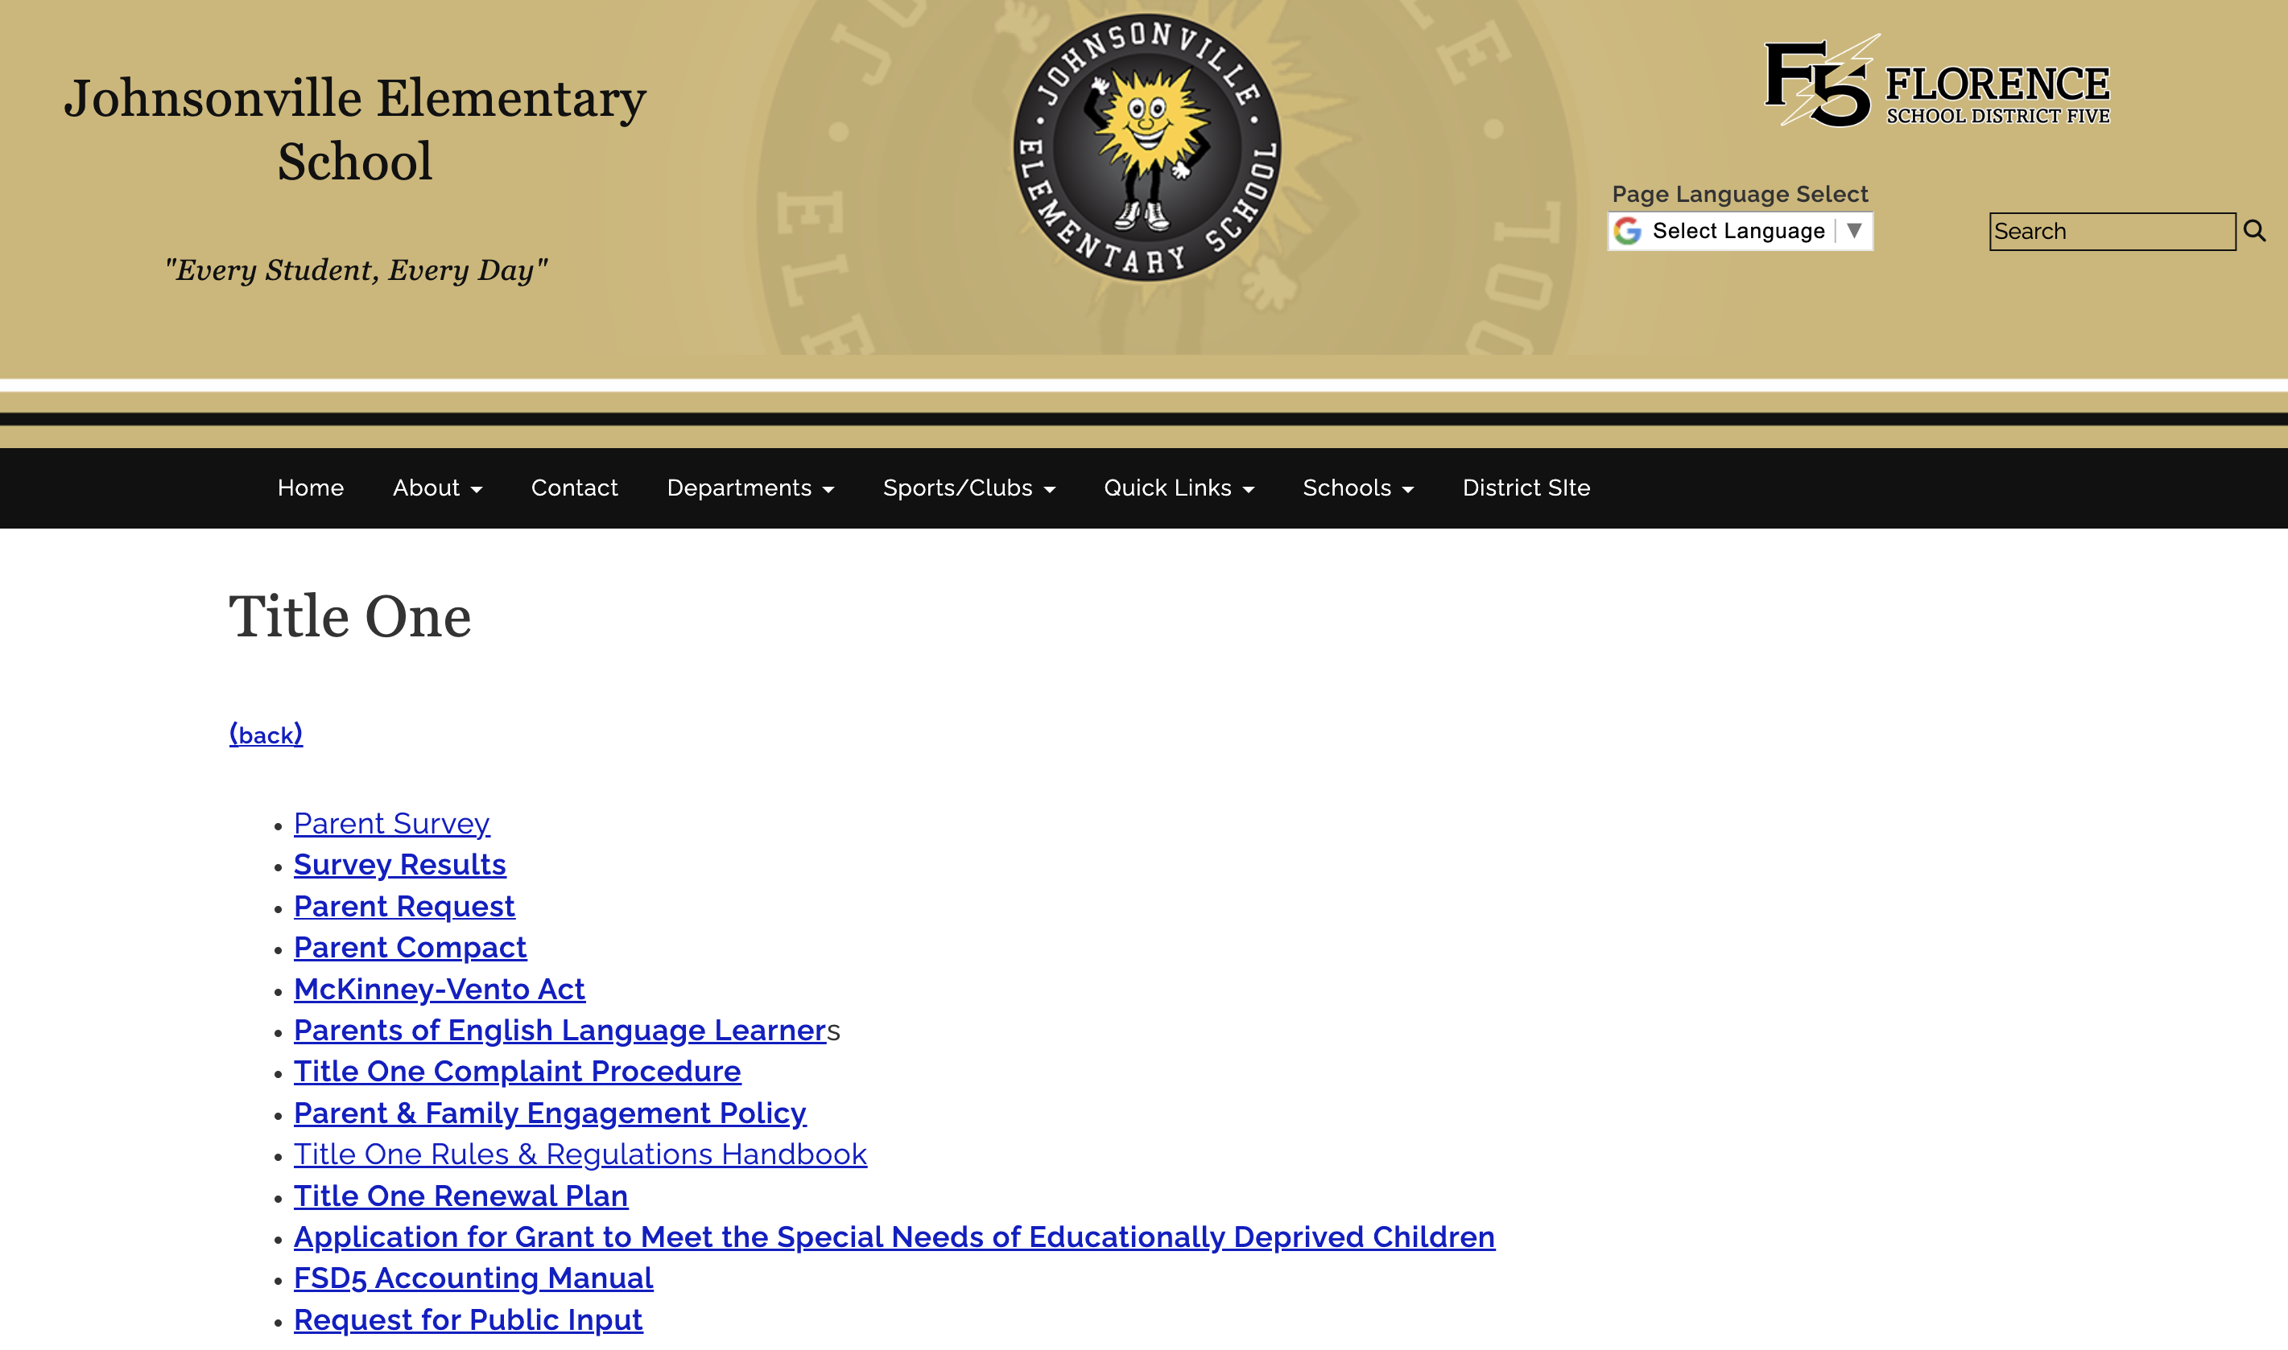
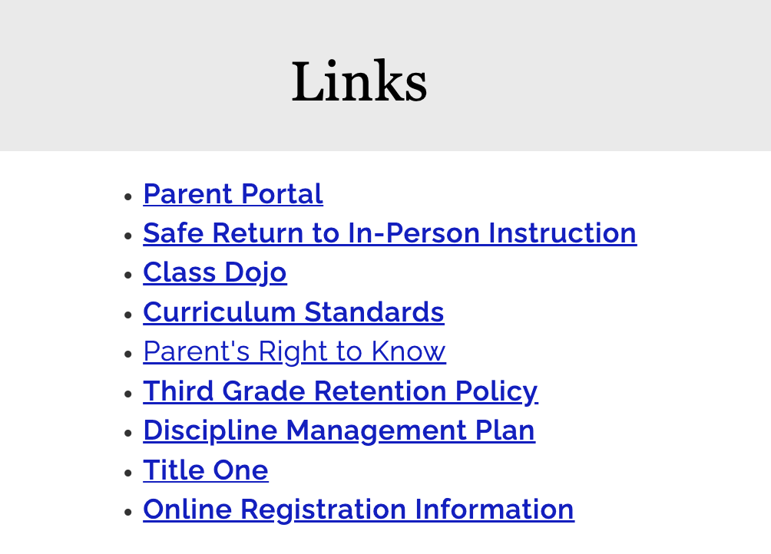
JES Title I - Webpage
https://elemflorencesc.schoolinsites.com/titleone
This link can be found by clicking the parents tab.

Slide 13
LETRS at JES
All of our teachers are receiving training in LETRS (Language Essentials for Teachers of Reading and Spelling)
LETRS is grounded in the science of reading. It addresses how to teach the skills required for proficient reading and writing.
Teachers meet with a certified LETRS trainer 4 times each year and complete weekly lessons in between. We have monthly meetings with the Reading Coach to discuss the application of what we have learned in our classrooms.
LETRS provides teachers with many different strategies for meeting the needs of our students.

Slide 14
HMH – Into Reading
Into Reading is the new state adopted curriculum that we are using at JES this year. It is 100% aligned to our SC ELA standards.
The program focuses on the 5 Big Areas of Reading – Phonemic Awareness, Phonics, Fluency, Vocabulary, and Comprehension
The curriculum is rigorous to match the rigor of the SC Ready Test.
The program is both digital and in book format. Students can access the HMH – Ed platform at home.

Slide 15
JES School Report Card
2022-2023
https://screportcards.com/overview/?q=eT0yMDIzJnQ9RSZzaWQ9MjEwNTA0Nw

Slide 16
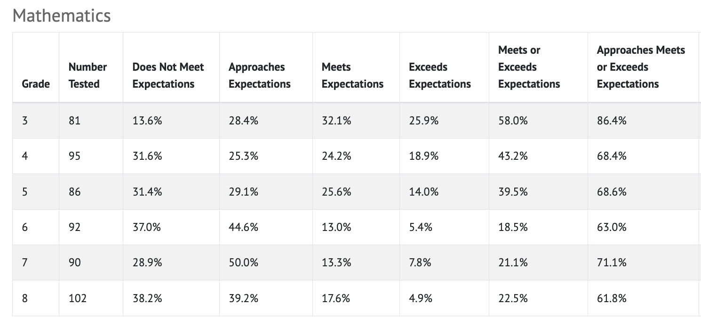
Y23 Test Scores
33%
29.5%
41.9%
46.6%
45.3%
43.3%
19.8%
28.4%
27.9%
31.8%
45.3%
34.6%
28.6%
21.6%
25.6%
14.8%
6.3%
8.7%
18.7%
20.5%
4.7%
6.8%
3.2%
13.5%
47.3%
42%
30.2%
21.6%
9.5%
22.1%
67%
70.5%
58.1%
53.4%
54.7%
56.7%
47.5% 70.0%
32.3% 65.6%

Slide 17
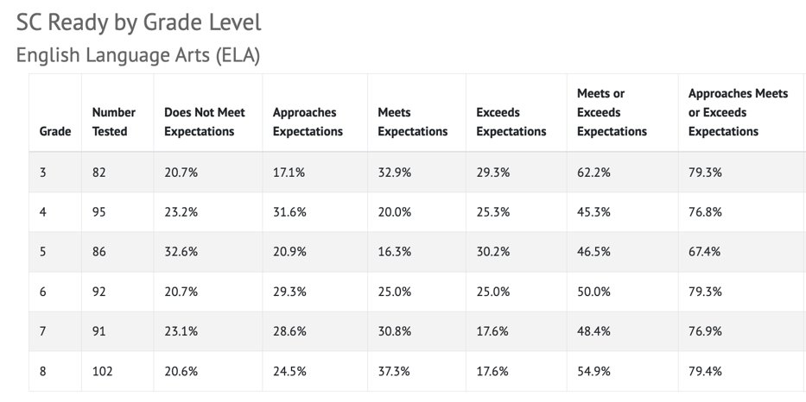
Y23 Test Scores
26.4%
38.6%
34.9%
25.0%
29.8%
28.6%
37.4%
26.1%
32.6%
36.4%
39.4%
33.3%
23.1%
10.2%
22.1%
28.4%
24.5%
24.8%
13.2%
25.0%
10.5%
10.2%
6.4%
13.3%
36.3%
35.2%
32.6%
38.6%
30.9%
38.1%
73.6%
61.4%
65.1%
75.0%
70.2%
71.4%
46.3% 73.8%
49.0% 68.8%

Slide 18
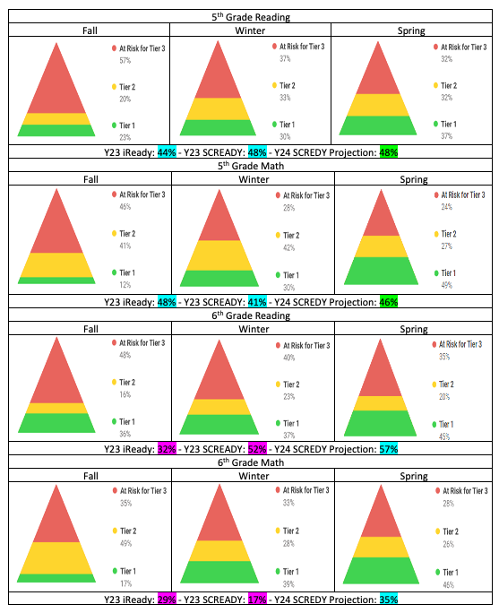
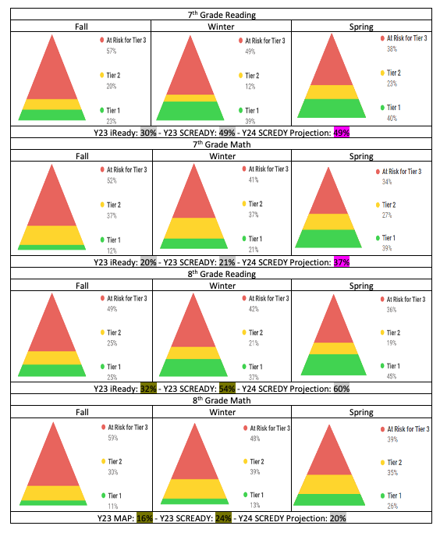
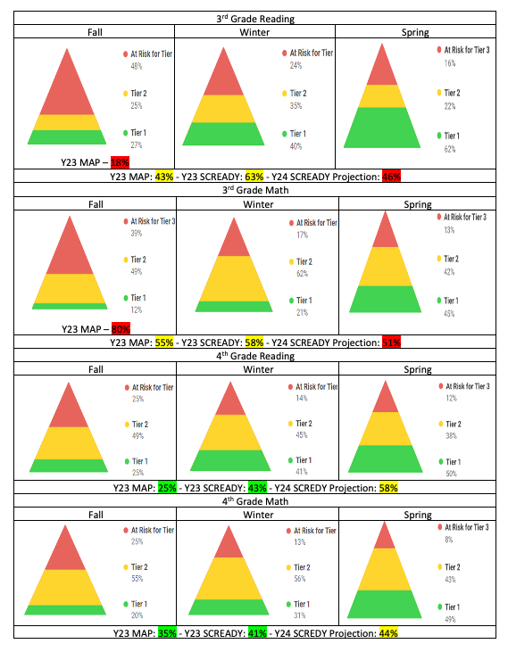
iReady Spring 2024

Slide 19
JES EVENTS
September 16, 2024 3rd Grade Parent Night
October P/T Conferences
December 3, 2024 JES Family Literacy Night

Slide 20
Questions
If you have questions, please don’t hesitate to contact Mrs. Burrows or Mr. Johnson.
Email lburrows@fsd5.org
Email ljohnson@fsd5.org
Phone # 843-386-2955

