Slide 1













Voices for
the Vision
SHARED DECISION MAKING PARENT MEETING
03/17/2026

Slide 2



Agenda
  Welcome and Introductions
  Our FE Program (highlights)
  Achievement Data
  2026 Parent Survey Results
  Family Engagement Plan
  School-Family Compact
  Program Supports & Use of Funds
  Parent Input Form

Slide 3
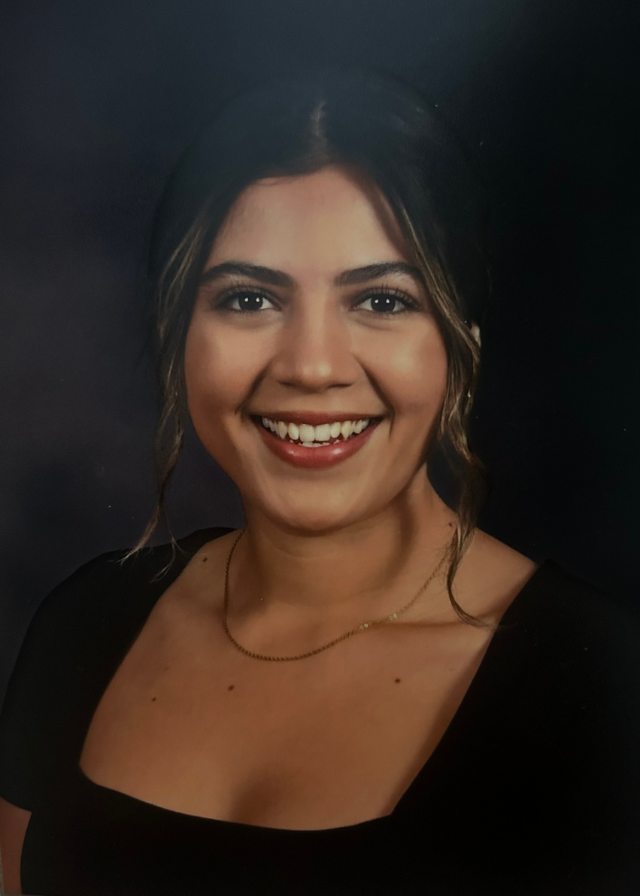
Welcome and Introductions
Family Engagement Liaison
Daniela Stockton. I’ve been at Miller Elementary since January 2025. .
Goal
My goal is to create a welcoming space where parents feel comfortable reaching out to me.
I’m here to support families, connect them with resources , and provide opportunities to be involved in their child’s education. I look forward to building strong partnerships this year.
Parents, please introduce yourselves and tell me your child’s name and grade level.

Slide 4


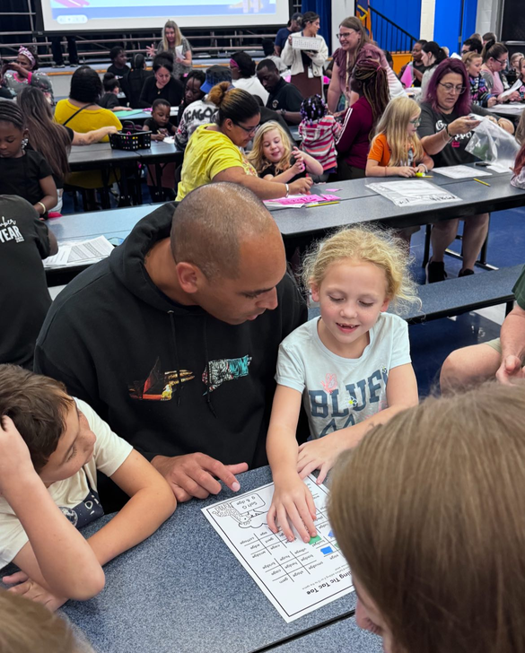
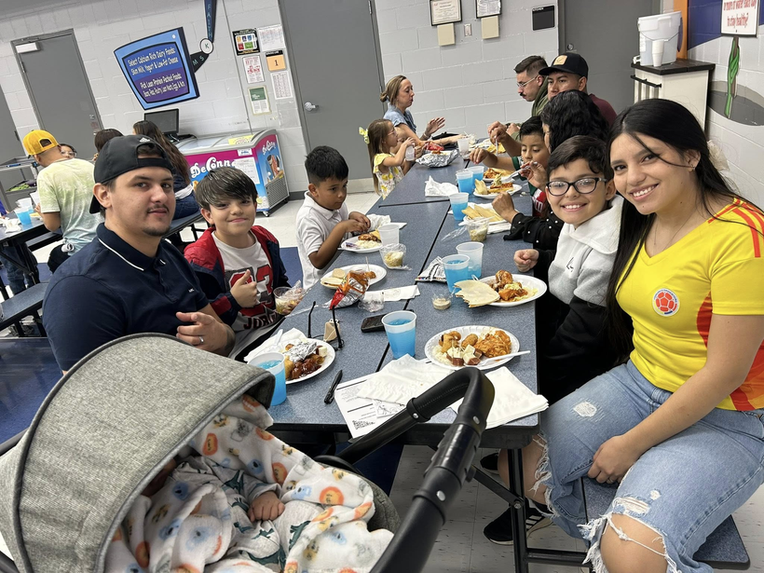
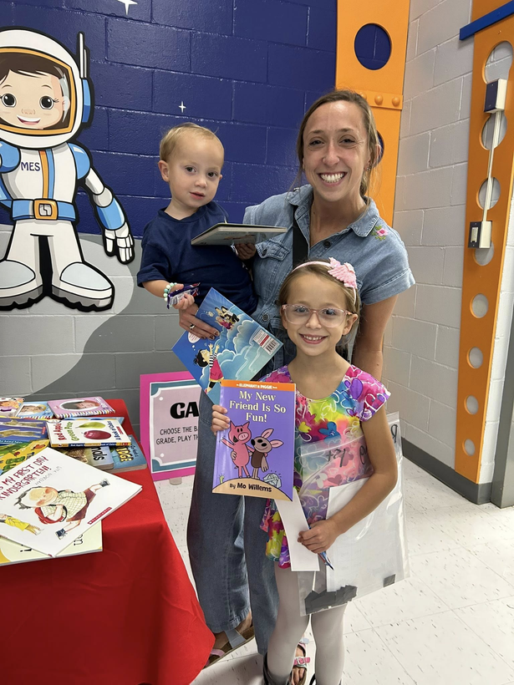
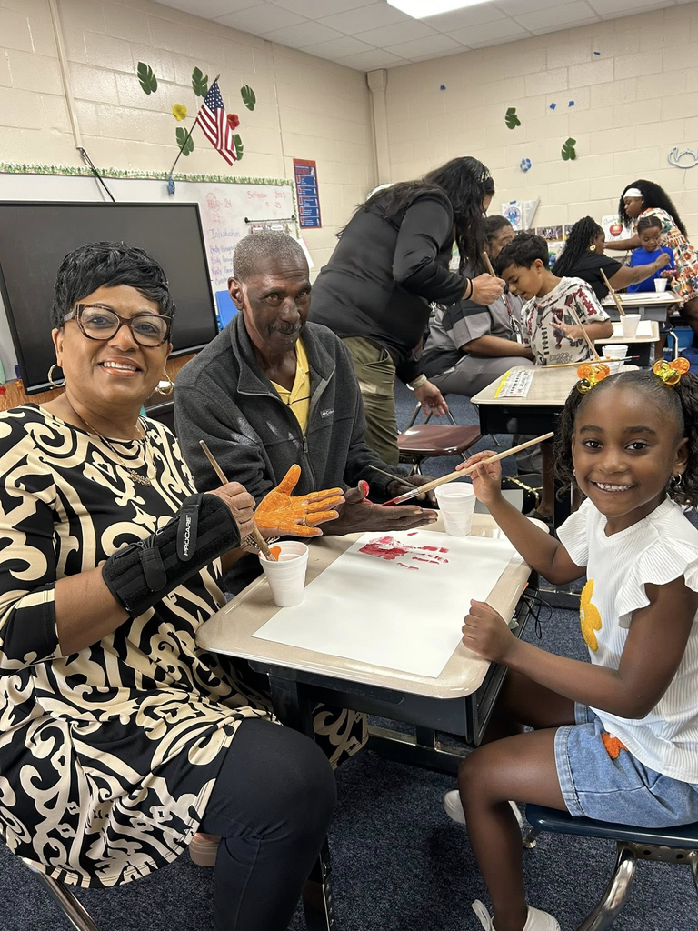
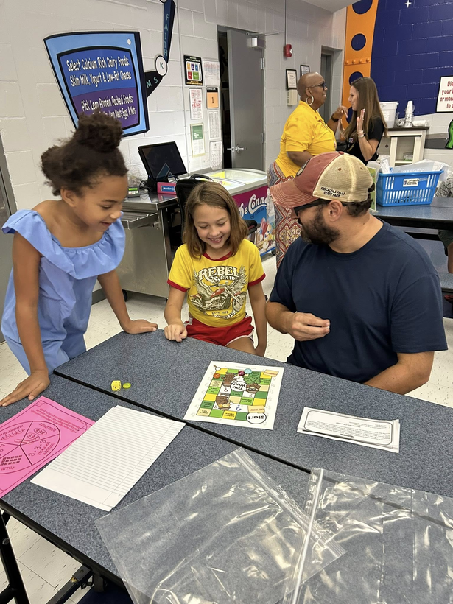
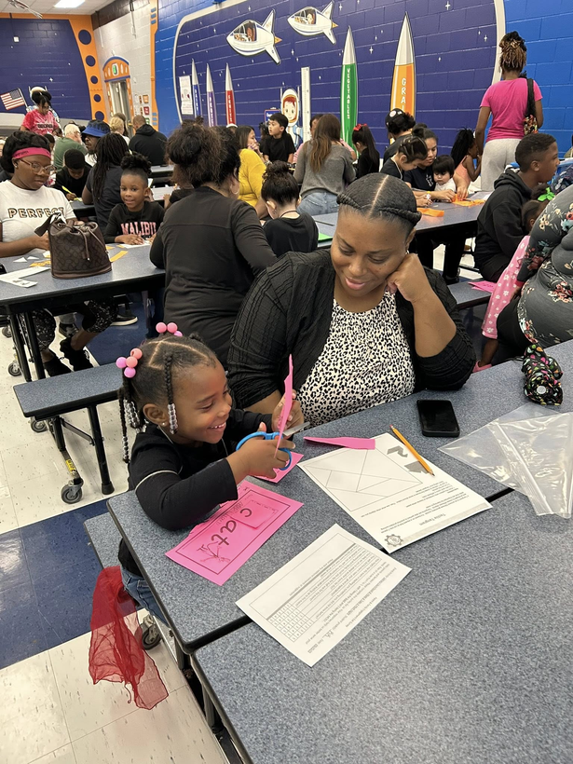
Our FE Program (highlights)

Slide 5
Achievement Data
Grade 1:
  ELA 58% → 64% (+6 pts)
  Math 35% → 41% (+6 pts).
Grade 2:
  ELA 38% → 43% (+5 pts)
  Math 32% → 38% (+6 pts).
Grade 3:
  ELA 50% → 57% (+7 pts)
  Math 44% → 50% (+6 pts).
Grade 4
  ELA 43% → 49% (+6 pts)
  Math 46% → 50% (+4 pts).
Grade 5
  ELA 41% → 48% (+7 pts)
  Math 25% → 30% (+5 pts).

Slide 6






2025-26 Parent Satisfaction Survey Results
I am comfortable communicating with my child's teacher(s).
My child's school has high expectations for student achievement.
All/most of the Time: 90.20%
Some of the Time – 8.33%
All/most of the Time: 91.04%
Some of the Time – 7.46%
What is the MAIN way you prefer your child's school to communicate
information to you?
How often did you attend the family events and workshops?
HCSD App: 38.83%
text messages – 21.36%
All/most of the Time: 41.58%
Some of the Time – 47.03%

Slide 7
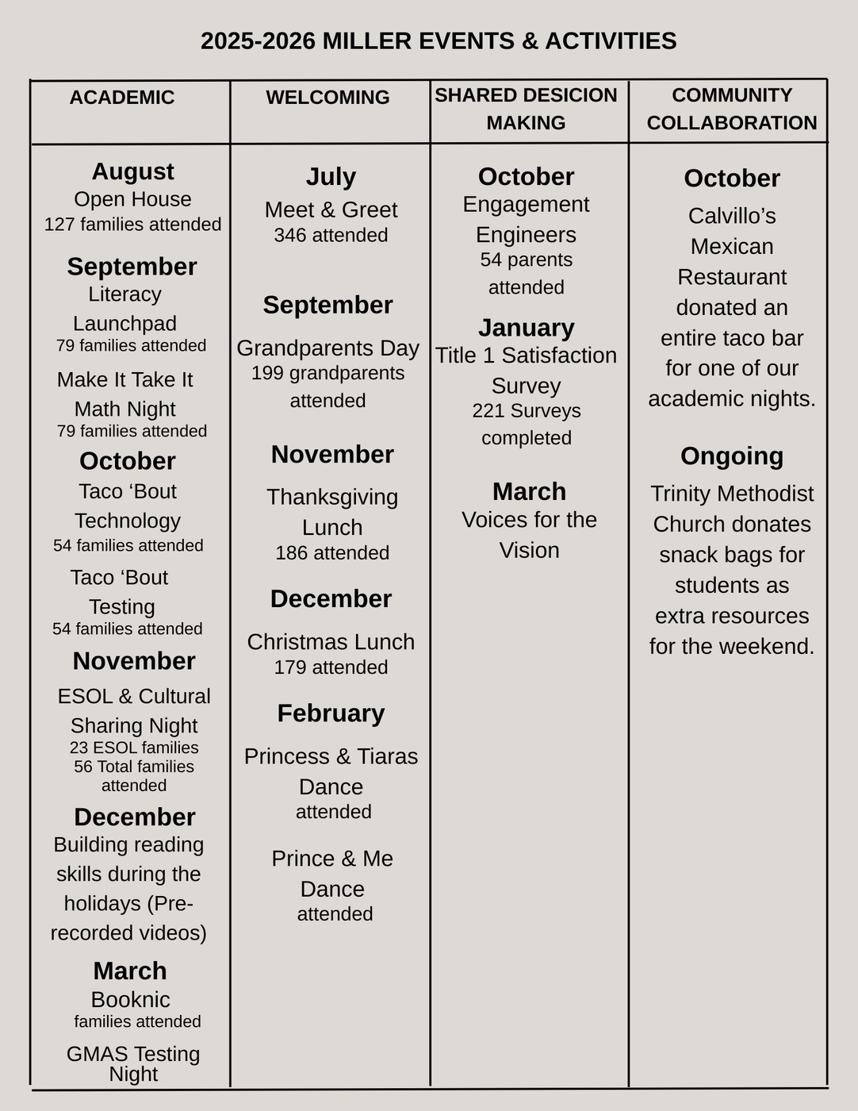
The Connection :
Family Engagement Plan
Where you able to attend any of these family engagement events this year?
If so, in what ways can we improve the event(s)?
What other academic-based or family-fun type activities would you like us to consider offering?

Slide 8
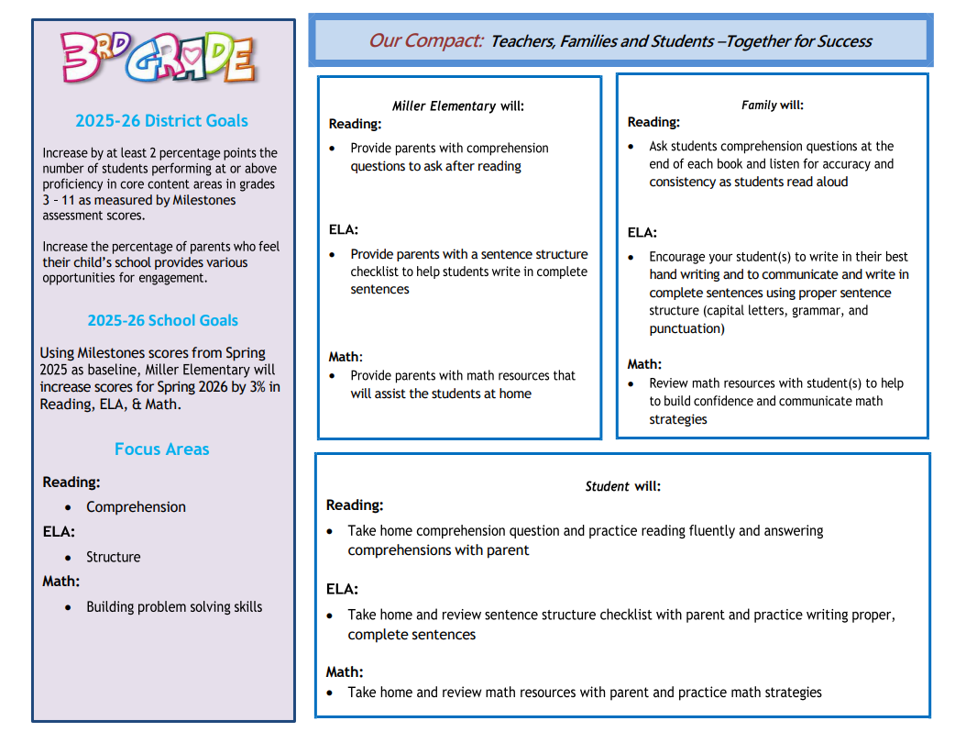
The Connection :
School-Parent Compact
In what subject area or concept does your child have the most difficulty?
What can the school do to better support you and your child in that area?
What are some things you and your child would be willing to do in order to see improvement in that area?

Slide 9


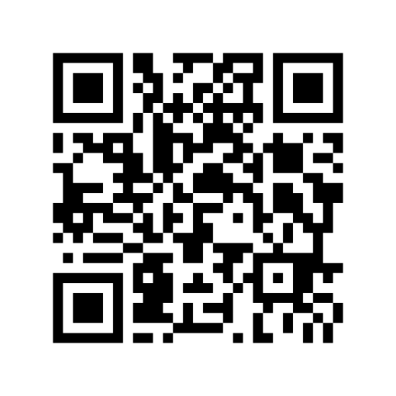
Program Supports & Use of Funds
How can we increase family engagement and participation?
Do you have any suggesions as to how Title 1 money could be used to improve or support the family program?
Do you agree for Title 1 schools to pool some of their funds to support a district-level project/activity?
What are some things you want teachers and administrators to learn more about to better support you and your child?
Are you interested in joining our Parent Action Team or working with school staff on Professional Development?
Lindsey Student Support Center
(478) 929-7818

Slide 10


Parent Input Form
Please complete the short Feedback Questionnaire. Your input is extremely important in helping us to improve our family program.​

Slide 11

Thank you!
FEL Contact Information​
Daniela Stockton
Daniela.stockton@hcbe.net
(478) 929-7814 Ext. 2457

