Slide 1
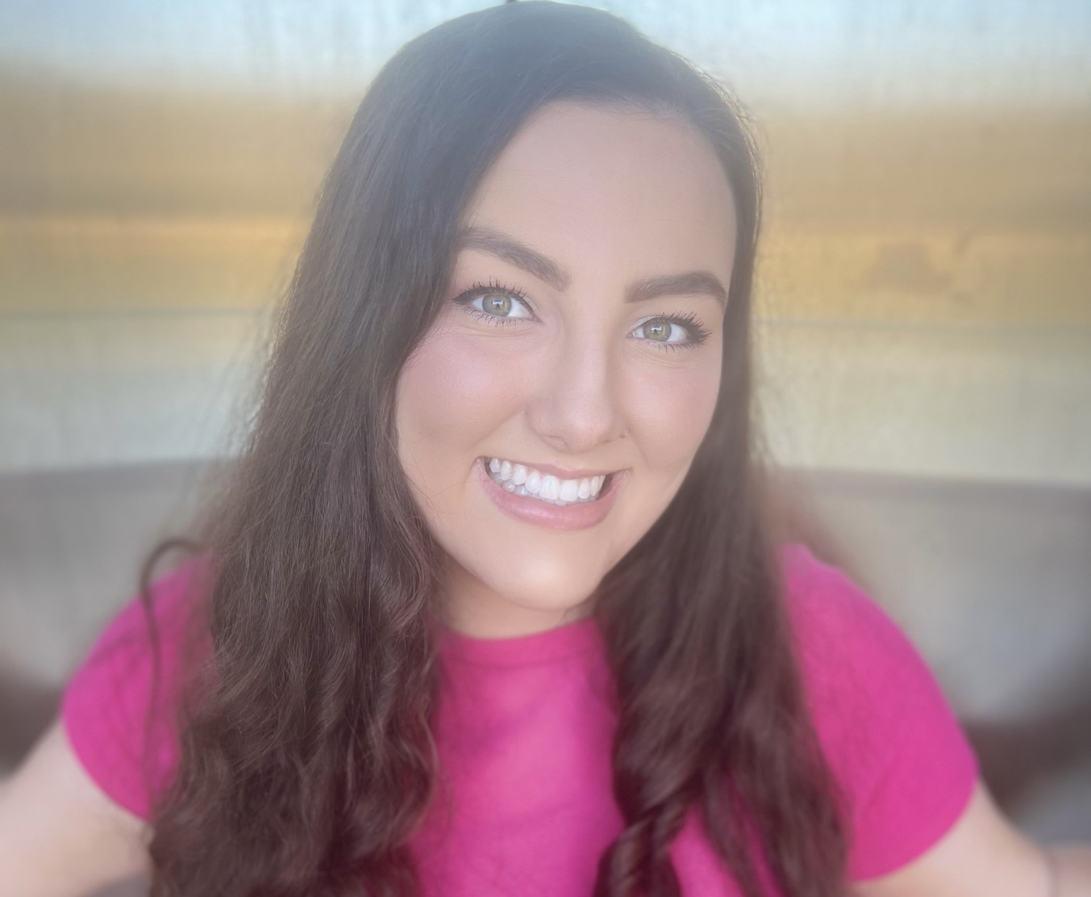
meet
the
teacher
About me
More info
hello
I am married to Jordan Phelps, and we are currently residents of Montgomery! We have a golden retriever (Charley), and two sweet kitty cats (Aubie and Socks). When I'm not at school I enjoy going to live music events, reading, and taking my dog on adventures! Jordan and I are also big Auburn Football fans! During football season you can find us in Auburn, or hosting football parties at our home!
Fun Facts:
-I am a vegetarian of 6 years
-I am a third generation teacher
Please join our remind group by downloading the app and using the code below.
OR
Text the code below to 81010
My name is Brianna Phelps, and I will be your child’s teacher this year! This is my second year teaching kindergarten here at Coosada! I have a passion for making learning fun, and teaching my students to have confidence.
I graduated with my Bachelor's degree in elementary education from AUM in 2022. I obtained my Master's of Elementary Education there in 2023.
I am currently pursuing my P.H.D in Educational Leadership, Policy and Law at Alabama State.
I am looking forward to helping your child grow this year!
contact
Remind code: @phelpsk5

