Slide 1
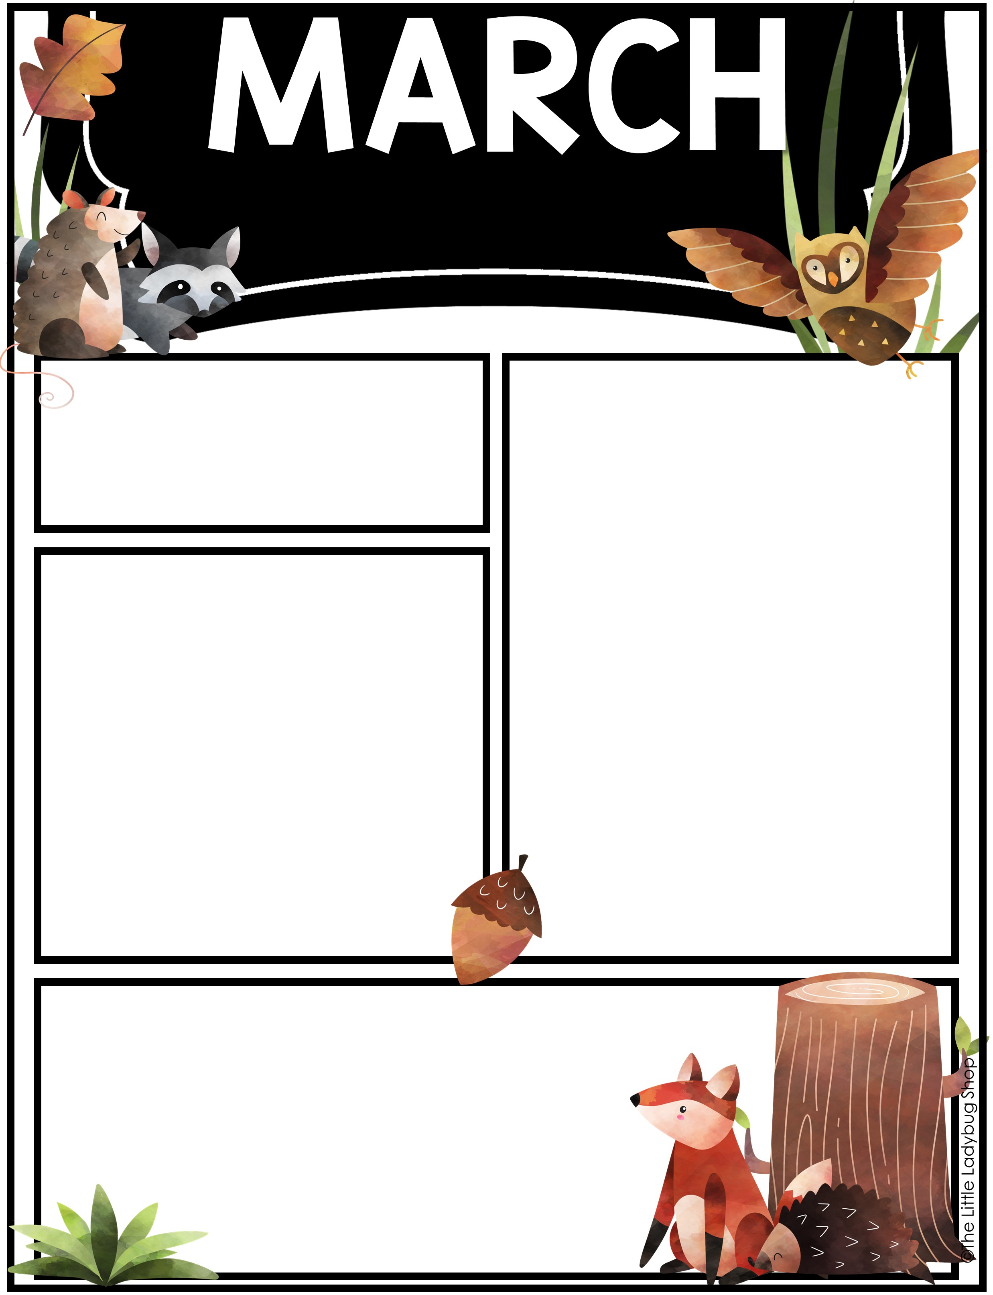
17-21
Student of the week:
Henry!
Skills:
Reading: Review
Sight Words: Review Red, Orange, and Yellow rainbow words
Writing: sight word sentences
Social Science: St. Patricks Day/Spring Break
Math: Review skills taught
Things to know:
Please send a seasonally appropriate change of clothes in backpacks in case of accidents or spills.
Please check student folders and remove papers daily.
Homework is divided up to complete Monday-Thursday. You can turn in completed homework on Friday for your student to get a GOTCHA!
Important Dates
3/14 Half Day
3/20 Report Cards Come Home
4/2 Cap and Gown pictures
4/17 Coosada Carnival
5/5-5/9 Teacher Appreciation week

