Slide 1
Bullying & Sexual Harassment
Be F.I.E.R.C.E.!

Slide 2
Bullying is an action
repeated over time
meant to hurt

Slide 3
Houston County Board Policy JCDAG: Bullying
Bullying is defined as follows: Actions which occur on school property, on school vehicles, at designated school bus stops, or at school related functions or activities, or by use of data or software that is accessed through a computer, computer system, computer network, or other electronic technology of a local school system, that is:
Any willful attempt or threat to inflict injury on another person, when accompanied by an apparent present ability to do so;
Any intentional display of force such as would give the victim reason to fear or expect immediate bodily harm; or
Any intentional written, verbal, or physical act, which a reasonable person would perceive as being intended to threaten, harass, or intimidate, that:
Causes another person substantial physical harm within the meaning of Code Section 16-5-23.1 or visible bodily harm as such term is defined in Code Section 16-5-23.1;
Has the effect of substantially interfering with a student's education;
Is so severe, persistent, or pervasive that it creates an intimidating or threatening educational environment; or
Has the effect of substantially disrupting the orderly operation of the school.

Slide 6
So…

Slide 7
Report bullying/Harassment anonymously
TELL YOUR TEACHER – you can write an anonymous note
ASK TO GO TO THE COUNSELORS’ OFFICE
ASK A FRIEND TO GO THE COUNSELORS’ OFFICE
ASK YOUR PARENT TO CALL THE COUNSELORS’ OFFICE
EMAIL OUR COUNSELORS
USE THE ANONYMOUS ALERTS APP on the BMS Website or your SSO Portal

Slide 8
Bullying can happen anywhere…
stop.
it.

Slide 9
What is Sexual Harassment?
Unwelcome conduct
of a sexual nature.
Verbal
Non-Verbal
Visual
Physical

Slide 10
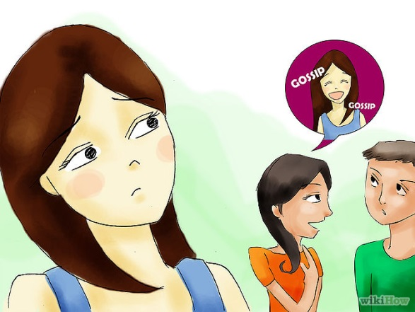
WHAT IS SEXUAL HARASSMENT?
Verbal Harassment
Comments about a person’s body
Spreading rumors that may be considered sexual
Sexual remarks or accusations
Telling “dirty jokes” or stories when those who are listening are uncomfortable with what is being told

Slide 11
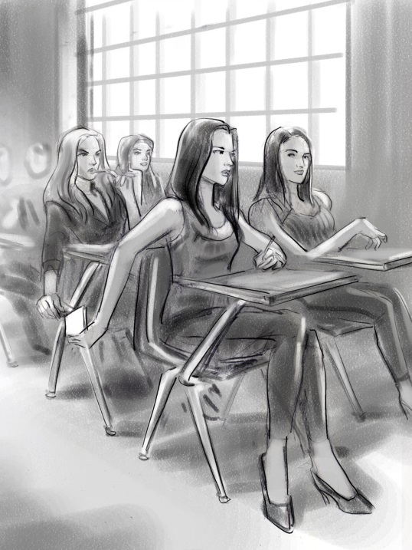
WHAT IS SEXUAL HARASSMENT?
Non-Verbal Harassment
Displaying or distributing sexually explicit drawings or pictures
Writing graffiti of a sexual nature
Sending crude or sexually descriptive e-mails or letters, sexting
Making obscene gestures

Slide 12
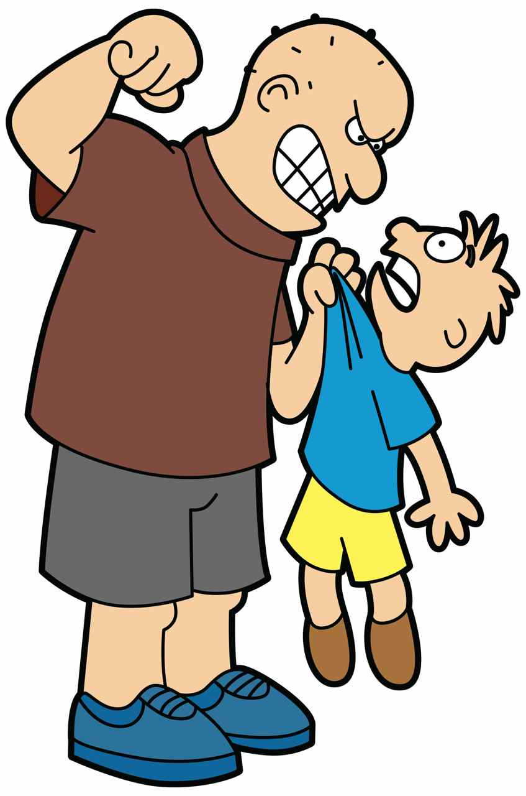
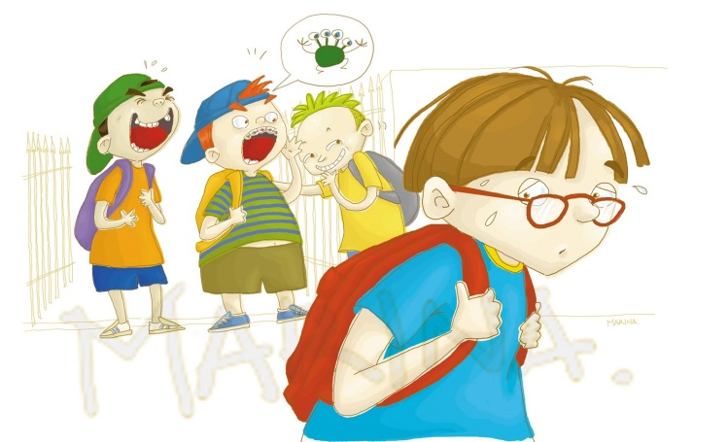
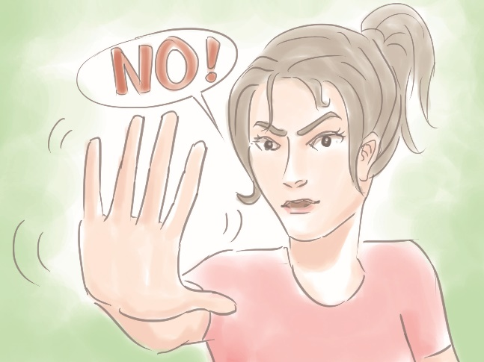
WHAT IS SEXUAL HARASSMENT?
Physical Harassment
Grabbing or touching oneself or another student in a sexual manner that is unwanted, uncomfortable, embarrassing or offensive
Sexual assault

Slide 13
Sexual Harassment can happen anywhere…
stop.
it.

Slide 14
Report bullying/Harassment anonymously
TELL YOUR TEACHER – you can write an anonymous note
ASK TO GO TO THE COUNSELORS’ OFFICE
ASK A FRIEND TO GO THE COUNSELORS’ OFFICE
ASK YOUR PARENT TO CALL THE COUNSELORS’ OFFICE
EMAIL OUR COUNSELORS
USE THE ANONYMOUS ALERTS APP on the BMS Website or your SSO Portal

Slide 15
Use the Anonymous Alerts App to report bullying,
Harassment, or unsafe behaviors!
You can make a report using your phone or a computer.
We REALLY cannot see who made the report
We can communicate with you to ask questions if you use your phone
Even if we communicate with you, we do not know who you are.

Slide 16
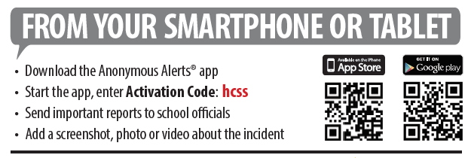
OR

Slide 17
Who is your trusted adult?
On the index card, write your name and the name of an adult here at school you can go to.

Slide 18
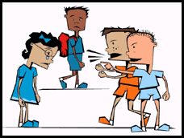
The BYSTANDER is the ONE
who can stop
Bullying &
Harassment

Slide 19
Report it… To stop it!
Be the One

