Slide 1
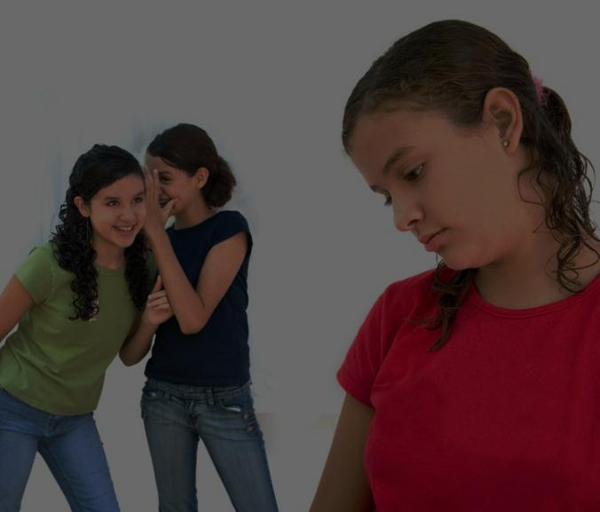
Mrs. Gregory
School Counselor
Thurgood Marshall Middle School
Bullying: A Little Bit of Theory and A Lot of Practicality

Slide 2
Why Am I Here?
Research shows that something must be done to address bullying
Must get past surface issues and find a solution to decrease bullying

Slide 3
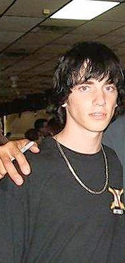
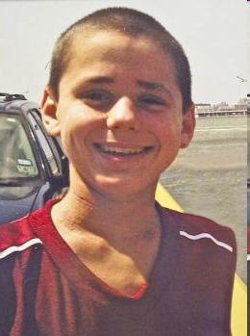
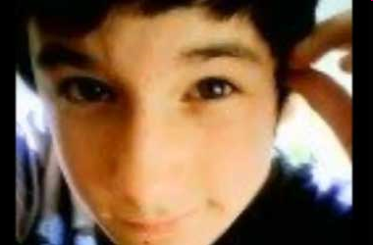
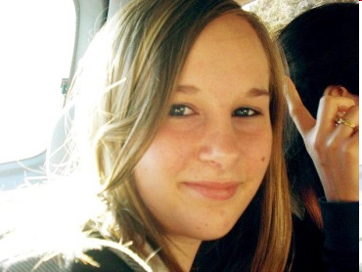

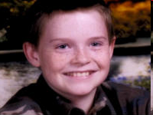

Bullying: A Societal Problem

Slide 4

Character…
How good of a person do you want to be?
You must stop being ordinary and be extraordinary!

Slide 5
Misconception or Truth?
Bullying is rampant like the media reports
Bullying is a right-of-passage through childhood
“Sticks & stones will break my bones, but words will never hurt me.”
Words Hurt

Slide 6
Forms of Bullying
OVERT
Psychological/Verbal Physical
Insults, teasing, Bodily harm
harassment, threats, (physical and
“dirty looks” sexual assault)
Patty

Slide 7
Forms of Bullying (cont’d)
COVERT
Psychological/Verbal Cyber
Exclusion, spreading Online, cell
rumors, shunning phone
destroying or stealing (texting, chat
property rooms, social
networking sites)
Cyber-bullying

Slide 8
Who is Affected By Bullying?
The Victim
The Bully
The Bystander
Evil Penguins

Slide 9
What Bully is and What Bullying is not…
Bullying is:
  Multiple episodes
  Unbalance of power
  Intentional
Bullying is NOT:
  Mutual conflict
  Social rejection
  Single episode

Slide 10
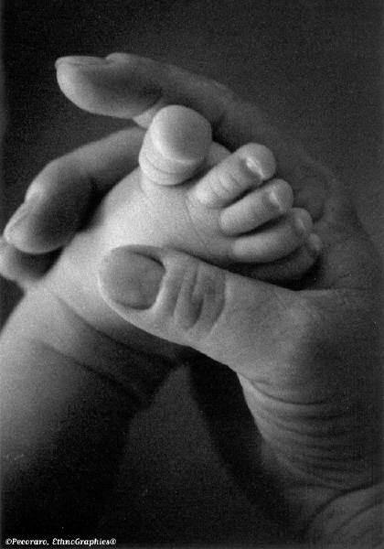
Why do people bully?
--Don’t judge from where I am, judge me from where I come from…

Slide 11
Preventative Measures and
Their Effectiveness
Educator & Student workshops
Anti-bullying programs
System-wide mandates

Slide 12
The Way to stop a rumor…..
Reporting v. Tattling
Don’t be a bystander, be a friend!!
What can we do to report/stop bullying?

Slide 13
Stand Up, Speak Up!
“The world is a dangerous place, not
because of those who do evil, but because
of those who look on and do nothing.”
- Albert Einstein
Anti-bullying Video

