Slide 1
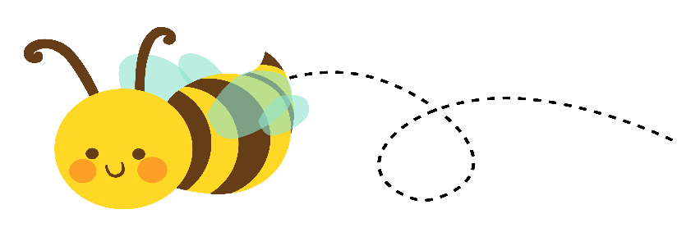
Mrs. Boshell’s Buzzworthy News
August 21, 2023
Hive Happenings
Spelling:
/j/ spelled dge
/k/ spelled ck
/ch/ spelled tch
Reading:
Main idea and details
Compare and contrast
Grammar:
Action verbs
Math:
Doubles, addition strategies, addends
Using addition to subtract, number lines
Social Studies/Science:
sound
Leader in Me:
Review of all Habits
Important dates
August 29th- Curriculum night
September 4th- Labor Day-No School
September 8th- special snack
Sweet Reminders
Language Arts-
Lesson 1 spelling test-Tuesday
Lesson 1- comprehension test- Wednesday
Math-
Daily grade- August 24th
.
Busy Bee of the Week
Kade

