Slide 1
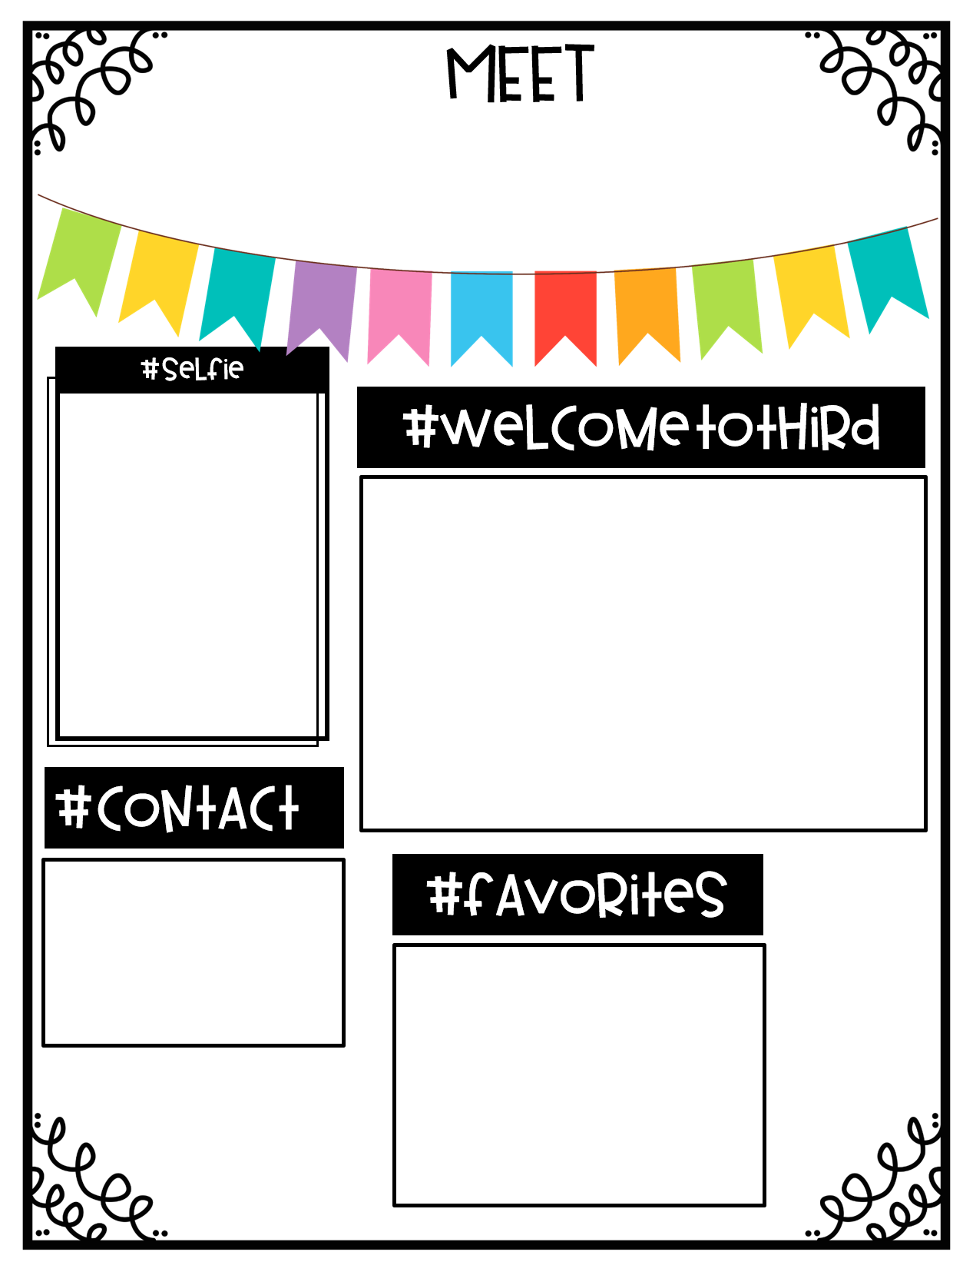
Mrs. Chandler
Dear Third Grader,
My name is Mrs. Chandler and I am thrilled to be your teacher this year! I am a graduate of Holtville High School. I attended Auburn University at Montgomery where I received a Master’s degree in Elementary Education. I’m currently working towards an Education Specialist degree. I am a newlywed! My husband and I were married in March over spring break. This will be my third year teaching 3rd grade, and my first year at PLES. I truly can’t wait for all the adventures we will have together! I would love to meet you at the Back to School Event on Monday, August 5th from 2-6 PM. You may bring your supplies when you drop by. We will be decorating our classroom with your family photos. If you are able, please bring a photo or drawing with you on the first day of school, August 7th. See you soon!
Primary Communication:
ParentSquare
Email:
Madison.Chandler@acboe.net
PLES Phone:
(334) 358-2658
Room 525
Colors: Lavender & Ice Blue
Season: Fall
Snacks: Reese’s, Popcorn, Nerds
Gummy Clusters, Cheez-its
Drinks: Sweet Tea, Iced Coffee
Children’s Book: Frindle
Hobbies: Reading, Crafts, Shopping
Place: Walt Disney World
Pet: Cooper, a Golden Retriever
Visit my teacher page on the PLES website for information throughout the school year!

