Slide 1
Shirley Hills Elementary
3rd Grade Open House
August 29, 2022
where learning is required

Slide 2
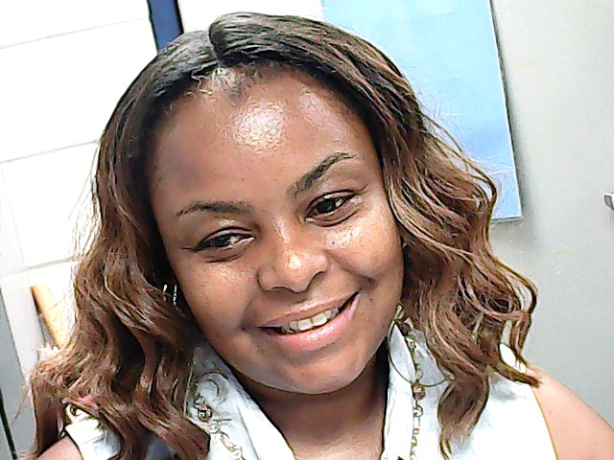
Meet our team:
Mrs. LaSwanda Davis
1st year in third grade
9th year teaching
Married for 26 years and has three children and a son-in law.

Slide 3
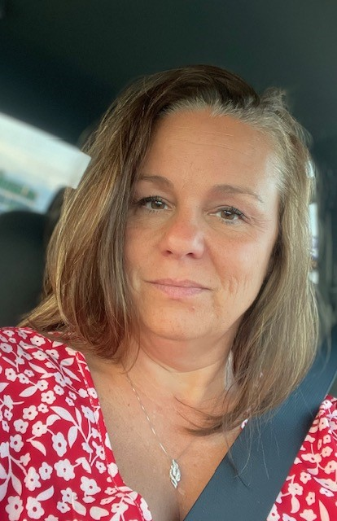
Meet our team:
Mrs. Jennifer Edmunds
Proud Houston County graduate (NHS), 30 years teaching, 5th year at SHES
Married for 21 years and has 1 daughter at WRHS

Slide 4
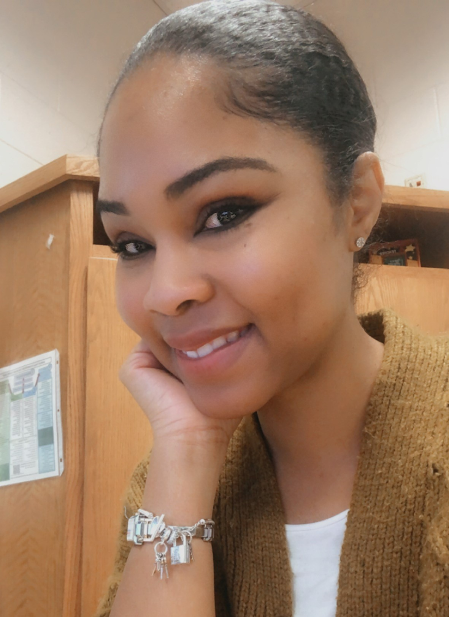
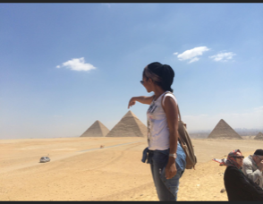
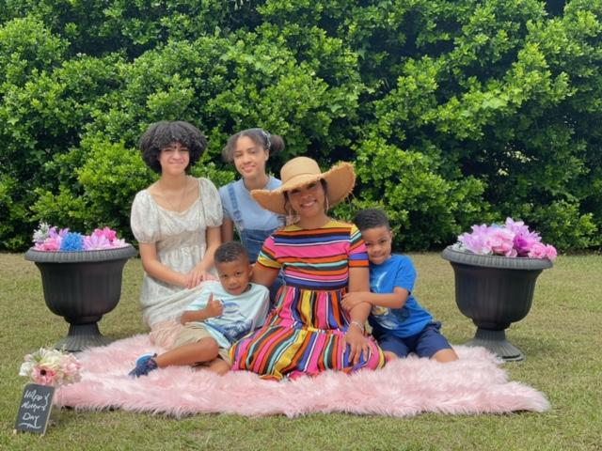
Meet our team:
Ms. Christen Neal
3rd year teaching third grade here at SHES.
Proud mother of four. 🤴🏽🤴🏽👩🏽‍🦱👩🏽‍🦱
Last name change uploading..I’m engaged!💍

Slide 5
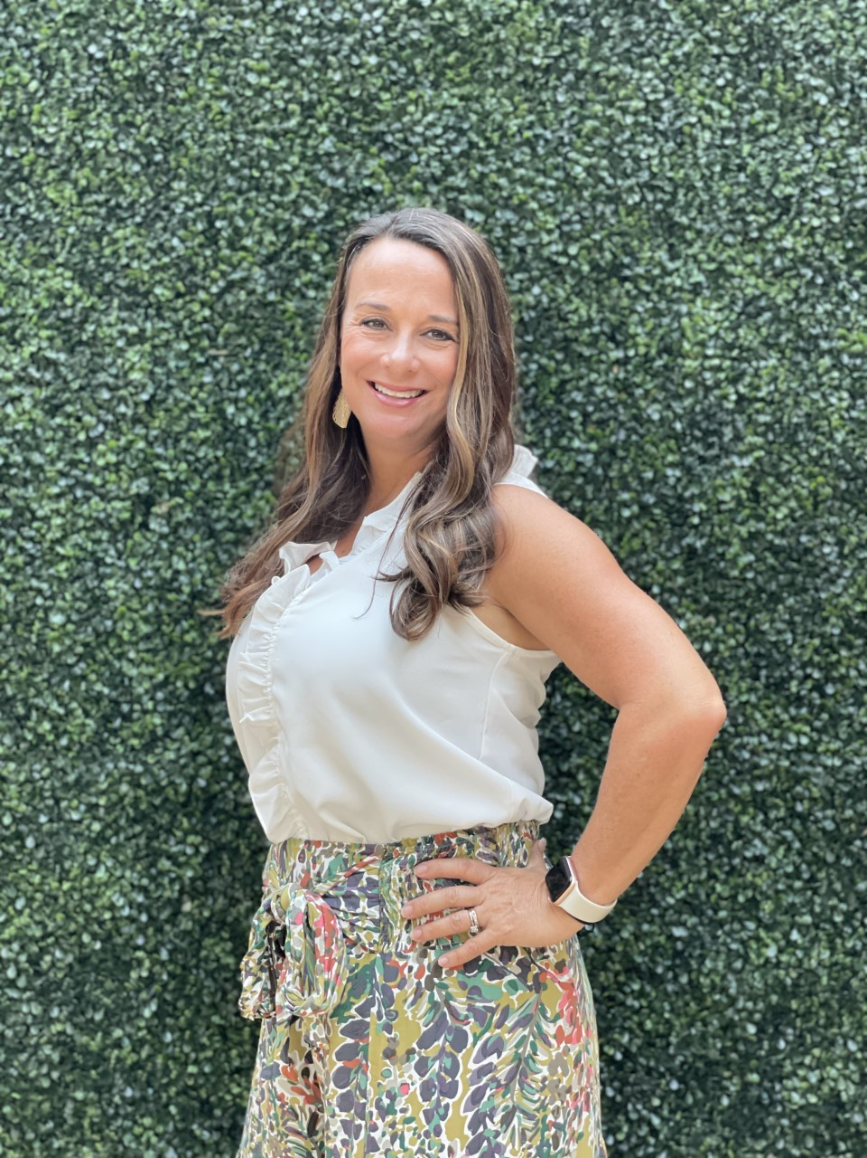
Meet our team:
Mrs. Lara Stanley
21 years teaching various grade levels and content; 17th year at SHES.
Married 16 years with 2 children, one at SHES and the other at WRMS.

Slide 6
Daily Schedule:
8:00 - 8:30 Morning Work
8:30 - 9:15 Intervention/Extension Time
9:15 - 10:15 Writing Workshop
10:15 - 11:00 Reading Workshop
11:00 - 11:35 Interactive Read Aloud
11:40 - 12:30 3rd Grade Lunch/Recess
12:30 - 1:10 Phonics/Vocabulary/Grammar
1:10 - 1:40 SS & Science
1:40 - 2:25 Specials
2:25 - 3:25 Math
3:25-3:30 Wrap Up
3:30 Dismissal

Slide 7
Intervention & Extension
Begins at 8:30 each day.
Needs are identified across the grade level based on a common assessment.
Students are grouped based on need (not teacher).
Plans are made to remediate or enrich students based on their needs.

Slide 8
School Expectations
The 5 Bs:
Be Safe
Be Responsible
Be Respectful
Be Caring
Be Mindful
We use Class Dojo as a way to communicate classroom news. Students are encouraged to follow our 5 Bs each day to earn Fun Friday events weekly and admission to the Good Behavior Celebration every 9 weeks.

Slide 9
Conferences:
Fall conferences will begin soon.
These conferences are required for all in-person or through Zoom. Students are encouraged to attend to discuss their progress.
Additional conferences throughout the year are scheduled as needed or upon request.

Slide 10
What are we
learning?

Slide 11
Reading Essential Standards
These are Georgia Dept. of Education 3rd Grade standards that are deemed essential for our students to master by the end of 3rd grade so that they are prepared for success in 4th grade.
Standards: RL.1, 2, 3 which includes:
asking and answering questions about a literary text
recounting stories, identifying the moral, central message or lesson of a story through key details
describing characters in a story and how their actions contribute to the sequence of events
Standards: RI.1, 2, 3 which includes:
asking and answering questions about a nonfiction text
determining the main idea and recounting details of a nonfiction text
describing the relationships between a series of historical events, scientific ideas or concepts, or steps in a technical procedure

Slide 12
Writing Essential Standards
Students in 3rd grade will be expected to master 3 types of writing:
W.1 Opinion-State a point of view on a given topic or text and support it with reasons and examples.
W.2 Informational/Explanatory-Develop a topic and convey information clearly with facts, definitions, and details.
W.3 Narrative- Develop real or imagined experiences or events using effective techniques including dialogue, descriptive details, and clear event sequences.

Slide 13
Math Essential Standards
These are Georgia Dept. of Education 3rd Grade standards that are deemed essential for our students to master by the end of 3rd grade so that they are prepared for success in 4th grade.
NBT.2 Fluently add and subtract within 1,000 using strategies and algorithms based on place value, properties of operations, and/or the relationship between addition and subtraction.
OA.7 Fluently multiply and divide within 100. By the end of 3rd grade, students should know from memory all products of two one-digit numbers.
OA.9 Identify arithmetic patterns.
NF.1 Understand a fraction as 1/b as the quantity formed by 1 part when a whole is partitioned into b equal parts (unit fractions)
MD.1 Tell and write time to the nearest minute and measure elapsed time intervals in minutes.
MD.7 Relate area to the operations of multiplication and addition.

Slide 14
For a full list of our standards for each subject
Please visit

Slide 15
MAPs
Assesses student learning
Taken 3 times a year (Fall, Winter, & Spring)
Provides a score showing student growth from each administration to the next
Strong indicator of Milestone results

Slide 16
3rd Grade Milestone (GMAS)
Test will be taken in reading, writing, and math
Writing consists of text-based essays and short response
Computer-based so typing skills are important
Taken at the end of the year

Slide 17
Reminders:
Please send excuses in for absences the day your student returns to school.
Grades are returned in both Google Classroom and in Wednesday Folders - please check both.
If your student is absent, please have them review their lessons in Google Classroom, if possible.

Slide 18
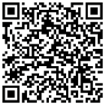
Questions? Please ask!
Please click the QR code or link for a survey
https://forms.office.com/r/zgXYBuSLPM

