Slide 1
FRESHWATER ON EARTH
Q4 WEEK 1

Slide 2
A. FRESHWATER ON EARTH
70% of Earth is covered in water.
3% of Earth’s water is freshwater (97% saltwater)
FRESHWATER CONTAINS LESS THAN 1% SALT
68.7% of FRESHWATER is frozen in glaciers and icecaps
30.1% is groundwater
1.2%- lakes, rivers, wetlands, swamps, water vapor, soil

Slide 3
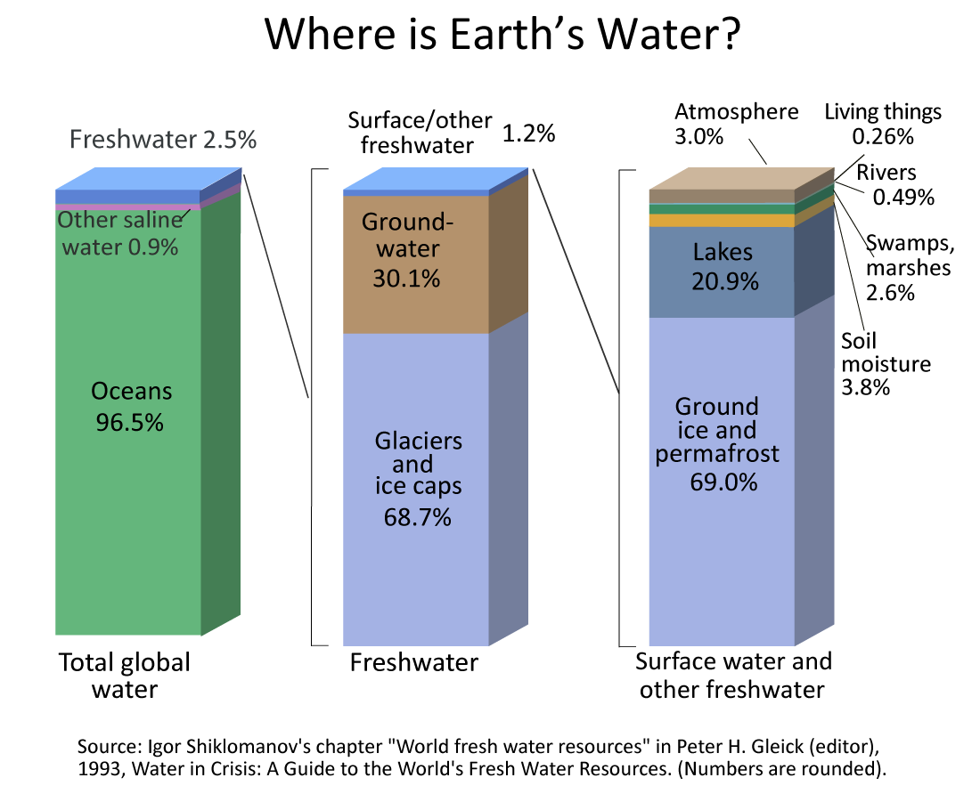

Slide 4
B. GROUNDWATER
1.Water enters the ground through cracks.
2. There is more water underground than in all the lakes and rivers.
3. Aquifer- any underground layer of rock that holds water and allows it to flow.
4. Aquifers provide water to millions of people in places where there are no lakes or other water available to drink.
5. Aquifers are not permanent. They can dry up if used faster than replenished.

Slide 6
C. WATERSHED
ALL OF THE LAND DRAINED BY A RIVER AND ITS TRIBUTARIES
WATERSHEDS CAN COVER VERY LARGE AREAS AND VERY SMALL AREAS.
THE QUALITY OF WATER IS AFFECTED BY ACTIVITIES WITHIN A WATERSHED.
WATER MOVES ACROSS THE LAND AND PICKS UP ALMOST EVERYTHING AND CARRIES IT TO CREEKS, STREAMS, AND RIVERS.

Slide 7
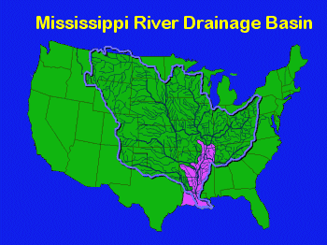

Slide 8
D. MISSISSIPPI RIVER WATERSHED
COVERS 1,245,000 MILES, 32 STATES AND 2 CANADIAN PROVINCES
THE MISSISSIPPI FLOWS 2320 MILES FROM ITS BEGINNING IN MINNESOTA, TO ITS MOUTH IN SOUTH LOUISIANA, WHERE IT ENTERS THE GULF OF MEXICO.
THINK ABOUT ALL OF THE THINGS, SEEN AND UNSEEN, THAT SHEDS OFF THE LAND AFTER EVERY RAIN AND INTO THE TRIBUTARIES AND MAIN RIVER.

