Slide 1
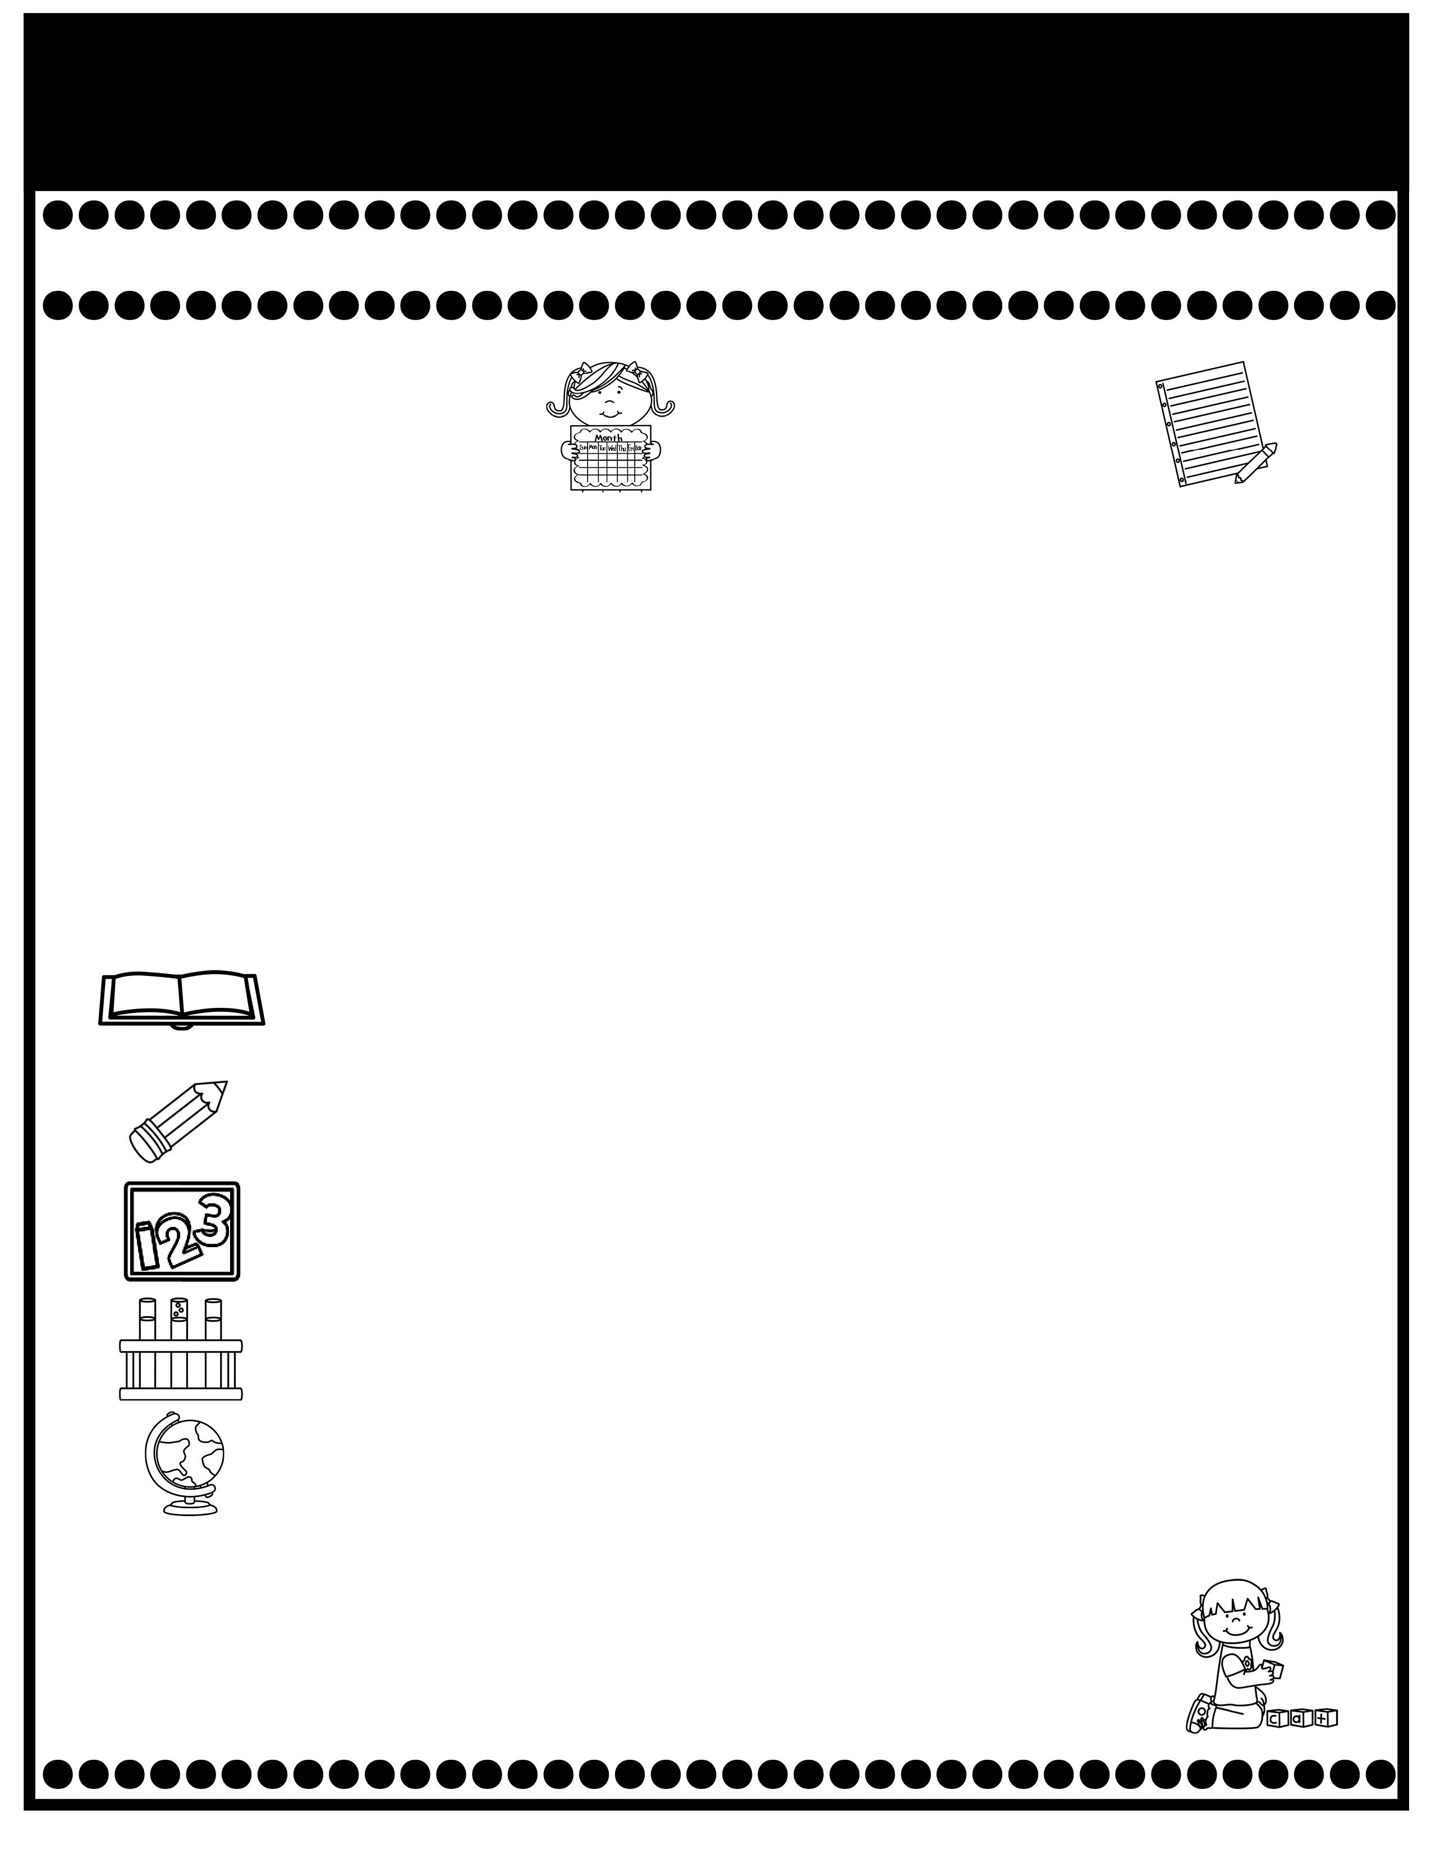
Branning’s Buzz
Week of: September 8-12, 2025
What’s Happening
This Week
Upcoming Events
Car riders will now dismiss at 2:50.
Pease check your child’s Take Home Binder for daily work and important information. Empty nightly.
Decodable Reader stories will be sent home in your child’s Take Home Binder after reading them in class. Please practice reading them with your child.
The cost for snack is $1.00 each. Please send the exact amount.
Parents are now allowed to attend lunch for our classroom on Thursday from 11:54-12:19. The cost is $5.00.
September is our Attendance Challenge month. Students with perfect attendance will be invited to a pizza party at the end of the month. Weekly prizes are also given.
Sept. 8: Progress Reports
Sept. 12: Special Snack: Ring Pops $1.00.
Sept. 8-12: Grits with Grandparents (Grandparents may come to eat breakfast with their grandchild. The cost is $4.00).
Sept. 19: Fall Pictures
If you have questions or concerns, you may email me at Wendy.branning@acboe.net.
A Peek At What We Are Learning
Reading | Phonics: b, l, o, b, Sequence, Compare & Contrast 9/12 High Frequency Words & Missing Sounds test
Writing/ Grammar | Singular & Plural Nouns. Practice correct letter formation. 9/12 Dictation & Singular & Plural Nouns test
Math | Topic 2: Fluently Add & Subtract within 10 9/11 Math minor grade
Science | Plants
Social Studies | We rotate Science and Social Studies.
Spelling Words
No Spelling Test will be given until Unit 7.
.

