Slide 1
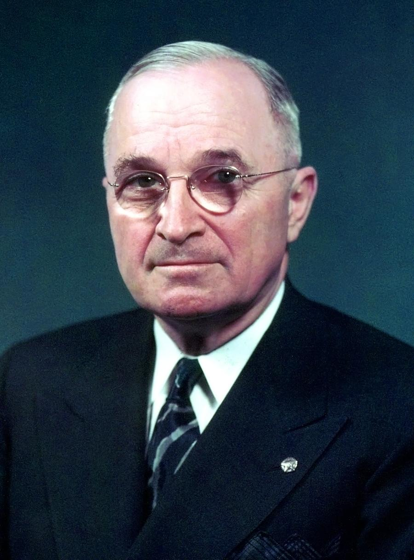
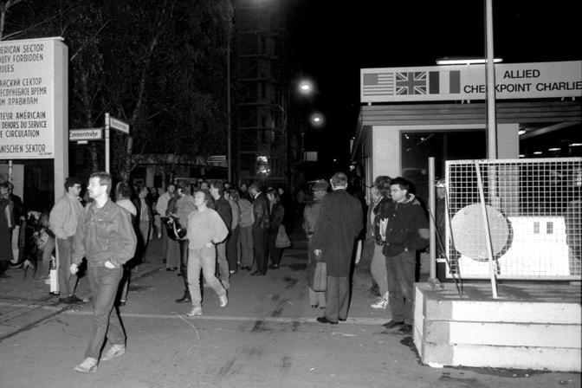
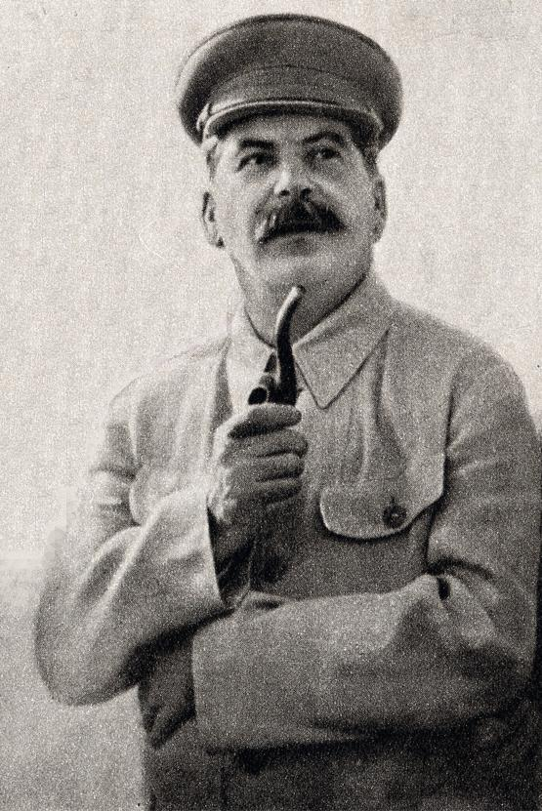
The Cold War
1945-1990
2/23/2022

Slide 2
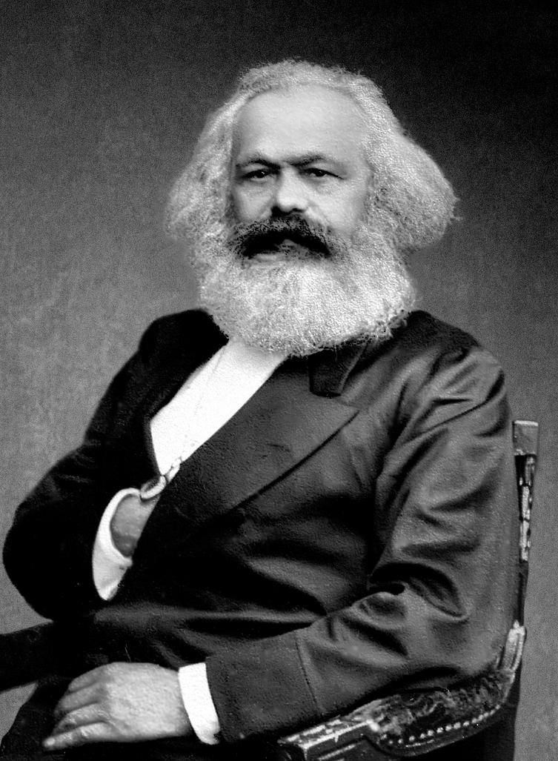
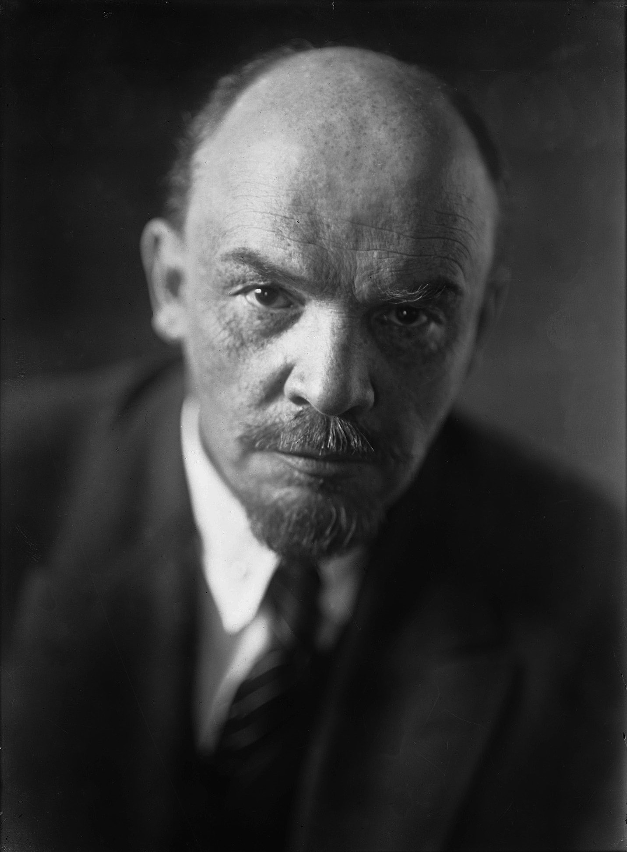
Founders of Communism
Karl Marx and Friedrich Engels write the Communist Manifesto
Vladimir Lenin founder of the Soviet Union
Stalin lead the Soviet Union through World War II and the Cold War

Slide 3
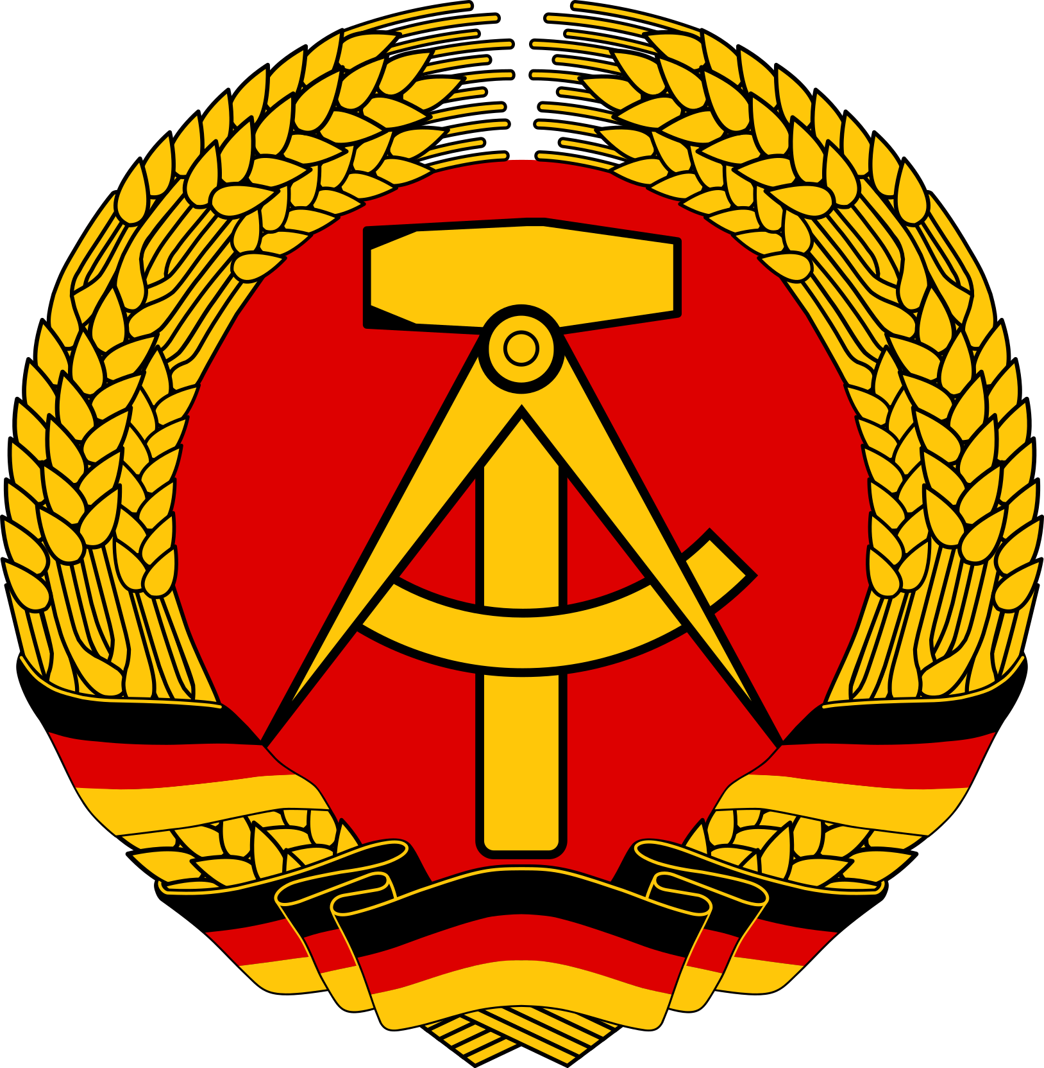
Communism Characteristics
State ownership of land
Classless society
Seeks to eliminate religion
Income redistribution

Slide 4
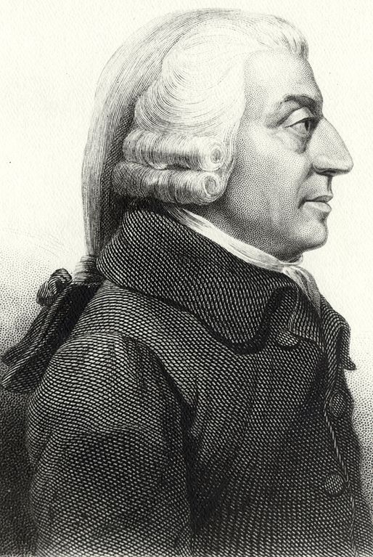
Capitalism
Dominant economic system in the United States
Based on economic theory by Adam Smith
Private ownership
Competitive markets
Profit motive
The United States is a predominantly capitalist economic system
Notes:
(French: laissez faire, lit. 'let do')

Slide 5
Cold War
First conflict about ideological matters
“Red Scare” existed since 1920
World economy collapses in 1930 leading some countries to look to communism
Soviet Union was born from the ruin of WWI
American policy after WWII focused on collective security
Demilitarization of Germany to provide security for Soviet Union
Free states in Eastern Europe were overtaken by the Soviet Union
Soviet Union dropped Iron Curtain on Europe

Slide 6
The Iron Curtain
The Iron Curtain was a political boundary dividing Europe into two separate areas from the end of World War II in 1945 until the end of the Cold War in 1991. The term symbolizes the efforts by the Soviet Union (USSR) to block itself and its satellite states from open contact with the West and its allied.
Metaphor: a figure of speech in which a word or phrase literally denoting one kind of object or idea is used in place of another to suggest a likeness or analogy between them

Slide 7
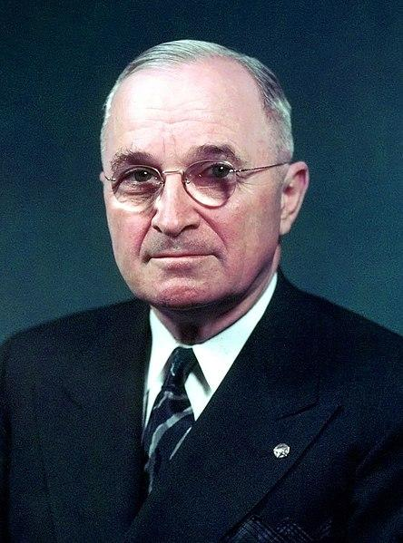
Truman Doctrine 1947
President Truman began the American foriegn policy of Communist containment under the Truman Doctrine in 1947

Slide 8
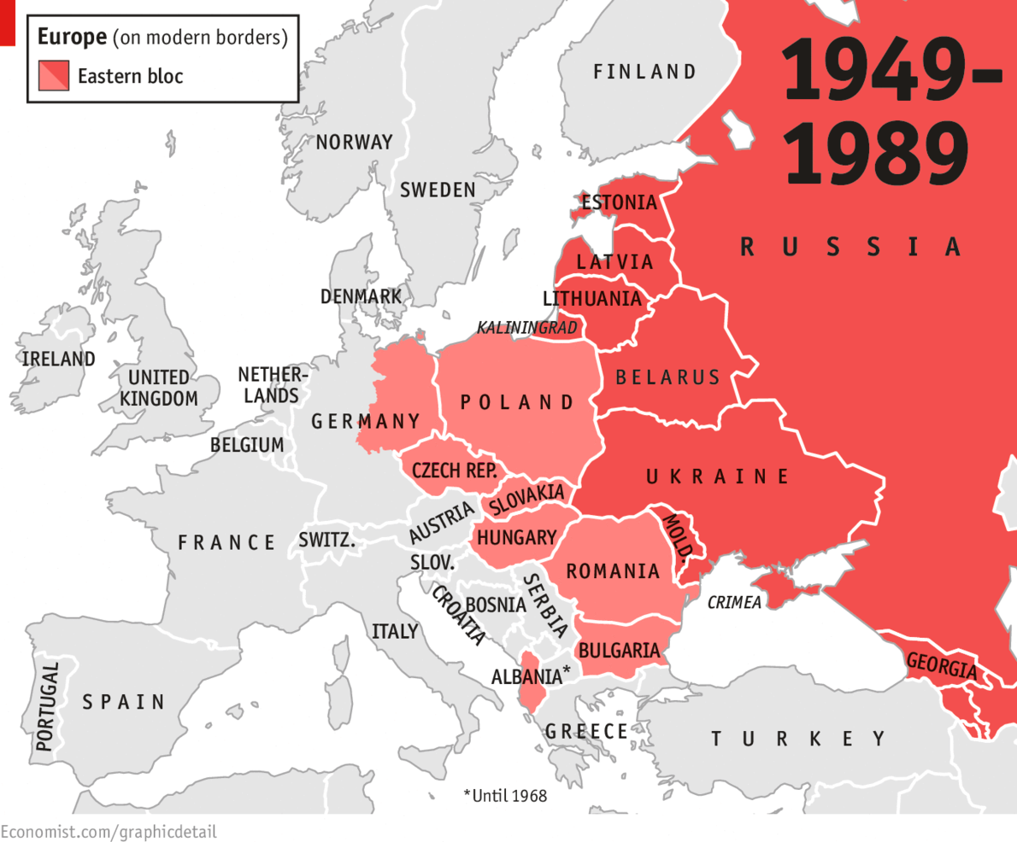

Slide 9
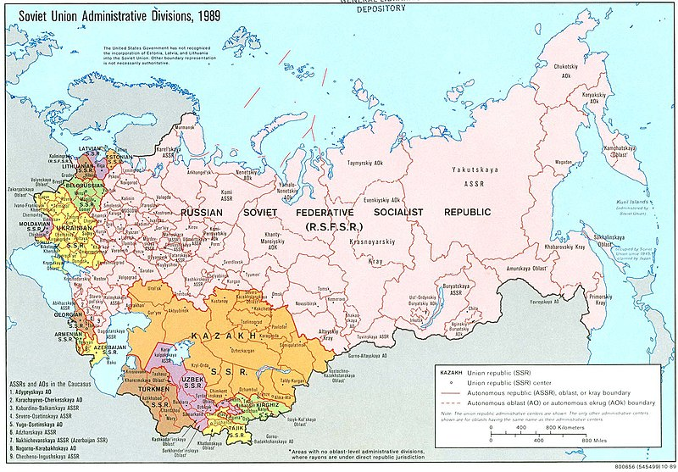

Slide 10
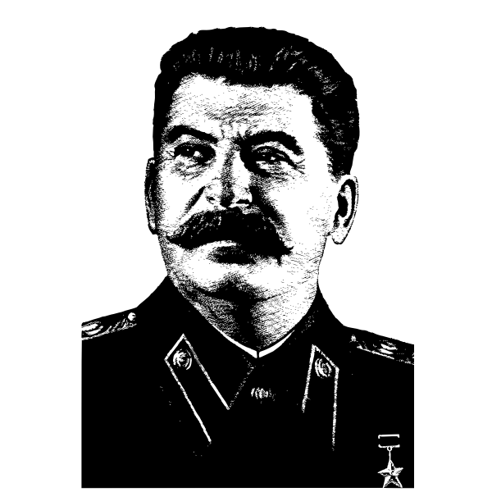
Capitalism vs. Communism & USA vs. USSR
Truman is the US President and ends WWII by dropping the atomic bomb
Joseph Stalin was the leader of USSR and wanted security from Germany after WWII
Joseph Stalin wants to make sure the world is safe for communism
Stalin creates a buffer zone between USSR and Europe with the Eastern Bloc
The US was worried that the USSR would take over the rest of Europe
The USSR was worried that the US was trying to spread their influence in Europe
Both countries had nuclear bombs

Slide 12
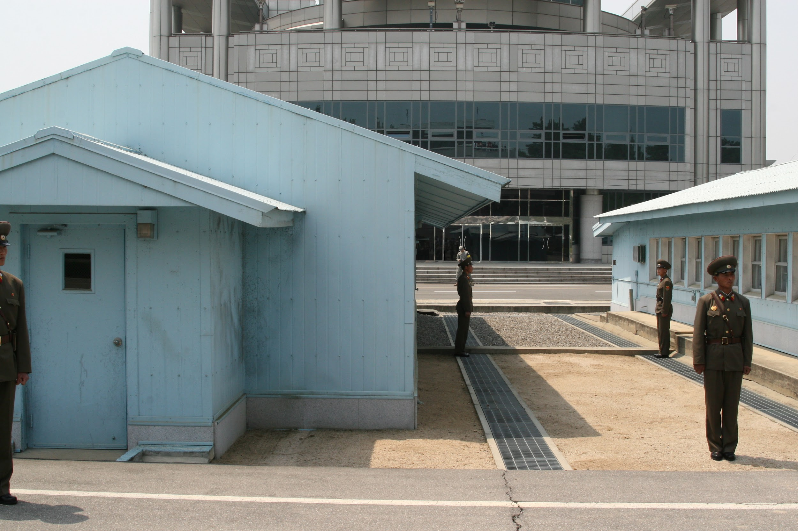
Korean War 1950-1953
During World War II Japan occupied the Korean Peninsula
In 1949 Mao, a communist, comes to power in China and supports North Korea
The United States supports South Korea
Both sides want to unify the Korean Peninsula
South and North is divided by the 38th parallel
War is in an armistice today

Slide 13
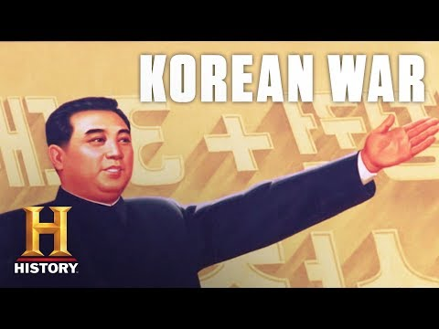

Slide 14
What is NATO?

Slide 15
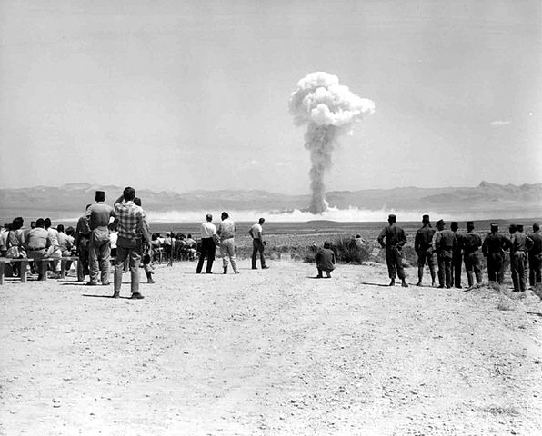
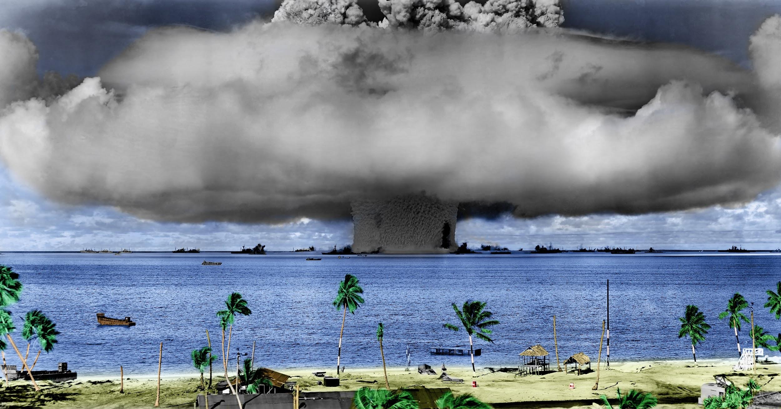
Nuclear Arms Race
For the first time major world powers had nuclear bombs
Both the Soviets and the US had nuclear weapons and engaged in the plan called, “Mutually Assured Destruction”
If either side used a nuclear bomb the other would retaliate and both would cease to exist.

Slide 16
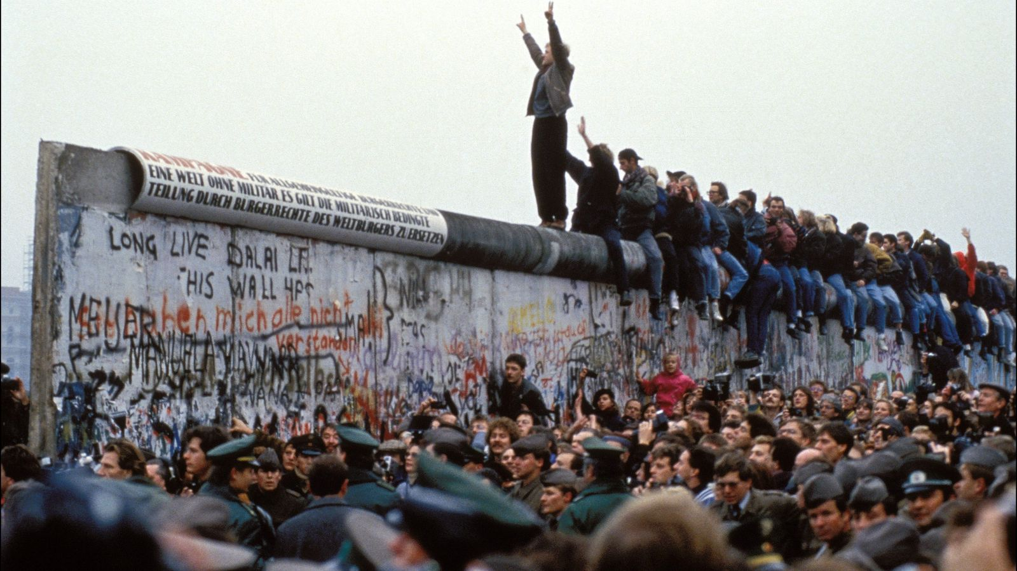
Berlin Wall 1962
Constructed without US knowledge overnight
Symbol of the illegitimacy of Soviet Union
20% of population in East Germany fled to the West before the wall was built
Wall fell in 1989

Slide 17
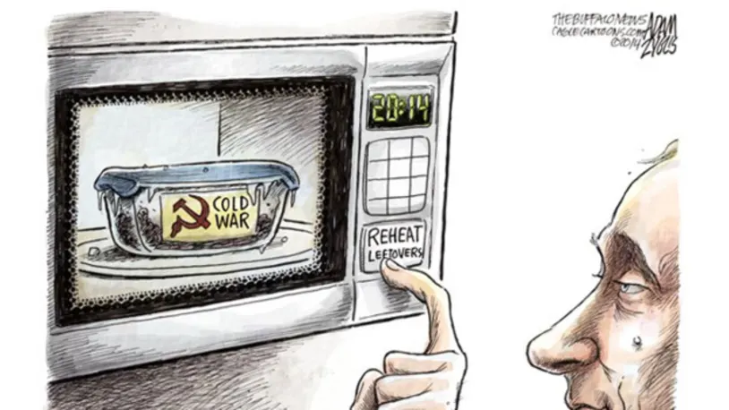

Slide 18
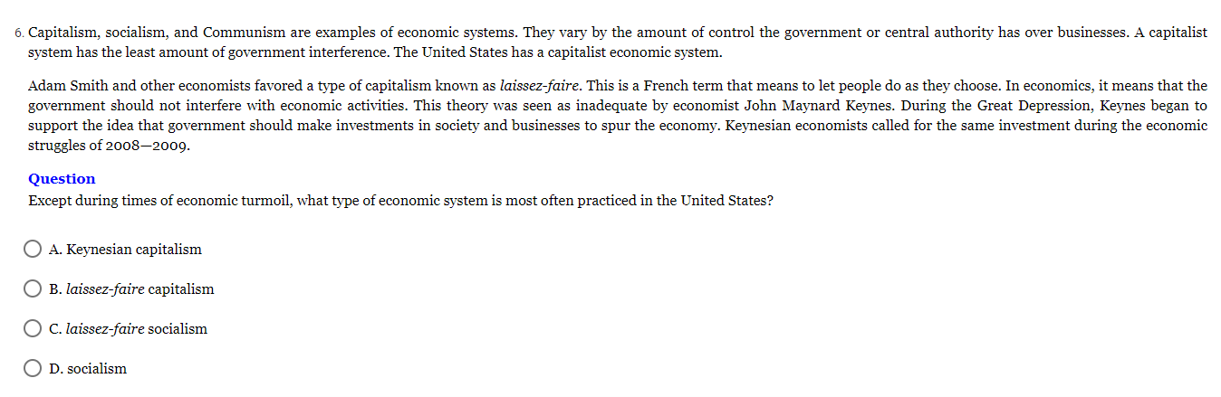
Notes:
Answer: B

Slide 19
Notes:
Answer: D Khrushchev begins this excerpt by declaring the unity of the Communist Party. While the goals in the rest of the excerpt depend on this unity, Khrushchev does not offer evidence to support that the Communist Party enjoys complete unity. He does not assert any specific reforms that are taking place in the Soviet Union, nor does he assert the economic prosperity of the country. He also does not assert that there will be a spread of Communism to other nations.

Slide 20
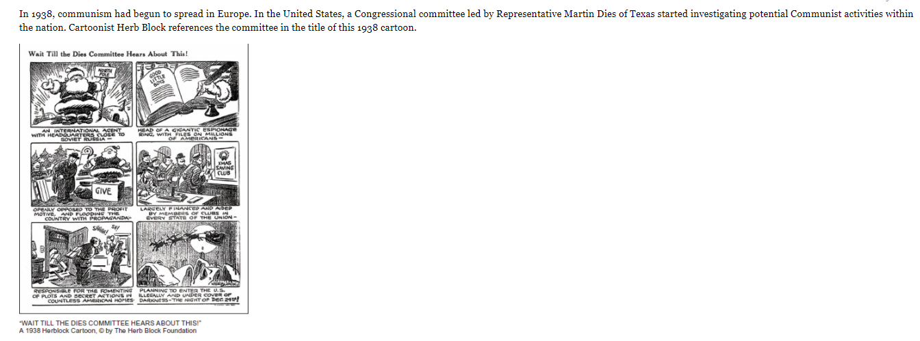
Notes:
Answer: B

Slide 21
Notes:
Answer: B

