Slide 1
Welcome to Daniel Pratt
Mrs. Boykins’ Class

Slide 2
Contents of Folder
Left Pocket
“Information to keep”
Right Pocket
“Information to fill out and leave/send back”

Slide 3
Morning Procedures: *Carpool Doors Open: 7:10 (Carpool Runs at the front of the school. Carpool students should go to the lunchroom for breakfast as soon as they enter the building. *Afterwards students should wait in the hallway until the 7:45 bell, then their teacher will have them enter the classroom. *School Begins: 8:00 *All students must enter the building quietly in a straight line. *Walkers, bus riders, and daycare students enter into the building from the Yellow hall side door and go to breakfast. *Student drop offs are not allowed in front of the building or in any of the parking lots at any time. *Carpool: 7:10-7:55 Students enter through the yellow hall side doors next to the gym. Carpool Closing Time 7:55: Carpool door closes (In the afternoon, parents will need a Carpool Sign to hang in the front window of their vehicle when picking up their child/children. Carpool signs can be picked up at Orientation. The first one is free and others are $5 each.) Carpool Student Drop-off’s *DO NOT drop your child off before the doors are opened. *DO NOT drop your child off after the doors have been closed. *DO NOT park in the front parking lot and walk your child to the front doors before 7:55. Safety is always a priority!!!

Slide 4
Dismissal
Front Parking Lot is closed from 2:30-3:30
2:50 Walkers exit out front exterior yellow hall doors. Daycare students are walked to the gym.
2:52 1st Grade Carpool students will go to the green hallway
2:55 Faculty and Staff Children to their parent’s classroom
3:00 Bus Riders: 1st Load
3:05 Bus Riders: 2nd Load
3:07 YMCA students will go to the gym

Slide 5
Parent Information for Students:
*Breakfast and Lunch are free to students this entire school year.
*Snack Shack: Open daily from 7:30-8:10 except on Special Snack Fridays
*Send a water bottle filled, preferably plastic.
*Allow students to wear no tie shoes, if they aren’t able to tie them. Same with pants fasteners, please make sure they can button/unbutton.
*Send a change of clothes for possible accidents to remain in backpacks. (Example: underwear, socks, top, and bottom-Please make sure that clothes are season appropriate.)
*No rolling backpacks
*Students will keep Yellow Transportation Tags attached to their backpacks.

Slide 6
Helpful Information
Keep lines of communication open via Parent Square, email, and written notes. (Keep in mind that I will not respond to Parent Square messages after 4:30 p.m.)
My conference times are during my planning time from 12:25-1:05. However, I can make exceptions for before and after school.

Slide 7
Important Information
Check D.P.E.S. website Parent Section
For School wide information see Student Handbook and Code of Conduct.
Principal Call Out every Sunday at 3:00 p.m. (Make sure your phone number is correct.)
ALL posted plans are subject to change!!!

Slide 8
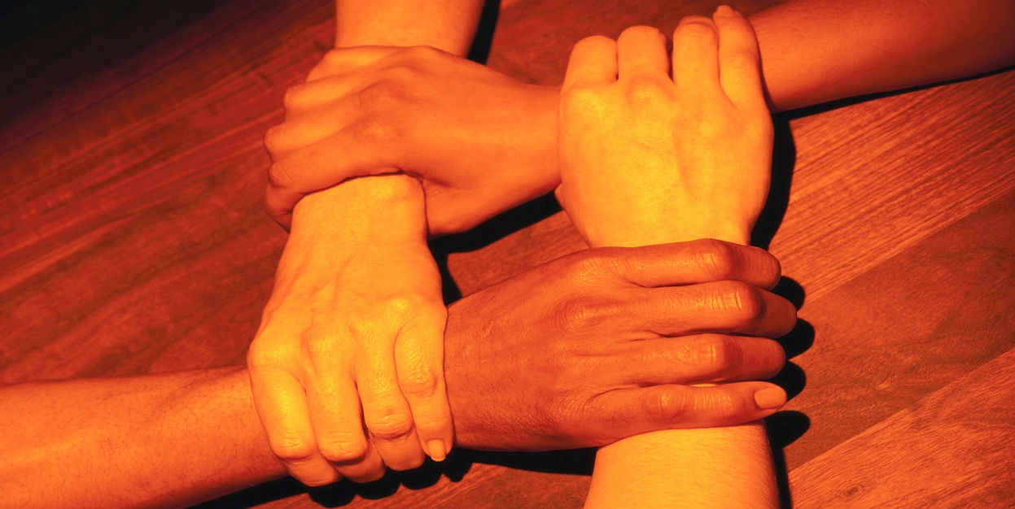
TOGETHER WE MAKE A DIFFERENCE WHEN WE R.I.S.E. (Respect, “Have” Integrity, “Have” Self-Control, and “Put forth” Effort)
Looking forward to a wonderful school year full of learning fun!

