Slide 1
Personal Safety
3rd-5th grades
Mt. Zion Elementary
There’s only one you!
A necessary discussion…

Slide 2
Important Rules for Today
1
2
3
4
No Personal Stories
Respectful Language
No Stories about Others
If you need to talk about something specific we will talk about it in private later
We may talk about awkward subjects today, but it is not a time to be silly
Again, if you need to talk about something specific, we can do that at a later time
Safety First
Safety is my #1 job. Just because we aren’t sharing personal stories in class doesn’t mean that we don’t need to talk about it.

Slide 3
Today’s Agenda
Trusted Adults | Who is your five? Everyone needs five trusted people to turn to for help.
Basic Safety in the Community | What you need to know now to stay safe in the everyday world.
Body Safety | Your body belongs to you.
Cybersafety | How to be a good digital citizen and keep yourself and family safe online.

Slide 4
Who is your five?
Everyone needs to think of, and keep in mind five adults that they know well and that they can trust to keep them safe if they are in danger
Examples:
Parents
Grandparents
Teachers
Spiritual Leaders
Older Siblings
Law Enforcement

Slide 5
1
Basic Safety in Your Community
Stuff everyone should know

Slide 6
Basic Safety in the Community
Meeting Place
What’s your plan
Know Your Info!
If you are in a crowded place, you need to decide on a meeting place if you get separated from your group.
Who do you ask for help in public? What is your plan if at home alone? Who do you talk to in public?
You should know your parent(s)/guardian(s) phone numbers and your address by heart

Slide 7
2
Body Safety
Your body belongs to you!

Slide 8
Types of Abuse
Physical
Emotional
Neglect

Slide 9
Physical Abuse
What is it?
What’s going to happen?
What do you do?
When a caregiver or adult causes physical injury to a child on purpose - a mark is left. Corporal punishment (spanking) is NOT necessarily considered abuse.
Remember, you deserve to be safe and loved, Physical abuse is against the law. Some people’s job is to keep children safe. They need to be involved to make it stop.
Get help from your trusted five. If possible, get away from that person. Tell someone as soon as possible. It is not your fault!

Slide 10
Your body belongs to you!
The part of your body that is covered by a bathing suit is what we refer to as your private area.
No one should ever try to touch you, or look at your private area.
No one should ever try to get you to touch or look at their private area.
If someone does this, you are in danger. Get away as soon as you can by any means necessary
Tell one of your trusted five immediately
Exception: the only exception to this would be a medical issue that requires help from a trusted adult (example: doctor, nurse)

Slide 11
Emotional Abuse
Maltreatment
Domestic Violence
Any type of mistreatment by an adult or caregiver of a child that damages a child’s emotional development or well being- name calling, threats, constant criticism, isolation
All parents/guardians argue sometimes. That is a normal part of life. But when arguments become violent, it’s not okay. Physical fights, throwing objects, & threatening with weapons is domestic violence, which can be a form of emotional abuse

Slide 12
Neglect
This is when a caregiver purposely withholds or fails to provide for a child’s basic needs, such as clothing, food, shelter, and prescribed medication. This can include
A caregiver not supervising their child due to drug use
A caregiver leaving a young child somewhere alone for long periods of time
Neglect is not when a family is struggling to afford clothes or other needs

Slide 13
Don’t be fooled!
Abusers may try to get you not to tell others…
Threats: They may say they will hurt you or someone else if you tell.
Games: They may try to say that what they are doing is just a game. No game involves inappropriate touch or abuse.
Secrets: Secrets are generally not a good thing unless it is a surprise for someone. Abuse is never a secret that should be kept.
Bribes: Abusers may give you things so that you will stay quiet.
*Abusers often spend lots of time getting you to trust them with these things so you won’t tell others that they are doing wrong*

Slide 14
Go to your five!
If something feels wrong, it probably is. 90% of all child abuse comes from people the child knows…

Slide 15
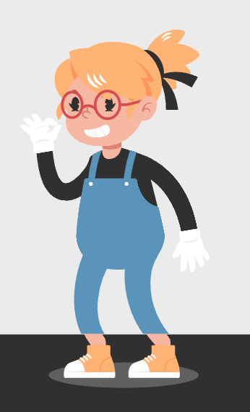
3
Cybersafety
Cyberspace and social media can be great entertainment, fun, and can be informative. It can also be a very dangerous place…

Slide 16
Where should you be cautious?
Google Suite
Any time you communicate with others digitally.
Social Media
Texting
Online Gaming
Youtube

Slide 17
What can happen?
What is out there?
Consequences
Inappropriate content
Inappropriate language
Dangerous people trying to get your personal information
Cyberbullying
Comparison Trap
Negative Feelings
Negative Digital Footprint
School Consequences
Legal Consequences
Dangerous people having access to your personal information

Slide 18
Cyber-safety Tips
Keep Passwords Secret
Don’t talk with people you don’t know
Don’t give out your phone number
Close and tell one of your five
Ask before you download something
Don’t post anything you wouldn’t want one of your five to see
Keep a secure password (not change.me). Make sure only your trusted five know your passwords.
Only talk to people you’ve met in person. People are often not who they say they are. This includes online games!
You need to ask for your parents’ permission to give out your digits…
If you see something bad online, accidentally or not, close it out immediately and tell one of your five.
Downloading things is the way hackers get into your computer and get your information. They even entice people to do this with games.
Even if you think they will disappear, things you post online have a way of lasting forever. People take screenshots

Slide 19
Be Safe! There is only one you!

Slide 20
Questions?
What do you need to know?

Slide 21
THANKS!
Do you have any questions?
youremail@freepik.com
+91 620 421 838
yourwebsite.com
Please keep this slide for attribution

