Slide 1
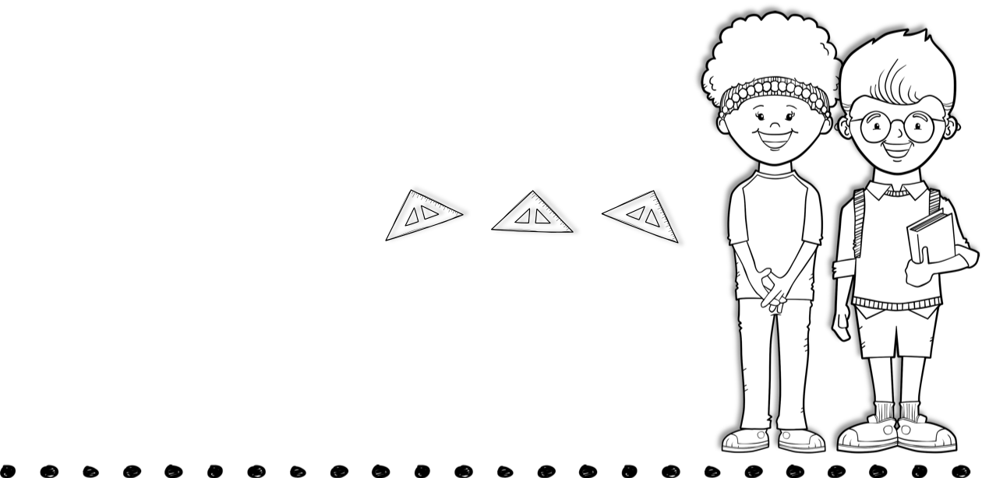
October 4th-8th
Skills for the Week
Contact Me
Reading- asking and answering questions, text features, & context clues
Writing-personal narrative
Math- word problems
Language-plural nouns
662-429-9117
mariann.word@dcsms.org
Text
Vocabulary Words
Tests
prepare –to get ready to do something or make something ready
embarrass- to make someone feel ashamed or uncomfortable
grip- hold something very tightly
huddle –move in close to someone or crowd together in a tight group
variety - many different kinds
characteristic - something that describes a person or thing
consume-eat or drink something or
use something up
unwelcome - means not wanted
fragile - easily broken or destroyed sip – drink something slowly, swallowing only small amounts
picky – hard to please
attract – get the attention of people or animals and cause them to come closer
Spelling, reading, vocabulary, and math test this week.
Spelling Words
slug jog wept
slush start than
trim blast crisp
trust crib kit
best jam stand
were from where
of was
Upcoming Events
October 4th- wear blue for World Bullying Awareness
October 7th- wear pink for Breast Cancer Awareness
October 11th- Fall Break
October 20th- wear orange for National Bullying Prevention Unity Day

