Slide 1
Harney County School District #3
2023 Integrated Application Presentation
Notes:
Suggestion: Add district/applicant logo

Slide 2
Contents
Purpose of Presentation
Background & Context
Planning Team
Plan Inputs
Plan Overview
What’s Next
Notes:
Explain that ‘’plan’’ includes your application, budget, and all materials submitted under the IG

Slide 3
Purpose for Presentation
To share what was prioritized in the plan given the range of inputs
To explain how the plan was developed
To hear additional feedback on the plan now that it has been developed
To introduce the developed plan for board approval

Slide 4
Background
Integration effort was responsive to requests from educational leaders and state legislators
Combined processes for community engagement, needs assessment, planning, budgeting and evaluation for 6 programs
Designed to reduce burden and redundancies and improve the framework by which progress can be measured over time

Slide 5
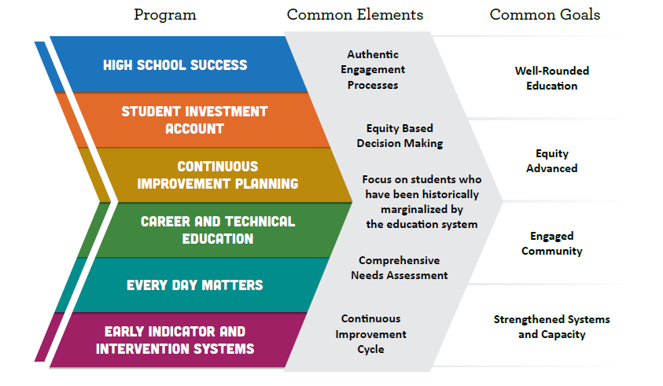
Six Programs & Common Goals

Slide 6
Summary of Program Purposes
High School Success (HSS) - Systems to improve graduation rates and college/career readiness.
Student Investment Account (SIA) - To meet students’ mental health, behavioral needs and increase academic achievement/reduce disparities for student focal groups.
Continuous Improvement Planning (CIP) - A process involving educator collaboration, data analysis, professional learning and reflection - toward improved outcomes for students and especially students experiencing disparity.
Career and Technical Education - Perkins V (CTE) - Improving access and participation in education and training programs that prepare learners for high-wage, high-skill, in-demand careers.
Early Indicator and Intervention System (EIIS) - The development of a data collection and analysis system, in which educators collaborate, to identify supports for students.
Every Day Matters - (EDM) - Embedded across the five other programs, focusing attention on student engagement, school culture, climate/safety & culturally sustaining pedagogy.
Notes:
Link to Integrated Guidance
Focal Student Groups:
Students of color;
Students with disabilities;
Emerging bilingual students;
Students navigating poverty, homelessness, and foster care;
Migrant students;
Students with experience of incarceration or detention;
LGBTQ2IA+ students;
Students recently arrived;
Other students who have historically experienced academic disparities.

Slide 7
Meet our Planning Team Members
Robert Medley – Interim Superintendent
Taci Weil – Student Services Director
Erin Toelle – High School Vice-Principal
Steph Lardy – Slater Elementary Principal & Parent
Son Burns – Hines Middle School Principal & Parent
Cara Wilber – Business Manager & Parent
Brandi Fulton – Monroe High Principal & Parent
Scott Smyth – TAPP Coordinator
Stephanie Frisbee – Parent
Paula Toney – Financial Specialist
Maggie Young - BHS/HMS Counselor
Kellie Mickel - Program Coordinator/Homeless Liaison
Notes:
Introduce the district team members and staff that have led your community engagement efforts, needs assessment and planning processes. These are the people (staff and community partners, if applicable) that have stewarded the development of our district plan and application.

Slide 8
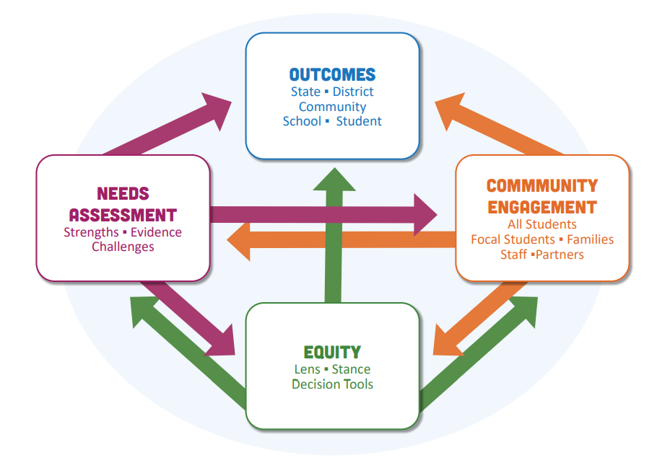
Required Planning Processes
Use of an equity lens
Community engagement
Tribal Consultation (if applicable)
Comprehensive Needs Assessment
Consider the Oregon Quality Education Model and Student Success Plans
Review and use regional CTE Consortia inputs
Further Examination of Potential Impact on Focal Students tied to Planning Decisions
Development of a four-year plan with clear Outcomes, Strategies, and Activities
Notes:
Speaker Notes: The Integrated Application process requires us to follow these steps in order to curate a quality plan matched to our local need. Provide a brief overview of each of these steps and actions. Remove Tribal Consultation and Student Success Plans if not required.

Slide 9
Equity Lens, Tool(s) & Decision Making
When taking into account our student population we were able to identify focal groups within our school community such as our tribal students through surveys, empathy interviews and our TAPP coordinator work. We will continue our work through this process by continuing to use the OEIB Equity Lens which will help us to guide all of our financial resources as the gathering of community engagement data will be a constant source of information to adapt all plans in a positive direction. The equity lens is guided by the following questions:
How does this decision align with our mission of creating high quality learning opportunities that foster a culture of belonging and promote self sufficiency.
Who does the decision impact? Have we evaluated the potential impacts on focal students and families, staff and community members?
Does this policy, program or practice address opportunity gaps and disparities for underserved students?
How will we measure success?
Notes:
Speaker Notes: Use of an equity lens or equity tools supports us to operationalize our commitments and values. It helps translate theory into practice, focuses on assets rather than deficits, and assists us to avoid making decisions that could marginalize or harm students, staff, families, and communities.
Share an example of how your team used equity tools to consider the impacts for students, staff and families in your community and provide specific examples.

Slide 10
Community Engagement Highlights
Community engagement took place in many different forms and on many different platforms. This included in-person meetings, community surveys, Paiute Tribal parent committee meetings, empathy interviews with student groups, staff surveys, administrative team meetings, student surveys at all grade levels as well as a Integrated guidance community night for questions and answers. Administrative team members have also increased their opportunities to have conversations with parents and community members at community events throughout the past year gaining great insight into what is needed in our school community. Through our student surveys we were able to gather data from our focal groups such as our Paiute Tribal students as well as our students attending Monroe High School
Notes:
Speaker Notes:
Critical in sharing information about engagement with focal groups is care about ensuring privacy and safety (additional notes below).
Detail which focal groups your district team engaged with.
Describe a few of the strategies and activities you used to engage with the community. Additional slides may be added with photos or other artifacts.
Summarize key learnings from engagement and how that information was used when assessing needs and considering priorities for planning.
Notes on Safety/Privacy
Since many focal groups have historically and/or are currently experiencing incidents of violence and harm due to their identities, special care must be taken when undertaking engagement efforts with these groups. For LGBTQ2SIA+ students, it is important to not inadvertently out a student’s sexual orientation or gender identity when they may otherwise not be out to their family, peers, and/or some school staff. Migrant students and emergent bilingual students and their families should not have immigration status, refugee status, or other information become public. This is particularly important in communities that have experienced unwelcoming or traumatic events against undocumented immigrants.
An excellent resource to consider when planning engagement efforts and sharing with the community, such as at board meetings, is the ODE Ensuring Focal Student Group Safety and Privacy resource. In one example, working with a trusted community partner or intermediary is recommended as a strategy to gather and share back student feedback in a safe manner.
In many cases, the data that is needed to make assessments about plan creation and implementation does not need to include identifiers like name, place, grade level, etc. Patterns from the data collection can still be analyzed and reported upon in a board meeting without these identifiers.
Above all, it is critical to maintain confidentiality, ensure that your data security practices are maintained, and to honor any agreements you made in the engagement space, (for example not sharing any stories or anecdotes that were expressed.)

Slide 11
Needs Assessment Highlights
As we analyzed all the information collected through our community engagement (i.e., survey results, empathy interviews and team meetings) and worked toward disaggregating our student outcomes with our focal groups, we were able to drive our decision making towards what will work best for the continuous improvement of our district and has reinforced our thoughts on spending in particular budget areas.
The data collected tells us that our school community as well as our community as a whole values our students safety and mental health over all other areas. It has shown that the community feels connected to our district more often than not and that the majority of our students have staff members they trust and believe in to support them through their academics.
Notes:
Speaker Notes:
Describe the data and information, including community engagement input, you used to determine strengths and needs in your district.
Summarize key learnings from grade bands and focal groups (taking care with privacy and safety needs of focal groups)

Slide 12
Investments and Strategies
Program and Aligned Strategies Allocation and Investments
Program and Aligned Strategies Student Investment Account Class Size Reduction & Address Behavior Ongoing Community Engagement Mental Health Services Health Services Well Rounded Education School Safety Increased Instructional Time | Allocation and Investments $700,212.15 Elementary Teaching & Support Staff Parent Coordinator Position Secondary and Elementary Counseling Staff District Nurse AVID District Coordinator Position Safe Entry Points and Additional Cameras After school activities and opportunities
Notes:
Through our community engagement efforts, our needs assessment process and examination of data, these priorities emerged.
Offer transparency where there may have been competing interests or limits to funding (tiered funding coming in a later slide) and how the district considered input and possible impact in order to make decisions

Slide 13
Investments and Strategies
Program and Aligned Strategies Allocation and Investments
Program and Aligned Strategies High School Success Attendance Improvement College Opportunities Dropout Prevention CTE Facilities CTE Maintenance and Supplies Middle School Allocation Alternative Education | Allocation and Investments $264,187.60 District Attendance Advocate All tuition for college and AP classes School culture improvement Upgrades to all CTE facilities Supplies for all CTE Programs Opportunities for HMS STEM Programs Funding for BHDVA
Notes:
Through our community engagement efforts, our needs assessment process and examination of data, these priorities emerged.
Offer transparency where there may have been competing interests or limits to funding (tiered funding coming in a later slide) and how the district considered input and possible impact in order to make decisions

Slide 14
Investments and Strategies
Program and Aligned Strategies Allocation and Investments
Program and Aligned Strategies EIIS Oregon Data Suite for pulling grades and attendance data from our student management system. | Allocation and Investments $2,271.72 Grant County ESD Supports
Notes:
Through our community engagement efforts, our needs assessment process and examination of data, these priorities emerged.
Offer transparency where there may have been competing interests or limits to funding (tiered funding coming in a later slide) and how the district considered input and possible impact in order to make decisions

Slide 15
Our Plan - Tiered Approach
Tiers of Planning & Budgeting allow for nimble course changes that have been pre-considered but aren’t within the current budget parameters.
In our district, these additional strategies and activities are possible if we move to another tier in our plan:
Notes:
Suggested Talking Points:
Explain the concept of tiered planning. Offer the following: At this time, we are working with anticipated budget allocations. Should the actual allocations change we have planned some back-up or bonus activities that we can easily pivot to if needed. For example, if we are unable to hire as many social workers as we are planning, we would have additional funds available and would be able to nimbly move toward these activities.

Slide 16
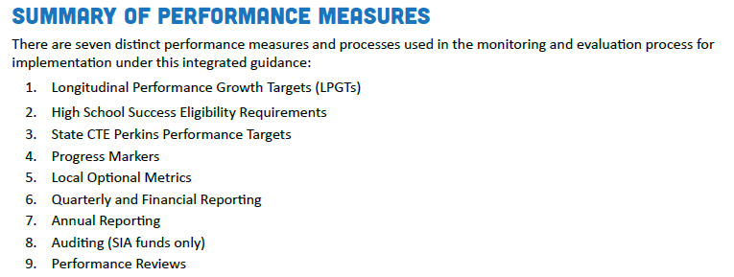
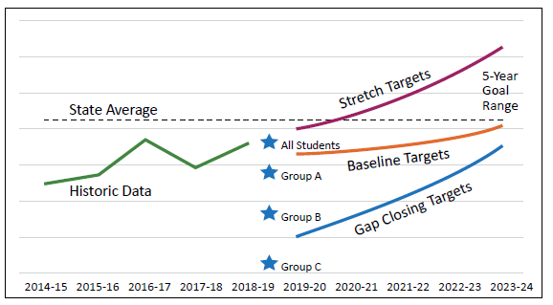
How the State understands success
Notes:
ODE’s Integrated Guidance offers a kind of ‘’performance framework’’ that our work is reviewed through. This includes a mixture of outcome measures, programmatic and financial reporting, and the opportunity for local optional metrics.

Slide 17
Longitudinal Performance Growth Targets (LPGTs)
ODE shall collaborate with the grant recipient to develop applicable Longitudinal Performance Growth Targets, based on:
Data available for longitudinal analysis;
Guidance established by the department; and
Use the following applicable metrics for the overall population and disaggregated:
Third-grade reading proficiency rates measured by ELA
Ninth-grade on-track rates
Regular attendance rates
Four-year or on-time graduation rates
Five-year completion rates
Other local metrics may be used to develop applicable performance growth targets.
Referred to as
‘’5 Common Metrics’’
Notes:
Applicants at or under 80 ADMr can delete this slide
For the Student Investment Account, growth targets are required in the areas shown.
We have been asked to develop draft LPGTs to submit with our Integrated Application due this March. Once ODE reviews and approves our plan, they will partner with us, as required by SIA legislation to further co-develop and finalize these growth targets. Our finalized growth targets will then need to be reviewed and approved by the board within the context of our grant agreement.
[You may add slides to show the draft targets or a hand-out if you wish to present them as drafts now, reminding participants that the final targets will need to be reviewed by the school board in the grant agreement coming later this spring or summer. ]

Slide 18
How we understand success
With the development of Longitudinal Performance Growth Targets (LPGTs) we will be able to develop baseline growth targets for student performance in the areas we have identified as important to HCSD 3 moving forward. ODE will support our district in developing these targets as they will be required as part of the formalized grant agreement with ODE funding.
Elementary reading
Math scores across all grade levels
ELA 3rd grade scores
9th Grade on track to graduate
High School Graduation Rates
5 year completion
Attendance consistency
College and Career Readiness
Notes:
Offer your own local optional metrics, your best ways to measure outcomes and review strategies and impacts, and share your draft LPGTs

Slide 19
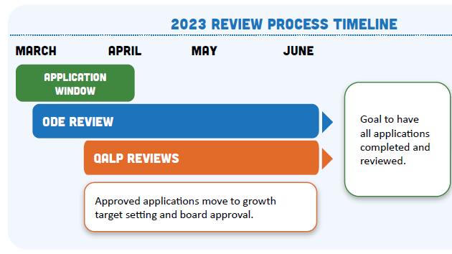
What Happens Next?
‹#›
Notes:
Speaker Notes:
In alignment with ODE’s commitment to develop shared responsibility and confidence in our public schools and to facilitate learning within and across schools, districts, and communities, the final step of the application review process will consist of a Quality Assurance & Learning Panel (QALP) review. The panel review is not determining whether or not an application meets the requirements. The panel review is either affirming or challenging the assessment made by ODE staff and spurring additional review processes for that given application.The basic concept is to bring together, virtually, panels of people to review and affirm/challenge the determination made by ODE staff while also increasing learning about the work being done in districts, charter schools, YCEPs, JDEPs, regions, and communities across the state of Oregon. The purpose of the Quality Assurance and Learning Panel is to: 1. Support public understanding and grow confidence in the implementation of the various initiatives 2. Create conditions conducive for learning across districts and communities 3. Support ODE’s review efforts with a quality check

Slide 20
Questions & Comments
‹#›

