Slide 1
Welcome
To
MUSIC

Slide 2
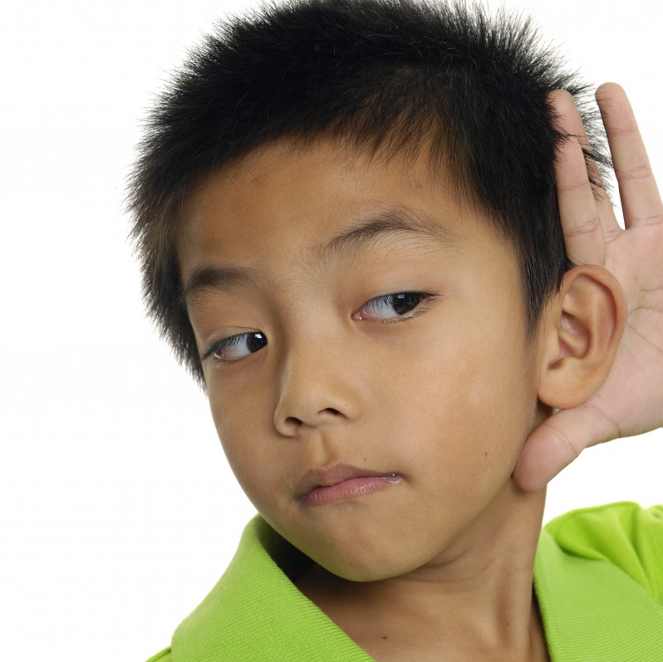
LISTEN while others are talking.

Slide 3
FOLLOW DIRECTIONS.

Slide 4
USE KIND WORDS.

Slide 5
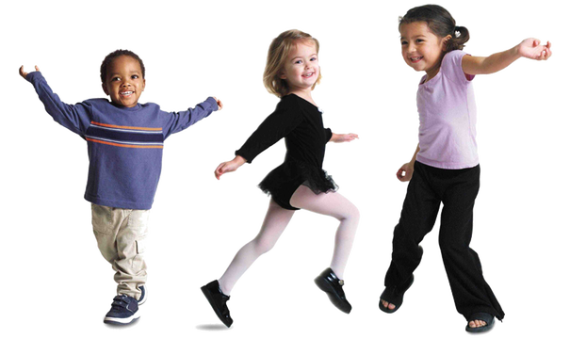
STAY in your space.

Slide 6
Don’t touch the instruments.
YET!

Slide 7
SECOND
GRADE
10:20 – 11:05

Slide 8
LET’S SOAR! ********* LET’S SOAR!
Teacher, count off ONE – TWO- READY – CHANT.
Do it two times.
We are lit-tle E - A G - L E S
If you didn’t know then we are the BEST
We love coming to school! * * *
Learning is so cool! * * *

Slide 9
Click here for Body Percussion (stand up)
Click here for JUMP go noodle (free dance)
SOLFEGE do re mi (sit down)
Call one person from end of each row to pass out rhythm sticks.
Click here for Rhythm Stick Line Dance (stand up)
Students sit down and pass sticks down the row back to the end person.
Click here for RELAXING MUSIC
Students sit quietly in their place and listen as teacher reads: WE WILL ROCK OUR CLASSMATES.

