Slide 1
Phones, ClassLink and Insight::K12 Oh my

Slide 2
New Phones
The help for the new phones is found at http://help.ena.com under Smart Voice
Click on your Phone We have Polycom 301 (black and white screen) or Polycom 401 (color screen).
To answer your phone—pick it up—If another phone is ringing—you will click Answer (one of the soft keys)
To make a call—It can be Long Distance…click New Call and dial—after it starts ringing—pick up the handset.

Slide 3
To edit the phone call in screen
Go to http://help.ena.com and click on Smart Voice
At the top—there is a link to ENA Smartvoice User Portal
Your username is 700358 followed by your extension number
Your password until you change it is 2357
Click on Settings—you can change your Account password, etc.
At the bottom—you will see DESK phone—set keys

Slide 4
To edit the phone screen
To expand this menu—click the arrow beside Programmable keys--Line

Slide 5
Use the Enhanced Monitored extension to transfer calls.
You can program in speed dials, etc.

Slide 7
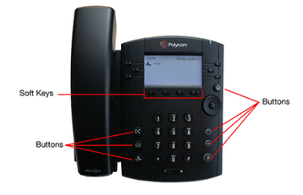

Slide 8
Settings
Every phone has different settings depending on whose phone it is.
But All of you might want to use DND.
Click the HOME buttom
Click DND—all incoming call will go directly to voice mail.

Slide 9
Questions?

Slide 10
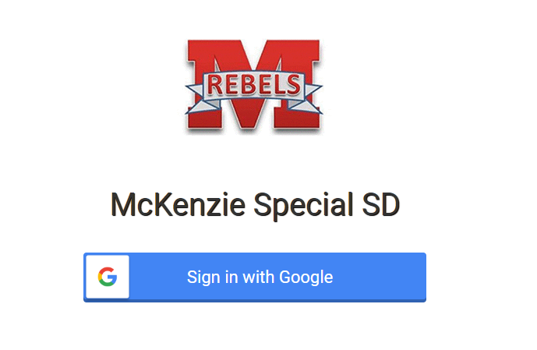
Classlink
ClassLink is a Single Sign on for anyone in MSSD
When you open a chromebook and chrome pops up—it should ask you to sign in with google.

Slide 11
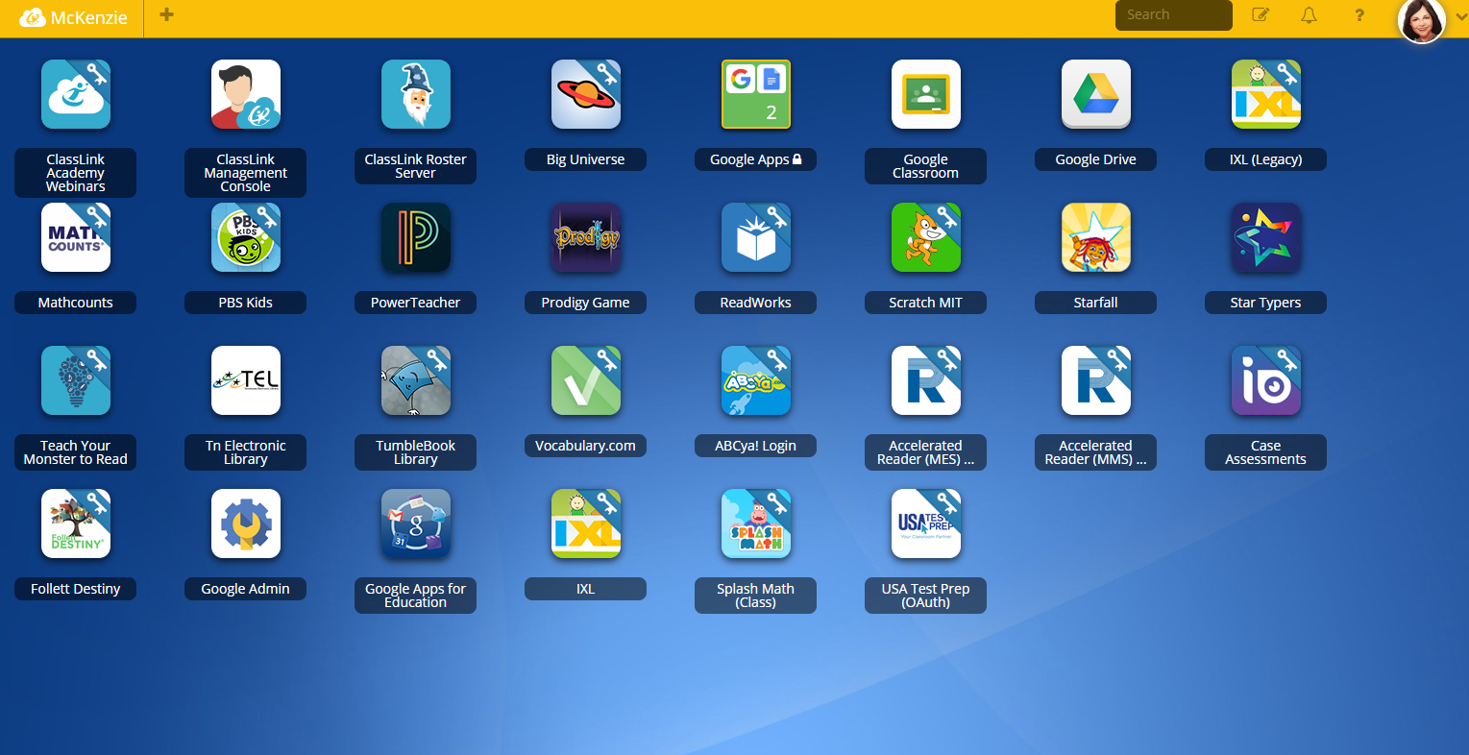
It looks like…
You may have to choose your account but if so choose the mckenziessd account
You will see a group of apps chosen especially for you and your students. If you see some you want to add—there are 2 ways to do that

Slide 12
To ask to add a Link to ClassLink
Go to the District website (https://www.mckenzieschools.org and click on Departments>Technology>Documents>Classlink and send the form to me
Go to the + sign by McKenzie and in the upper right click add your own app

Slide 13
Some icon have key and blue ribbon
The blue ribbon and key means that this app can sign the students in automatically or the app will allow the student to save the password to classlink and never have to put it in again.
Google apps sign in automatically
Without the blue ribbon and the key—it is a website Example PowerTeacher

Slide 14
There is an app library
You can look in the app library for apps that you might want to add to your classlink but to add to all your students—it either needs to be in the student app library or you need to fill out the classlink form

Slide 15
To edit your icons
To edit this page—click on the pencil to the right of the search bar in upper right
A dark screen opens up—you can move them, delete them, make folders, change the icon style, etc.

Slide 16
My files
At the bottom you will see my files—opens in a new window
You and your students can save to the classlink drive or the google drive
You will need to click on the link to Connect to google

Slide 17
Questions?

Slide 18
Aristotle Insight::K12
This program will take the place of Go Guardian.
You will see an A+ icon in your extensions in your chrome browser on your regular computer (if you are synced with your mckenziessd.org email)
Your students will see a pie with a piece missing for their part of Aristotle.

Slide 19
To start a class
Click the A+ app in the extensions—If you do not have the A+ extension—holler at me and it could be that it did not get sent to you.
Or
Right click on chrome and click Start Class

Slide 20
Create your class
As a teacher you will begin by creating your class.
Google Classroom
Classlink might sync your classes
Just click + class and add your class
The class name must start with the @ symbol

Slide 21
Student’s icon
The extension for the students looks like a pie!
They can click on this to join a class

Slide 22
To begin every day
Open Borderless Classroom by clicking the extension or right clicking in Chrome
Your students will be listed with a gray screen. Click Force Students and Force for _____ minutes
The light on the side will turn from red to green and you will see their screens.

Slide 23
Activity feed
On the right hand side—you will see the activity feed
This will give you a list of every site that your students have been on during that forced time slot.
It Can also show you the open tabs.
If you click the Red—the tab will close
If you click the box with the arrow—it will send it to all students
If you click the middle icon—it is a filter

Slide 24
Filter
There are several ways to filter
Go to website filter across the top—you can block sites just during that class period
Allowed sites will not override the ena filter

Slide 25
Controls across the top
Open tabs will send everyone to a site
Multi-select—can select just a few students
Heads up—blanks their screen
Send a message—message
Test mode—lockdown browser

