Slide 1
Getting Down to the Fundamentals
Formula for Quality Instruction

Slide 2
Back to basics

Slide 3
Objective
Today, we will learn about a structure that, if implemented with consistency and quality, will increase student achievement.
By the end of today, you will understand this structure and be ready to teach it to your faculty and expect them to implement it.
You will also know how to use a walk-through to provide feedback to teachers, based on this structure and the new TTESS system.

Slide 4
So how do we get there?
Basic practices of quality instruction are not a secret.
Where do teachers learn these?
One class in instructional methods?
Being thrown into the lion’s den?
Experience?
Innate ability?
How did you learn about quality instruction?

Slide 5
Simple but not easy: These issues will Sink the ship
Not having a good plan: old school teaching
Not having the desire: satisfied with how students are performing
Procrastination: Deal with it later. No sense of urgency
Not having support: Change is hard. Easier to go back to TWWADI
Not having a way to regularly and accurately gauge progress. Need short term measures to determine effectiveness and adjust.

Slide 6
Learn the Plan that will begin improving instruction tomorrow
High frequency, high quality implementation of five critical practices, which yield highly effective instruction.
Frame the Lesson
Work in the Power Zone
Frequent, Small-Group, Purposeful Talk about the Learning
Recognize and Reinforce
Write Critically

Slide 7
What Really Makes the difference?
Schmoker sums it up: “…the single greatest determinate of learning is not socio-economic factors or funding levels. It is instruction.”
“Teacher’s craft is the most critical component in student academic success.” Cain

Slide 8
We have to get past this
Poor performance is the student’s fault.
Lowering expectations by “dumbing down” lessons
Needing more time in the schedule for instruction
“I’ve been doing this for 25 years . . .”
Realization that what we have always done may not be effective for today’s students
Teaching the textbook
What do you do to counter this thinking?

Slide 9
How will this structure change practices and results?
These are not new ideas.
This is not a secret.
The difference comes with the fidelity, the quality and the consistency.
In a study done by Cain, 924 unannounced classroom observations were done on 56 campuses in 4 school districts. All grade levels and the four content areas were included. The results show where instruction is without the use of Fundamental Five criteria.
See chart next slide.

Slide 10
The facts

Slide 11
Five Standards to success
Let’s get started with learning the Five.

Slide 12
Framing the Lesson
A verbal and written way to introduce the lesson
Not a list of TEKS for today
Essentially-the beginning and end of a lesson
The effective lesson frame gives the student a clear picture of the major objectives that will be taught and how the student will be asked to demonstrate mastery.
The “how” can come in the form of a question, product or task.
Notes:
Need walk-through forms for framing

Slide 13
Table Talk
How would framing help the teacher with student achievement?
Notes:
Use the walkthrough piece on framing

Slide 14
Missing Piece
Today’s current practice:
Teachers plan.
Teachers teach.
Teachers test.
Teachers grade.
On a daily basis, how do teachers know that
students “got it”?
We need proof that learning has occurred.
We remember the first and last thing we hear.
Notes:
Formative assessment

Slide 15
In action
Watch how to frame a lesson
https://www.bing.com/videos/riverview/relatedvideo?&q=video+of+framing+the+lesson&&mid=BB6E171BFE9DE4B85FA9BB6E171BFE9DE4B85FA9&&FORM=VRDGAR

Slide 16
How to
Every day, consistently, teachers must write and present the objective.
The objective must be written in kid-friendly terms.
Objective should begin with “We will . . .”
Objective communicates a clear focus for the student.
Students should demonstrate understanding at the end of class. Closing question, product or task is stated in the form of “I will. . .”
Post both parts so that all students can see.
Notes:
Improves rigor-students have to demonstrate thinking!!!!

Slide 17
Example of Framing
Objective : We will use factual details to support our opinion on a student-selected topic.
Closing Task: I will write a paragraph using factual details to support my opinion and underline the details.
Objective: We will review lab safety practices and procedures.
Closing Task: I will create a lab safety poster with my lab partners and share it with my group.
Objective: We will discuss the characters in Lord of the Flies.
Closing Task: I will write down how I am like/or unlike one of the characters and share it with my partner.
Notes:
My students will move from application to evaluation.

Slide 18
Filters: What about ‘em?
Students receive lots of info
“Research indicates that an individual’s working memory is limited in what it can track, and so it acts as a sort of spam filter.”
Mental hooks are affected by prior academic knowledge, prior academic success, life experiences, motivation, stress level.
Some students have ‘em; some don’t. Some have only one file drawer: very important info.
Info overload

Slide 19
Advantage: affluent
Affluent: Why?
What did your kids get to do during childhood?
Life experiences have given them more filters or “file drawers” for knowledge.
This is why socio-economic is a predictor of student performance.

Slide 20
How does framing the lesson help with mental filters?
Framing the lesson takes the place of mental filters for students who do not have mental filters or whose mental filters are weak.
When students are told (and can see posted) specifically the objective and what they will be expected to do for the day, then they can process the information more effectively.
Ex: As the students move through the lesson, they can “file” the information in categories such as
This info is really important for helping me perform the closing task.
This info might help me.
This info I will not need.
Notes:
For students with mental filters, this heightens their capacity to “file” info resulting in higher levels pf learning. *Boosts performance of all students.

Slide 21
Helps students
Visual reminder of what they are learning and how they will have to demonstrate their learning.
Sets the expectation for the day
Students do not have to guess the purpose of the lesson
Why do I need to know this?
When will I ever use this?

Slide 22
Helps teachers too!
How would framing the lesson help teachers?
Clarifies concept to be taught
Keeps teacher on track for student learning: helps them tie lesson back to objective
Planning of lesson is focused: what activities will get students from objective to demonstrating mastery?
Prevents chasing rabbits

Slide 23
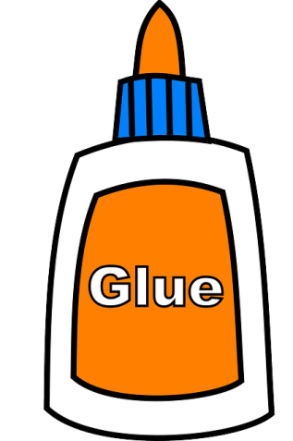
Make it sticky
Making the examples relevant is crucial.
In-content: students using prior knowledge to help them understand today’s objective. (We learned how to use specific adjectives in our writing last week. Now we are taking it a step further and will use these to make sensory imagery in our writing.)
Across contents: students using what they know about science to understand a math problem (How big of an area would a zebra need for feeding and grazing?)
Real-world: relate to students non-academic world.(use math skills to make and calculate a list of Christmas gifts to present to parents)

Slide 24
Helps instructional leaders
Think feedback.
Without a posted objective, what are your limitations?
Improve feedback.
Does the observed classroom activity address the planned objective?
Will the activity effectively move the student to mastery?

Slide 25
Your Turn
Notes:
Give out student expectations and have them select one and do a frame for it. Then share with group. Use the TEKS app.

Slide 26
What do you think?
Watch this teacher for framing the lesson. https://www.bing.com/videos/riverview/relatedvideo?&q=video+of+framing+the+lesson&&mid=64C2A52C5C409CCA4A1364C2A52C5C409CCA4A13&&FORM=VRDGAR
Notes:
Need walk-through form—what comment would u make to teacher?

Slide 27
How is framing the lesson like an oreo?

Slide 28
Ready for Step 2
Instructional leaders: we have learned about framing the lesson, which is the first step towards a structured lesson delivery and will therefore increase student achievement.
Remember that we are learning this process in order to teach it to our faculty, expect them to implement it and be able to use it to give valuable feedback.

Slide 29
Step 2 : workin In the Power Zone

Slide 30
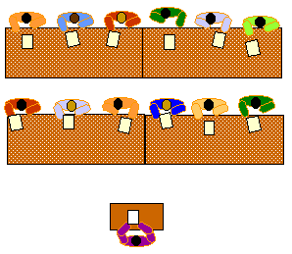
Power zone is a work area
3 old school places for teachers to accomplish goals
1. Teaching from work areas
Teacher desk for administrative tasks.
The waiting place, mostly front of classroom
Delivering the lesson from the desk
2. Teaching from Lecture Position
Professional distance
Sage on the stage
3. Teaching from Power Zone
Close proximity to students
In the middle of the action
Monitoring
Ability to see when students need clarification or when adjustments to instruction are needed
Ability to see when differentiation is needed

Slide 31
Think about it
What happens when students are doing independent practice, and the teacher is at the desk?

Slide 32
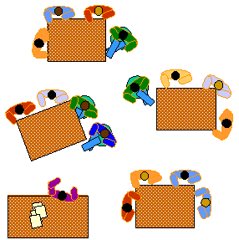
Tips for teaching in the power zone
75% rule
Arrange classroom for effective power zone movement
Remove teacher distractions: computer e-mail, cell phones, paper grading
Proximity

Slide 33
Think about it
What happens when you, as the instructional leader, sends out an e-mail during the instructional day?
Do you immediately receive responses from teachers who should be teaching?

Slide 34
Let’s locate the power zone
Using white paper posters, illustrate the power zone.
How will you teach the power zone to faculty?
How will you monitor for teaching in the power zone?

Slide 35
Clarification of goal
We have been learning the steps of structured lesson delivery in order to maximize student achievement.
We are working towards learning the five step process in order to teach best practices in your classroom to provide quality instruction.
Next

Slide 36
Step 3: FSGpT
Frequent small -group, purposeful talk about learning
10-15 minute rule after teacher-centered instruction
Groups of 2-4 students
Seed question about learning or activity
Brief but structured 30 seconds-3 minutes

Slide 37
what does fsgpt look like in the classroom?
A lesson in FSGPT
https://www.youtube.com/watch?v=qf3uN8IfwEo

Slide 38
Frequency
Commit to the process
10-15 minute rule
Plan for it
Be consistent
These are power discussions.
Why is this strategy necessary?

Slide 39
Group Size
Maximum size: 4
What is the advantage of limiting the group size?

Slide 40
Seed questions
Pre-planned
Guides student conversation toward learning outcome
Make connections
“Discuss with your partner: ___________”
Helps teacher determine level of student understanding.

Slide 41
Power Zone
Teacher should remain in the Power Zone during seed question discussion.
Why?

Slide 42
Share
Students briefly share the ideas that surfaced during small group.

Slide 43
Meeting the needs of bi-lingual students
Bi-lingual: ability to speak and understand both adult language and student language
Small group discussion helps students who do not speak or understand adult language: when they do not understand the “teacher (adult) talk”, the small group, which takes place in “student talk” helps clarify ideas for these students in the their own language.

Slide 44
Increasing rigor for both groups
Students who understand “adult language” translate for those who do not. How does this help increase rigor?
Students who do not speak adult language listen to the translation during group. How does this help increase rigor?
Helps with retention of material
Managing student attention span: for teens 8-10 minutes, for 12 and under-even shorter—the small group can reset the attention span time clock
Decreases boredom

Slide 45
getting started with FSGPT
Takes careful planning, implementation and adjustment
Students have to be trained because their conversations are social, not academic. This is new to them!
Students need lots of opportunities to practice (guided).
Effective seed questions (must be open-ended)
Use question stem wall.
Use a timer.

Slide 46
Talk Like a genius question stems
Smart Questions (Knowledge & Comprehension) | Smarter Questions (Application & Analysis) | Smartest Questions (Synthesis & Evaluation)
Who is it that …? | How would you use…? | What would happen if…?
Tell why | How is this similar to…? | Develop a plan to …
Give an example of … | Contrast this to … | Find a better solution…
What do you think will happen next? | What is the relationship between … | What is the most important…?

Slide 47
How will you evaluate?
What should instructional leaders look for when observing and providing feedback?
Two levels of observation:
Fidelity: Is the teacher following the structure, as trained?
Rigor: Is the teacher requiring critical thinking in seed questions?
Notes:
See walk-through form

Slide 48
A final thought about FSGPT
“You can teach what you have always taught. You can teach it almost the same way you have always taught it. Just add FSGPT. More of your students will learn more of what you want them to know.”
From Cain’s Fundamental Five

Slide 49
Step 4: Recognize and Reinforce
Two levels: academic and social/behavioral
Academic recognition:
Who gets it? Who needs it? Who deserves it?
The teacher blind spot
Example: Curtis has not turned in a single homeroom assignment for a week. Today, however, he remembered it !
Think about it: For Curtis to remember to turn homework in, what all was really involved in this task?
Write down homework assignment.
Take it home.
Remember that he had homework when he got home.
Actually do the homework.
Remember to put it in backpack and bring it back to school.
Bring assignment to class.
Turn it in with his name on it.
WOW ! Does this warrant academic recognition?

Slide 50
Marzano studies reinforcement
In a study reported in Marzano’s Classroom Instruction That Works , with the use of consistent, quality academic reinforcement, students can achieve a 20% to 48 % gain.
Think about it!
Benefits?
To student?
To teacher?
To school?
“Reinforcing effort can help teach students one of the most valuable lessons they can learn—the harder you try, the more successful you are.” (Marzano)

Slide 51
Social/behavioral recognition
Clarify who is being addressed: address specific students or specific group.
Why? So students can clearly understand the behavior or action that needed attention.
Ex. During group work, Micah did not have paper or markers for the activity. Debbie offered him the use of her materials without being asked.
If the teacher says nothing, then what is the effect?
If the teacher addresses Debbie, what is the effect?
How should the teacher express the recognition?

Slide 52
Which works better?
“Great job class. Most of you turned in your science projects on time.”
OR
“Great job groups 3 and 4. All of you turned in your science projects on time.”
Teachers reinforce behaviors they want to see and remove reinforcement of behaviors they want to decrease.
Think about reinforcing students for coming to class on time.
What would this look like?

Slide 53
tips
The idea of recognition and reinforcement of behaviors we want to see can be opposite of some teachers’ practices. (Who usually gains the teacher’s recognition and reinforcement?)
Changing a habit takes effort, time and support. Teachers are encouraged to make a list of 2-5 targeted student behaviors they want to encourage.
Teachers who intentionally practices R and R create a caring, engaging, empowering classroom environment.
Extrinsic rewards can affect intrinsic motivation: fact.
Notes:
Do you like your job? Would you do it for free?

Slide 54
Flashback
Our goal today is learning this process in order to understand its effect on student achievement—and then be able to teach it and set expectations for implementation.

Slide 55
Step 5: Write Critically
Notes:
Least utilized of all five techniques. WHY?

Slide 56
What is critical writing?
Write to organize
Write to clarify
Write to defend
Write to analyze
Write to connect ideas
Write to express opinion
It is not happening as often as it should!

Slide 57
“To gain knowledge, we must construct it in our minds. Writing what we are trying to internalize helps us achieve that purpose. When we are able to make connections in writing, we begin to take ownership of these connections. To do this we must learn how to identify core ideas . . .and then explain those ideas in writing.” ---Paul and Elder 2007
Notes:
Increases rigor!!!!

Slide 58
Rules of writing critically
Does not have to be an essay
Does not have to be multi-pages
Does not have to be perfect, polished and grammatically
Fits into all content areas
It is not copying
It is not a fill in the blank
It is not free writing

Slide 59
Stats for writing critically
Range of gains
Identify similarities and differences 31 to 46%
Summarize 23 to 47%
Note taking 13 to 44%

Slide 60
How to implement
Relation between reading and writing
Math journaling
Science interactive journals
Plan for a writing segment daily
Have students put their ideas into writing.
Ex.: Students, write in your journal how your group conducted today’s experiment. Be sure to include the results of your experiment.
“When students write about what they have learned in a given class and do this in all classes, each student has had the time devoted to improving his or her literacy skills significantly increased.” Cain

Slide 61
Teachers may not know
How to integrate writing in their content.
Train for it!
Plan it.
Expect it.
Share the writing at PLC’s
It’s great formative assessment.
It’s a perfect closing task for the day’s lesson. Use index cards as exit tickets.

Slide 62
Add five to ten minutes of critical writing (at higher level of Bloom’s).
Replace an instructional activity of lower rigor.
Good trade-off?

Slide 63
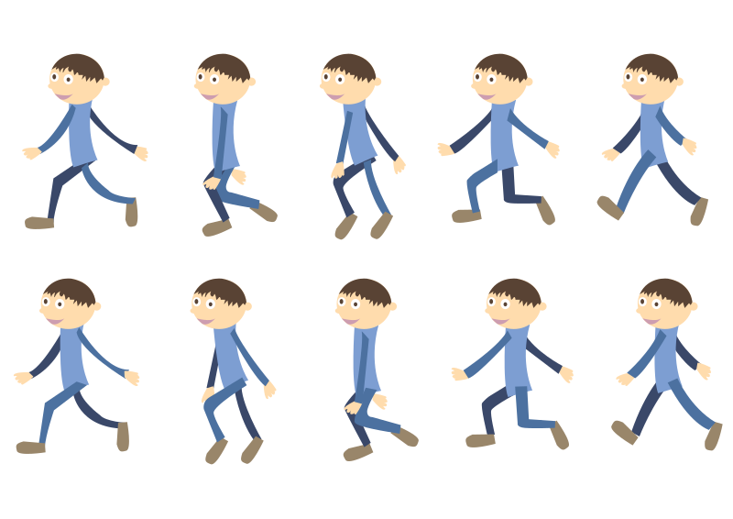
Walk-it-through
How do instructional leaders check for implementation?
Walk-through (full or focused)
Review the walk-through tool provided.
Utilize it here:
Notes:
Need walk-through form

Slide 64
Alignment to ttess
Highlighter activity: Let’s look at how TTESS fits the Fundamental Five structure.
Notes:
Copy of TTESS rubric to see parallel in “Proficient” column.

Slide 65
Teach it (Closing Task)
We have learned the structure for effective lesson delivery.
With a partner, teach the process to each other.
Draw a summary poster to share with your staff.

